Slide 1




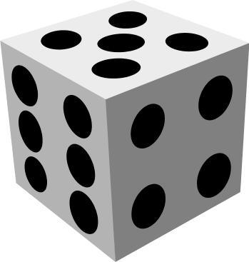
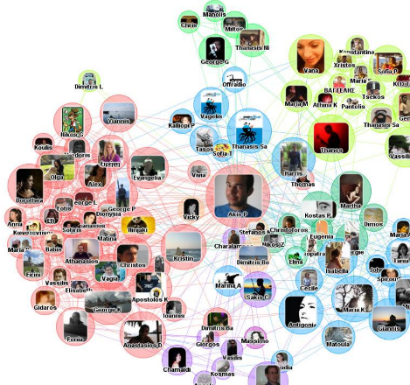

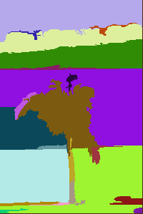
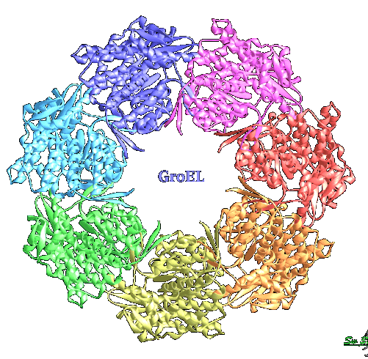
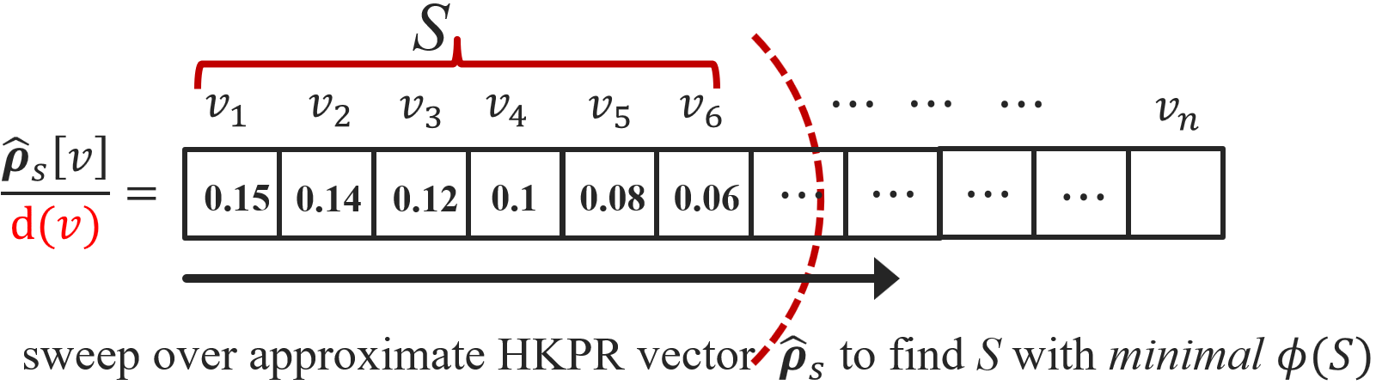
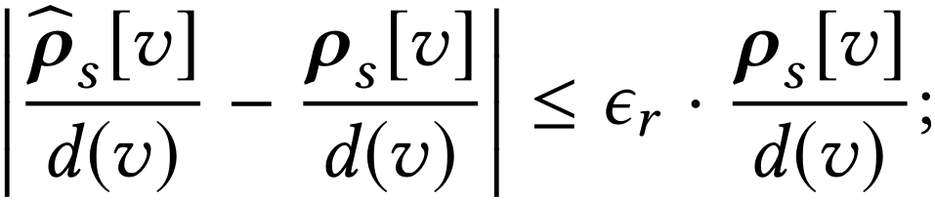
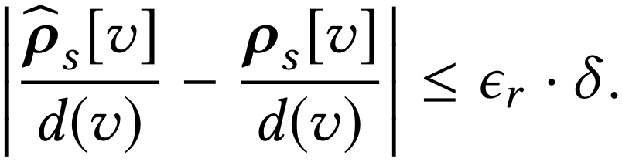
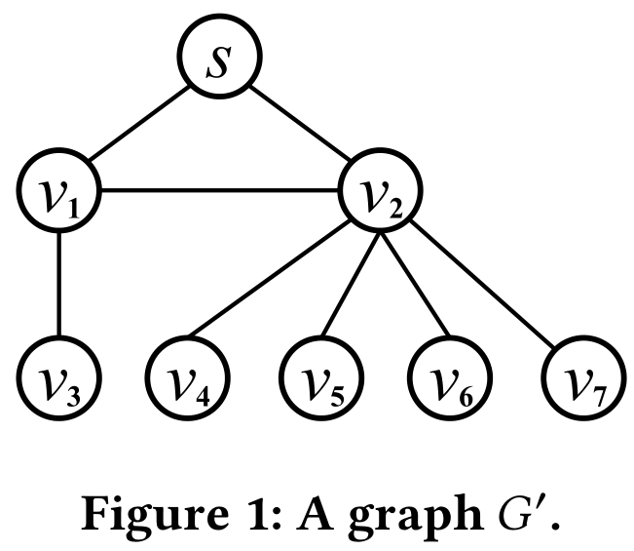
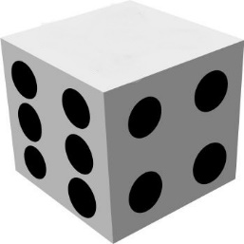
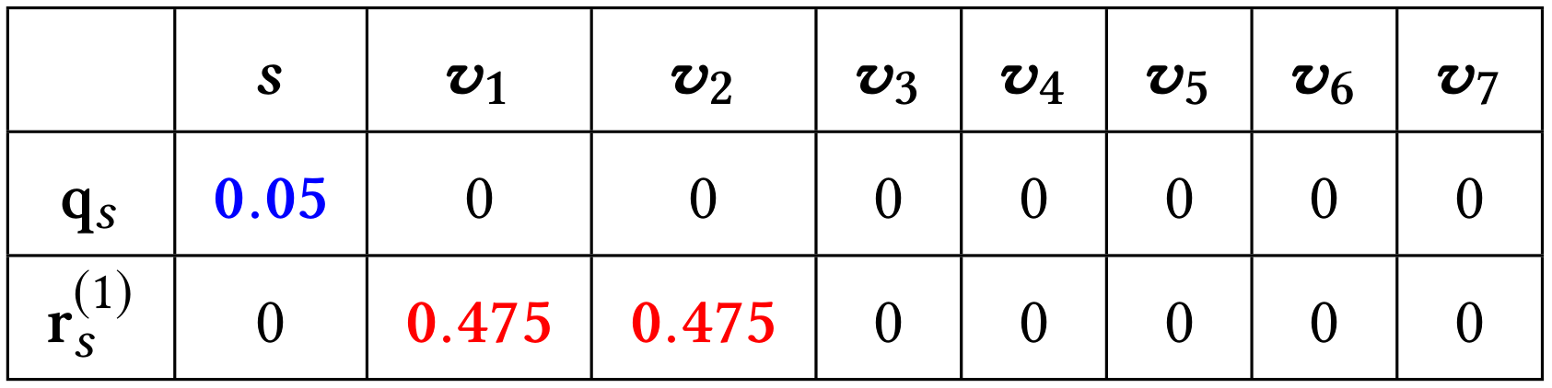
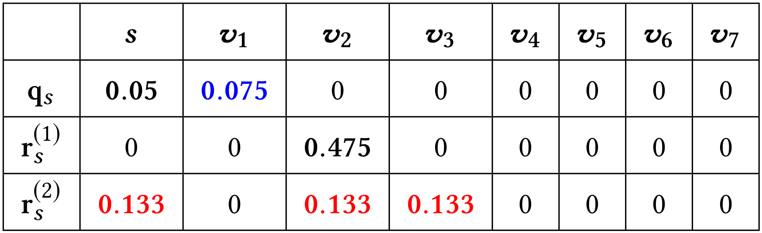
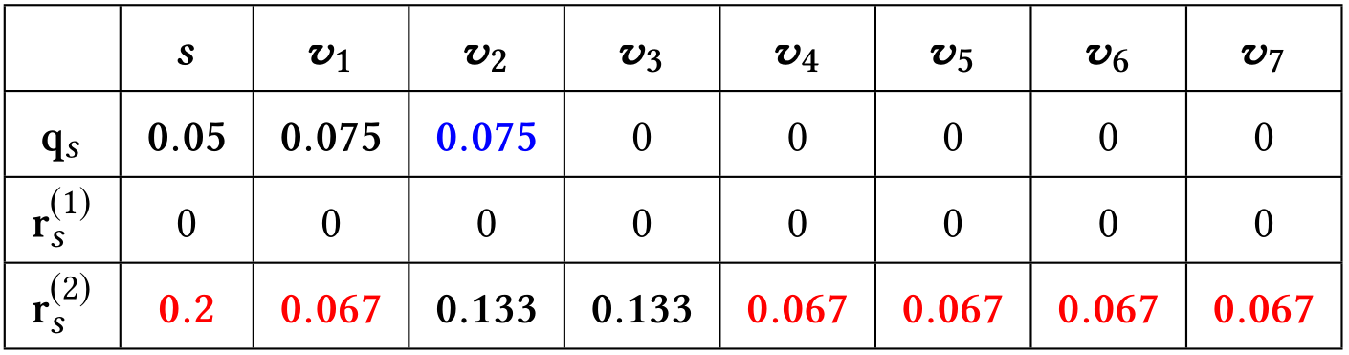
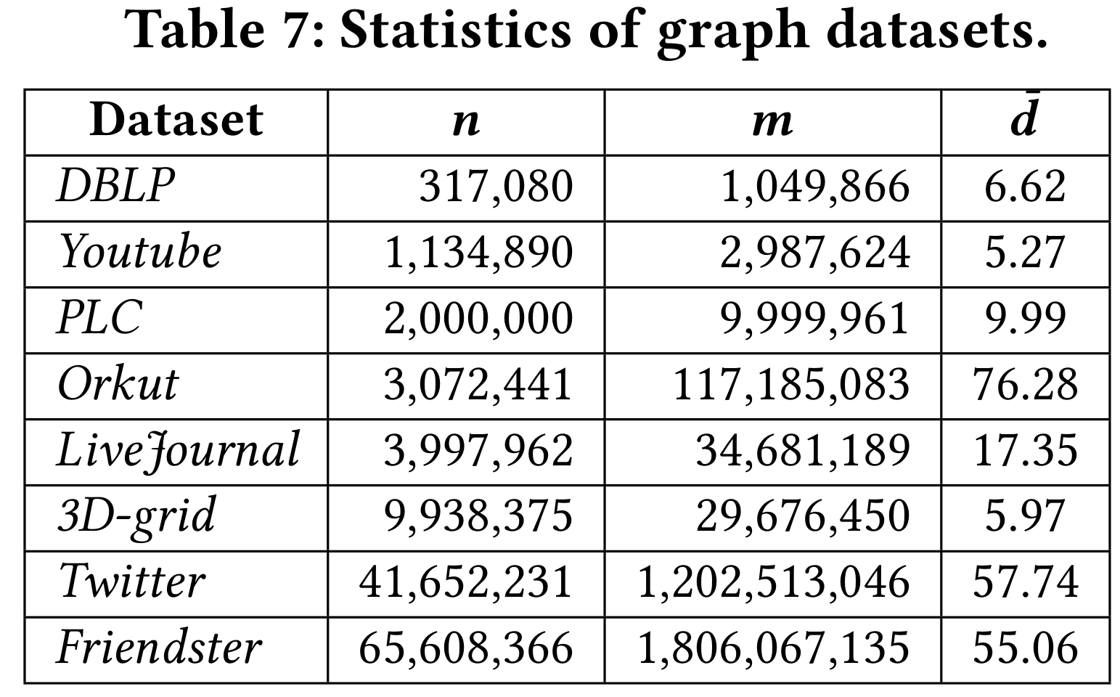
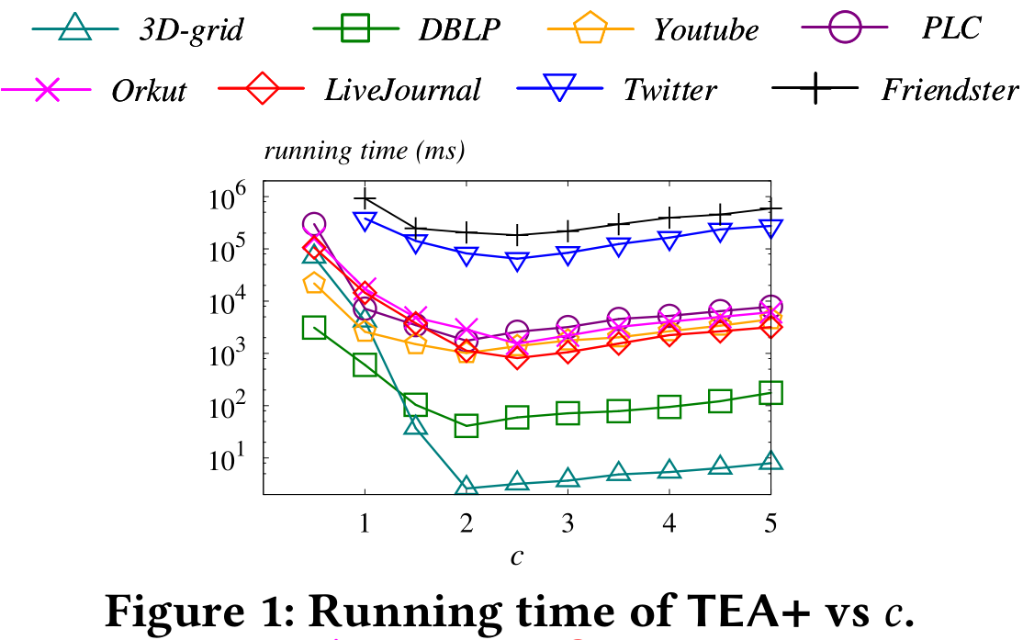
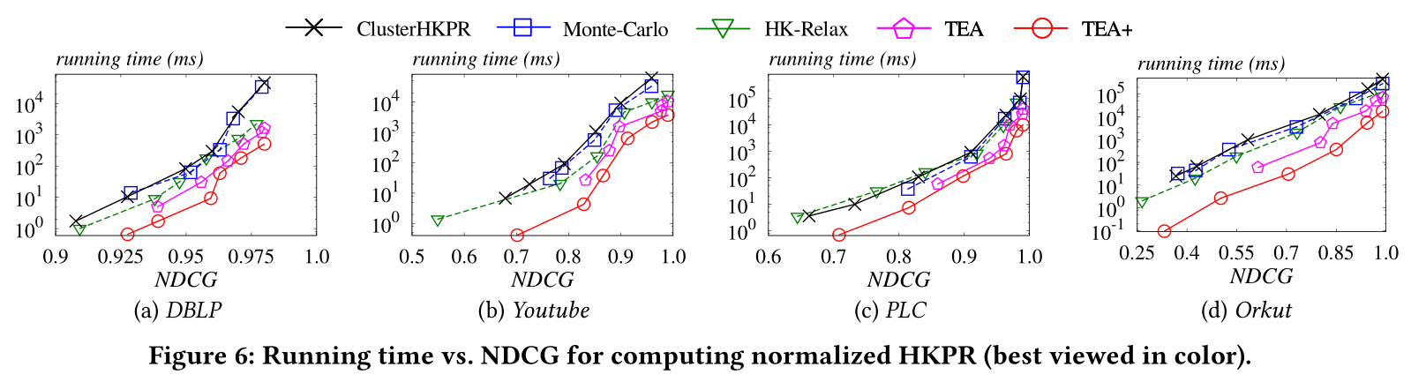
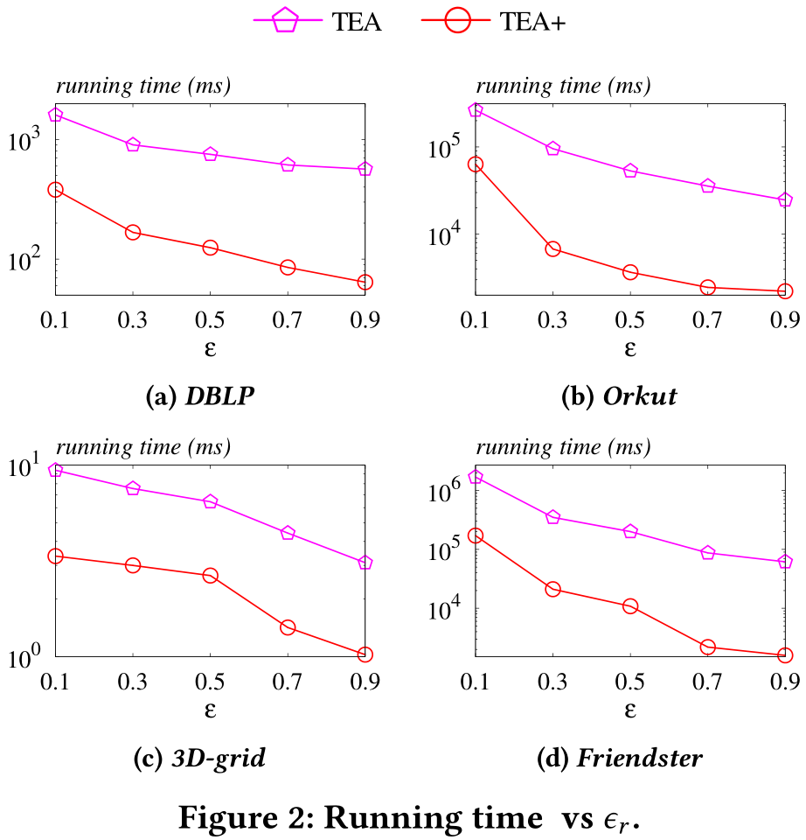
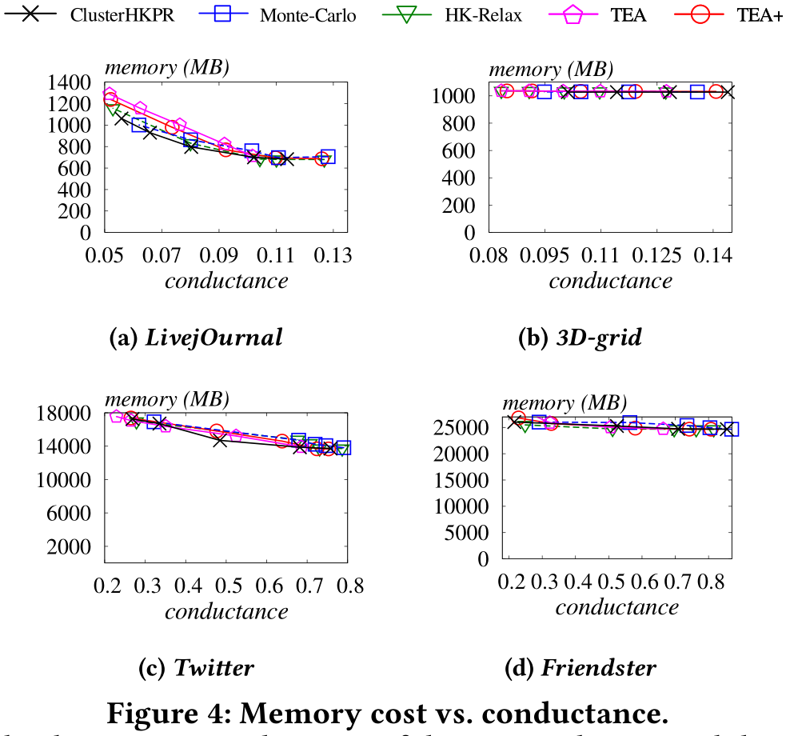
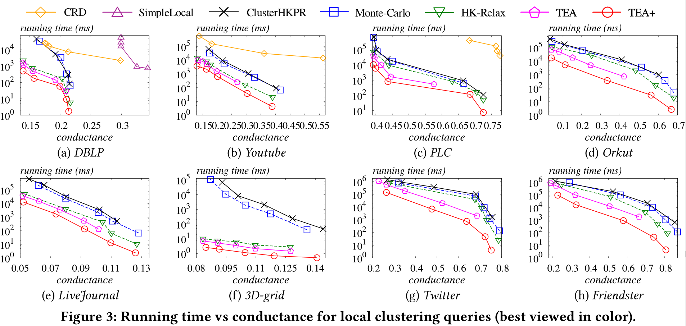




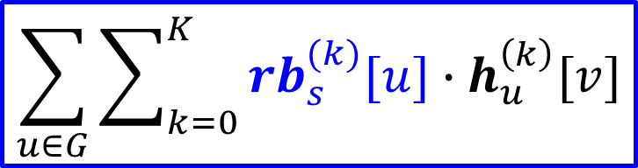




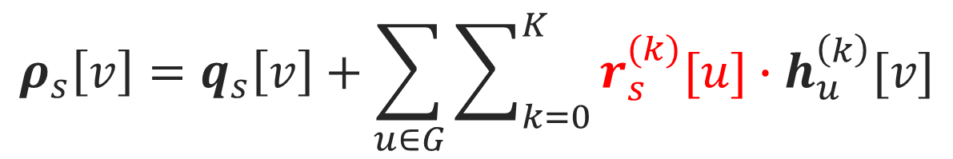

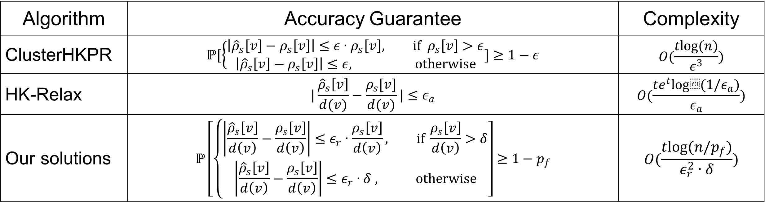

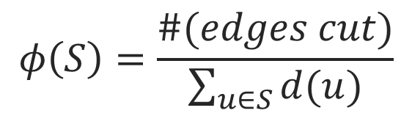


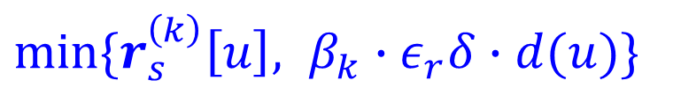



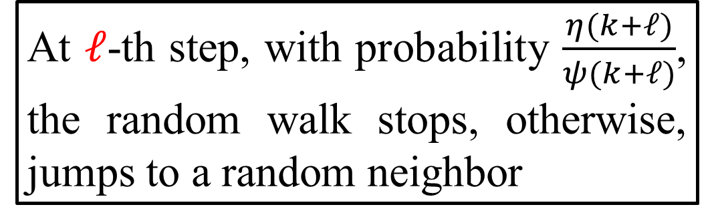


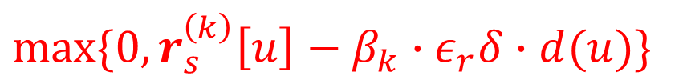




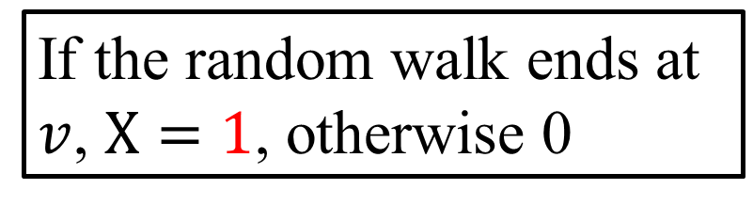
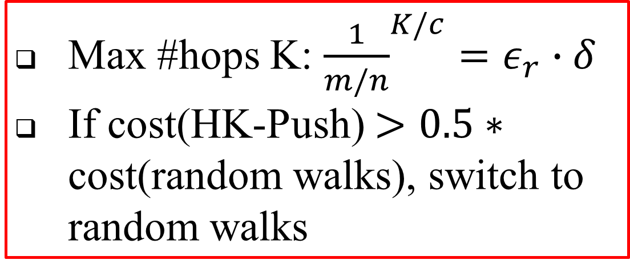

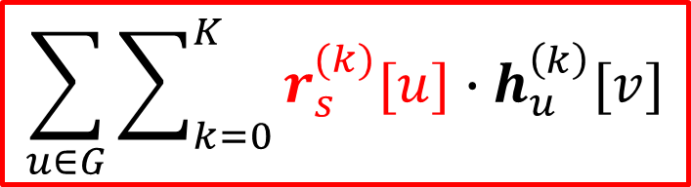


Efficient Estimation of Heat Kernel PageRank for Local Clustering Renchi Yang, Xiaokui Xiao, Zhewei Wei, Sourav Bhowmick, Jun Zhao, Rong-Hua Li
1. Heat Kernel-based Local Clustering
2. Existing Approximate Solutions
Applications
✔
Local Clustering
Explodes the local neighbourhood around the seed node only to find S
S has min conductance
The Heat Kernel PageRank (HKPR) from 𝑠 to v is
$ρ_{s}\left[v\right]$=ℙ[Random walk of length-k from 𝑠 stops at v]
k follows a Poisson distribution with mean t; k’s probability: $η\left(k\right)=\frac{e^{−t}t^{k}}{k!}$
Sweep Cut
ClusterHKPR
Sets max random walk length $K=O(\frac{log⁡(1/ε)}{log\log\left(1/ε\right)})$
${16log⁡(n)}/{ε^{3}}$ truncated random walks from s
${\hat{ρ}}_{s}[v]$= Fraction of random walks stopping at $v$
HK-Relax
Sets initial residual $r_{s}[s,0]=e^{−t}$
At $k$-th hop from s, $r_{s}[v,k]→$ reserve ($k≤2tlog(\frac{1}{ε_{a}})$) ; distributes $\frac{t}{k+1}×r_{s}[v,k]$ to neighbors evenly
${\hat{ρ}}_{s}[v]$= Sum of reserves at $v$
3
4
$$v_{1}$$
$$v_{1}$$
✔
K=4
$$φ\left(S\right)=\frac{\#(edges cut)}{\sum_{u∈S}{d(u)}}$$
community detection
image
segmentation
protein
grouping
s
5
$$v_{2}$$
✘
local cluster S
5
$$v_{1}$$
✘
s
Algorithm | Accuracy Guarantee | Complexity
ClusterHKPR | $$ℙ[\left\{\begin{aligned}\left|{{\hat{ρ}}_{s}\left[v\right]−ρ}_{s}\left[v\right]\right|≤ε∙ρ_{s}\left[v\right], if ρ_{s}\left[v\right]>ε \\ \left|{{\hat{ρ}}_{s}\left[v\right]−ρ}_{s}\left[v\right]\right|≤ε, otherwise\end{aligned}]≥1−ε\right.$$ | $$O(\frac{tlog(n)}{ε^{3}})$$
HK-Relax | $$|\frac{{\hat{ρ}}_{s}\left[v\right]}{d(v)}−\frac{ρ_{s}[v]}{d(v)}|≤ε_{a}$$ | $$O(\frac{te^{t}log⁡(1/ε_{a})}{ε_{a}})$$
Our solutions | $$ℙ\left[\left\{\begin{aligned}\left|\frac{{\hat{ρ}}_{s}\left[v\right]}{d\left(v\right)}−\frac{ρ_{s}\left[v\right]}{d\left(v\right)}\right|≤ε_{r}∙\frac{ρ_{s}\left[v\right]}{d\left(v\right)}, if \frac{ρ_{s}\left[v\right]}{d\left(v\right)}>δ \\ \left|\frac{{\hat{ρ}}_{s}\left[v\right]}{d\left(v\right)}−\frac{ρ_{s}\left[v\right]}{d\left(v\right)}\right|≤ε_{r}∙δ , otherwise\end{aligned}\right.\right]≥1−p_{f}$$ | $$O(\frac{tlog(n/p_{f})}{ε_{r}^{2}∙δ})$$
$ψ\left(k\right)=\sum_{ℓ=k}^{∞}{η(ℓ)}$
3. The Basic Ideas
4. The TEA+ Algorithm
$(d,ε_{r},δ)$-approximate HKPR
$∀ v∈G s.t. {ρ_{s}\left[v\right]}/{d\left(v\right)}>δ$,
$∀ v∈G s.t. {ρ_{s}[v]}/{d⁡(v)}≤δ$,
Monte-Carlo Random Walks
At $k$-th hop, stops with probability $\frac{η(k)}{ψ(k)}$; otherwise, jumps to a random neighbor. $ω=\frac{2\left(1+ε_{r}/3\right)log⁡(n/p_{f})}{ε_{r}^{2}δ}$ random walks.
${\hat{ρ}}_{s}[v]$= Fraction of random walks stopping at $v$. ${\hat{ρ}}_{s}[v]$ is a $(d,ε_{r},δ)$-approximate HKPR vector.
HK-Push
$ρ_{s}\left[v\right]=q_{s}\left[v\right]+\sum_{u∈G}{\sum_{k=0}^{K}{r_{s}^{(k)}[u]∙h_{u}^{\left(k\right)}[v]}}$
Each node $v$: a reserve $q_{s}\left[v\right]$ and a k-hop residue $r_{s}^{(k)}[v]$
Initially, sets $r_{s}^{(0)}\left[s\right]=1$ ; at k-th hop, converts $\frac{η(k)}{ψ(k)}×r_{s}^{(k)}[v]→q_{s}\left[v\right]$, pushes the remaining residue to neighbors evenly
${\hat{ρ}}_{s}[v]$= Sum of reserves at $v$
A combination of HK-Push & Random Walks
$ρ_{s}\left[v\right]=q_{s}\left[v\right]+\sum_{u∈G}{\sum_{k=0}^{K}{r_{s}^{(k)}[u]∙h_{u}^{\left(k\right)}[v]}}$
$α=\sum_{u∈G}{\sum_{k=0}^{K}{r_{s}^{(k)}[u]}}$
needs $αω$ random walks $→O(αωt)$ time
Optimization 1: Balancing HK-Push and random walks
Optimization 2: Pruning random walks
Time: $O\left(n_{p}\right)+O(αωt)→O(\frac{tlog⁡(n/p_{f})}{ε_{r}^{2}δ})$, Space: $O(m+n+\frac{tlog⁡(n/p_{f})}{ε_{r}^{2}δ})$
$$𝔼\left[X\right]= \\ \frac{\#(random walks ends at v)}{\#(all random walks)}$$
Total portion of random walks that not stopped yet
1
Rolling a biased dice, with probability $r_{s}^{(k)}[u]/α$, it shows $v_{5}$
2
At $ℓ$-th step, with probability $\frac{η(k+ℓ)}{ψ(k+ℓ)}$, the random walk stops, otherwise, jumps to a random neighbor
$$v_{1}$$
$$v_{2}$$
$$v_{5}$$
$$v$$
3
If the random walk ends at $v$, $X=1$, otherwise 0
s
$$v_{1}$$
estimation
error!
$$v_{4}$$
$$v_{1}$$
Max #hops K: ${\frac{1}{m/n}}^{K/c}=ε_{r}∙δ$
If cost(HK-Push) $>0.5∗$ cost(random walks), switch to random walks
HK-Push
_{s}
$$v_{1}$$
Random walks
$$v_{2}$$
_{K hops}
$$v_{2}$$
3
If $r_{s}^{(k)}\left[u\right]$ becomes 0, meaning it’s accurate and no need for random walks
Otherwise, pruning $β_{k}∙ε_{r}δ∙d(u)$ portion of random walks
$$ρ_{s}\left[v\right]=q_{s}\left[v\right]+\sum_{u∈G}{\sum_{k=0}^{K}{r_{s}^{(k)}[u]∙h_{u}^{\left(k\right)}[v]}}$$
Estimated as $0.5∙ε_{r}δ∙d(u)$
1
$$\sum_{u∈G}{\sum_{k=0}^{K}{r_{s}^{(k)}[u]∙h_{u}^{\left(k\right)}[v]}}$$
$∈[0,ε_{r}δ∙d(v)]$
$$\sum_{u∈G}{\sum_{k=0}^{K}{{rb}_{s}^{(k)}[u]∙h_{u}^{\left(k\right)}[v]}}$$
2
$max⁡\{0,r_{s}^{\left(k\right)}\left[u\right]−β_{k}∙ε_{r}δ∙d(u)\}$
$min⁡\{r_{s}^{\left(k\right)}\left[u\right], β_{k}∙ε_{r}δ∙d(u)\}$
5. Experimental Results

