Slide 1




Homogeneous Network Embedding for Massive Graphs via Reweighted Personalized PageRank
Renchi Yang, Jieming Shi, Xiaokui Xiao,
Yin Yang, Sourav Saha Bhowmick
August 2020
Notes:
Hello everyone. I am Yang Renchi from Nanyang Technological University. Today I would like to present you with our efficient homogeneous network embedding method based on reweighted PPR.

Slide 2
Outline
Problem Definition & Applications
Existing Work & Motivations
Proposed solution: NRP
Experiments
Notes:
First, I would like to give you some backgrounds about the problem we studied, followed by a brief review of existing work and the motivations of our work.
Then our solutions will be introduced and finally we will show some interesting experimental results.

Slide 3


Homogeneous Network Embedding (HNE)
G=(V, E)
n=|V|, m=|E|
Link Prediction
[Backstrom et al., WSDM’2011]
[Gupta et al., KDD’2013]
Graph Reconstruction
[Radivojac et al., Nature methods’2004]
Node Classification
[Perozzi et al., KDD’2014]
[Ribeiro et al., KDD’2017]
$$f:v_{5}→ℝ^{k}$$
k
0.1 | -0.2 | 0.3 | -0.6 | 0.7 | 0.4
$$X_{v_{5}}$$
Notes:
Given a homogeneous graph G with n nodes and m edges, homogeneous network embedding aims to map each node, for example v5, into a compact k-dimensional feature vector X_v5
Such that X_v5 is able to capture the graph topology surrounding v5. For short, we refer to homogeneous network embedding as HNE in the following slides.
The embedding vector can be further fed to different downstream graph mining tasks, like link prediction, graph reconstruction and node classification.

Slide 4

Existing Work
Learning-based HNE methods
with random walks
truncated random walks: Deepwalk [Perozzi et al. KDD14],
biased random walks: Node2vec [Grover et al. KDD16],
Personalized PageRank (PPR):VERSE [Tsitsulin et al. WWW18], APP [Zhou et al. AAAI]
A large number of
random walks are required !
$$X_{u}∙X_{v} \sim Pr⁡[u→v]$$
without random walks
Auto-encoders, graph neural networks (GNN), generative adversarial networks (GAN), long short-term memory networks (LSTM)
Expensive training courses!
Notes:
There exist many related work on HNE.
The most popular category of HNE methods is learning embeddings by training an objective function with random walk samples. More specifically, these methods learn an embedding vector per node such that the inner product of the embedding vectors of two nodes can preserve their co-occurrence probability on the random walks. Among these methods, PPR –based methods achieve the best performance. Unfortunately, these methods require sampling a large number of random walks and thus are very inefficient.
Another category of methodology uses deep learning techniques. They input the graph topology matrix into deep neural networks to learn effective embedding vectors. However, they incur expensive overheads in training courses.

Slide 5
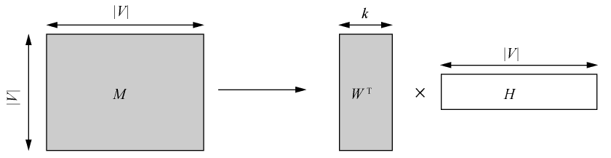









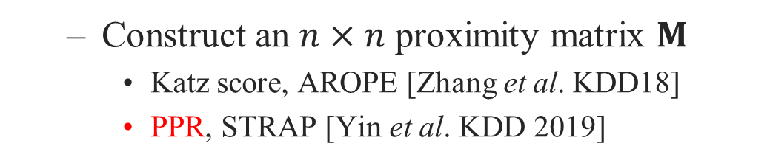
Existing Work
Factorization-based HNE methods
$$O\left(n^{2}\right) !$$
Construct an $n×n$ proximity matrix $M$
Katz score, AROPE [Zhang et al. KDD18]
PPR, STRAP [Yin et al. KDD 2019]
Factorize $M=X∙Y^{T}$ (e.g., SVD, NMF)
$$n$$
$$n$$
$$n$$
$$X$$
$$M$$
$$Y$$
Notes:
Recently, some researchers theoretically proved that the random walk-based HNE methods can be directly transformed into factorizing a proximity matrix.
The state-of-the-art method in this category is based on factorizing a PPR matrix. However, this is still immensely expensive due to the construction and factorization of the n by n matrix.

Slide 6
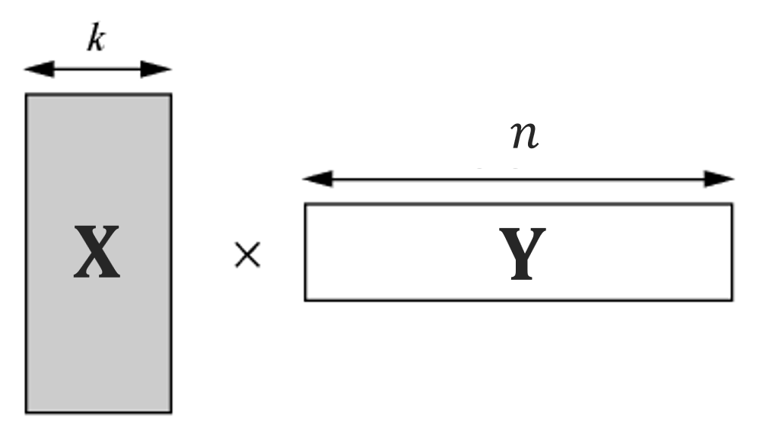
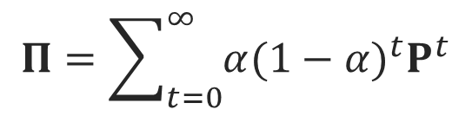

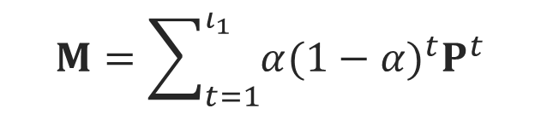





Motivations: Efficiency
Exact PPR
$ι_{1}$-truncated PPR
$$Π=\sum_{t=0}^{∞}{α{(1−α)}^{t}P^{t}}$$
$$M=\sum_{t=1}^{ι_{1}}{α{(1−α)}^{t}P^{t}}$$
Space:
$$O(n^{2})$$
too dense!
Time:
$$O(n^{3})$$
too slow!
0 1/3 1/3 1/3 0 0 0 0 0
1/3 0 1/3 0 1/3 0 0 0 0
1/4 1/4 0 1/4 1/4 0 0 0 0
1/3 0 1/3 0 1/3 0 0 0 0
0 1/4 1/4 1/4 0 1/4 0 0 0
0 0 0 0 1/2 0 1/2 0 0
0 0 0 0 0 1/2 0 1/2 0
0 0 0 0 0 0 1/2 0 1/2
0 0 0 0 0 0 0 1 0
SVD
$$P$$
Time:
$$O(mklog(n))$$
Space:
$$O(m)$$
How to refine?
Notes:
The first motivation of our work is to reduce the high costs of construction and factorization of PPR matrix.
Recall the definition of PPR., in which P denotes the random walk matrix of the graph G.
After ell_1 iterations, even the computation of ell_1 step truncated PPR matrix requires up to O(n^2) space and O(n^3) time.
A naïve thinking is factorizing the sparse random walk matrix with SVD instead factorizing the dense PPR matrix.
And then refine the factorized results such that the inner products of the refined embedding vectors can approximate PPR values.

Slide 7
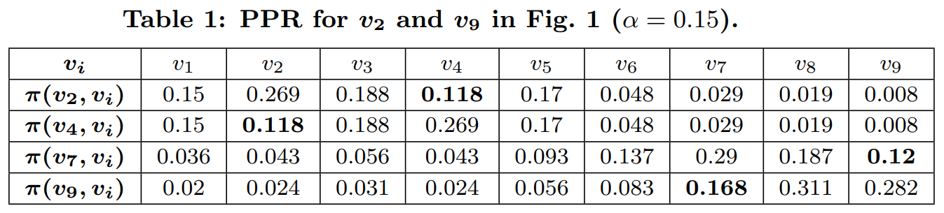

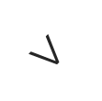
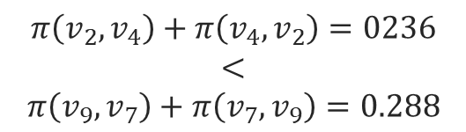
Motivations: Effectiveness
3 common neighbours
$$π\left(v_{2},v_{4}\right)+π\left(v_{4},v_{2}\right)=0236$$
$$<$$
$$π\left(v_{9},v_{7}\right)+π\left(v_{7},v_{9}\right)=0.288$$
$$>$$
Why?
1 common neighbour
How?
Neglect node global importance
Reweight nodes with weights !
Potential link:
$${(v}_{2},v_{4})>(v_{7},v_{9})$$
Notes:
Another motivation is that PPR itself suffers some deficiency, making it fail to accurately capture graph topology.
For example, Given an example social network G, in which each node is a user and each edge is friendship. Let’s consider user pairs (v2,v4) and (v7,v9) .
We note that v2 and v4 share three common friends while v7 and v9 share only one. Intuitively, if we were to make a friend recommendation, it is more likely to be (v2,v4) than (v7,v9).
However, according to the PPR values in Table 1, the PPR value of pair (v7,v9) is much higher than that of pair (v2,v4), which violates our intuition.
The reason is that PPR is used to measure the importance of each node from the perspective of a given node, which neglects the importance of a node in a global view.
How do we solve this? Apparently, reweight each node with an importance weight.

Slide 8
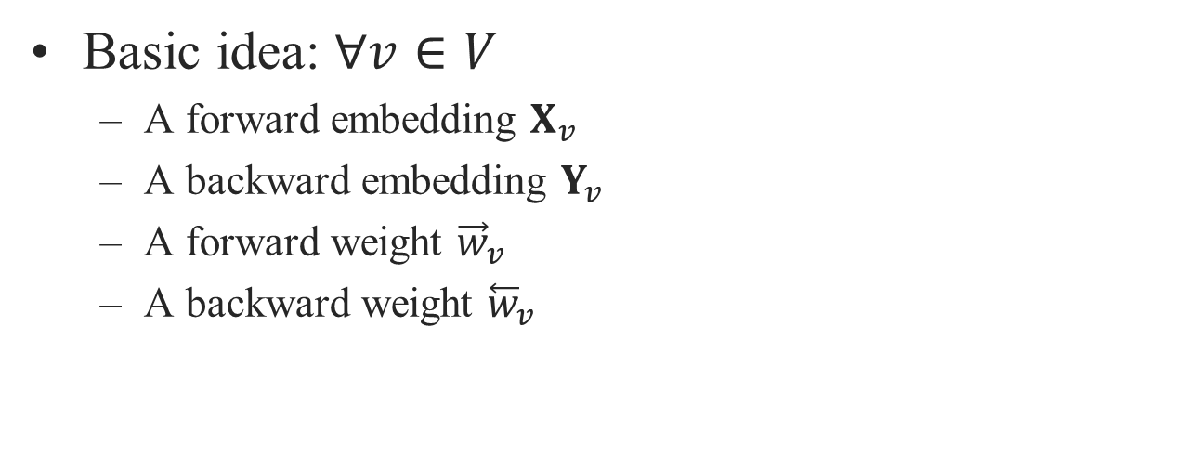
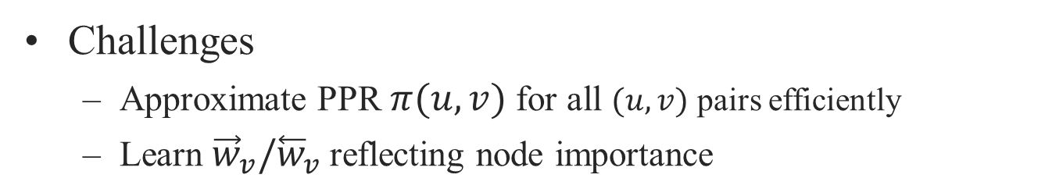


Proposed solution: NRP
Basic idea: $∀v∈V$
A forward embedding $X_{v}$
A backward embedding $Y_{v}$
A forward weight ${\vec{w}}_{v}$
A backward weight ${\overset{⃖}{w}}_{v}$
Preserve node proximity
Preserve edge direction
$$X_{u}∙Y_{v}^{T}≠X_{v}∙Y_{u}^{T}$$
Preserve node global importance
$$X_{u}∙Y_{v}^{T}≈{\vec{w}}_{u}∙π(u,v)∙{\overset{⃖}{w}}_{v}$$
Challenges
Approximate PPR $π(u,v)$ for all $(u,v)$ pairs efficiently
Learn ${\vec{w}}_{v}/{\overset{⃖}{w}}_{v}$ reflecting node importance
Notes:
Based on the two motivations illustrated in last two slides, we are ready to introduce our HNE solution, NRP, which consists of four parts for each node: a forward and backward embedding , a forward and backward weight. The forward embedding Xu and backward embedding Xv not only preserve the proximity between u and v, but also preserve the edge direction from u to v.
The forward and backward weights of node v preserve the global importance of v in the graph.
Next we consider how to learn embeddings and weights.

Slide 9
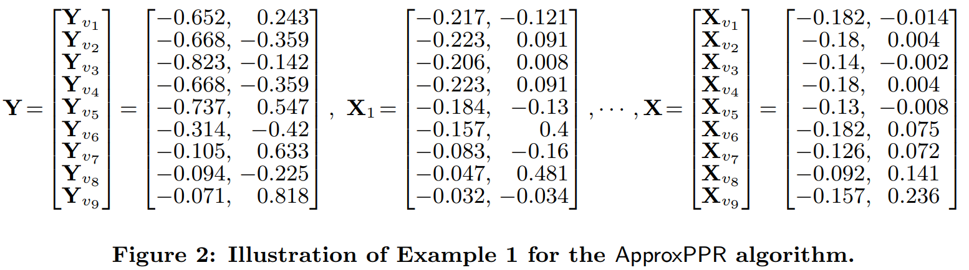

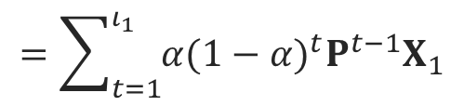




NRP: Step 1: Approximate PPR
0 1/3 1/3 1/3 0 0 0 0 0
1/3 0 1/3 0 1/3 0 0 0 0
1/4 1/4 0 1/4 1/4 0 0 0 0
1/3 0 1/3 0 1/3 0 0 0 0
0 1/4 1/4 1/4 0 1/4 0 0 0
0 0 0 0 1/2 0 1/2 0 0
0 0 0 0 0 1/2 0 1/2 0
0 0 0 0 0 0 1/2 0 1/2
0 0 0 0 0 0 0 1 0
SVD
$$P$$
$$P≈X_{1}∙Y^{T}$$
$$O(mklog(n))$$
$$=\sum_{t=1}^{ι_{1}}{α{(1−α)}^{t}P^{t−1}X_{1}}$$
$$M≈X∙Y^{T}$$
$$O(mkι_{1})$$
Notes:
The first step is to preserve the PPR values into the embeddings.
Initially, we employ SVD over the random walk matrix P to obtain the initial forward embeddings X1 and backward embeddings Y.
Then by the definition of PPR, we iteratively multiply random walk matrix P with the forward embeddings such that the inner product between X and Y approximates the PPR matrix.
By doing so, we avoid the n^2 space and n^3 time for the construction and factorization of PPR matrix and reduce the complexities to linear.

Slide 10
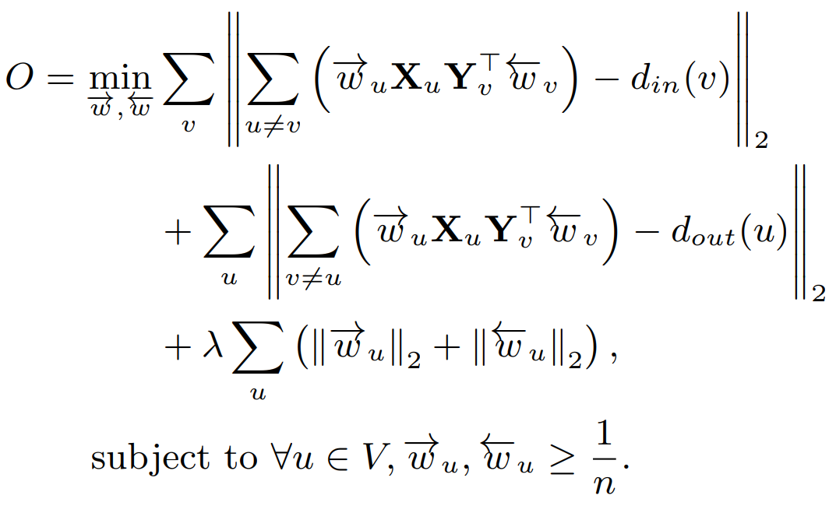
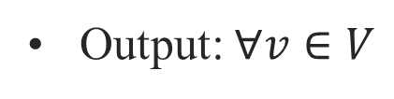


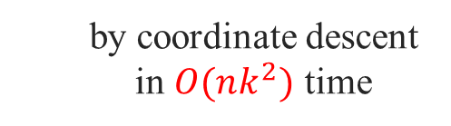
NRP: Step 2: Node Reweighting
Intuition:
₁
total strength of connections from other nodes to u = in-degree of u
total strength of connections from u to other nodes = out-degree of u
₂
Objective function:
₁
by coordinate descent in $O(nk^{2})$ time
₂
Output: $∀v∈V$
$$X_{v}←{\vec{w}}_{v}∙X_{v}$$
$$Y_{v}←{\overset{⃖}{w}}_{v}∙Y_{v}$$
Notes:
The second step is to learn the forward and backward weight for each node.
The intuition behind node reweighting is that:
Thus we can formulate the objective function.
This can be optimized with O(nk^2) time with coordinate descent by our update acceleration techniques. Due to time limit, we will not go to details here.
Finally, we return the reweighted forward embedding and reweighted backward embedding for each node.

Slide 11
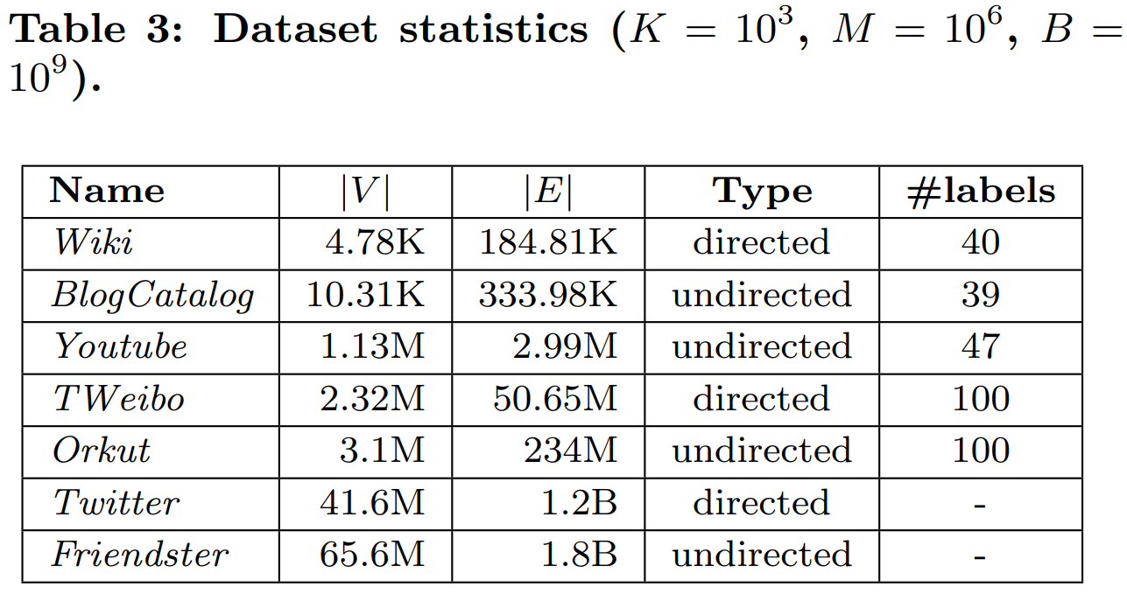
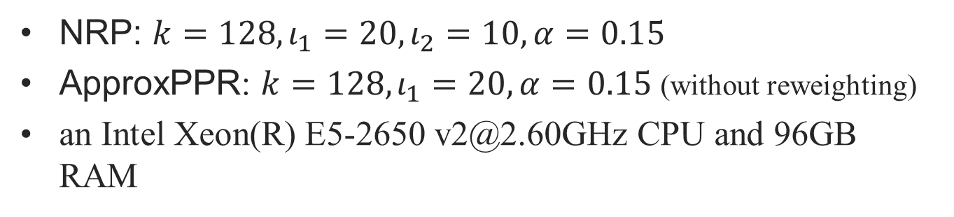
Experiments: Settings
Table 2. Data Sets
NRP: $k=128, ι_{1}=20,ι_{2}=10,α=0.15$
ApproxPPR: $k=128, ι_{1}=20, α=0.15$ (without reweighting)
an Intel Xeon(R) E5-2650 v2@2.60GHz CPU and 96GB RAM
Notes:
We then evaluate the efficiency and effectiveness of NRP against recent HNE methods over 7 datasets (including both large and small real-world graphs).

Slide 12
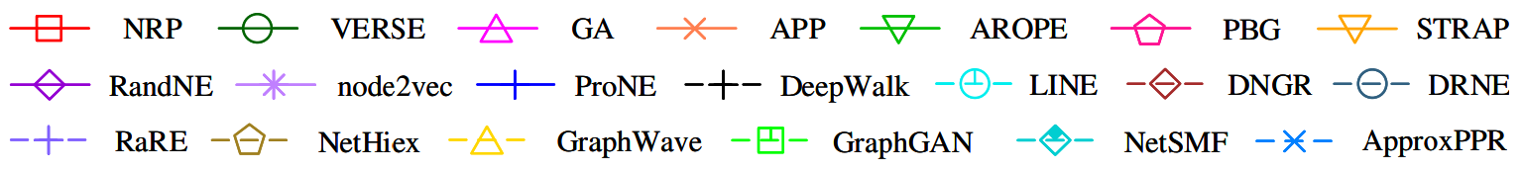
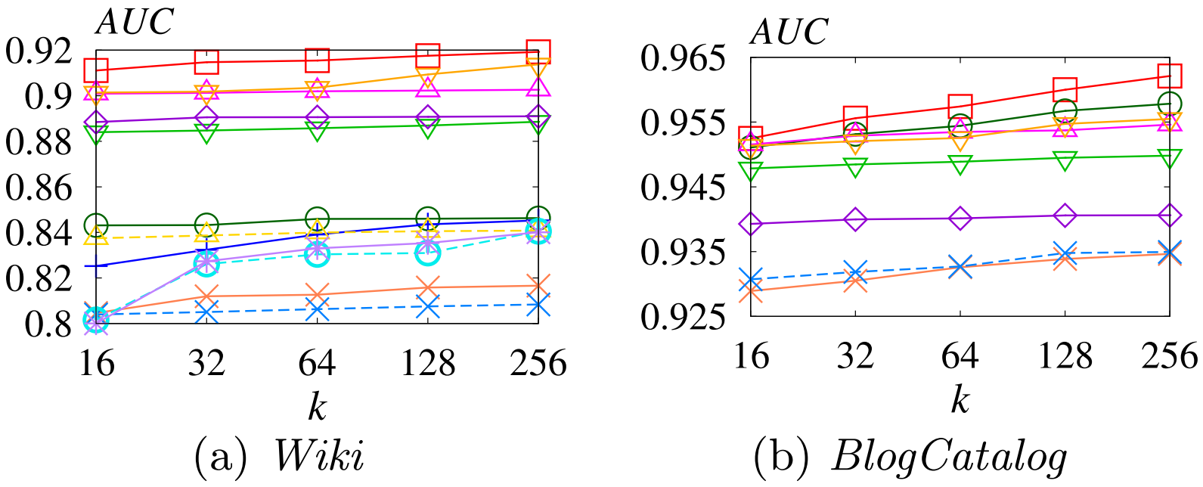
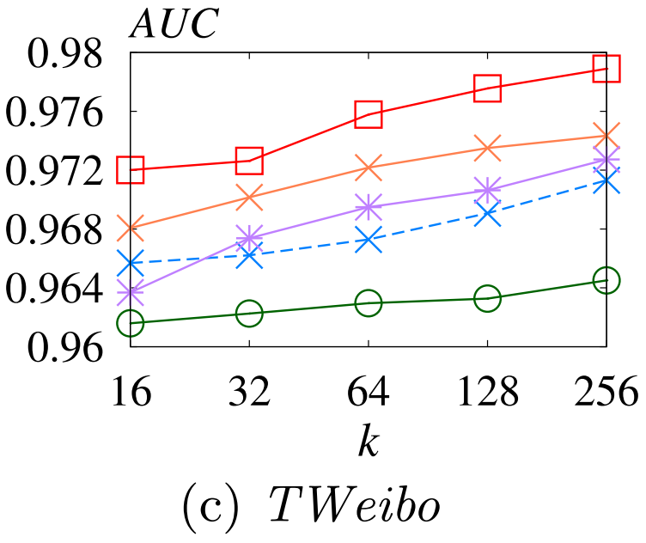
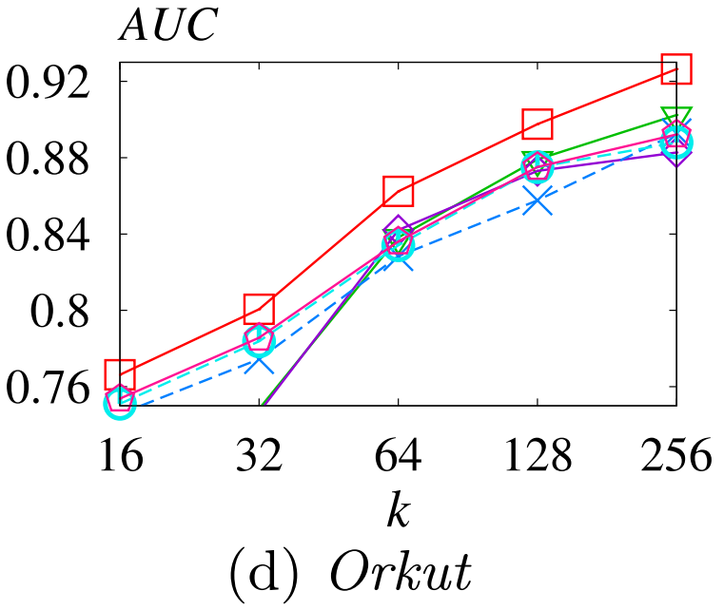
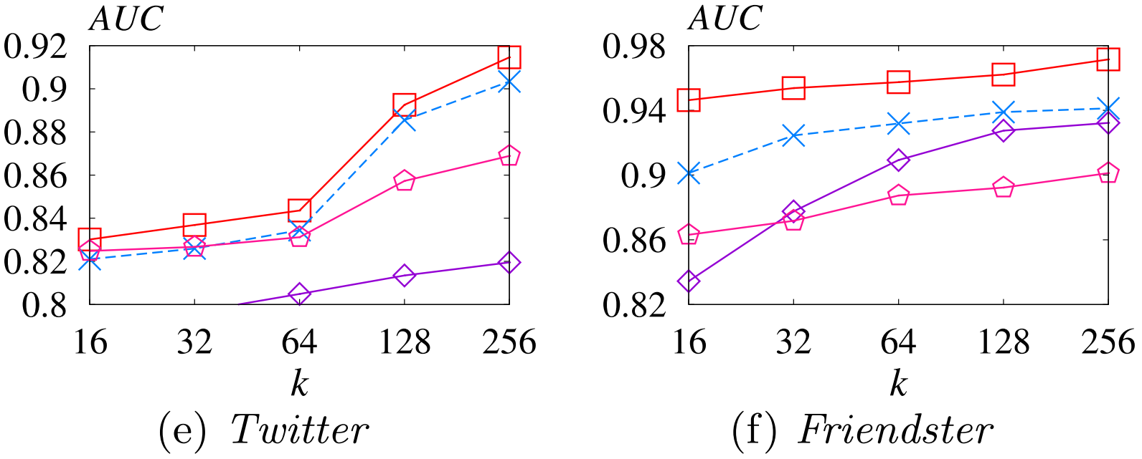
Experiments: Link Prediction
Notes:
From the figures for link prediction experiments, we can observe that NRP consistently outperforms all competing HNE methods with the embedding dimensionality k increases.

Slide 13
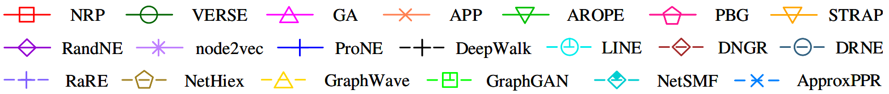
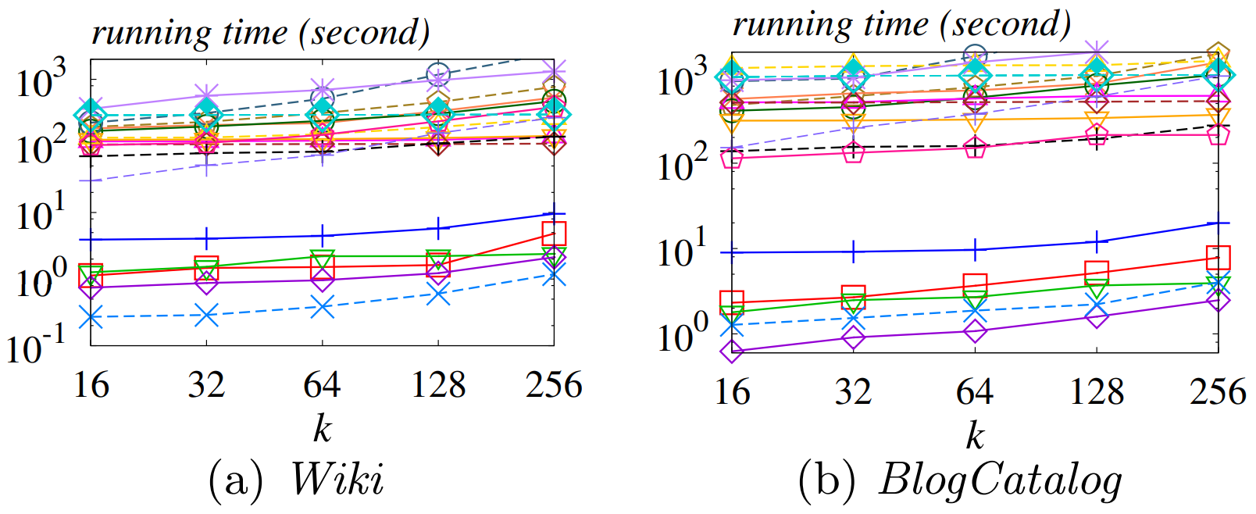
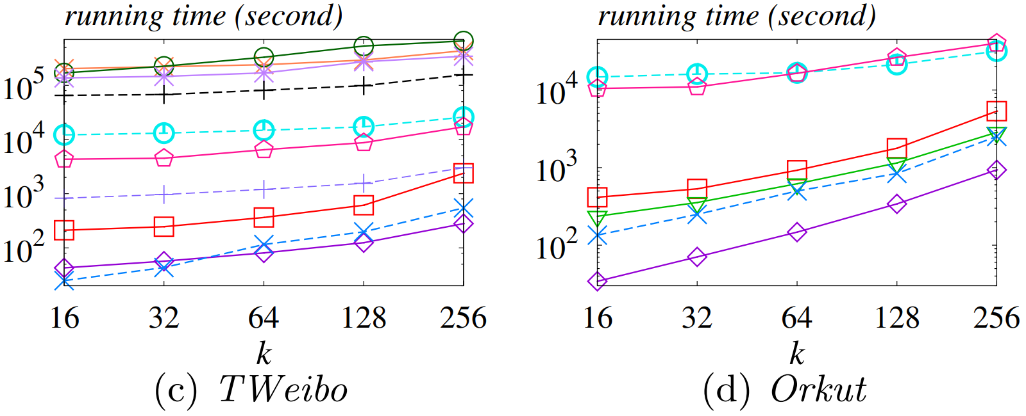
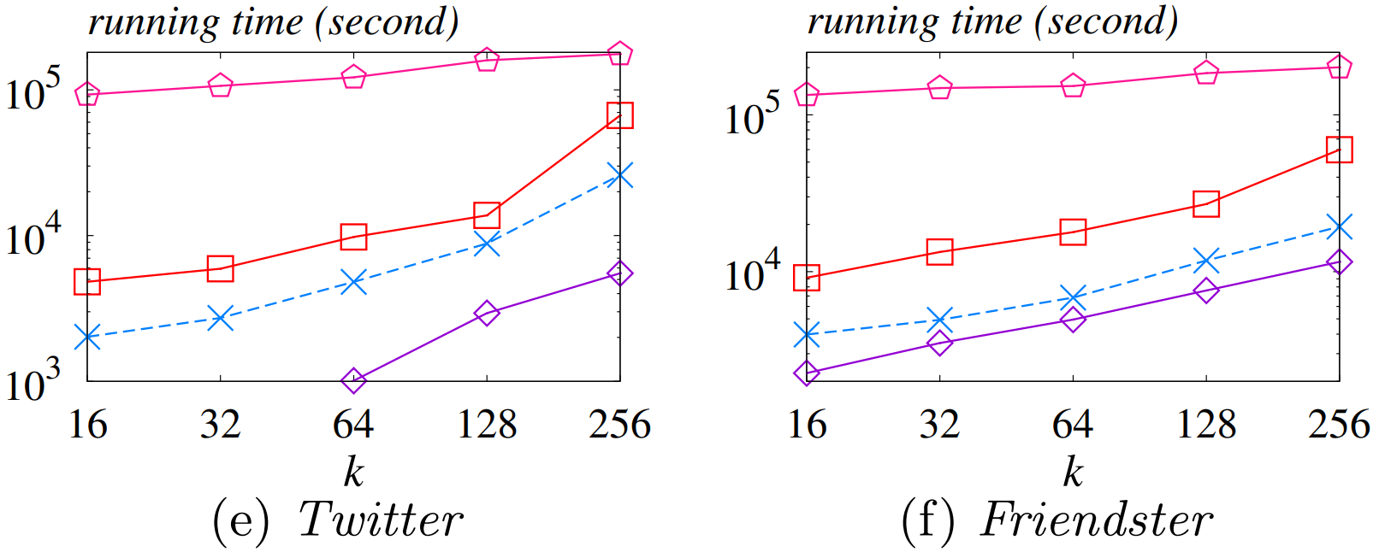
Experiments: Efficiency
Notes:
In terms of efficiency, we can observe that NRP is one of the fastest method and one of the three methods that is capable of handling billion-edge graphs Twitter and Friendster within several hours.
Considering the effectiveness of NRP in link prediction tasks, we may conclude that NRP outperforms existing HNE methods.

Slide 14
Thanks
Q & A
Notes:
That’s all. Thanks for your listening.

Slide 15



Why NRP Works
NRP preserves
Multi-hop proximity between nodes (PPR)
The global importance of nodes (Reweighting)
Edge directions (forward/backward embeddings)
For example
Follow
Follow?
Me (Nobody)
Not interested!

Slide 16
Competitors
Factorization-based
AROPE, RandNE, NetSMF, ProNE, STRAP
Random-walk-based
DeepWalk, LINE, node2vec, PBG, APP, VERSE
Neural-network-based
DNGR, DRNE, GraphGAN, GA
Other
RaRE, NetHiex, GraphWave

Slide 17
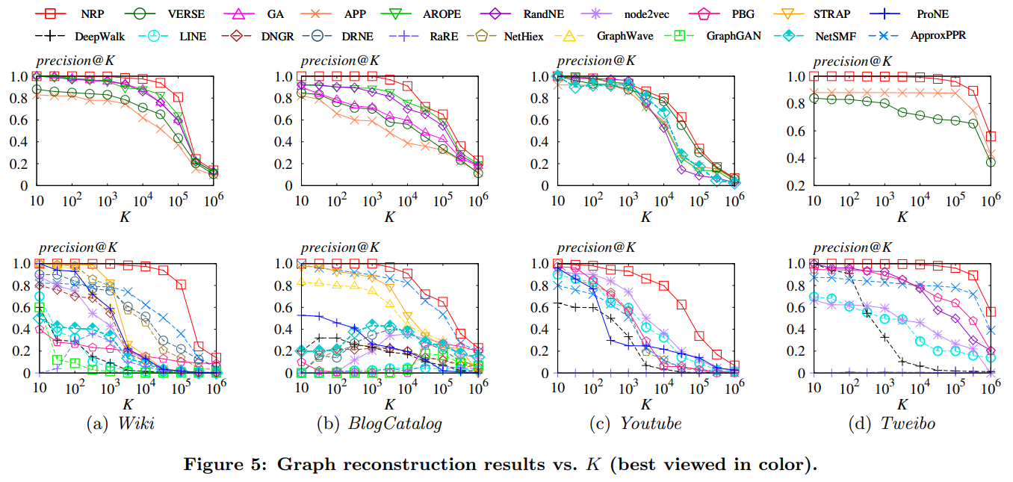
Experiments: Graph Reconstruction
Notes:
take a set S of node pairs from the input graph G. On Wiki and BlogCatalog, we let S be the set of all possible node pairs. On Youtube and TWeibo, following previous work, we construct S by taking a 1% sample of the n^2 possible pairs of nodes.
compute the score of each pair using the same approach as in link prediction
examine the top-K node pairs to identify the fraction of them that correspond to the edges in G

Slide 18
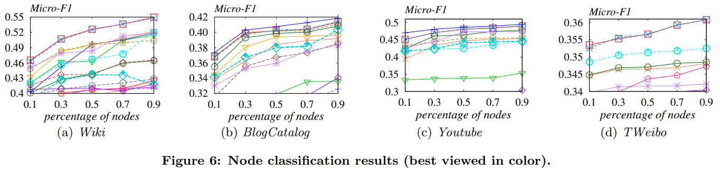
Experiments: Node Classification

Slide 19
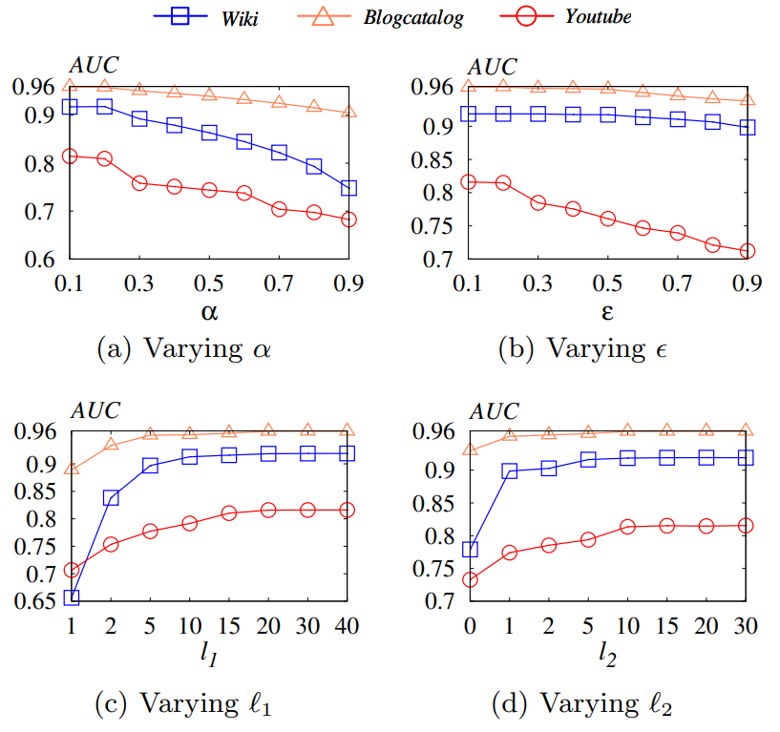
Experiments: Parameter Analysis
Figure 8. Link prediction results

Slide 20
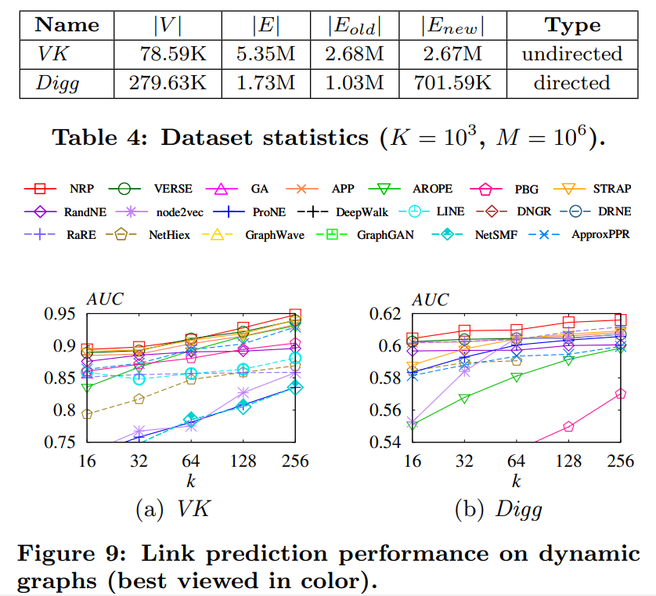
Experiments: Link Prediction on Dynamic Graphs

Slide 21
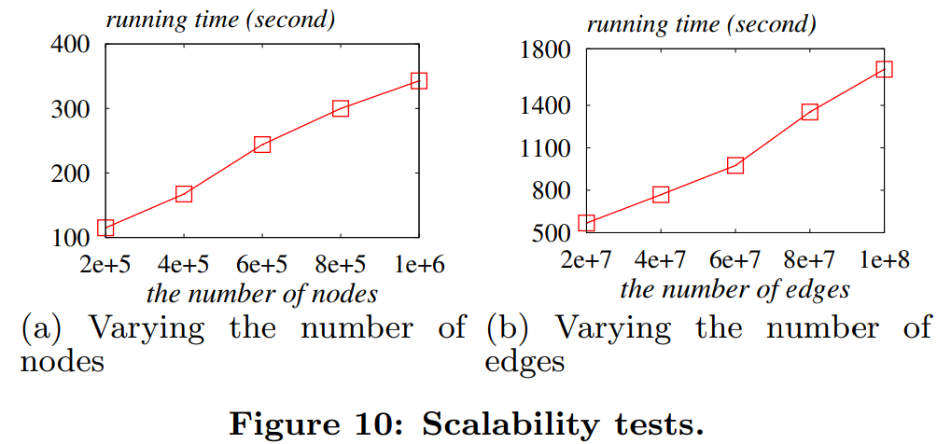
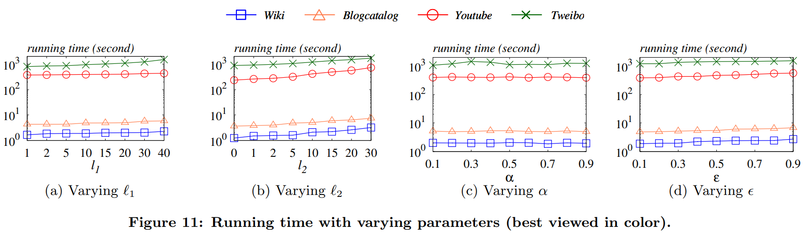
Experiments: Efficiency

Slide 22
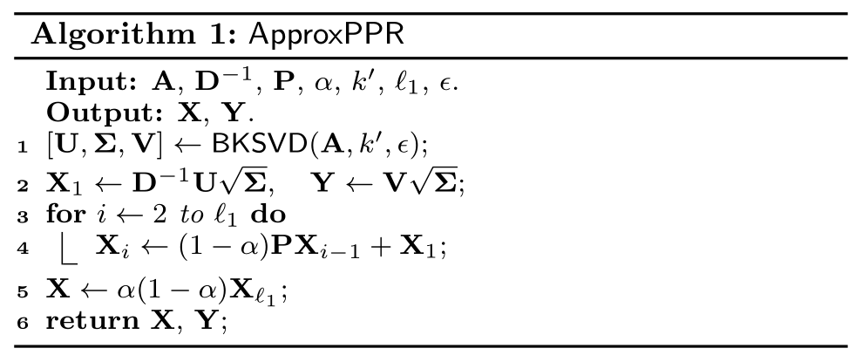
PPR Approximation

Slide 23
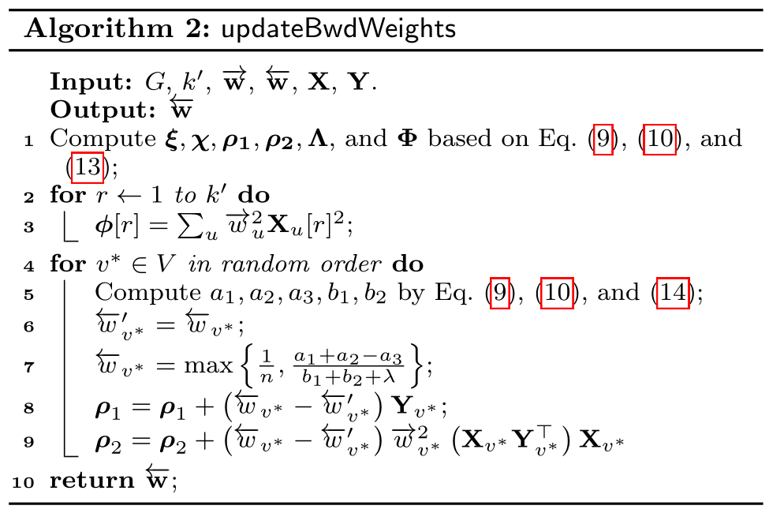
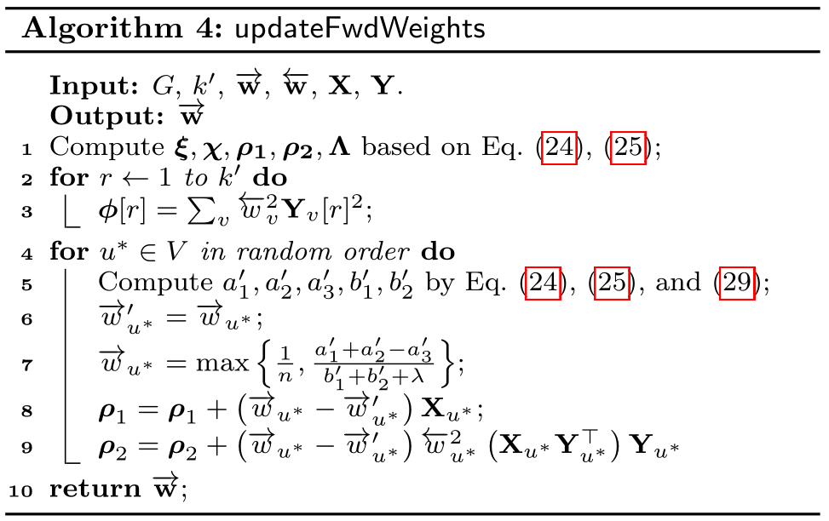
Node Reweighting

Slide 24
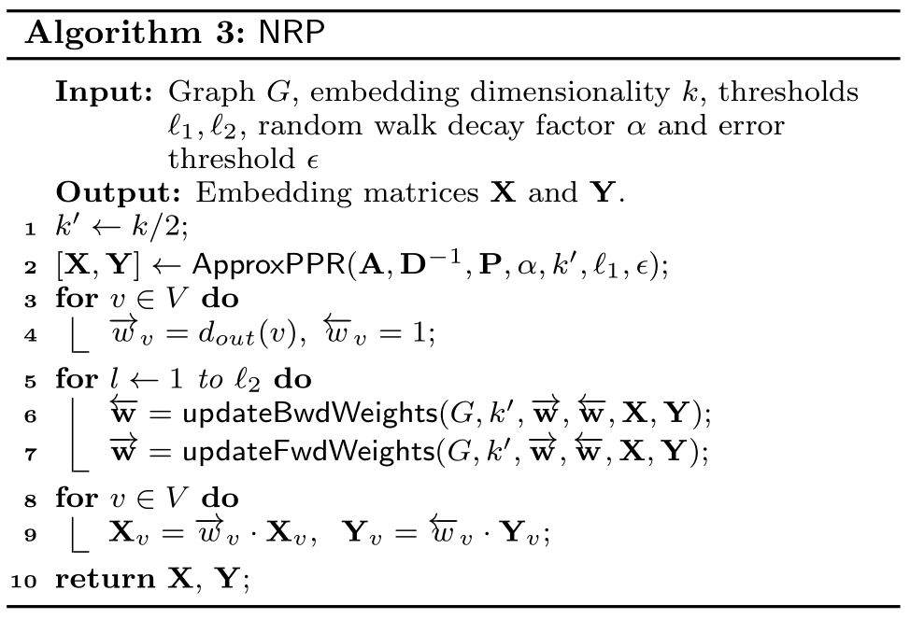
NRP

