Slide 1
Web development

Slide 2
Plan for the lecture
About myself, acquaintance
About this course
Structure, topics to discuss
Group project
Intro into web development
HTML
CSS
JavaScript
HTTP, client-server
How it works altogether

Slide 3



Introduction to Web Dev

Slide 4


Web page files

Slide 5

Server

Slide 6


Web browser

Slide 7
Web file types

Slide 8
HTML
<!DOCTYPE html> <html lang="en"> <head> <title>Hello, world!</title> </head> <body> <h1>Welcome to web development course</h1> </body> </html>

Slide 9
CSS
.class { padding: 2px; } #id { color: red; background-color: green; }

Slide 10
JavaScript
var total = sum(1, 2); function sum(a, b) { return a + b; } console.log(total);

Slide 11
HTTP – hypertext transfer protocol

Slide 12
http://google.com

Slide 14
CSS, JavaScript, images, etc.

Slide 16
HTML basics

Slide 17
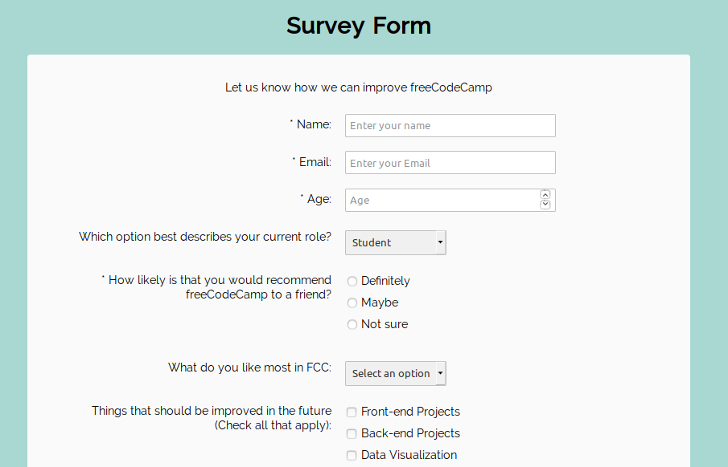
Practice

