Slide 1
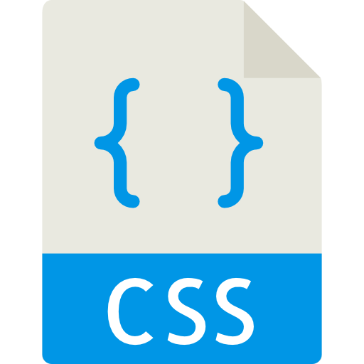

Slide 2
CSS syntax
selector { property1: value1; property2: value2; }
h1 { color: green; }

Slide 3
CSS selectors
Element
Class
ID

Slide 4
CSS selectors
Element
header { color: blue; }

Slide 5
CSS selectors
Class
<h1 class="big-header"> Title </h1>
.big-header { font-size: 30px; }

Slide 6
CSS selectors
Class
<div class=”full-width green"> Content </div>

Slide 7
CSS selectors
Class
Button 1
<button class="btn blue">Button 1</button>
Button 2
<button class="btn green">Button 2</button>
Button 3
<button class="btn red">Button 3</button>

Slide 8
CSS selectors
.btn { color: white; padding: 10px; }
.blue { background-color: blue; }
Button 1
Button 2
Button 3

Slide 9
CSS selectors
ID
<button id="search"> Search </button>
#search { color: yellow; }

Slide 10
How to load CSS?
1. Inline
<button style=”color: blue"> Search </button>

Slide 11
How to load CSS?
2. Style element
<head> <style> .blue { color: blue; } </style> </head>

Slide 12
How to load CSS?
3. External CSS
<head> <link rel="stylesheet" href="style.css"/> </head>

Slide 13


Slide 14
Practice is everything

Slide 15
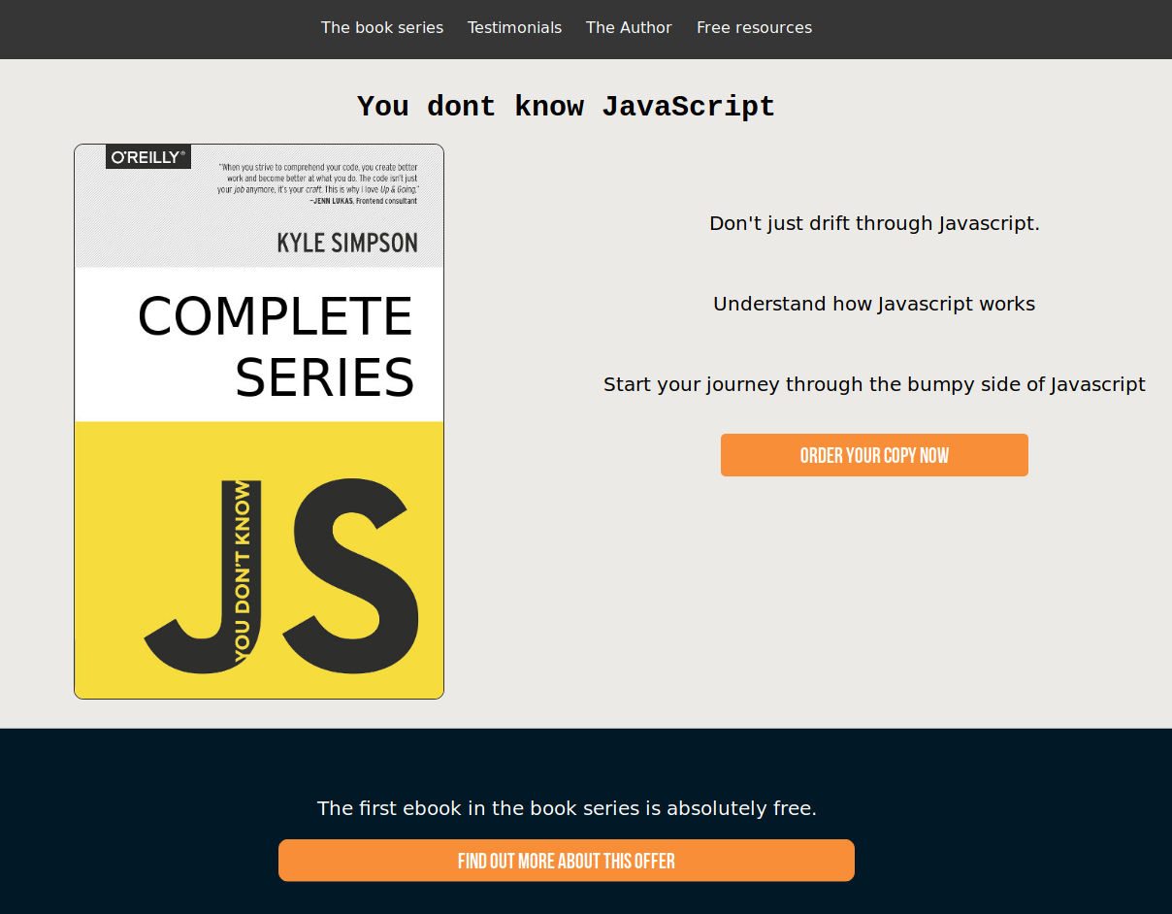

Slide 16


Slide 17
Reading
CSS combinations - https://www.w3schools.com/css/css_combinators.asp
CSS specificity - https://developer.mozilla.org/en-US/docs/Web/CSS/Specificity
CSS units - https://www.w3schools.com/cssref/css_units.asp

Slide 18
Video
https://www.youtube.com/watch?v=1PnVor36_40&list=PLZlA0Gpn_vH9xx-RRVNG187ETT2ekWFsq&index=7

