Slide 1
Cross-Domain Lifelong Learning for SDN Control of Satellite-Airborne-Terrestrial Edge Networks
Final presentation: implementation and results | Reproduction of Wu et al., IEEE TWC 2026
Vedant Amit Agrawal (23CSB0A08) | Abu Fahad Ansari (23CSB0A45) | Shwetang Wasnik (23CSB0A55)
Advanced Computer Networks, Project ID 22 | Guide: Dr. Venkatarami Reddy Chintapalli, Dept. of CSE, NIT Warangal

Slide 2
Project overview
1
Built
2
Ran
3
Found
A SATECN simulator driven by real Starlink TLEs, six RL domains, NAC, MSR-NAC, ELLA, CDLL and an exhaustive search, all from the paper's equations
Every experiment of the paper's evaluation (Figs. 3-9, Table V), 3 seeds, plus ablations; 5 unit tests
Several qualitative claims reproduce (MSR-NAC beats NAC, cross-domain beats single-domain sharing, beta trade-off, scalability, no forgetting). The large gains claimed for CDLL (70%, 8x faster) do not.
Notes:
What was built and the one-line outcome.

Slide 3
Problem statement
min (1/T) sum_t sum_i [ beta * AoI_i(t) + eps * (1 - beta) * ( E_i(t) + sum_o E_i,o(t) ) ]
Each task runs on exactly one node: IoT, UAV or LEO (no splitting)
CPU and UAV/LEO capacity limits, transmit power limits
Satellites visible for about 90 s; load and channels change every slot
Recast as a stream of RL tasks from 6 domains with 3 to 15 policy parameters
Notes:
Minimise long-run AoI plus scaled energy over offloading, CPU and power decisions in a changing network.

Slide 4
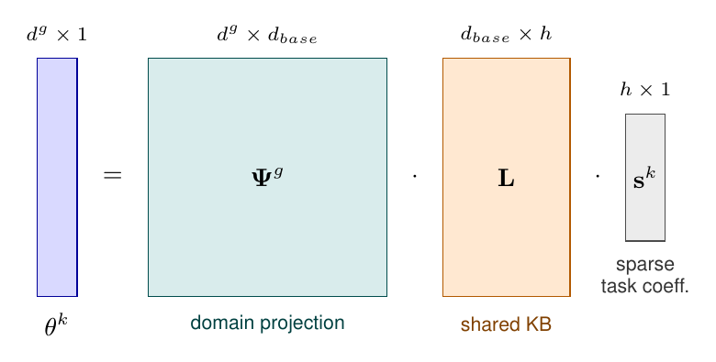
Methodology: theta_k = Psi_g L s_k
MSR-NAC: critic + n-step advantage, natural gradient via compatible features
H_k: Fisher information of the roll-out
L, Psi_g: gradient steps on the 2nd-order loss (Eqs. 23-24)
s_k: weighted Lasso by coordinate descent (Eq. 25)
ELLA baseline: separate L_g per domain
Notes:
Shared basis L, per-domain projection Psi_g, sparse task code s_k. Updated with Eqs. 23-25 after every MSR-NAC step.

Slide 5
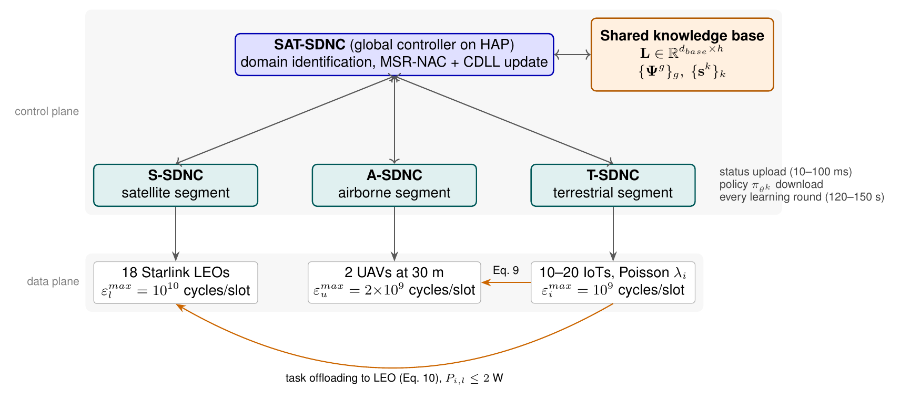
Architecture: hierarchical KB-SAT-SDN

Slide 6
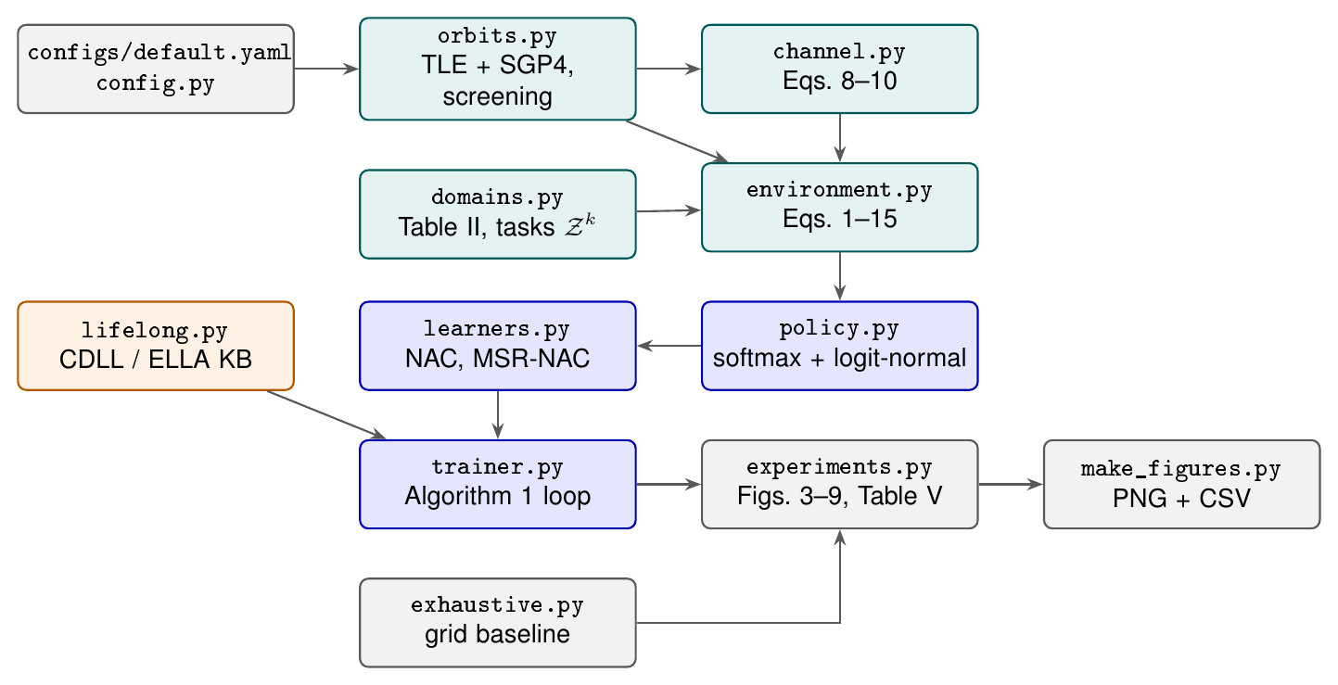
Implementation: code architecture
~2,000 lines of Python (incl. tests and scripts)
Every config value tagged [paper] or [assumed]
One command per experiment, one for all figures
Windows: one PowerShell script recreates the project
Notes:
Python + NumPy, one YAML config, sgp4 for orbits. CPU only.

Slide 7
Dataset: a simulator fed by real Starlink orbits
10,623
18
2.73
Starlink TLEs (CelesTrak, 8 Nov 2026)
satellites kept: >= 55 deg for >= 90 s in 600 s
visible per slot on average; the paper also reports 2.73
Workload: D_i ~ N(1.2, 0.6^2) MB, rho in [180, 284] cycles/bit, lambda rescaled x0.05 (deviation: Table IV rate is ~100x capacity)
LEO altitude band widened to 440-600 km: Starlink shells were lowered to ~480 km after the paper
Notes:
No dataset in the paper. The only external data is the CelesTrak TLE snapshot.

Slide 8
Experimental setup
Protocol
Metrics
24 tasks (4 per domain). One iteration = every task once, in random order: one 120-slot episode, then one update. 200 iterations, 3 seeds. Curves record the exploring on-policy penalty.
Penalty (Eq. 15), AoI and scaled energy per IoT per slot; jumpstart on unseen tasks; iterations to reach NAC's final level; forgetting on old tasks after new ones are learned.
Learners compared: MSR-NAC-CDLL (proposed), MSR-NAC-ELLA, MSR-NAC, NAC, exhaustive grid search
Same hyperparameters for every learner; none tuned per method
Full run: about 37 minutes on 2 CPU cores
Notes:
Same tasks, seeds and budget for every learner.

Slide 9
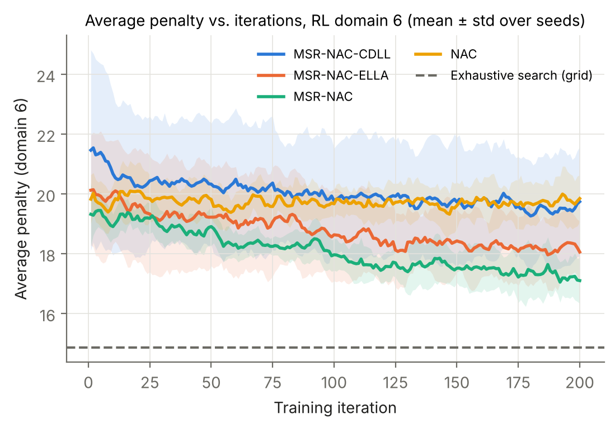
Domain 6 convergence: all learn, MSR-NAC lowest
Method | First 5 | Last 10
MSR-NAC-CDLL | 21.40 | 19.60
MSR-NAC-ELLA | 19.93 | 18.22
MSR-NAC | 19.45 | 17.12
NAC | 19.67 | 19.83
After 200 iterations: MSR-NAC 17.1, ELLA 18.2, CDLL 19.6, NAC 19.8. Grid search (deterministic) reaches 14.9. CDLL starts highest because Psi_6 is still random on first visit.
Notes:
Paper's Fig. 3: CDLL starts near 100, NAC near 320. Ours: all start near 20 because U(0,1) initial policies are already reasonable.

Slide 10
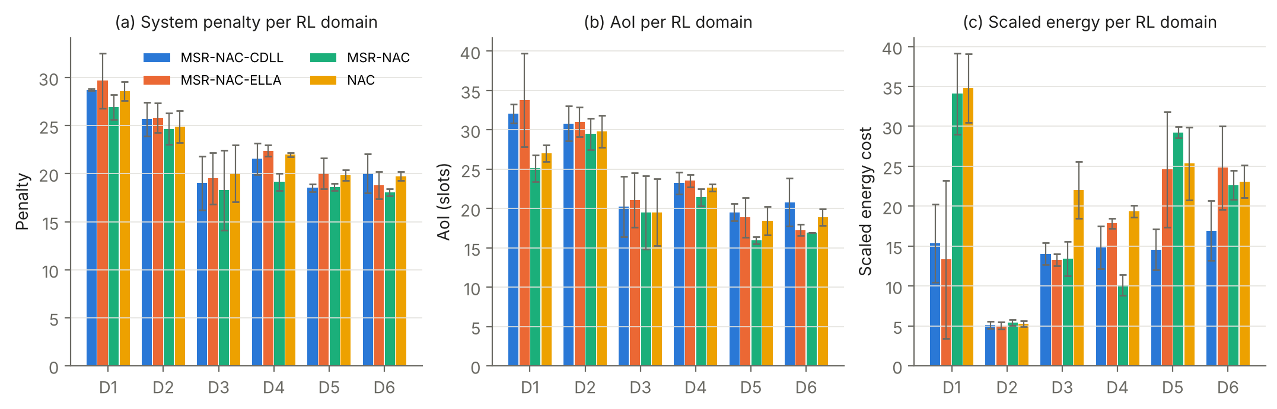
Per-domain penalty, AoI and energy
End of training | D1 | D2 | D3 | D4 | D5 | D6 | All
MSR-NAC-CDLL | 27.81 | 25.45 | 18.74 | 20.12 | 18.16 | 19.60 | 21.65
MSR-NAC-ELLA | 29.17 | 25.55 | 18.73 | 22.13 | 19.58 | 18.22 | 22.23
MSR-NAC | 26.40 | 24.53 | 18.22 | 18.20 | 18.41 | 17.12 | 20.48
NAC | 28.26 | 25.04 | 19.89 | 21.69 | 20.36 | 19.83 | 22.51
Notes:
Bars average all 200 iterations (as in the paper); the table shows the end of training. Bold = lowest per domain.

Slide 11
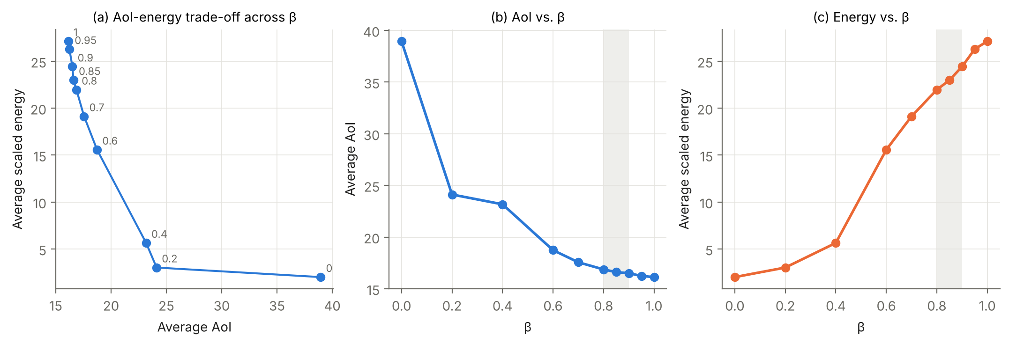
AoI-energy trade-off versus beta
AoI falls 38.95 -> 16.13 as beta goes 0 -> 1 (paper: 38.58 -> 20.54); energy rises 2.0 -> 27.1. No 'win-win' region: energy grows with beta throughout. Gains flatten above beta = 0.8, so 0.8 remains a sensible default.
Notes:
CDLL trained on domain-6 tasks for each beta, seed 0.

Slide 12
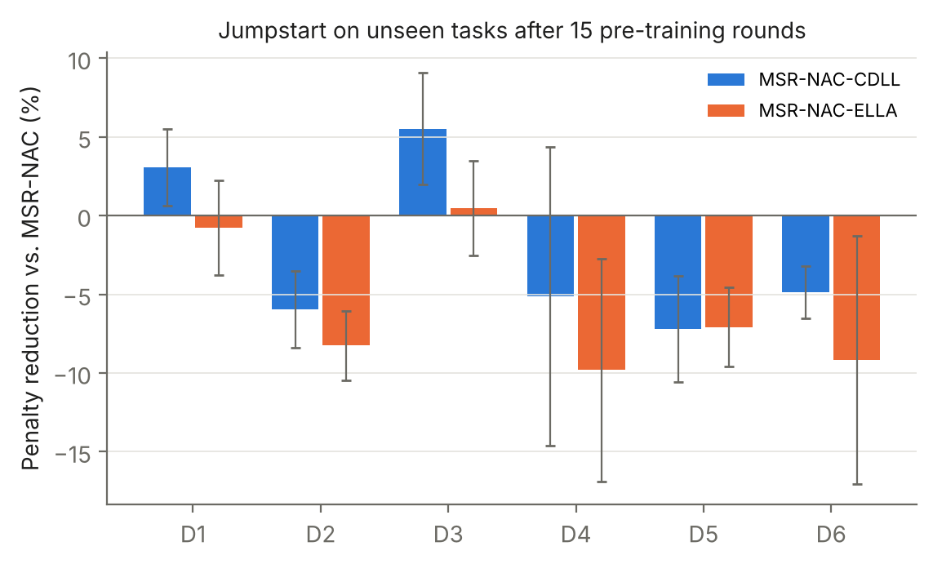
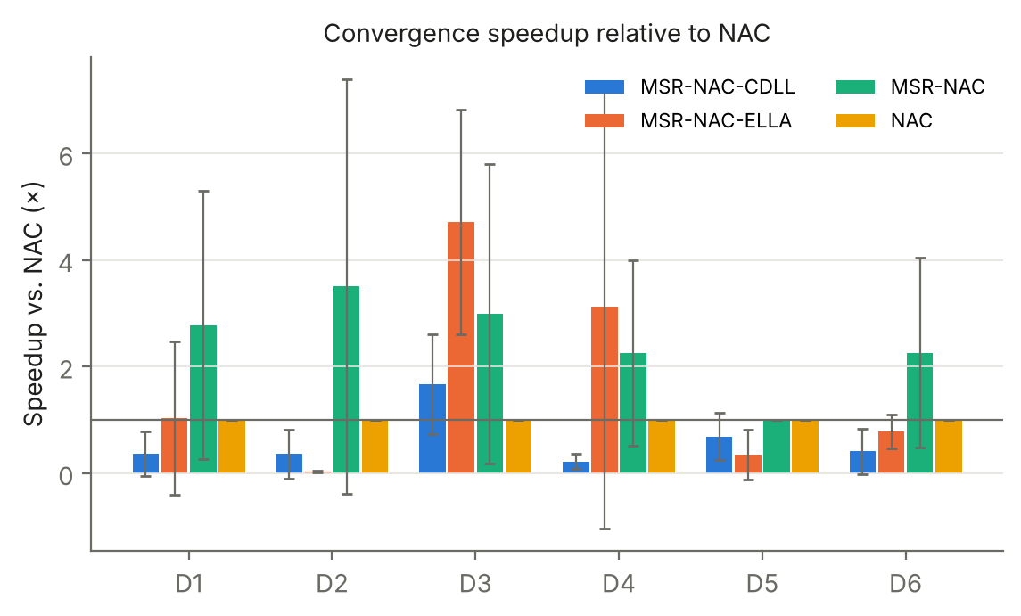
Jumpstart and convergence speed
No positive jumpstart on average (CDLL -2.4%, ELLA -5.8%; paper: 27-67%), though CDLL beats ELLA in 5 of 6 domains. Speedup vs NAC: MSR-NAC 2.5x, ELLA 1.7x, CDLL 0.61x (paper: CDLL > 8x).
Notes:
Left: initial penalty on unseen tasks vs MSR-NAC from random start. Right: iterations to reach NAC's final level, relative to NAC.

Slide 13
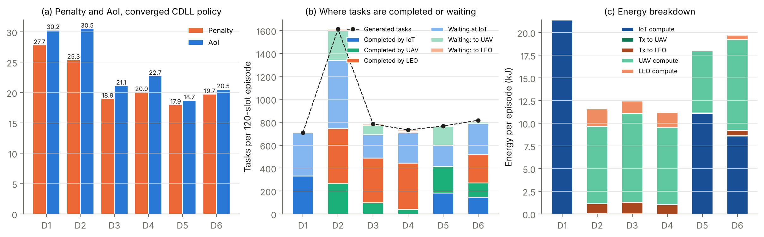
System analysis with the trained CDLL policy
Matches the paper qualitatively: domain 1 completes about half its tasks and has the highest AoI; domain 2 has the lowest energy; LEOs carry 80-90% of completed work in domains 3-4; UAVs dominate domain 5. Unlike the paper, adding LEOs (D5 -> D6) does not lower the penalty here (17.9 -> 19.7).
Notes:
Per 120-slot episode, 5 evaluation episodes per task, 3 seeds.

Slide 14
Scalability: 80 to 280 IoTs, U = N/5, 18 LEOs
N IoTs | AoI | Energy / slot | Energy / IoT | Ctrl energy (model) | Ctrl latency ms (model)
80 | 98.07 | 875.3 | 10.941 | 0.0040% | 0.213
120 | 89.09 | 1303.9 | 10.866 | 0.0042% | 0.233
160 | 93.51 | 1682.4 | 10.515 | 0.0041% | 0.254
200 | 86.38 | 2043.2 | 10.216 | 0.0043% | 0.274
240 | 87.15 | 2429.0 | 10.121 | 0.0043% | 0.295
280 | 87.91 | 2763.2 | 9.868 | 0.0043% | 0.315
Policy size is independent of N; AoI stays roughly flat (98 -> 88) and energy per IoT falls 10% (paper: -29%). Absolute AoI is far above the paper's ~3 because the shared satellites saturate at this load. Modelled signalling energy is < 0.01% of data energy.
Notes:
Same 15-parameter domain-6 policy for every N. Control-plane values are modelled, not measured.

Slide 15
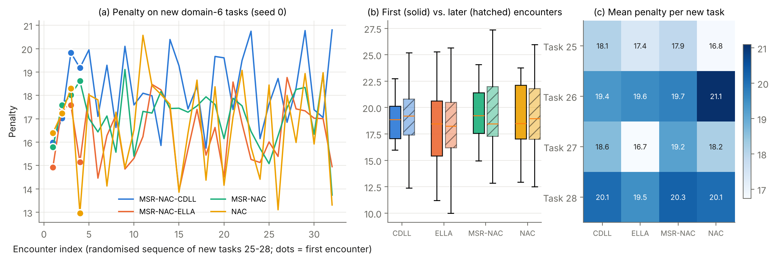
Continual learning of new tasks 25-28
Algorithm | New: 1st | New: later | Old: before | Old: after
MSR-NAC-CDLL | 18.57 | 19.10 | 21.62 | 21.61
MSR-NAC-ELLA | 18.56 | 18.26 | 22.20 | 22.19
MSR-NAC | 19.43 | 19.23 | 20.48 | 20.48
NAC | 19.01 | 19.03 | 22.52 | 22.52
Lifelong learners start new tasks lower (18.6 vs 19.0-19.4). Old-task penalty changes by <= 0.01: no catastrophic forgetting.
Notes:
KBs pre-trained on tasks 1-24; then 32 randomised encounters of the 4 new domain-6 tasks.

Slide 16
Comparison with the paper
Claim | Paper | Ours | Verdict
Mean visible LEOs | 2.73 | 2.73 | Yes
MSR-NAC beats NAC, all domains | yes | yes (-6.9% / -9.0%) | Yes
CDLL beats single-domain ELLA | most domains | 5 of 6 domains | Yes
Up to 70% lower penalty | 70% | max gap ~18% | No
Convergence speedup vs NAC | > 8x | 0.61x (MSR-NAC 2.5x) | No
Jumpstart vs MSR-NAC | 27-67% | -2.4% | No
AoI 0 -> 1 in beta | 38.6 -> 20.5 | 39.0 -> 16.1 | Yes
LEOs help (D5 -> D6) | 61.9 -> 48.5 | 17.9 -> 19.7 | No
Scaling 80 -> 280 IoTs | AoI +3%, E/IoT -29% | AoI -10%, E/IoT -10% | Trend
No forgetting | qualitative | change <= 0.01 | Yes
Notes:
Paper numbers are from Wu et al. 2026; ours from this implementation.

Slide 17
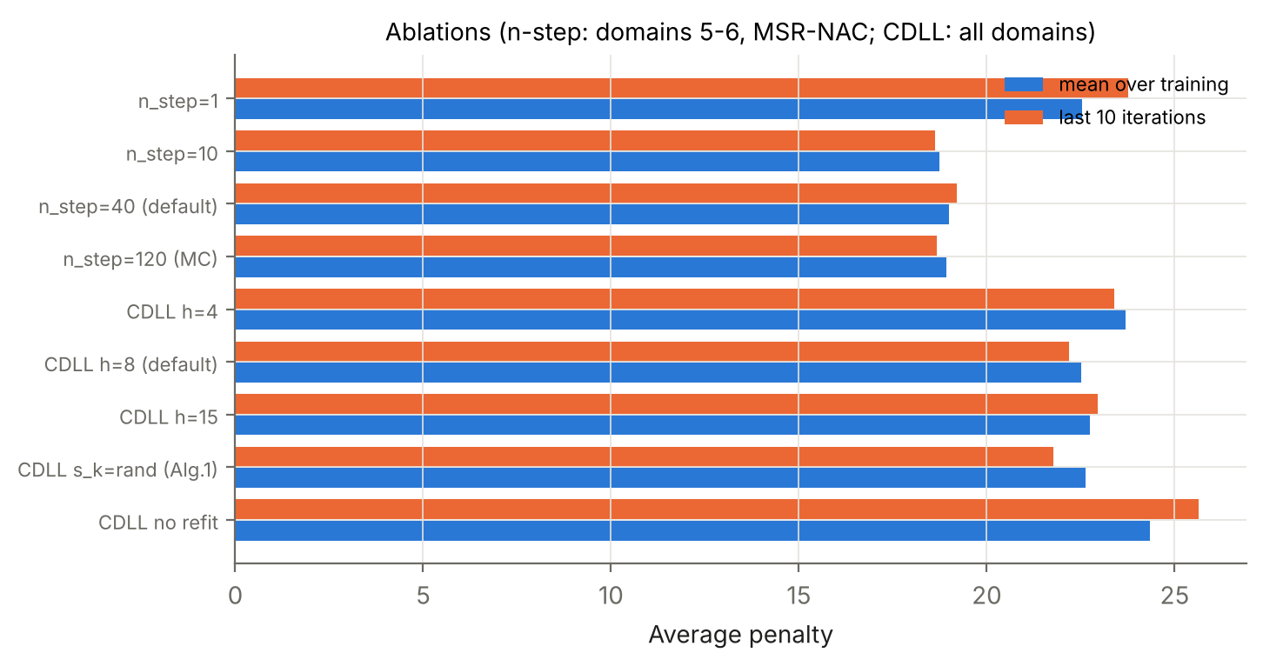
Ablations
n = 1 is clearly worse (22.5 vs 18.7-19.0): offloading credit arrives many slots later, so multi-step returns matter, which supports MSR-NAC.
h = 8 beats h = 4 and h = 15.
Refitting all s_k is essential: without it the penalty rises 22.5 -> 24.4.
Random s_k init (Alg. 1) is as good as our warm start.
Notes:
Seed 0, 100 iterations. n-step variants: MSR-NAC on domains 5-6. CDLL variants: all domains.

Slide 18
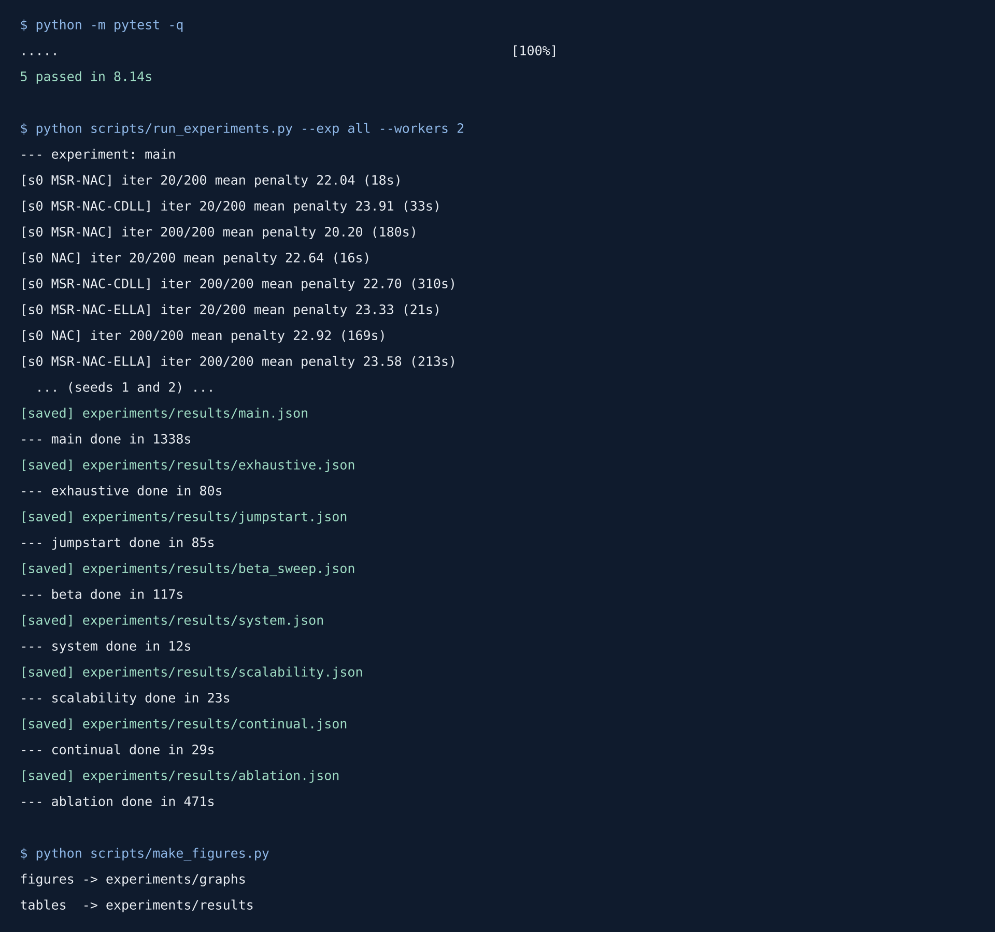
Demonstration: running the project
python -m pytest -q
python scripts/run_experiments.py --exp all --workers 4
python scripts/make_figures.py
--quick runs everything in about 5 minutes
Full run: about 37 minutes on 2 CPU cores
Notes:
Real terminal output from the test suite and the experiment runner.

Slide 19
Limitations
Simulation only; channel, energy-scale and policy parameters marked [assumed] shift absolute numbers
Paper omits learning rates, h, d_base, n and policy form; ours were fixed once for all methods, not tuned per method
Arrival rate rescaled (Table IV rate is ~100x capacity); LEO altitude band widened for today's lower Starlink shells
3 seeds; some differences are within seed-to-seed spread
Exhaustive baseline searches stationary decisions only; control-plane overhead is modelled, not measured

Slide 20
Conclusion and future scope
Conclusion
Future scope
A complete, tested re-implementation of KB-SAT-SDN and CDLL-SATECN. Real Starlink geometry matches the paper exactly. Multi-step returns help in every domain and cross-domain sharing beats within-domain sharing, but in our setting CDLL does not beat an independent MSR-NAC learner: executing the KB's reconstruction loses part of each policy update.
Tune h, d_base and KB steps for transfer; let each task take several PG steps before the KB update; test with weak initial policies; compare domains 5 and 6 on identical tasks; measure control overhead in Mininet + ONOS/Ryu; add UAV battery and secrecy constraints (paper's own future work).

Slide 21
References
Y. Wu, N. Wang, B. Lorenzo, S. Samarakoon, B. Liu, "Lifelong learning-based SDN design for dynamic configuration and resource allocation in satellite-terrestrial networks," IEEE TWC, 2026, doi:10.1109/TWC.2026.3716226.
H. Bou Ammar et al., "Online multi-task learning for policy gradient methods," ICML, 2014.
H. Bou Ammar et al., "Autonomous cross-domain knowledge transfer in lifelong policy gradient RL," IJCAI, 2015.
J. Peters, S. Schaal, "Natural actor-critic," Neurocomputing, 2008.
Z. Zhu et al., "Federated multiagent actor-critic learning for age sensitive MEC," IEEE IoT-J, 2022.
CelesTrak Starlink GP elements; B. Rhodes, sgp4 Python package.

Slide 22
Thank you
Questions and discussion

