Slide 1
Cross-Domain Lifelong Learning for SDN Control of Satellite-Airborne-Terrestrial Edge Networks
Initial presentation | Reproduction of Wu et al., IEEE Trans. Wireless Commun., 2026
Vedant Amit Agrawal (23CSB0A08) | Abu Fahad Ansari (23CSB0A45) | Shwetang Wasnik (23CSB0A55)
Advanced Computer Networks, Project ID 22 | Guide: Dr. Venkatarami Reddy Chintapalli, Dept. of CSE, NIT Warangal
Notes:
Introduce the paper being reproduced and the goal: a working, documented implementation of its system model and learning algorithm.

Slide 2
Problem: fresh IoT data where there is no ground network
1
Where to compute?
2
How much to spend?
3
AoI + energy penalty
Each task runs on exactly one node: the IoT itself, a UAV hovering at 30 m, or a Starlink satellite at about 500 km.
CPU cycles and transmit power cut delay but cost energy: E = alpha * cycles * f^2 grows with the square of the CPU speed.
Penalty C = beta * AoI + eps * (1 - beta) * Energy, with beta = 0.8. AoI is the age of the freshest processed task.
The paper: a hierarchical SDN control plane learns these decisions with cross-domain lifelong reinforcement learning, so knowledge carries over when the network configuration changes.
Notes:
IoT devices in remote areas can compute locally or offload to UAVs and LEO satellites. The controller must decide where each task runs and how much CPU and power to spend, trading data freshness (AoI) against energy.

Slide 3
Motivation: the network never sits still
~90 s
2.73
6
a Starlink satellite stays above 55 degrees elevation
satellites visible on average (paper and our TLE screen)
RL domains with different action spaces (3 to 15 parameters)
Retraining from scratch for every change is too slow, and a single neural policy forgets earlier configurations (catastrophic forgetting).
Notes:
Satellites pass overhead in about 90 seconds, UAVs move, loads change. Any learned policy goes stale, and a standard RL agent forgets old situations when it learns new ones.

Slide 4
Literature review
Line of work | Representative papers | Gap for SATECNs
AoI-aware offloading | Xia et al. 2023; Liao et al. 2024; Zhu et al. 2022 | one fixed configuration, no transfer
SDN for space-air-ground | Shi et al. 2019; Chen et al. 2022 | controller placement, no learned policies
Lifelong policy gradients | PG-ELLA (Bou Ammar 2014); cross-domain LL (2015) | not applied to heterogeneous SATECN domains
Continual learning | EWC 2017; GEM 2017; A-GEM 2019 | fixed network shape, replay memory grows
Notes:
Summarise the four lines of related work and what each misses.

Slide 5
Research gap and objectives
Research gap
Implement the SATECN system model (Eqs. 1-15)
Implement MSR-NAC, ELLA and CDLL (Eqs. 20-25)
Reproduce Figs. 3-9 and Table V of the paper
Document every assumption and deviation
Compare our numbers with the paper honestly
Existing learners assume one fixed action space. In a SATECN, an IoT that only computes locally learns 6 parameters while one choosing among local, UAV and LEO learns 15. Knowledge cannot be shared between them.
Notes:
Gap: no method combines a hierarchical SDN control plane, AoI-energy optimisation and knowledge transfer across action spaces of different sizes. Objectives are for this project.

Slide 6
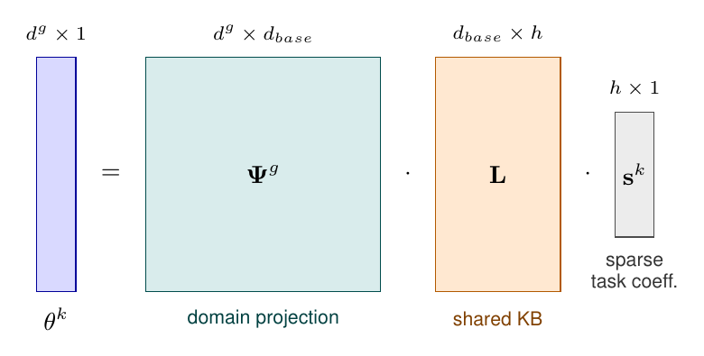
Proposed methodology: one shared knowledge base
L: knowledge shared by all tasks and domains
Psi_g: maps L into domain g's parameter space
s_k: sparse task code found by a Lasso (Eq. 25)
L and Psi_g updated by gradient steps (Eqs. 23-24)
Base learner MSR-NAC: natural actor-critic with n-step returns
Notes:
Every task policy is a domain projection times a shared basis times a sparse code. New tasks only need a small code; new domains only need a projection.

Slide 7
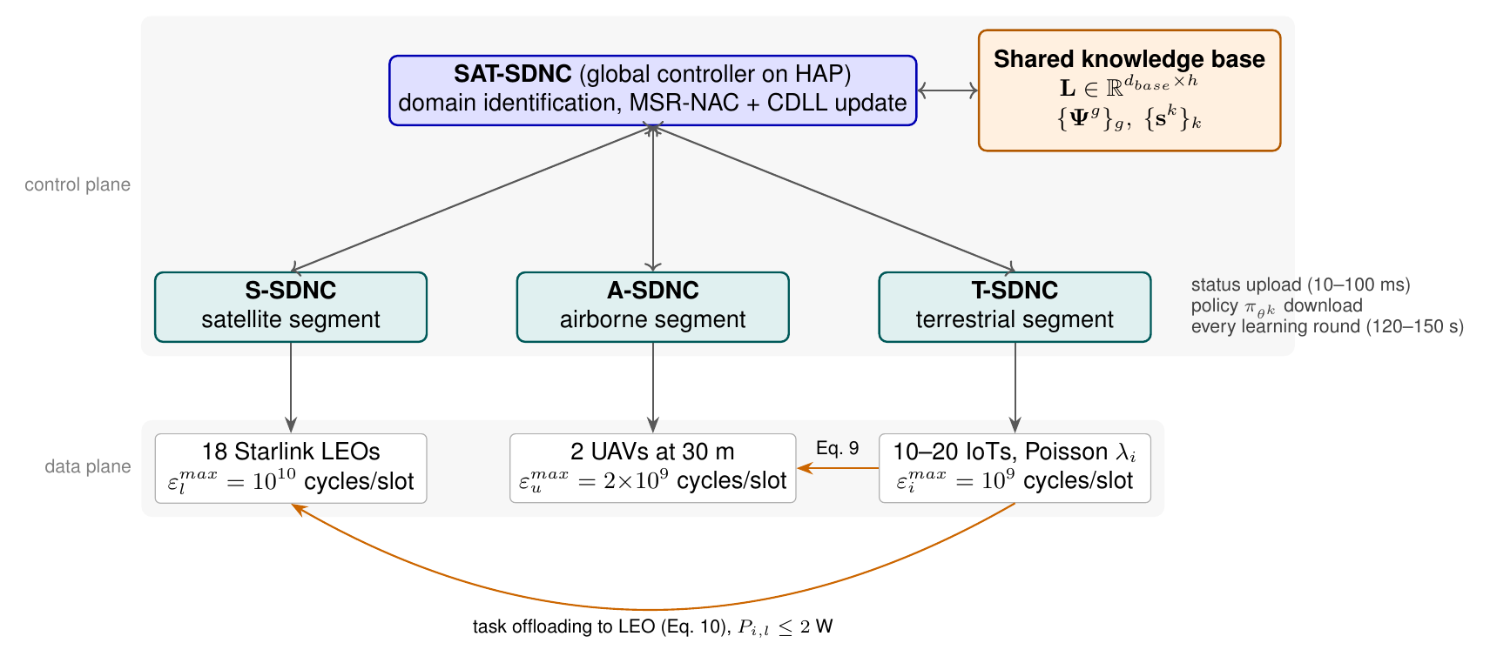
Proposed architecture: hierarchical KB-SAT-SDN
Notes:
Local controllers per segment report to a global SAT-SDNC on a high-altitude platform, which learns and disseminates policies. Execution is distributed per slot.

Slide 8
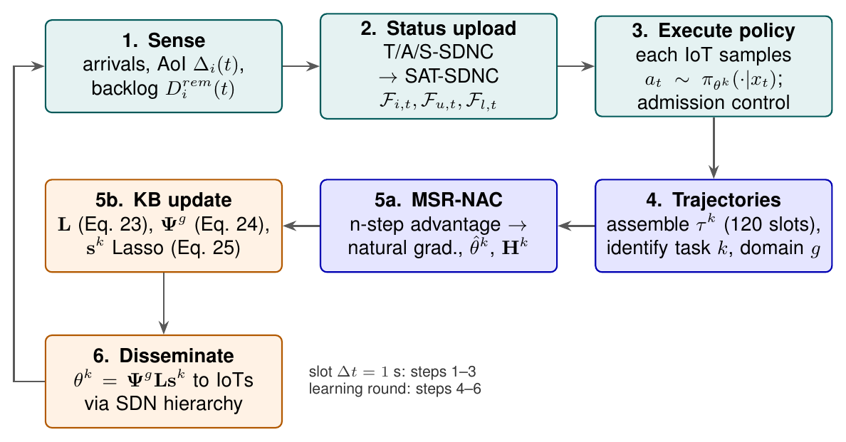
Learning loop inside the SDN hierarchy
Notes:
Steps 1-3 run every 1 s slot; steps 4-6 run once per 120-150 s learning round.

Slide 9
Technology stack
Python 3 + NumPy
sgp4 + CelesTrak TLEs
PyYAML
simulator, learners, linear algebra
real Starlink positions and visibility
one config file, every value tagged paper/assumed
Matplotlib
pytest
LaTeX + PowerPoint
all figures and tables
unit tests of the model and the maths
report and slides
Notes:
Simulation-only paper: no dataset, no GPU. Linear policies with at most 15 parameters.

Slide 10
Implementation plan
1
2
3
4
5
Environment
Learners
Experiments
Validation
Write-up
orbits, channels, simulator
NAC, MSR-NAC, ELLA, CDLL
Figs. 3-9, Table V, ablations
unit tests, paper comparison
report, slides, package
Deliverables: tested source code, experiment logs and figures, LaTeX report (PDF), two slide decks, one TAR.GZ archive.
Notes:
Milestones in order; each one ends with a runnable check.

Slide 11
Expected outcomes
What the paper reports
What we will check
CDLL lowers average AoI and energy by up to 70%, converges about 8x faster than NAC and transfers knowledge to new tasks without forgetting old ones.
Whether an independent re-implementation shows the same ranking (CDLL < ELLA < MSR-NAC < NAC), how large the gaps are, and which unstated parameters the outcome depends on.
No results are claimed at this stage. The numbers above are the paper's; our own measurements are reported in the final presentation.
Notes:
Expectations from the paper, not results. Results come in the final presentation.

Slide 12
References
Y. Wu, N. Wang, B. Lorenzo, S. Samarakoon, B. Liu, "Lifelong learning-based SDN design for dynamic configuration and resource allocation in satellite-terrestrial networks," IEEE TWC, 2026.
H. Bou Ammar et al., "Online multi-task learning for policy gradient methods," ICML, 2014.
H. Bou Ammar et al., "Autonomous cross-domain knowledge transfer in lifelong policy gradient RL," IJCAI, 2015.
J. Peters, S. Schaal, "Natural actor-critic," Neurocomputing, 2008.
Z. Zhu et al., "Federated multiagent actor-critic learning for age sensitive MEC," IEEE IoT-J, 2022.

Slide 13
Questions
Next: implementation and experiments

