Slide 1
SimpleSideDrawer v2
adamrocker
Mar 19th, 2013
adamrocker@gmail.com

Slide 2
What’s this?
Side Drawer library for Android
Easy to use
High affinity
Light weight
OSS
(Add only 2 lines)
(Not need to extend)
(Less than 11KByte)
(Apache License, v2.0)

Slide 3

Demo

Slide 4
Demo
Tap!

Slide 5
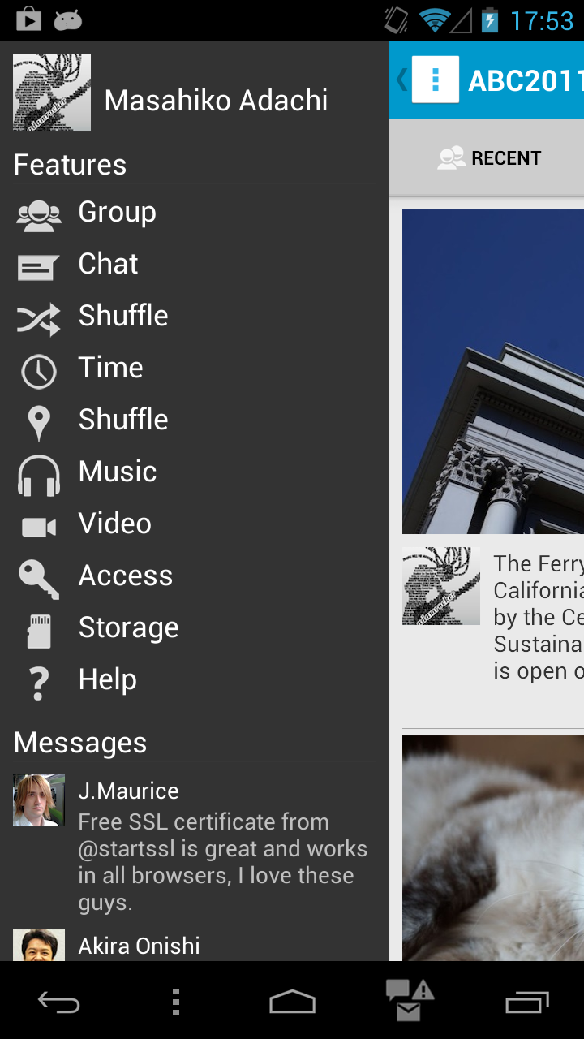
Demo

Slide 6
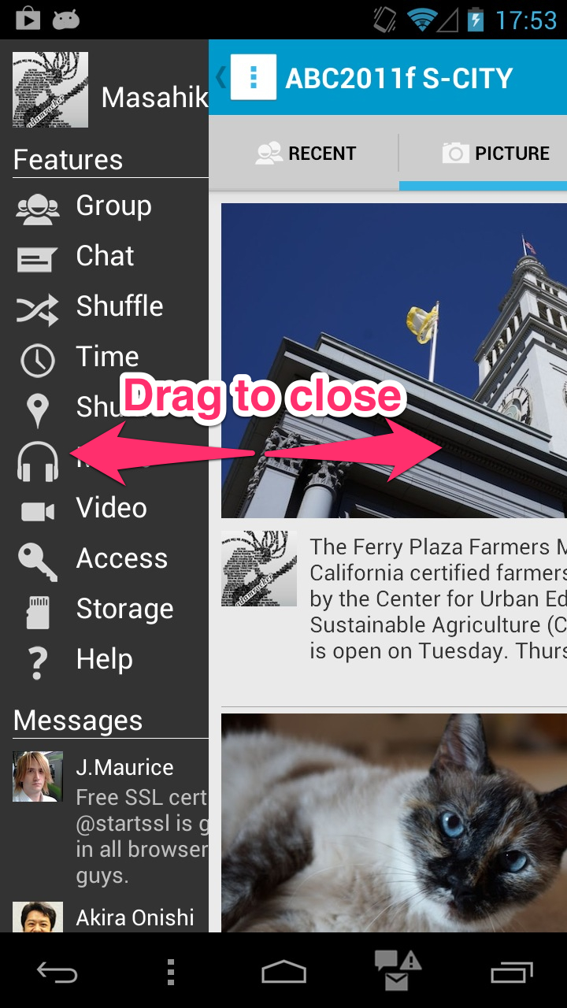
Demo

Slide 7
How to use?
◆ Add only 2 lines
public void onCreate( Bundle saved ) {
super.onCreate( saved );
setContentView( R.layout.main );
}
public void onCreate( Bundle saved ) {
super.onCreate( saved );
setContentView( R.layout.main );
nav = new SimpleSideDrawer( this );
nav.setLeftBehindContentView( R.layout.left_menu );
}
Easy and high affinity to use

Slide 8
Right side menu is also available
◆ Add 1 more line
public void onCreate( Bundle saved ) {
super.onCreate( saved );
setContentView( R.layout.main );
}
public void onCreate( Bundle saved ) {
super.onCreate( saved );
setContentView( R.layout.main );
nav = new SimpleSideDrawer( this );
nav.setLeftBehindContentView( R.layout.left_menu );
nav.setRightBehindContentView( R.layout.right_menu );
}
NEW!!

Slide 9
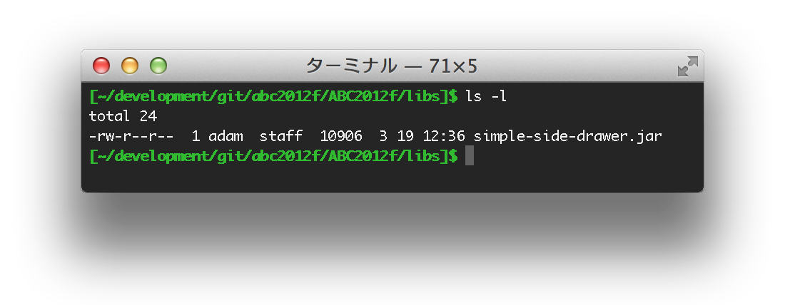
Light weight library ever!!
◆ less than 11KByte
This PNG file size is around 82KByte!!

Slide 10
How does it work
◆ Android’s layout system
Application’s layout view
set with setContentView() method
Above
Decor: the base of layout

Slide 11
How does it work
◆ Remove the above layout view from the decor
Above
decor = window.getDecorView();
above = decor.getChildAt( 0 );
decor.removeView( above );

Slide 12
How does it work
SimpleSideDrawer (extends FrameLayout)
◆ Insert the behind layout view
LinearLayout (horizontal)
wrap
RightBehindBase
weight=0
wrap
Above
LeftBehindBase
Spacer

Slide 13
How does it work
◆ Open the left-side menu
RightBehindBase is GONE
weight=0
wrap
Above
LeftBehindBase
Spacer

Slide 14
How does it work
◆ Open the right-side menu
wrap
RightBehindBase
weight=0
LeftBehindBase is GONE
Above

Slide 15
How does it work
◆ Control drag action
Handling the touch event
Above
Overlay

Slide 16
Structure of SimpleSideDrawer
Original
Using SimpleSideDrawer library

Slide 17
Thank you
Side Drawer library for Android
Easy to use
High affinity
Light weight
OSS
(Add only 2 lines)
(Not need to extend)
(Less than 11KByte)
(Apache License, v2.0)

