Slide 1
WEB LOG ANALYSIS

Slide 2
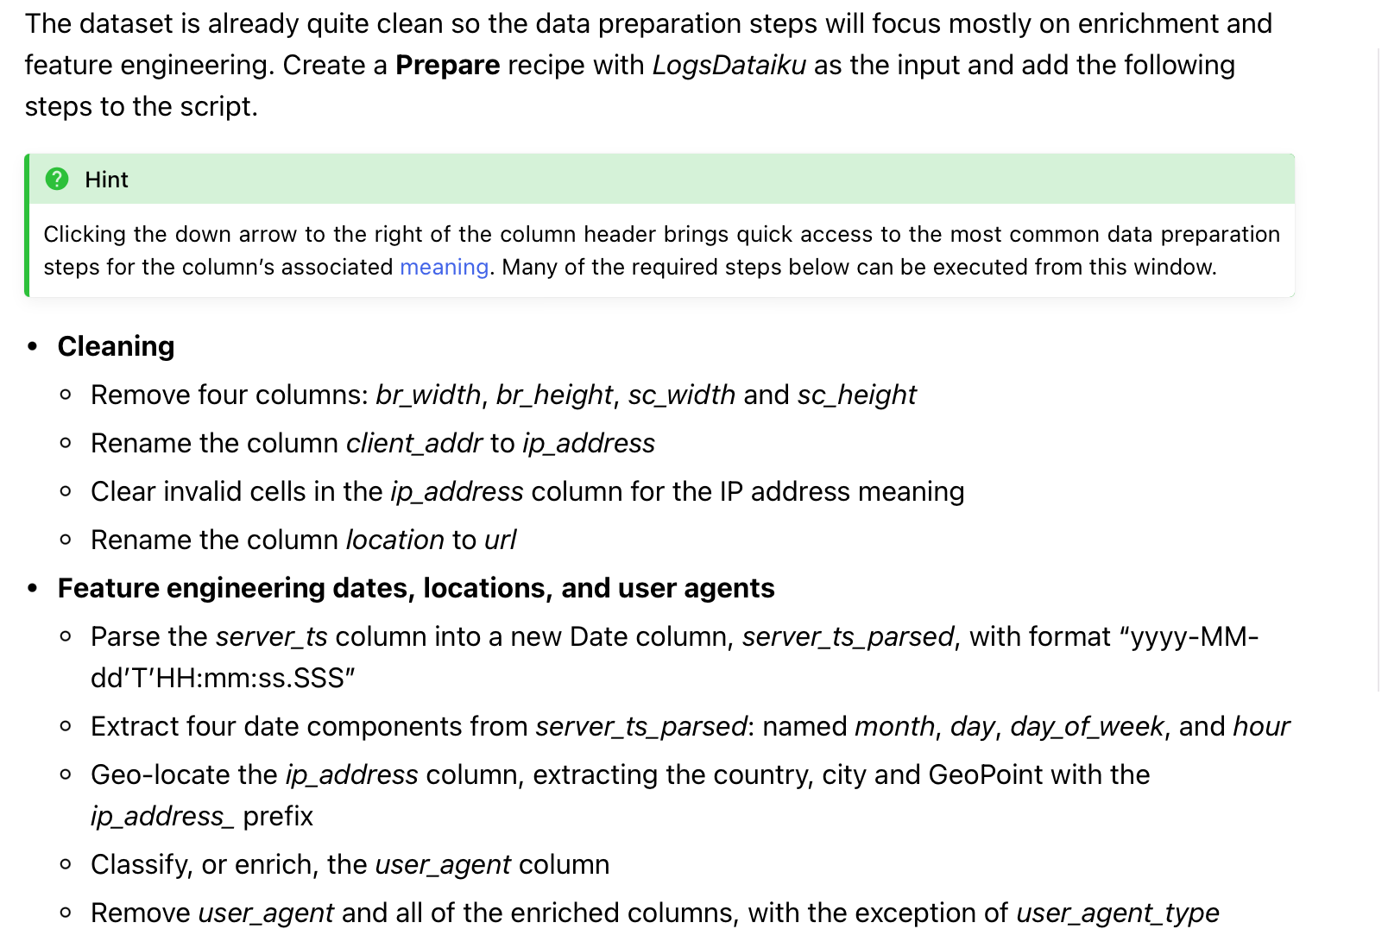
Cleaning / Feature Engineering

Slide 3
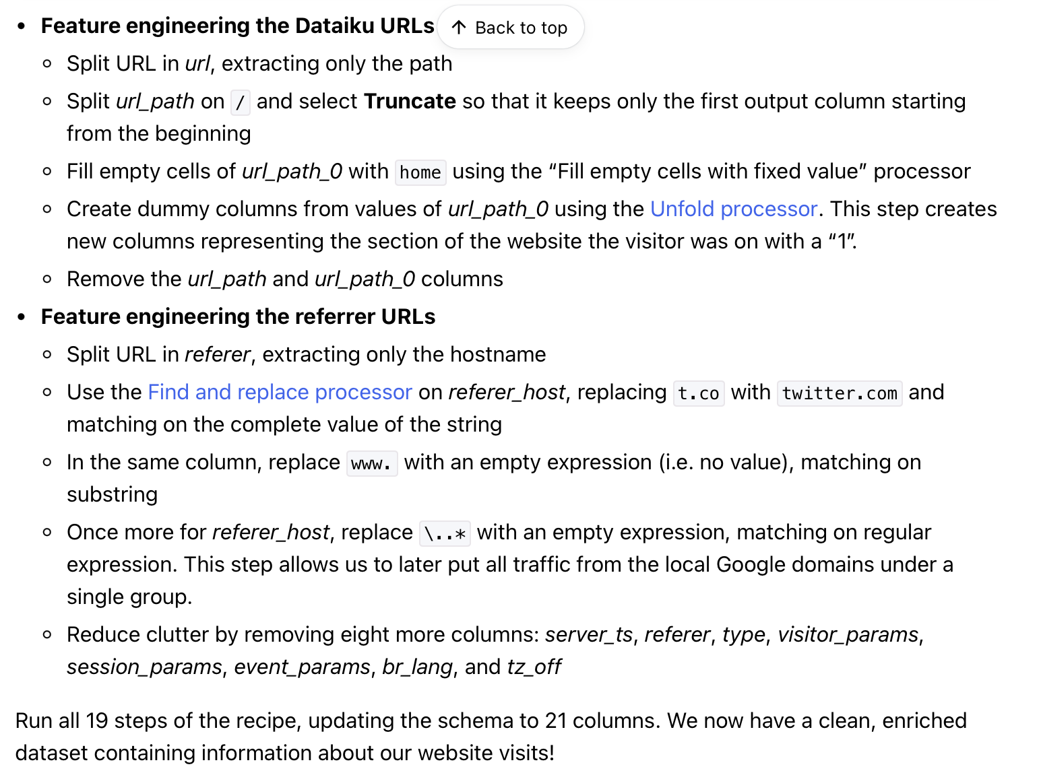
Feature Engineering

Slide 4
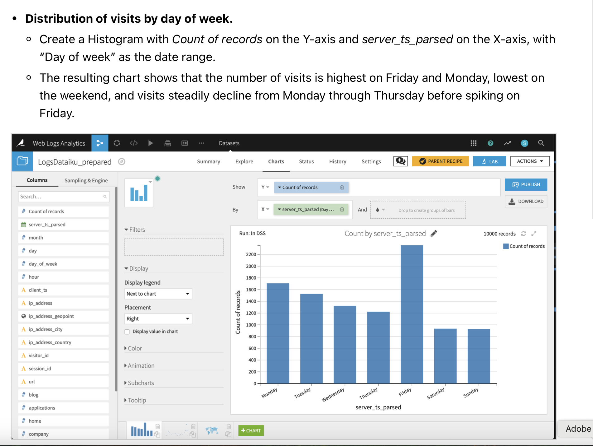
Distribution of visits

Slide 5
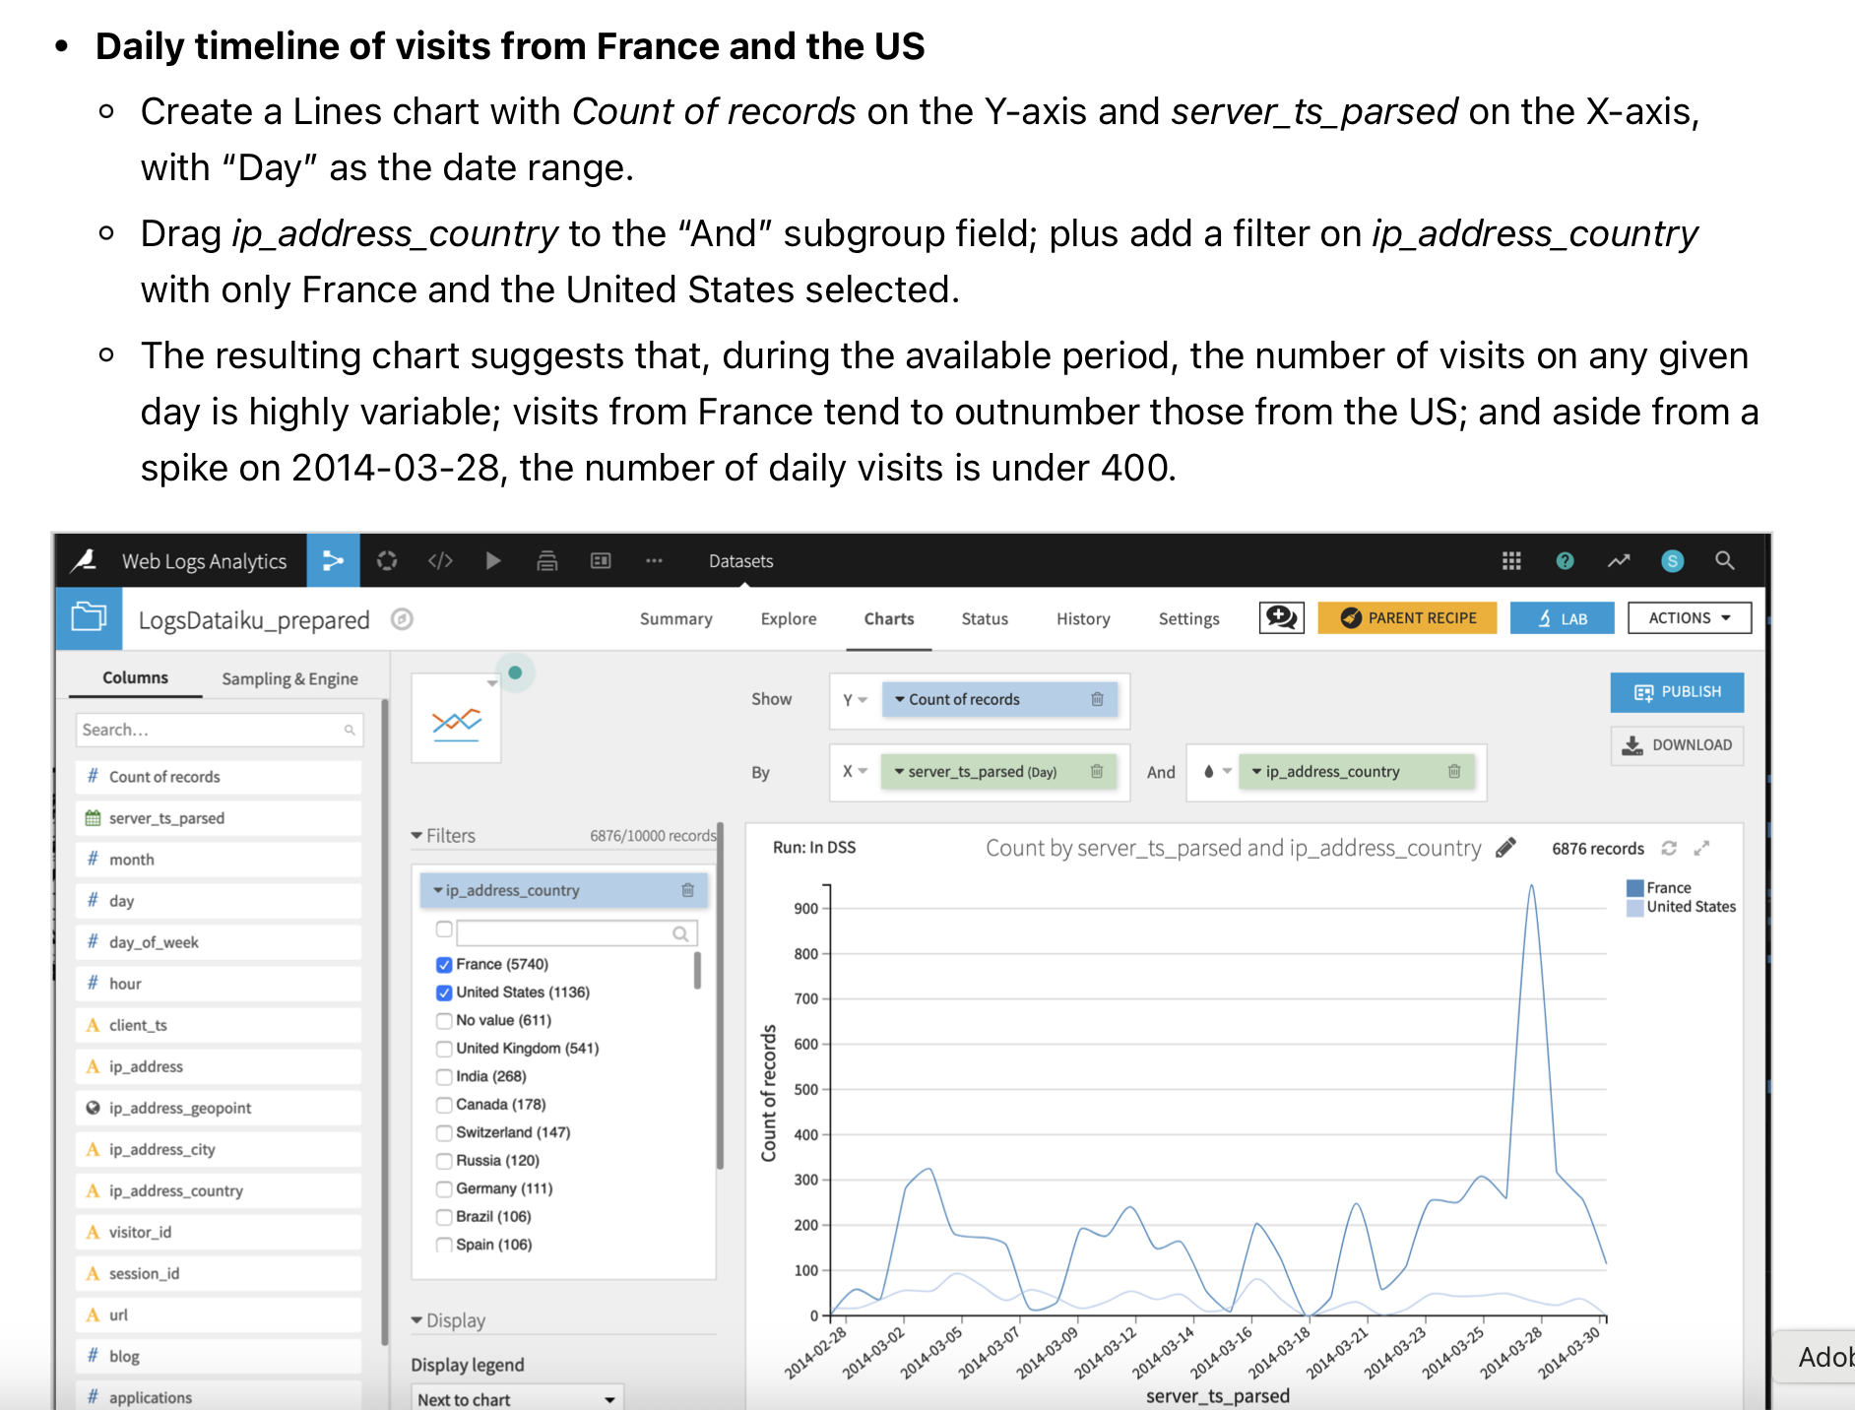
Timeline of visits

Slide 6
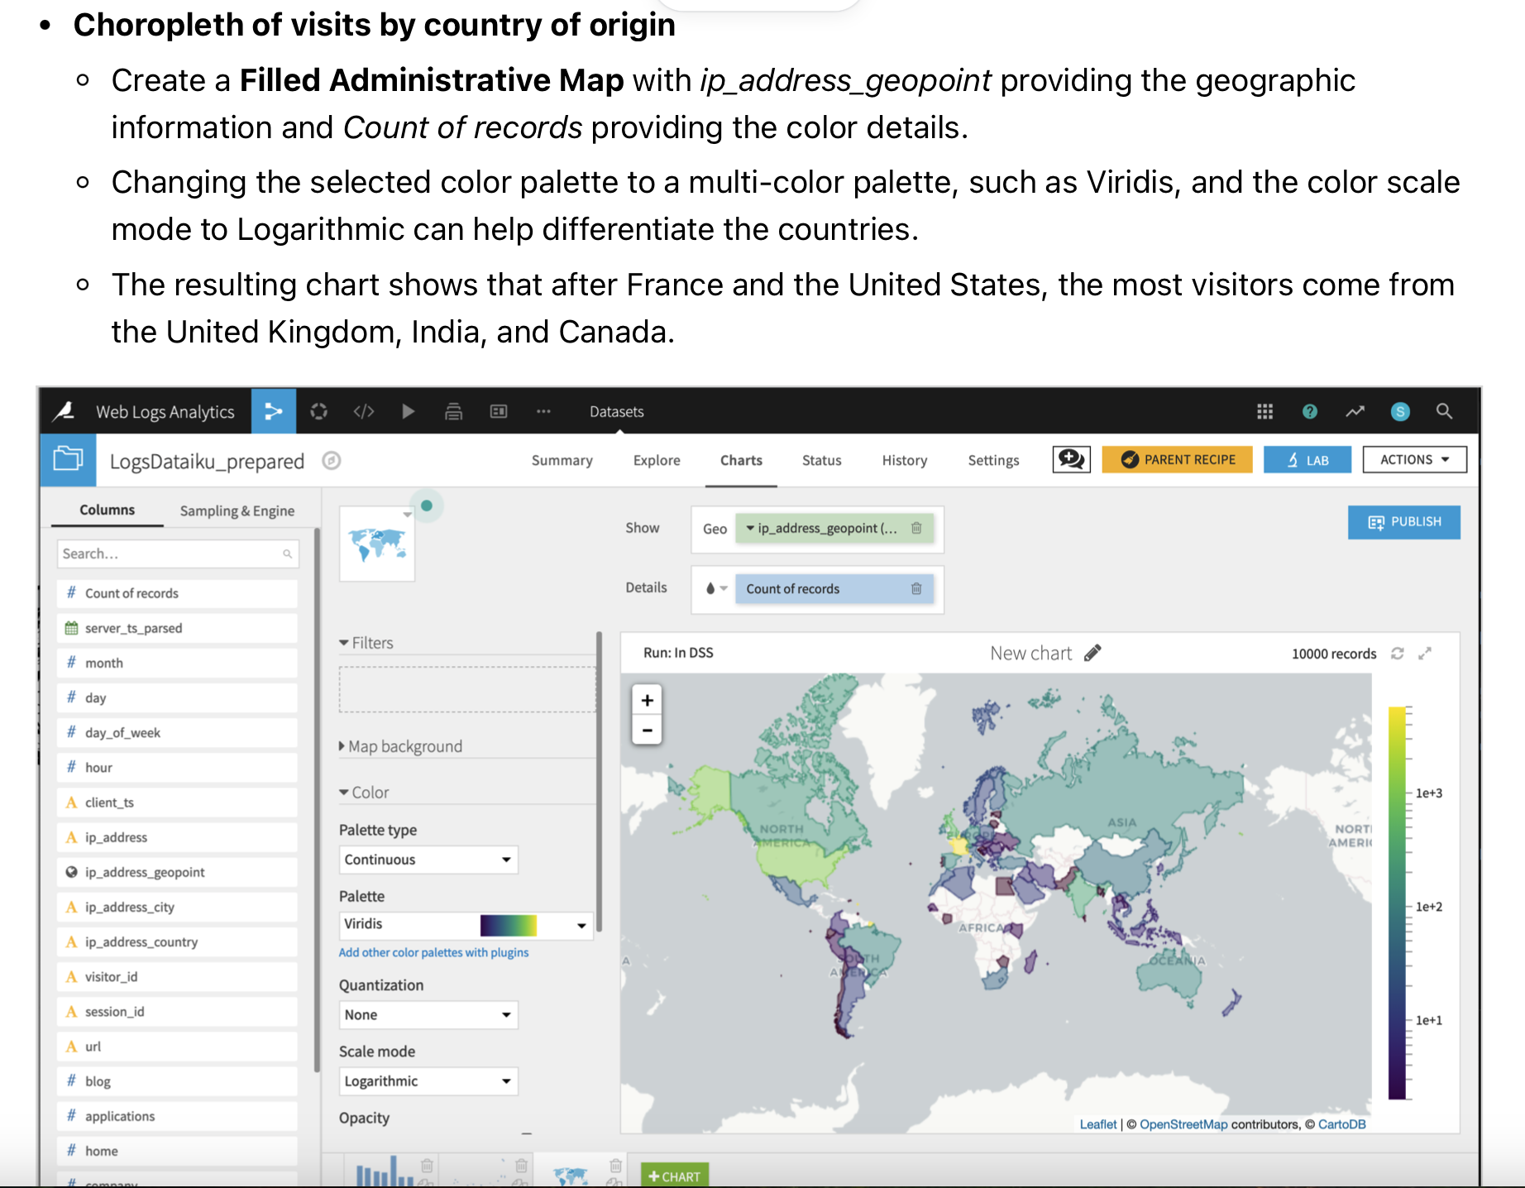
Visits by Country

Slide 7
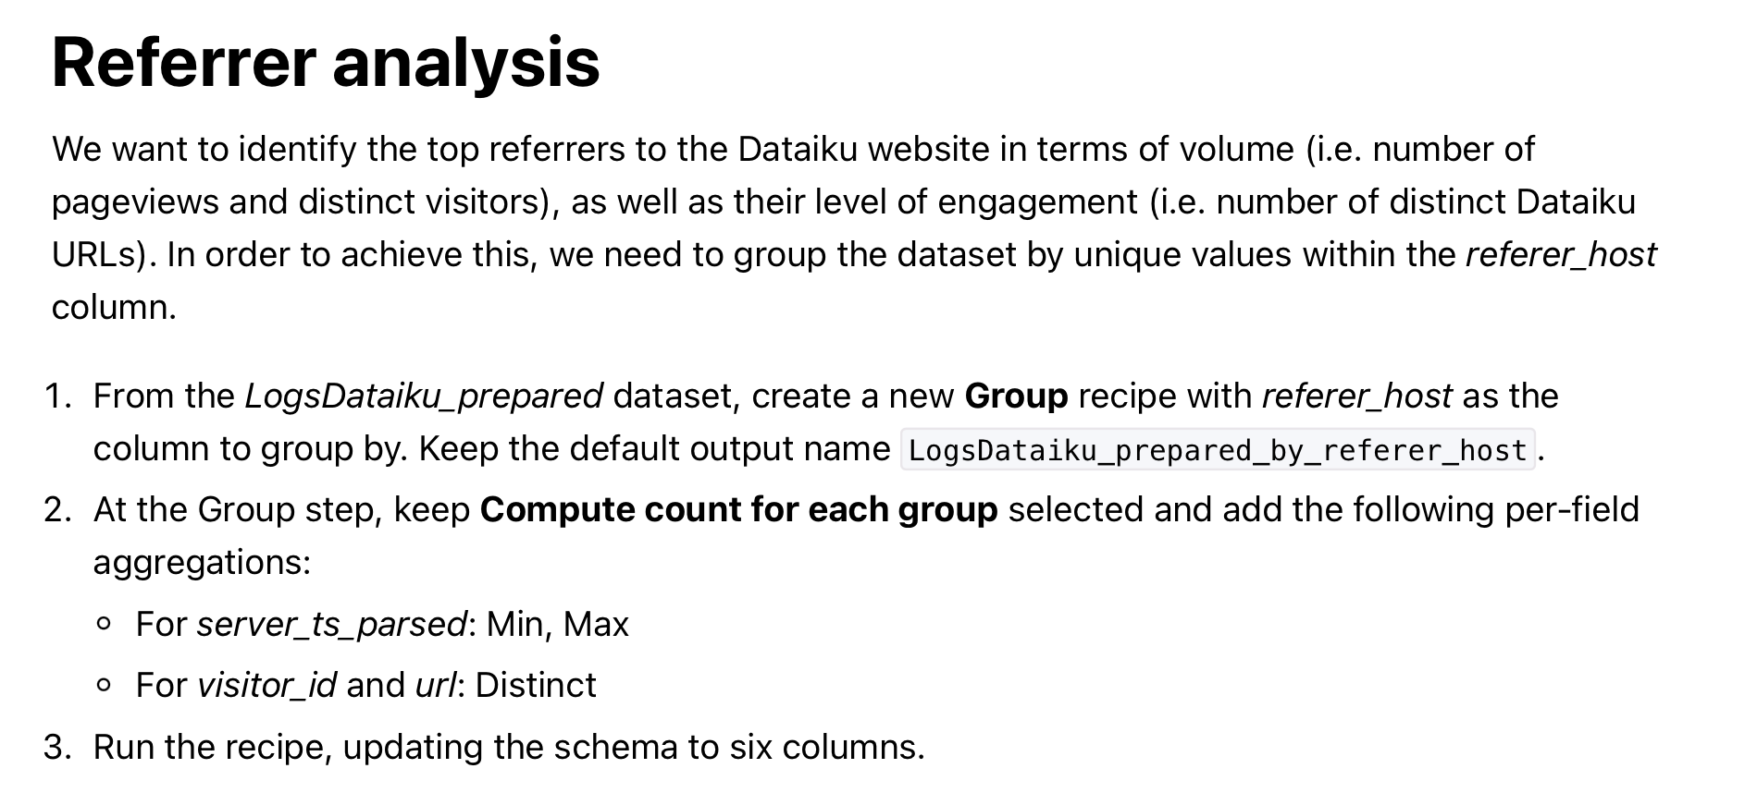
Referrer Analysis

Slide 8
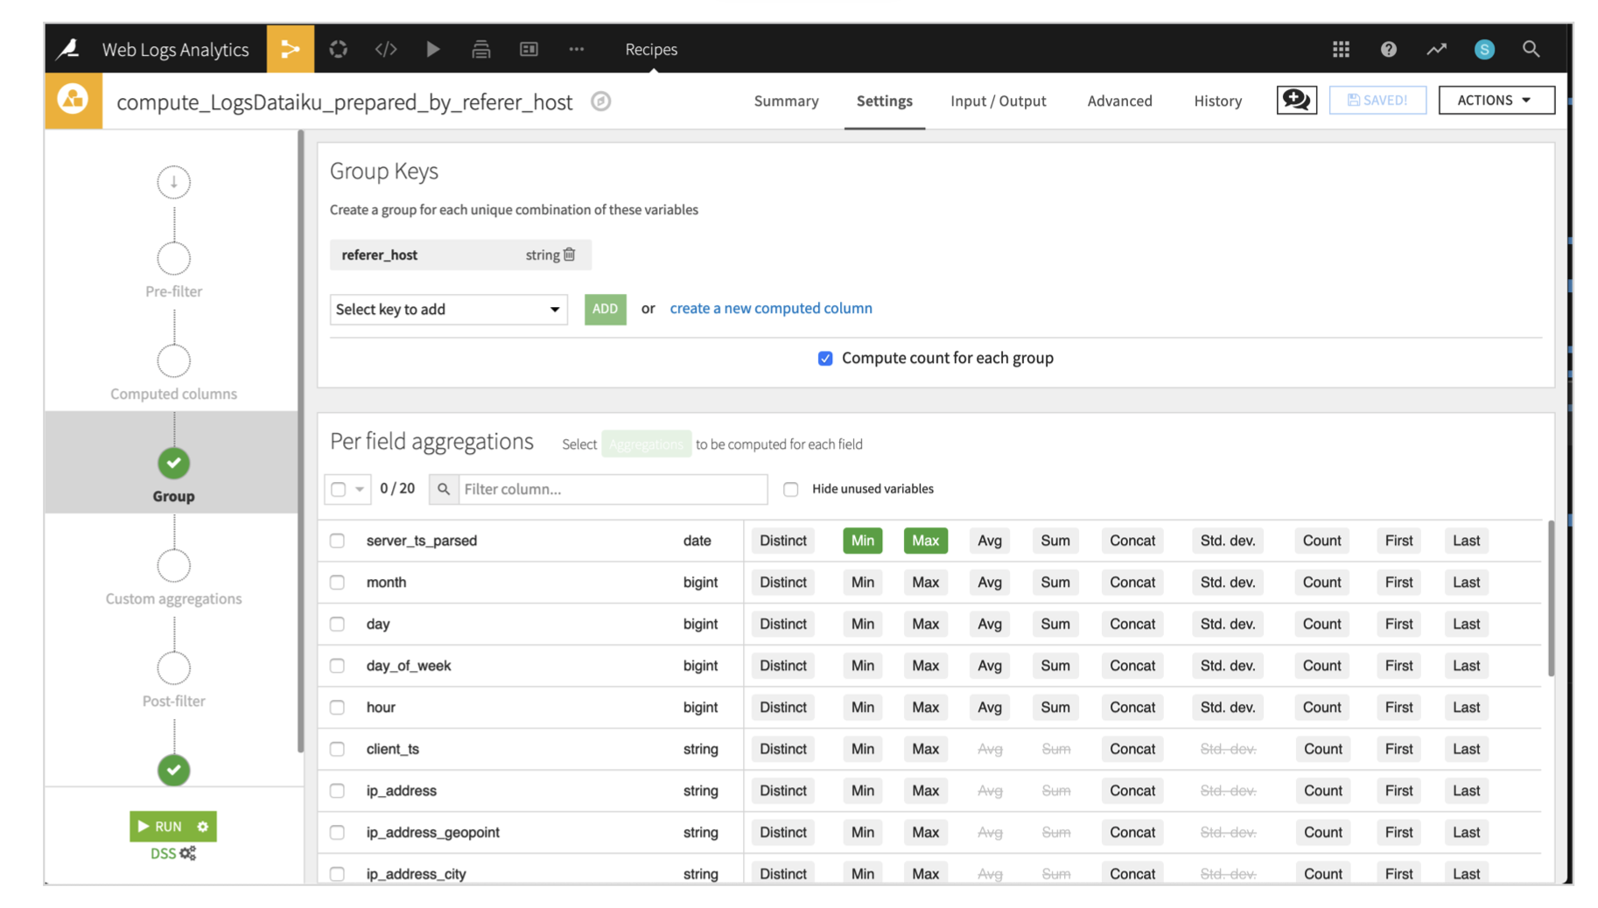
Grouping Referrer

Slide 9
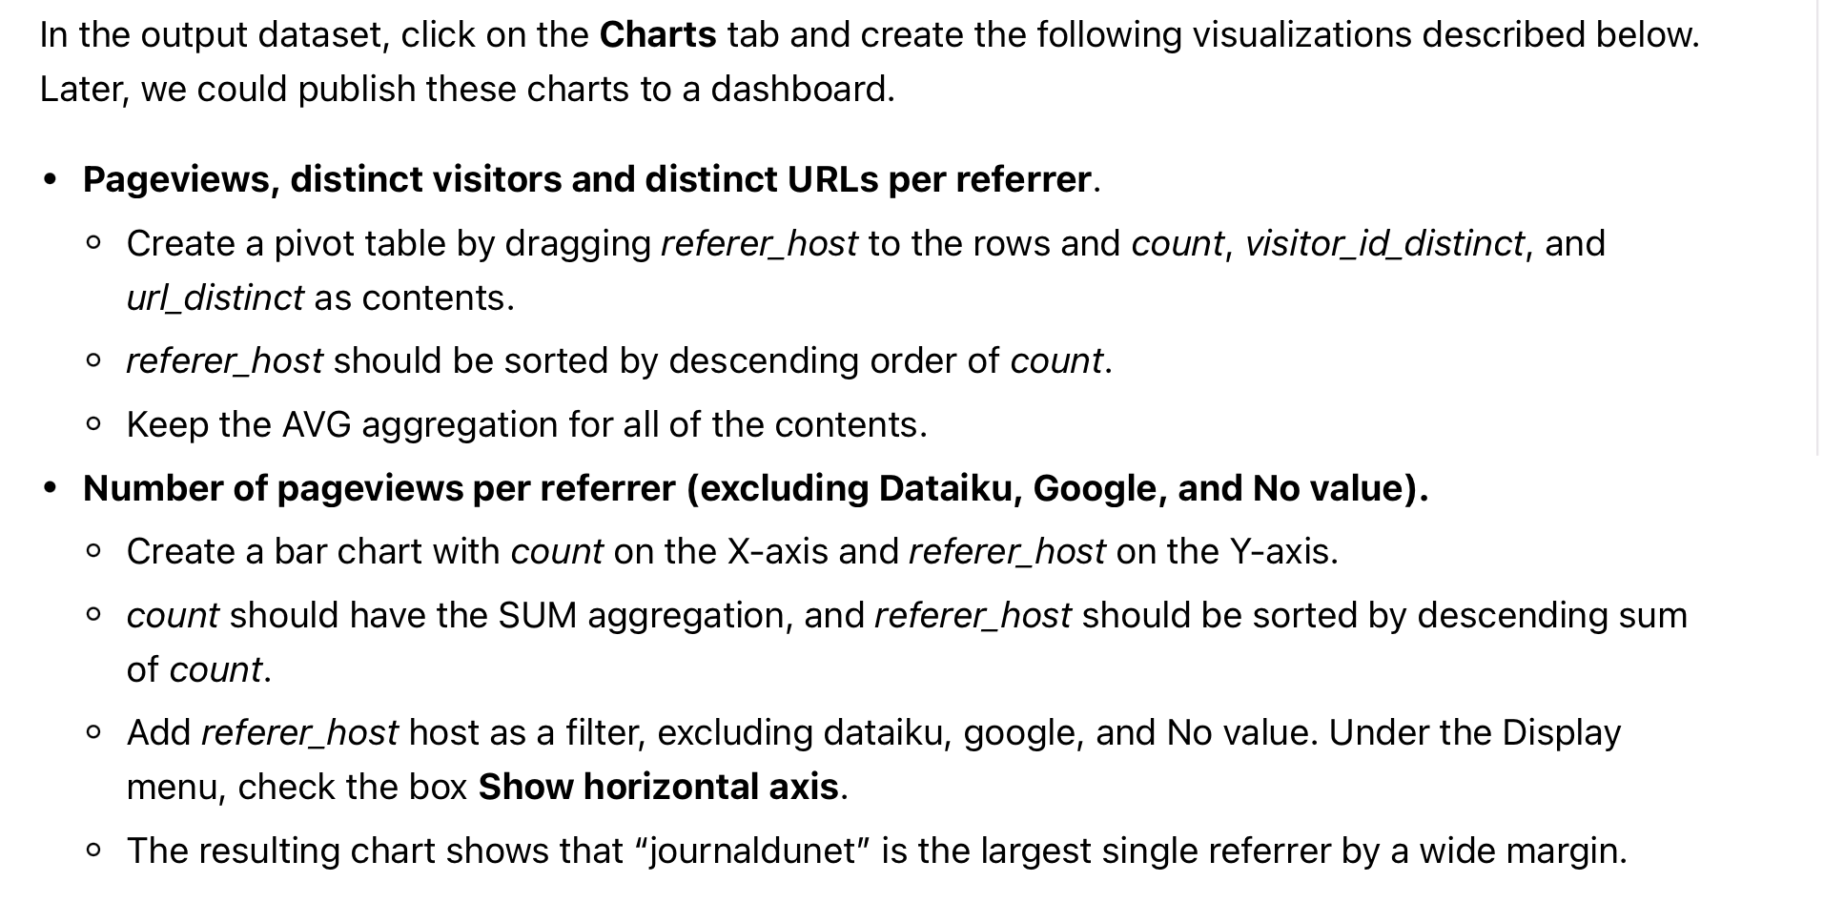
Page Views Graphs

Slide 10
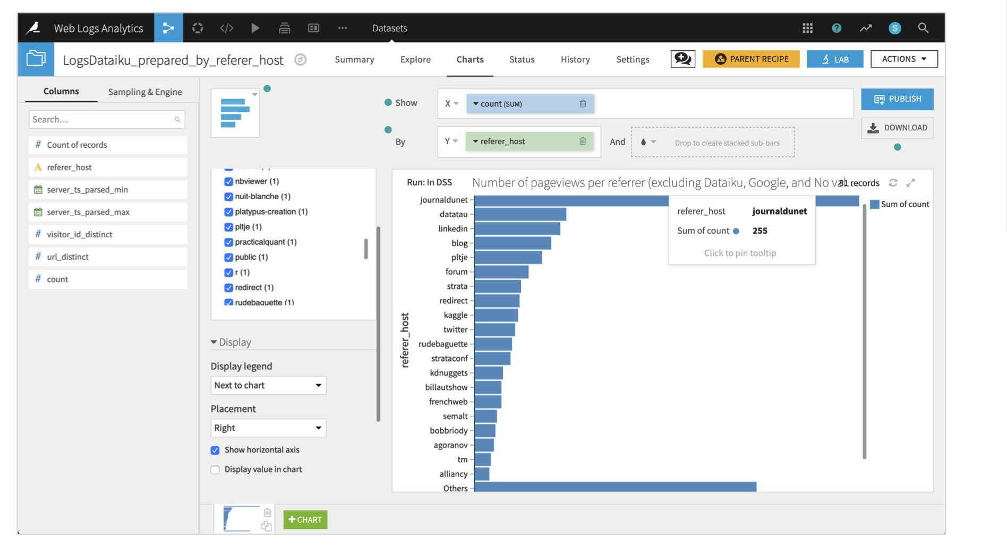
Graph

