Slide 1
Stellar Object Classification
Shakil Ansari
ansarishakeel006@gmail.com

Slide 2
Agenda
Project objective
Classifying Stars, Galaxy, Quasar
Understanding Dataset and features
Type of ML problem
Models Implemented
Target Variable
Evaluation Metrics
Exploratory Data Analysis (EDA)
Model Training and Evaluation & Comparison.
Model Deployment
Dashboard with PowerBI

Slide 3
Project Objective
This project aims to develop robust machine learning models for the classification of celestial objects—specifically stars, galaxies, and quasars. The core objectives are as follows:
Automated Classification: Enable efficient and accurate classification of celestial objects.
Feature Interpretation: Provide insights into the key characteristics that differentiate stars, galaxies, and quasars.
Optimized Data Processing: Optimize data processing methods for large-scale astronomical surveys.
Comparative Analysis: Conduct a comparative analysis of various machine learning algorithms to identify the most effective approaches for this classification task.
By using predictive models and data visualizations, this project aims to improve astronomical cataloging, guide research directions, and deepen our understanding of the universe.

Slide 4
Classifying Stars, Galaxies, and Quasars Based on Spectra
Astronomers utilize stellar classification to categorize stars based on their spectral characteristics. These spectral features reveal critical information about a star’s composition, temperature, density, and magnetic field.
Spectral classification is a foundational concept in astronomy, providing critical insights into the physical characteristics and life cycles of celestial objects. By analyzing properties such as temperature, luminosity, and chemical composition, astronomers can classify stars and better understand stellar evolution and galaxy formation.
The classification of galaxies, stars, and quasars is a cornerstone of modern astronomy. This project focuses on categorizing these celestial objects—particularly quasars, which are luminous, supermassive black holes—based on their spectral characteristics.

Slide 5
Understanding Data Set and Features
The data consists of 100,000 observations of space taken by the SDSS (Sloan Digital Sky Survey). Every data point is described by 17 feature columns and 1 class column which identifies it to be either a star, galaxy, or quasar [1]
I understand that some features in the dataset are significantly useful such as navigation angles — ascension and declination, filters of the photometric system — u, g, r, i, z, and redshift. And, the rest of the other columns in the dataset are IDs that are not useful in the learning stage.

Slide 6
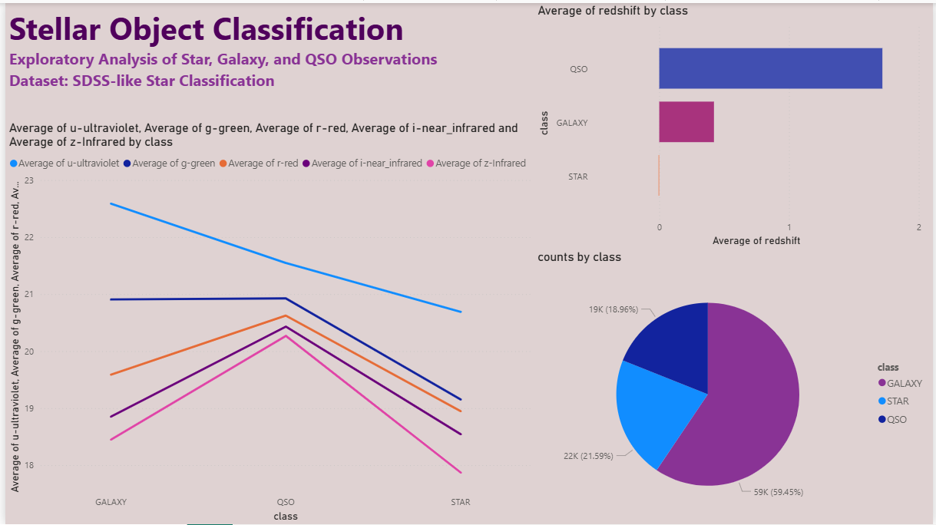
Dashboard Using Power BI

Slide 7
Type of ML problem
Target feature ‘class’, has multiple classes thus this is Multi-class Classification problem.

Slide 8
Models Used
Decision Tree
Random Forest
K-Nearest Neighbors (KNN)
Support Vector Machines (SVM)
Gradient Boosting
AdaBoost
XGBoost
Simple Neural Network

Slide 9
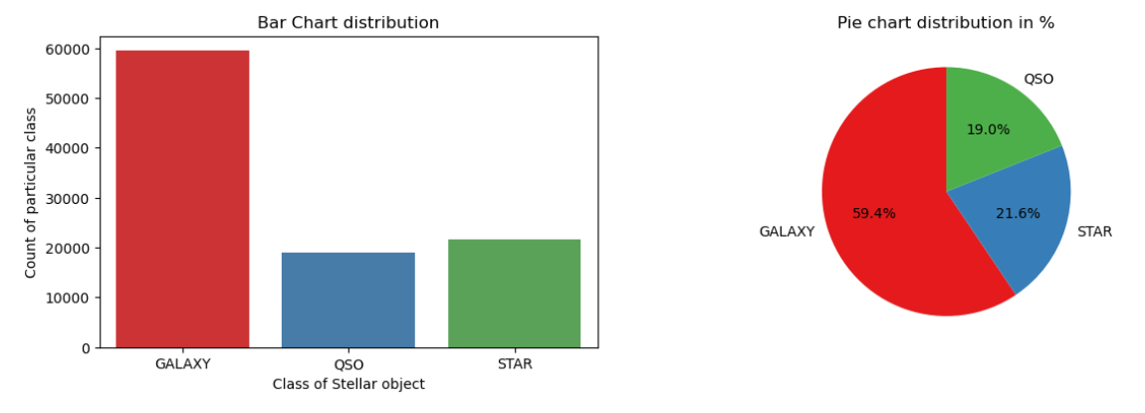
Target variable
We are dealing with imbalance dataset.

Slide 10
Evaluation Metrics
For classification, we used metrics like
Accuracy
Recall
Precision
F1 Score
Confusion Matrics and
Classification report

Slide 11
Exploratory Data Analysis
Understanding the data
Handling the Missing Values
Outlier Analysis
Univariate Analysis
Bivariate Analysis
Standardizing all values to one scale(min-max Scaler)
Label Encoding

Slide 12
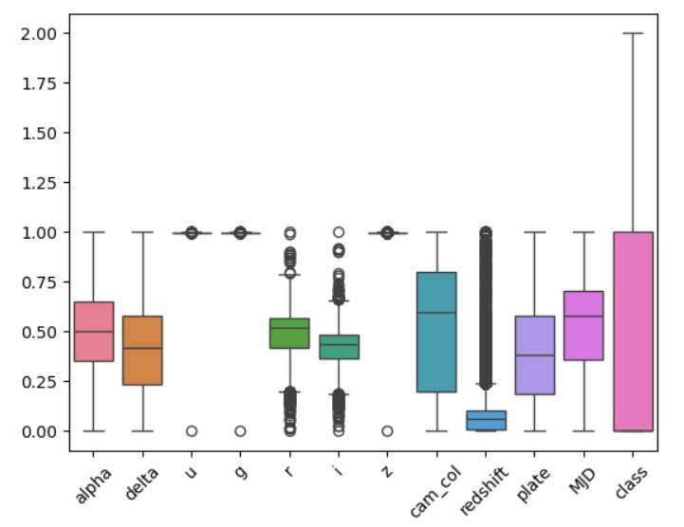
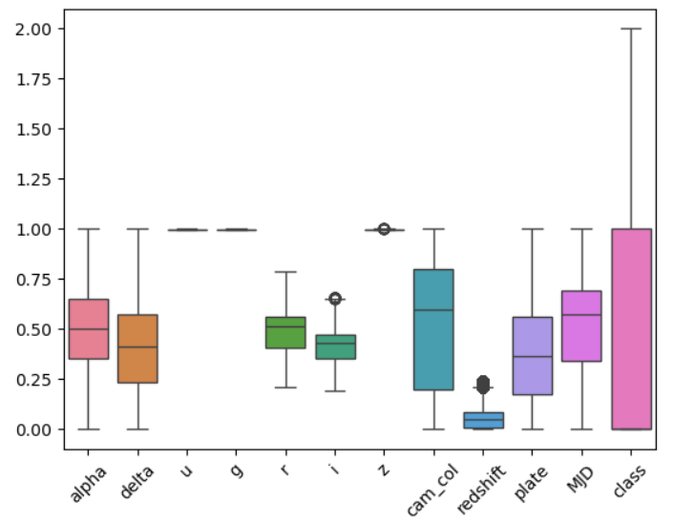
Outlier Analysis
Percentage of outliers removed from the data set is 9.4%
Before
After

Slide 13
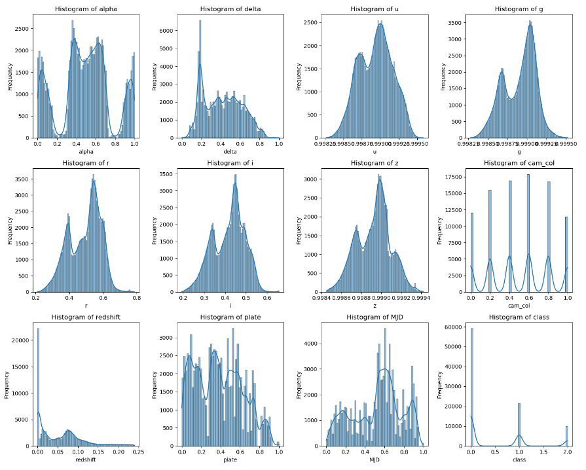
Univariate Analysis

Slide 14
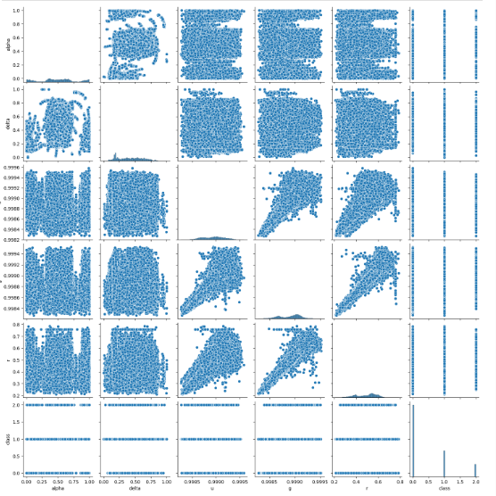
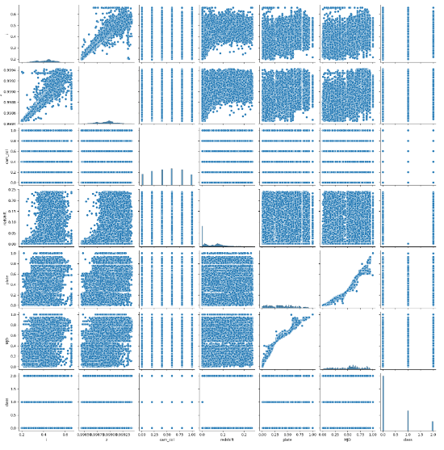
Bivariate Analysis (pair-plot)

Slide 15
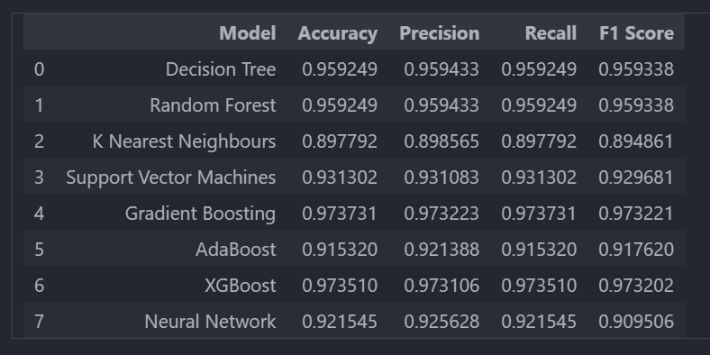
Model Training and Evaluating
The dataset is trained with all the above mentioned models and the evaluation metrics are used to check the performance.

Slide 16
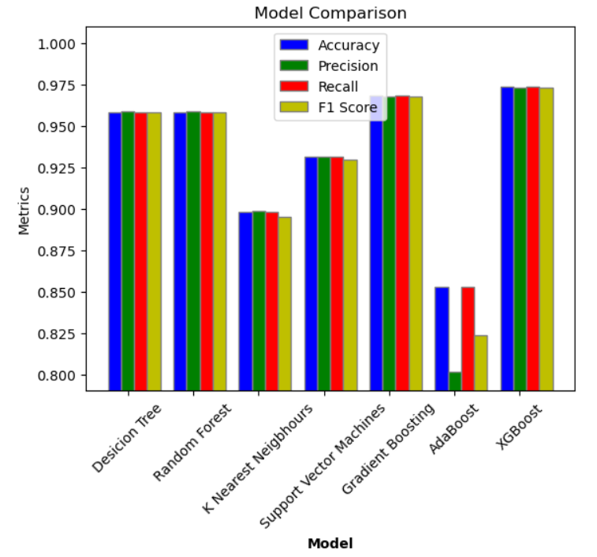
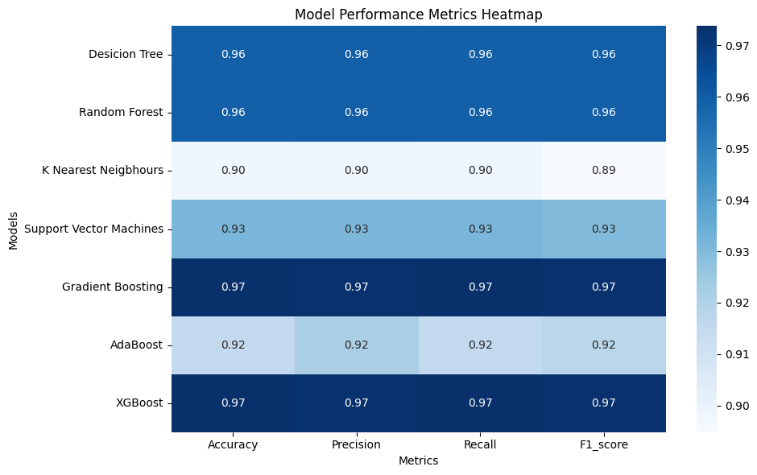
Comparing Model Performance

Slide 17
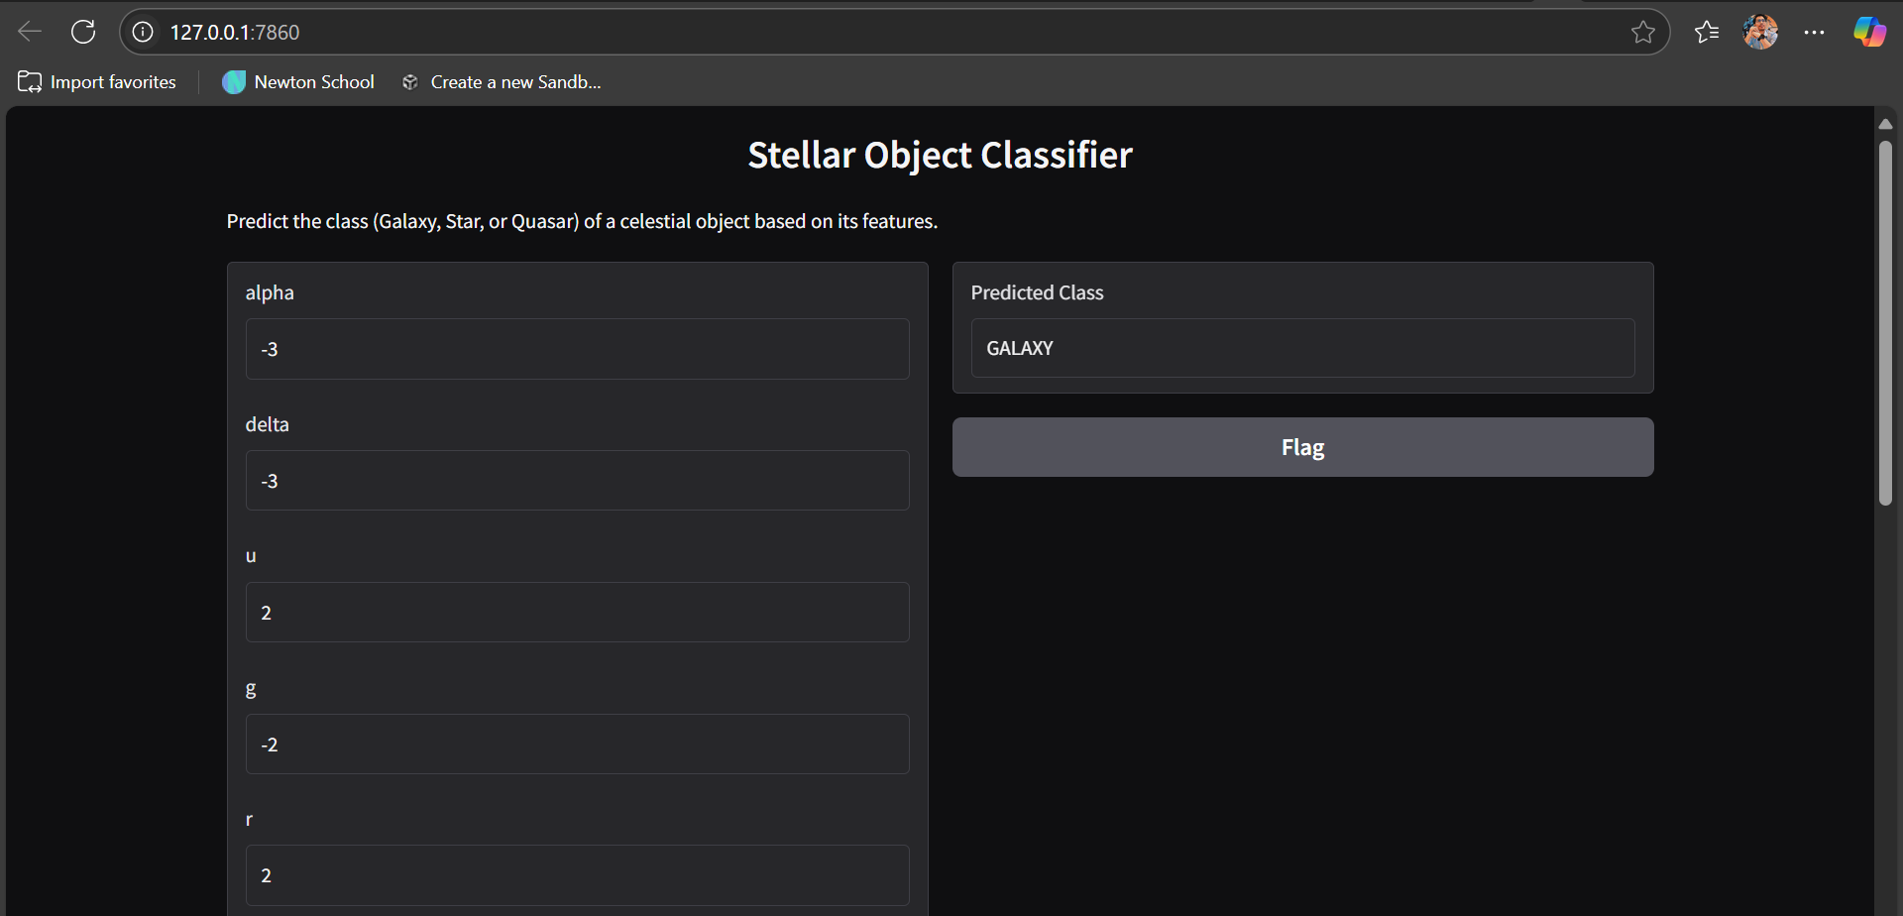
Deployment using Gradio

Slide 18
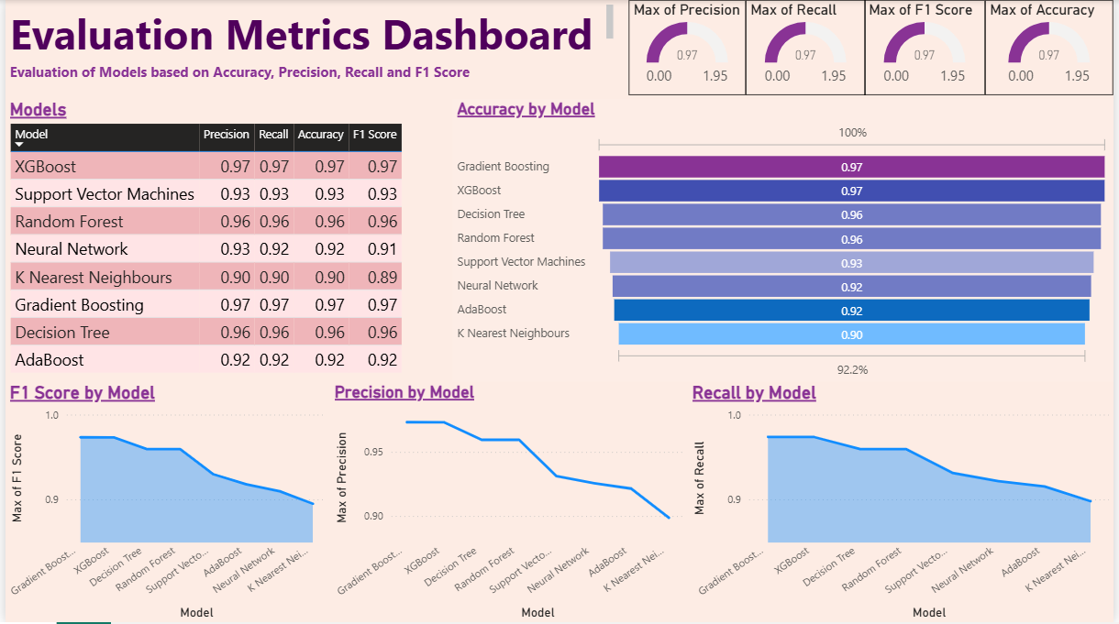
Dashboard Using Power BI

Slide 19
Project Link
GitHub repository for the project.
Ansareze/stellar_object_classification
Kaggle
Huggingface – Try Live Demo

Slide 20
Questions ?
Shakil Ansari
ansarishakeel006@gmil.com

Slide 21
Thank You!
Shakil Ansari
ansarishakeel006@gmail.com

