Slide 1
Employee Data Analysis using Excel
STUDENT NAME: Ansari.A
REGISTER NO: 122203937 (asunm1647unm1647ay1221647002)
DEPARTMENT: B. Com(Corporate Secretaryship)
COLLEGE: R.B. Gothi Jain College For Women

Slide 2
PROJECT TITLE
Employee Performance Analysis using Excel

Slide 3


AGENDA
Problem Statement
Project Overview
End Users
Our Solution and Proposition
Dataset Description
Modelling Approach
Results and Discussion
Conclusion
3/21/2024 Annual Review

Slide 4

PROBLEM STATEMENT E mployee Performance is done to track the performance of business by employee which helps to focus on the growth. The Organisation growth is fully based and their individual growth too by makes the best performer to get incentives, promotion etc and motivate the lower performer in effective manner by this Employee Performance Analysis.

Slide 5

PROJECT OVERVIEW
Employee Performance Analysis is the analysing of theperformer of employee by considering various factor like gender, rating, score, level of the employee, etc. To state the growth and development of the organisation.

Slide 6
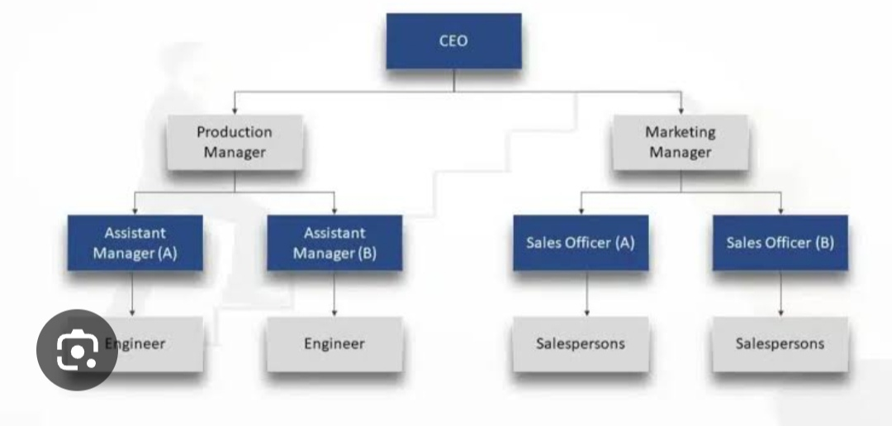

WHO ARE THE END USERS?

Slide 7

OUR SOLUTION AND ITS VALUE PROPOSITION Conditional formatting – Missing value highlight . Filter – Remove Formula – Performance Pivot Table – Summary Graph – Data Visualization

Slide 8
Dataset Description Employee Dataset – Kaggle website Data entry – Edunet platform 26 – Prescribed Features 9 – Selected Features Employee id – Numeric value Name – Text Employee type – Performance level Gender – Male,Female Employee Rating - Numeric

Slide 9

THE "WOW" IN OUR SOLUTION
=IFS(z8>=5,”VERY HIGH”,z8>=4,”HIGH”,z8>=3,”MED”,”TRUE”,”LOW”)
Performance Level is done to create the Current Performance Rating numeric value to the text format.
3/21/2024 Annual Review
9

Slide 10
MODELLING
Data Collection:
1) Kaggle website
2) Edunet platform
Features:
1) 26 collected
2) 9 selected
Data Cleaning:
1) Conditional Formatting
2) Filtering
10

Slide 11
Performance Level: 1) Performance rating 2) Current Employee Rating 3) Performance level Summary: 1) Pivot Table 2) Slicer . Data Visualization: 1) Column chart . 2) Trend line.

Slide 12
RESULTS
12

Slide 13
conclusion Comparing the performance of the employee using the excel shows the Medium performer of employee are very high and to motivate them for effective outcome and makes them to very high performer by giving incentives, promotion, etc. in the development of the Organisation.

