Slide 1

GUDLAVALLERU ENGINEERING COLLEGE
(An Autonomous Institute with Permanent Affiliation to JNTUK, Kakinada)
Seshadri Rao Knowledge Village, Gudlavalleru – 521 356
Department of
Electronics and Communication Engineering
8-bit Binary Counter interfacing with LEDs by using 8051 Microcontroller
By
M.A.A.Ansari (17481A04C9)
M.Bhagya Raj (17481A04D1)
B.Pavan Kalyan (18485A0431)
Under the guidance of
Ch.Balaswamy
(Professor)

Slide 2
Contents
Introduction
Circuit diagram
Working
Advantages
Disadvantages
Applications
Results
Conclusion
References

Slide 3
INTRODUCTION
During generating time delay for counter operations, we make use of delay which can be counted using a binary counter.
A 8-bit binary counter basically counts from 0 to 255 which is from 00H state to 0FF state.
This is precisely used where there is a need of generation of time delay which can be accessed by delay function.

Slide 4
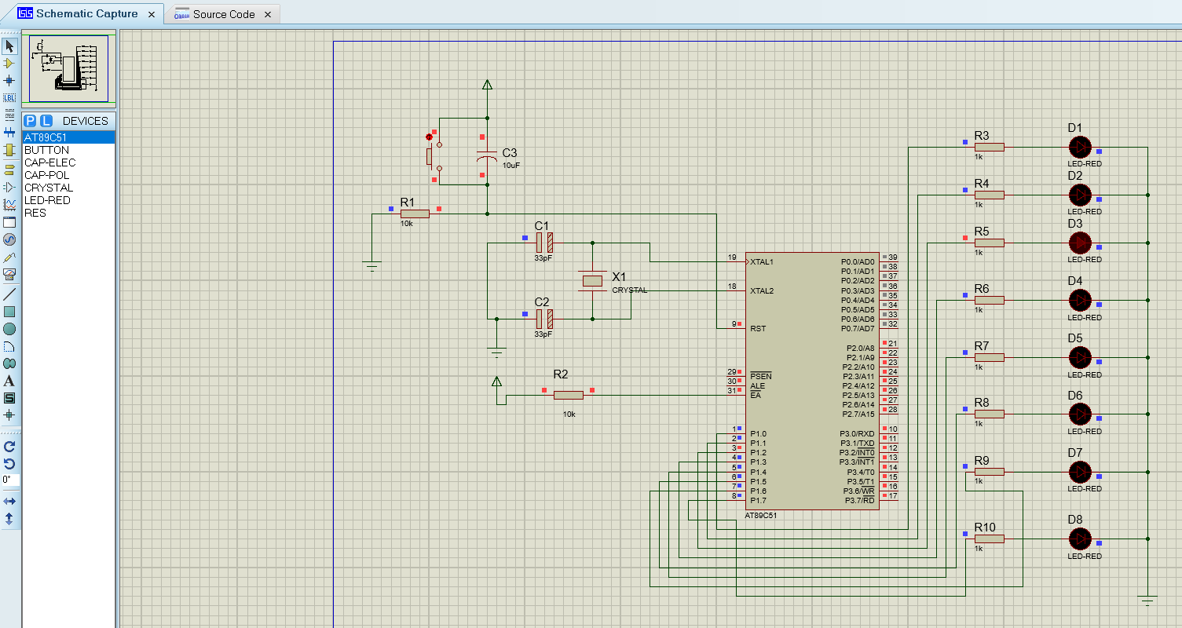
Circuit Diagram
Circuit

Slide 5
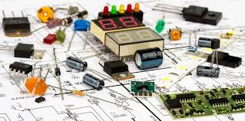
Components Required
Components
AT89C51 (8051 Microcontroller)
8 LEDs
8 Resistors – 1KΩ
Crystal oscillator – 11.0592MHz
2 Capacitors – 33pF
2 Resistors – 10KΩ
1 Capacitor – 10μF
1 Push Button
8051 Programmer
5V Power Supply

Slide 6
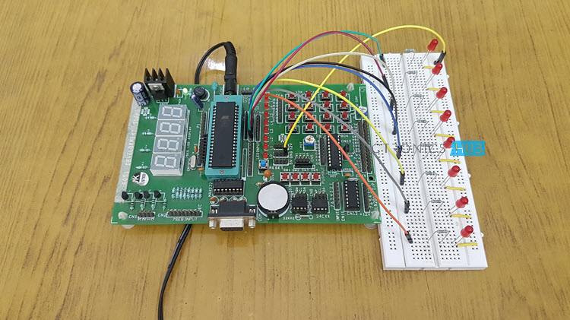
Circuit Design:

Slide 7
Working:
The 8 bit binary counter starts to count from 00H state to FFH state which is from (00000000 to 11111111)
We are using pin one of port 1 to connect the LED
We have connected a crystal oscillator of 11.0592MHz frequency to generate clock pulses, and clock pulse is used to provide the mean for timing calculation, which is mandatory to synchronize all the events.
Pin 9 (RST) is the reset PIN, used to reset the microcontroller and program again starts from the beginning.

Slide 8
We connect the LED in reverse, means negative leg with microcontroller PIN, because microcontroller don’t provide enough power to glow an LED.
The LED run on the negative logic like when, pin P1_0 is 1 then LED will be tuned OFF and when pin output is 0 then LED will be turned ON.
When PIN output is 0, it behaves like ground and LED glows.

Slide 9
Advantages
It will provide timing counter for different circuits where there is a need of creating delay. This system will be suitable for all environmental conditions.
DISADVANTAGES
A 8 bit binary counter can count a maximum of 255 numbers which is nearly 4 minutes, It can’t be used for environments where the time delay is greater than 4 minutes

Slide 10
Applications
LEDs are widely used in many applications like in seven segments.
They are used in dot matrix displays.
They can be used for street lights.
They are used as indicators.
They can be used in traffic lights.
They are used in emergency lights
They can used to make electronic designs.

Slide 11
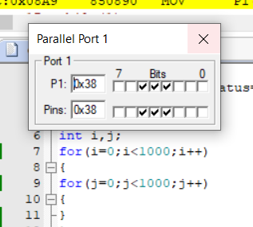
Results:

Slide 13
Conclusion
From the above implementation we have concluded that the delay or count required for some circuit operations can be implemented successfully by using this 8-bit binary counter which can count from 0 to 255.

Slide 14
References
https://www.elprocus.com/8051-microcontroller-8-16-bit-timers-and-counters/
https://www.elprocus.com/led-interfacing-with-8051-microcontroller/

Slide 15
Thank you
Any Queries
?

