Slide 1
RESUME SCREENING SYSTEM USING NATURAL LANGUAGE PROCESSING AND SIMILARITY

Slide 2
APPLICATION FLOW
Pre-Processing
Removal of characters except alphabets
Lower Case
Tokenization
Stopwords removal
Stemming
Corpus
Feature Extraction
TF-IDF Vectorizer
Resume vector
JD Vector
Resume to be screened
Resume Corpus
Job description
JD Corpus
Score>75%
Threshold
Suitable CV
Match Score
Cosine Similarity
Score<75%
Unsuitable CV

Slide 3
PROBLEM STATEMENT
A job posting on Internet receives a massive number of applications within a short window of time.
Manually filtering of resumes is time consuming and incurs huge costs.
Manual screening to match keywords in CV with JD to get suitable candidates.
No fixed template of resume. Different layouts and templates.
Different file formats like .pdf,.docx,.doc
Delay in sending the 1st batch of CVs to client was creating negative impression.

Slide 4
SOLUTION
Manually filtering of resumes eliminated
Program matches keywords in CV with JD to get suitable candidates as per match score
Works with different layouts and templates of resumes
Works with different file formats like .pdf,.docx,.doc except JPG.
Reduced the lead time in sending the first batch of CVs to the client by 3 days
Achieved manpower reduction of 3 manpower from screening department

Slide 5
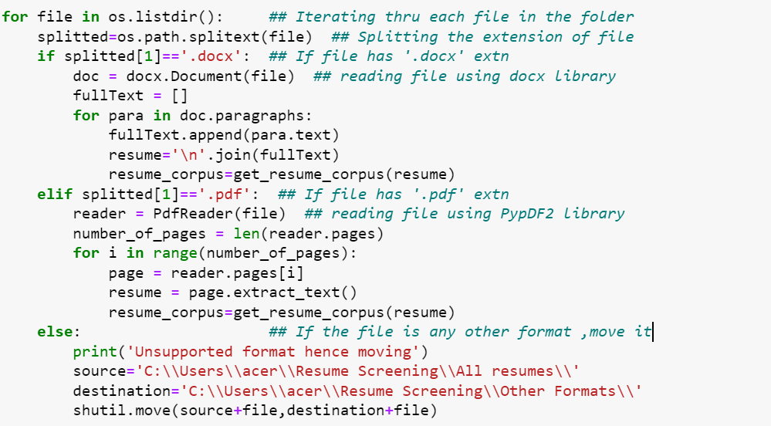
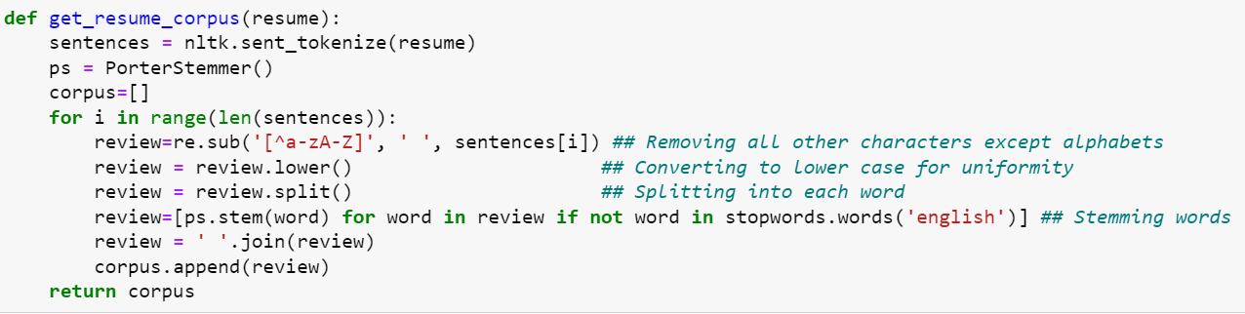
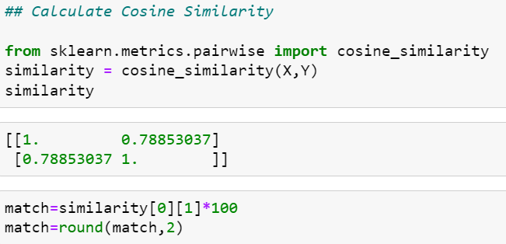
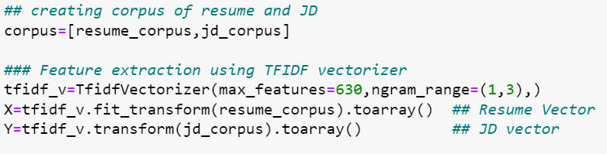
Code snippets

Slide 6
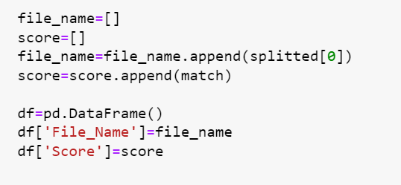
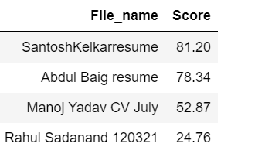
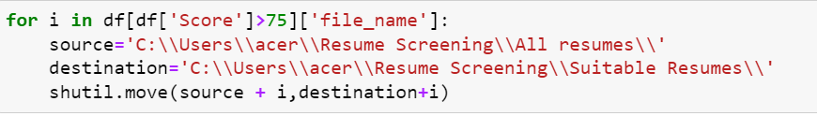
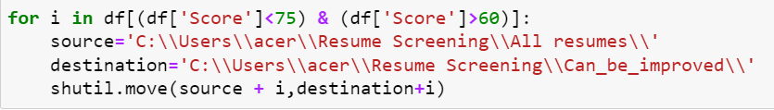
Code snippets

