Slide 1
Team Name: Code Command
Team Leader: Ansari Farhaan Naseem
Problem Statement No.: PS004
Team Members:
Aditya Agrahari
Krishna Agarwal
Hamza Siddiqui

Slide 2
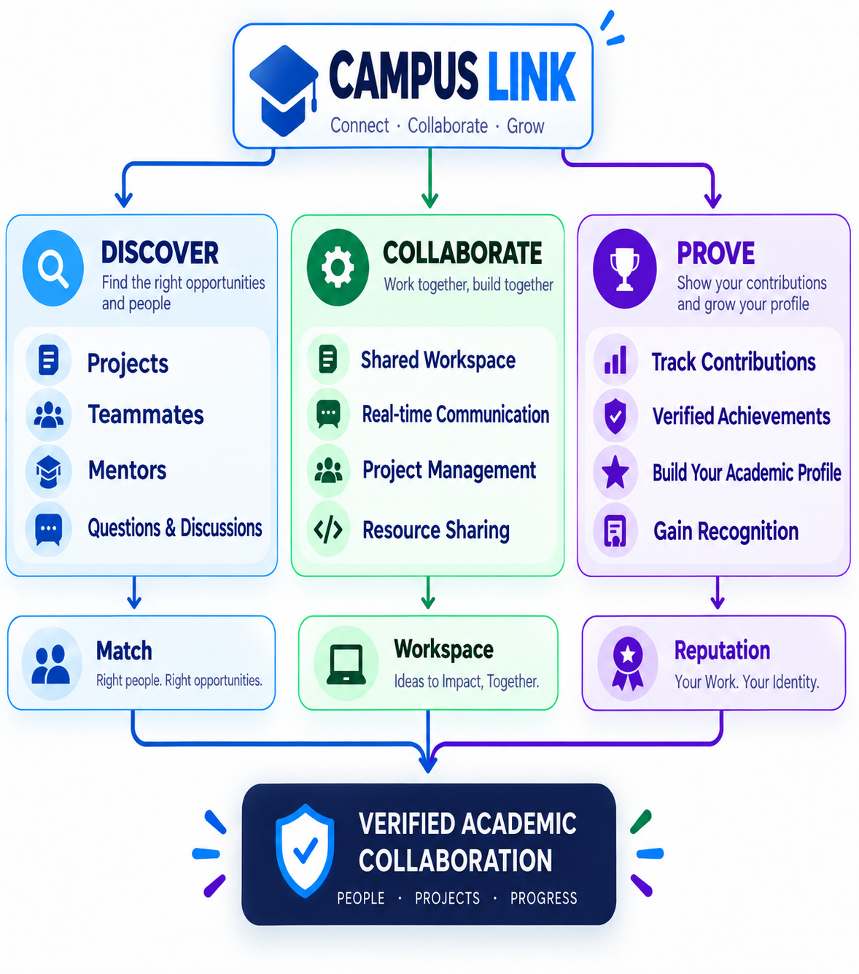
IDEA TITLE
CAMPUS LINK — Verified Academic Collaboration Platform
Proposed Solution
A verified platform connecting students and faculty across institutions to discover projects, find teammates and mentors, collaborate, and build a trusted academic reputation.
How It Addresses the Problem
Centralized opportunities — Projects, questions, mentorship & academic activities in one place.
Skill-based matching — Connect students with relevant projects, teammates and mentors.
Verified profiles — Build trust between students and faculty.
Collaboration workspace — Manage tasks and work together in one platform.
Contribution-based reputation — Make meaningful academic contributions visible.
Innovation & Uniqueness
🎯 Skill-to-Project Matching
Match student skills with project requirements.
🪪 Academic Reputation Passport
Build reputation through verified projects, answers, mentorship & contributions.
🌐 Cross-Institution Collaboration
Connect students and faculty beyond their own institution.

Slide 3
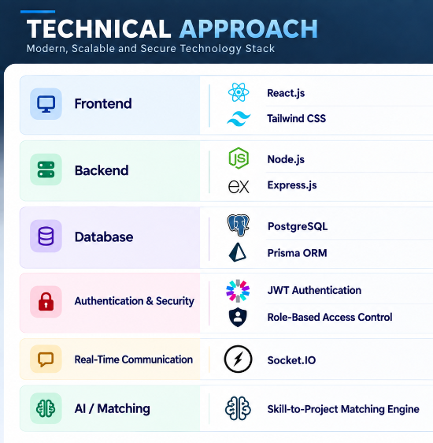
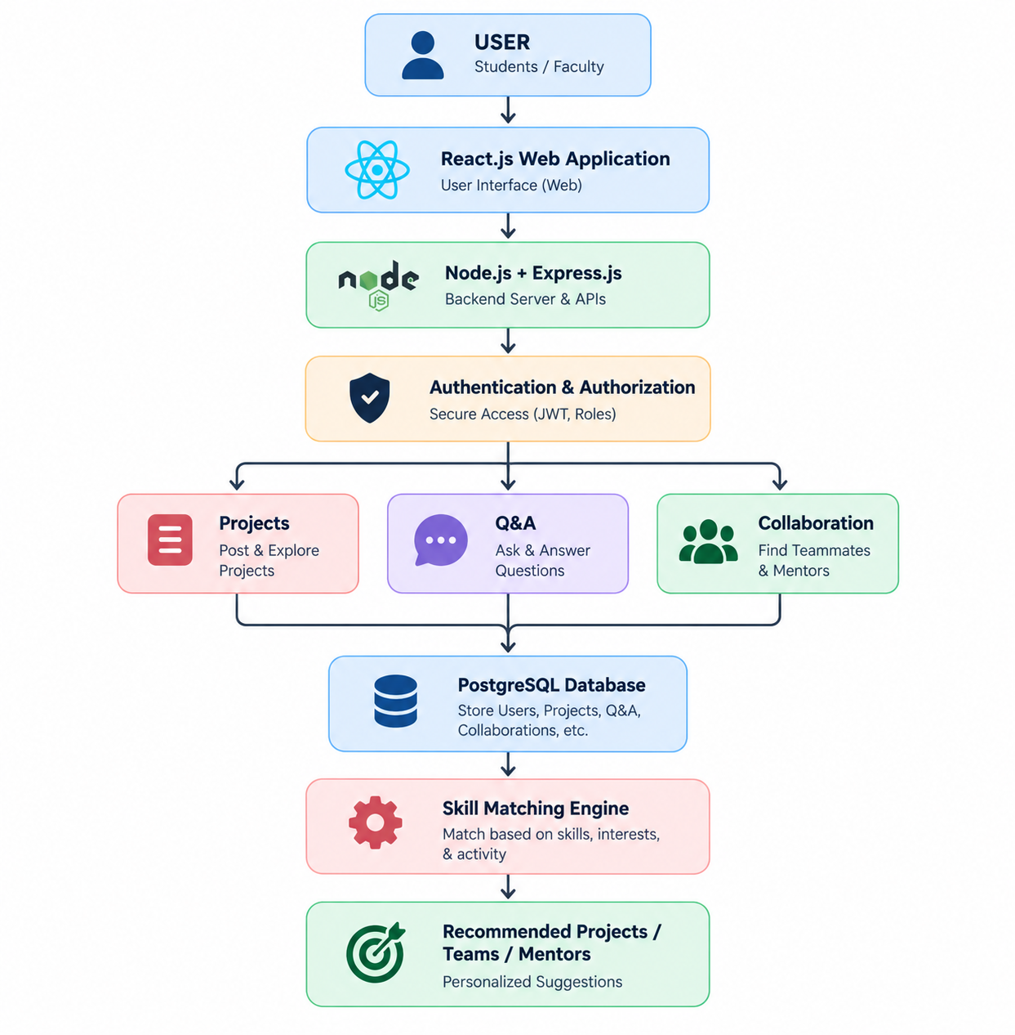

Slide 4
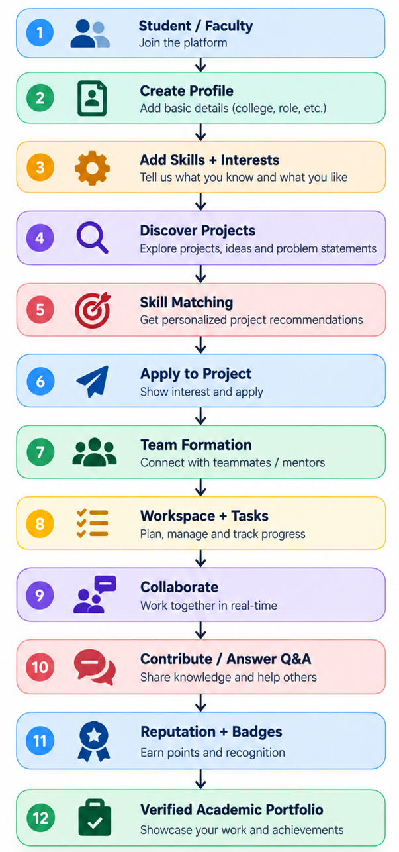
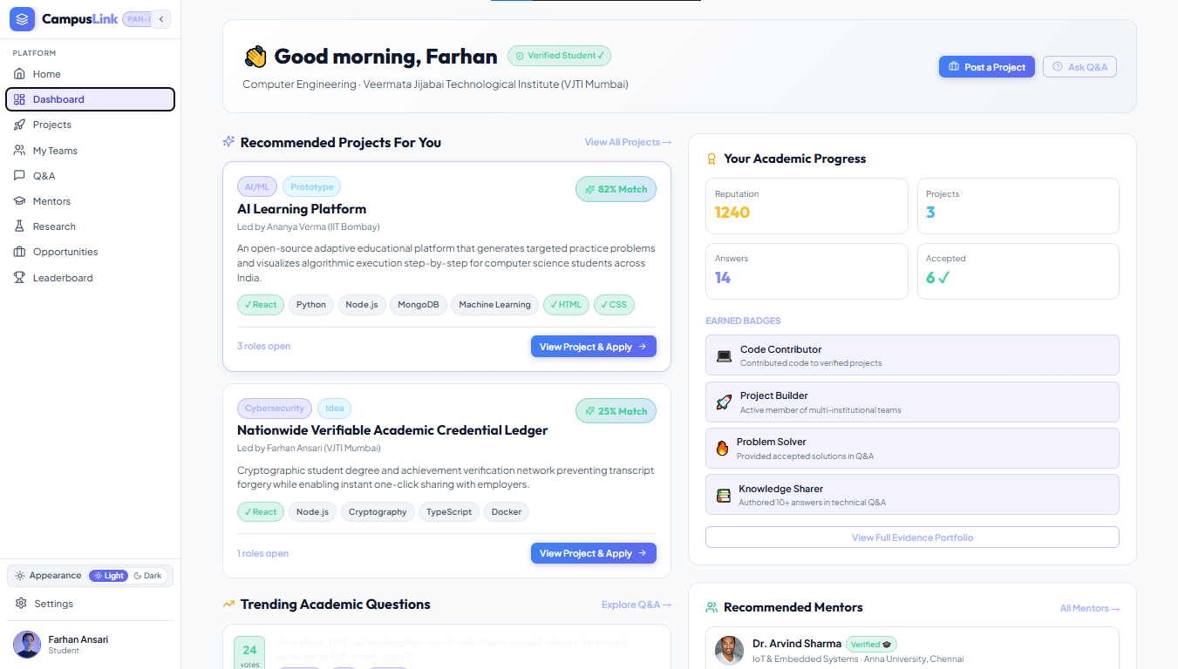

Slide 5
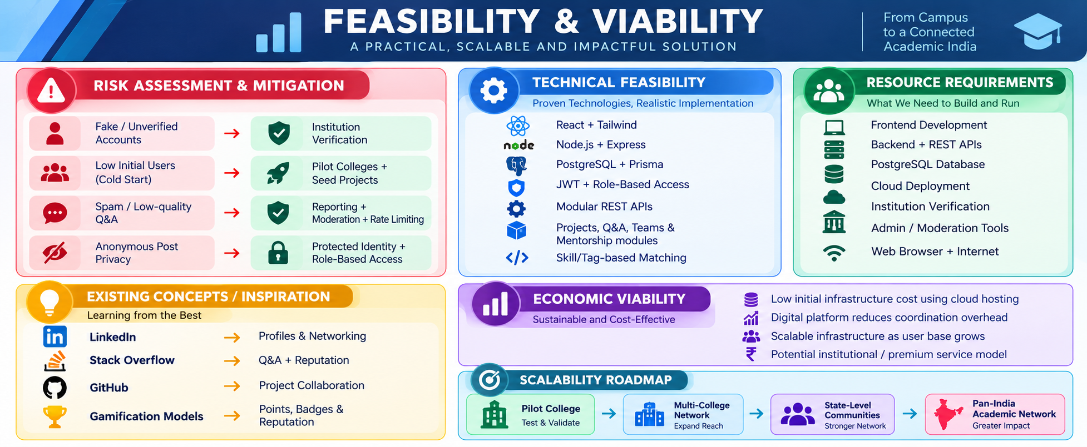

Slide 6
APAAR & ABC — Verified academic identity, record management & credit mobility.
🔗Official APAAR Portal
Fassinger (1995) — Research on classroom participation and student silence.
🔗 ERIC — Fassinger Research Record
NEP 2020 & NETF — Multidisciplinary education, academic mobility & technology-enabled learning.
🔗 NEP 2020 — Official PDF
Deterding et al. (2011) — Research foundation for gamification and game-design elements.
🔗 DOI — Deterding et al. 2011
Sarwar et al. (2001) — Foundation for collaborative-filtering recommendation systems.
🔗 DOI — Sarwar et al. 2001

