Slide 1
Developing a Recommender System for Crunchyroll
Anime Recommendations
Name: Shaik Ansar Subhani
College: SRM University-AP
Roll-No: AP2110010088
Mail: ansarsubhani_shaik@srmap.edu.in

Slide 2
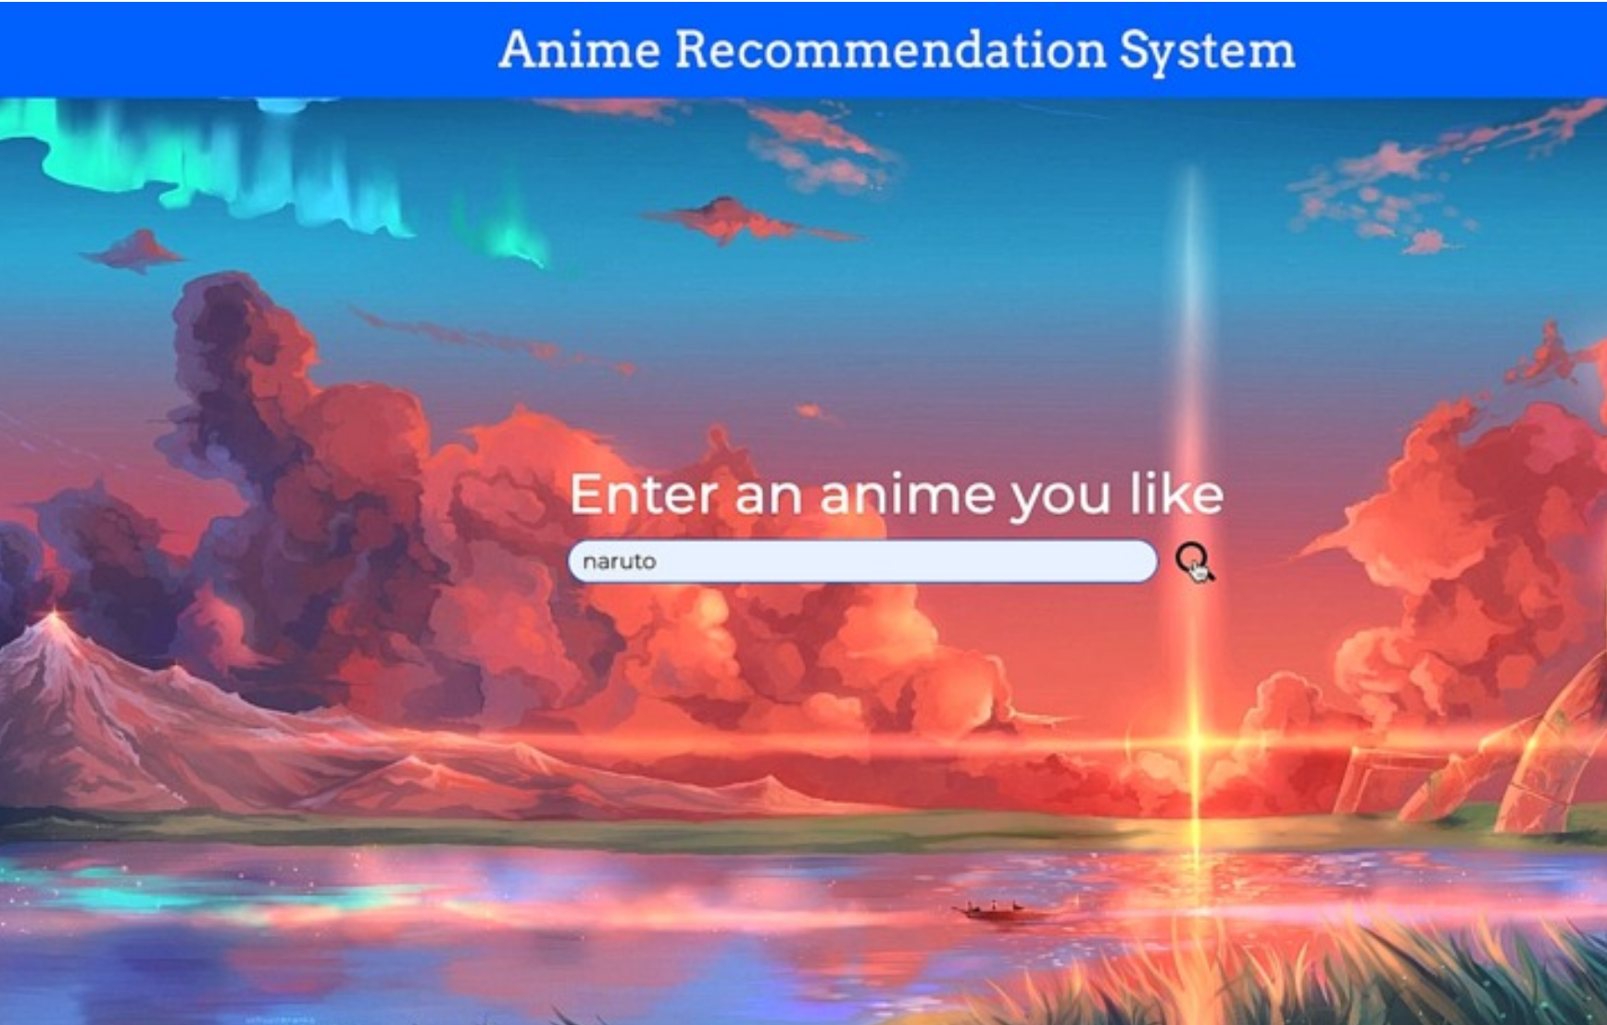
Introduction & Problem Statement
Objective:
Explain the importance of personalization for Crunchyroll’s large user base.
Goal to boost user engagement, satisfaction, and retention through customized anime recommendations.
Challenges:
Managing Crunchyroll’s extensive anime library.
Understanding and adapting to diverse user preferences.
new users, new anime.

Slide 3
Data Collection
Data Sources
User Data : Include profiles, watch history, ratings, search patterns, and interaction time.
Anime Metadata : Genres, cast, production studio, release dates, episode count, ratings, etc.
External Data : Reviews, popularity scores, social media sentiment analysis.
Data Preparation:
Data cleaning and preprocessing steps to ensure high data quality.
Creation of user-item matrices and embedding structures for ML models.

Slide 4
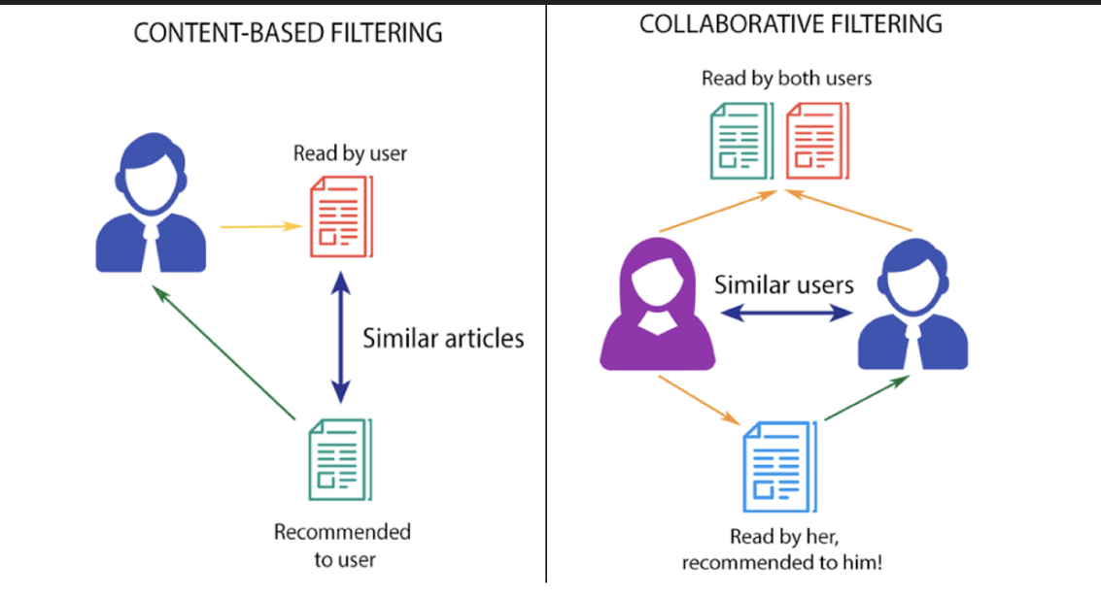
Recommender System Approach
Collaborative Filtering:
User-Based Filtering: Recommends based on similar users (identifying common user behaviors).
Item-Based Filtering: Suggests anime similar to what users have already enjoyed (anime-to-anime similarities).
Content-Based Filtering:
Uses anime metadata (genre, cast) to create profiles based on users’ past interactions.
Personalized recommendations using genre and theme analysis
Hybrid Approach:
Combines collaborative and content-based
filtering to address weaknesses of each method
Eg: used for new user for cold start.

Slide 5
Model Training and Evaluation
Training Process:
Training on historical user data, including explicit (ratings) and implicit feedback (watch history).
Embedding layers for dimensionality reduction, allowing better feature representation.
Evaluation Metrics:
Precision and Recall: Measure the accuracy of recommendations.
F1 Score: Balances precision and recall.
Diversity: Ensures recommendations cover various genres.
Novelty: Introduces users to lesser-known anime titles.
A/B Testing:
Evaluate and refine recommendations by comparing with the current recommendation system in live testing.

Slide 6
Challenges and Solutions
Cold Start Problem:
New Users: Addressed by initial popular or genre-specific recommendations or quick preference surveys.
New Anime: Handled by using metadata to classify and recommend similar content.
Scalability:
Use frameworks like Apache Spark for efficient data handling and TensorFlow for scalable model training.
Low-latency database solutions (like Redis or Elasticsearch) to handle high traffic.
Bias and Fairness:
Implement strategies to balance recommendations to avoid over-representing popular anime.
Ensure visibility for a diverse range of anime titles to provide users with variet

Slide 7
Deployment and Real-Time Recommendations
Pipeline Overview:
Data Flow: Process data → Generate recommendations → Display to user in real-time.
Architecture Components:
Database: Fast retrieval (e.g., Redis).
Cloud Deployment: Scalability (e.g., AWS, Google Cloud).
Dynamic Model Updates:
User Interaction Tracking: Adjust recommendations based on real-time user actions (watch time, skips).
Model Refresh: Regular updates with new data to keep recommendations current.

Slide 8
Impact Assessment and Future Work
Impact Metrics:
Engagement: Track metrics like viewing time, repeat visits, and new subscriptions.
User Feedback Loop:
Integration: Use user ratings and watch history to enhance model accuracy.
Future Enhancements:
Reinforcement Learning: Adapt recommendations based on user responses.
Contextual Suggestions: Tailor recommendations based on time, device, and inferred user preferences.

Slide 9
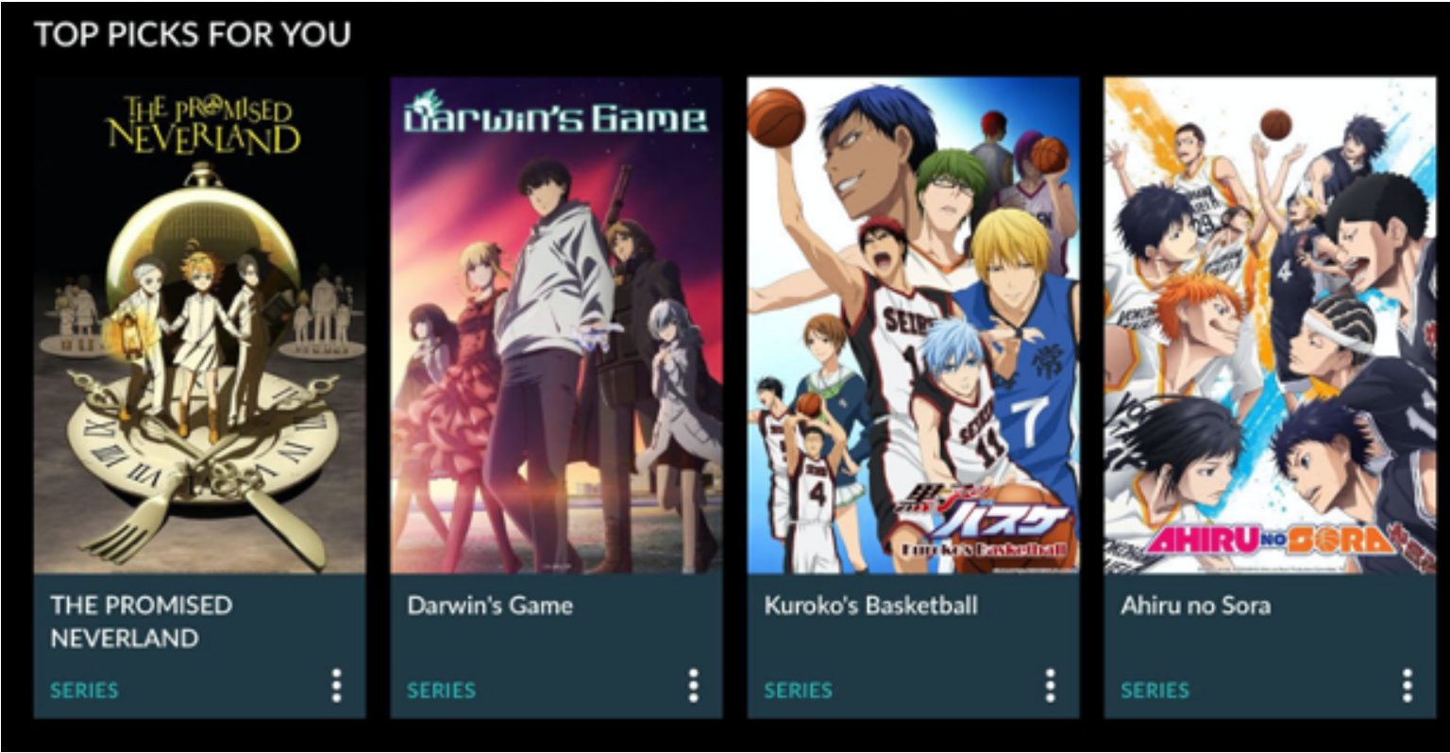
Conclusion
Summary:
Key Outcomes: Improved personalization, higher engagement potential, scalable solution for Crunchyroll.
The project demonstrates how machine learning enhances user experience, providing Crunchyroll with a competitive edge in anime streaming.

Slide 10
Thank You

