Slide 1

Architecture challenge

Slide 2
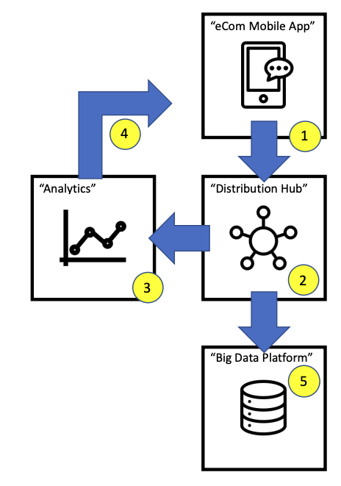
The problem
The diagram left shows an eCommerce mobile application. In this, an embedded SDK is emitting stream of json format tagging data containing behavioral information (e. g. product viewed by a consumer logged into) as consumers are using the app. The eCommerce company owning the app would like to:
1) Capture the incoming message stream and be able to distribute this to multiple downstream systems.
2) Analyze the incoming stream and update the consumer segment based on application browsing behavior (e. g. propensity to purchase football products).
3) Make the results of this segment available for personalizing the consumer experience on the mobile application (at scale and performance).
4) They would also like to persist the data to a typical Hadoop based big data platform and prepare for analytics team use in a tabular data mart.

Slide 3
The problem
Customer value
Event value
Budget
Response time
Uniqueness of the event: Consumer/Producer retries

Slide 4



The analysis: Input
Scalable response against incoming data streams
AWS Kinesis |  | Kafka
 | Performance
 | Cost
 | Scalability
 | Security
 | Ease of Use
Amazon Kinesis
Data Streams
Apache Kafka

Slide 5




The analysis: Process
Distribution hub
Amazon Kinesis
Firehose
AWS Glue
Apache Spark
AWS
ElasticMapReduce
Apache Hadoop
Amazon Kinesis
Analitics

Slide 6
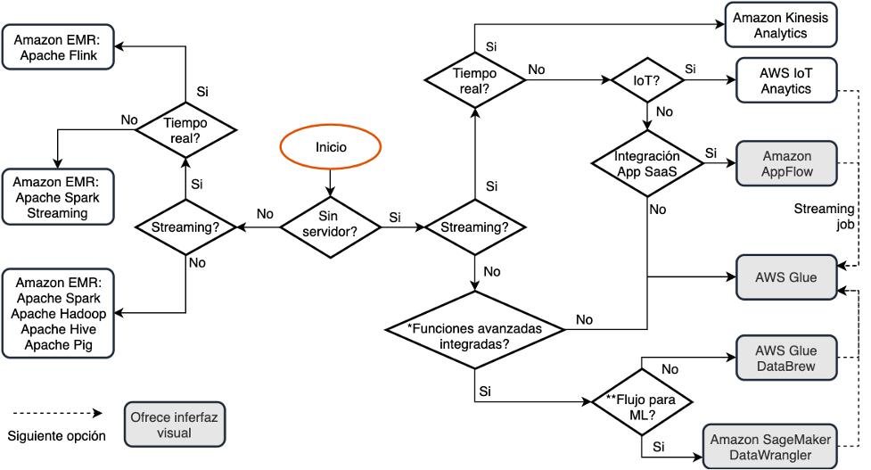
The analysis: Process

Slide 7



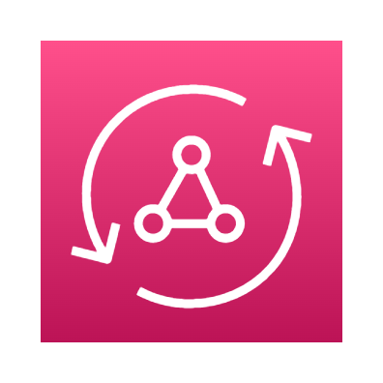
The analysis: Outputs
AWS
ElasticMapReduce
Apache Hadoop
Amazon
Redshift
AWS OpenSearch
AWS S3
AWS AppSync

Slide 8
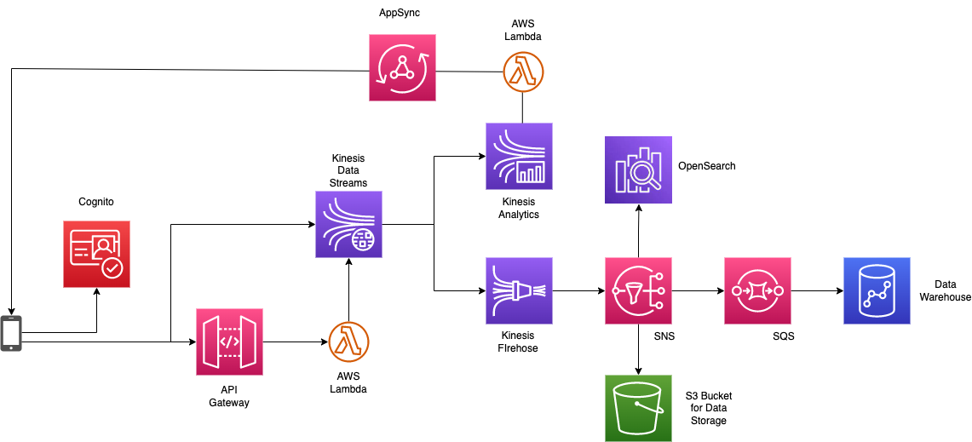
The solution

Slide 9
Related work
Paper:
Evaluation of a User Model to Support Interface Adaptability through Navigation Patterns
Presentation:
Slides

Slide 10
Questions & Answers

