Slide 1
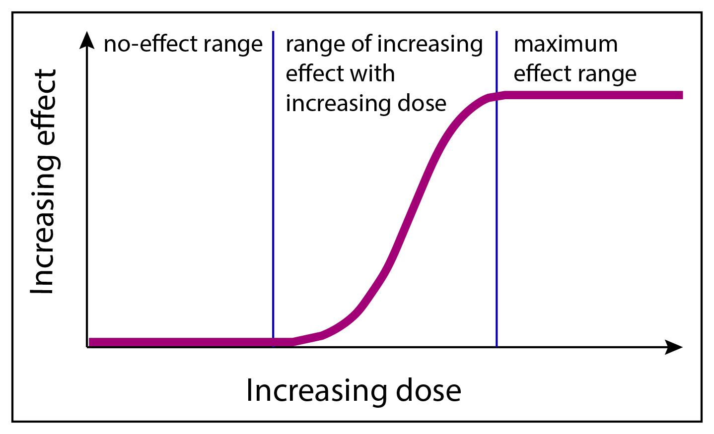
ED₅₀ (Optimal dose)

Slide 2
% of the population responded
ED₅₀ (Optimal dose)

