Slide 1
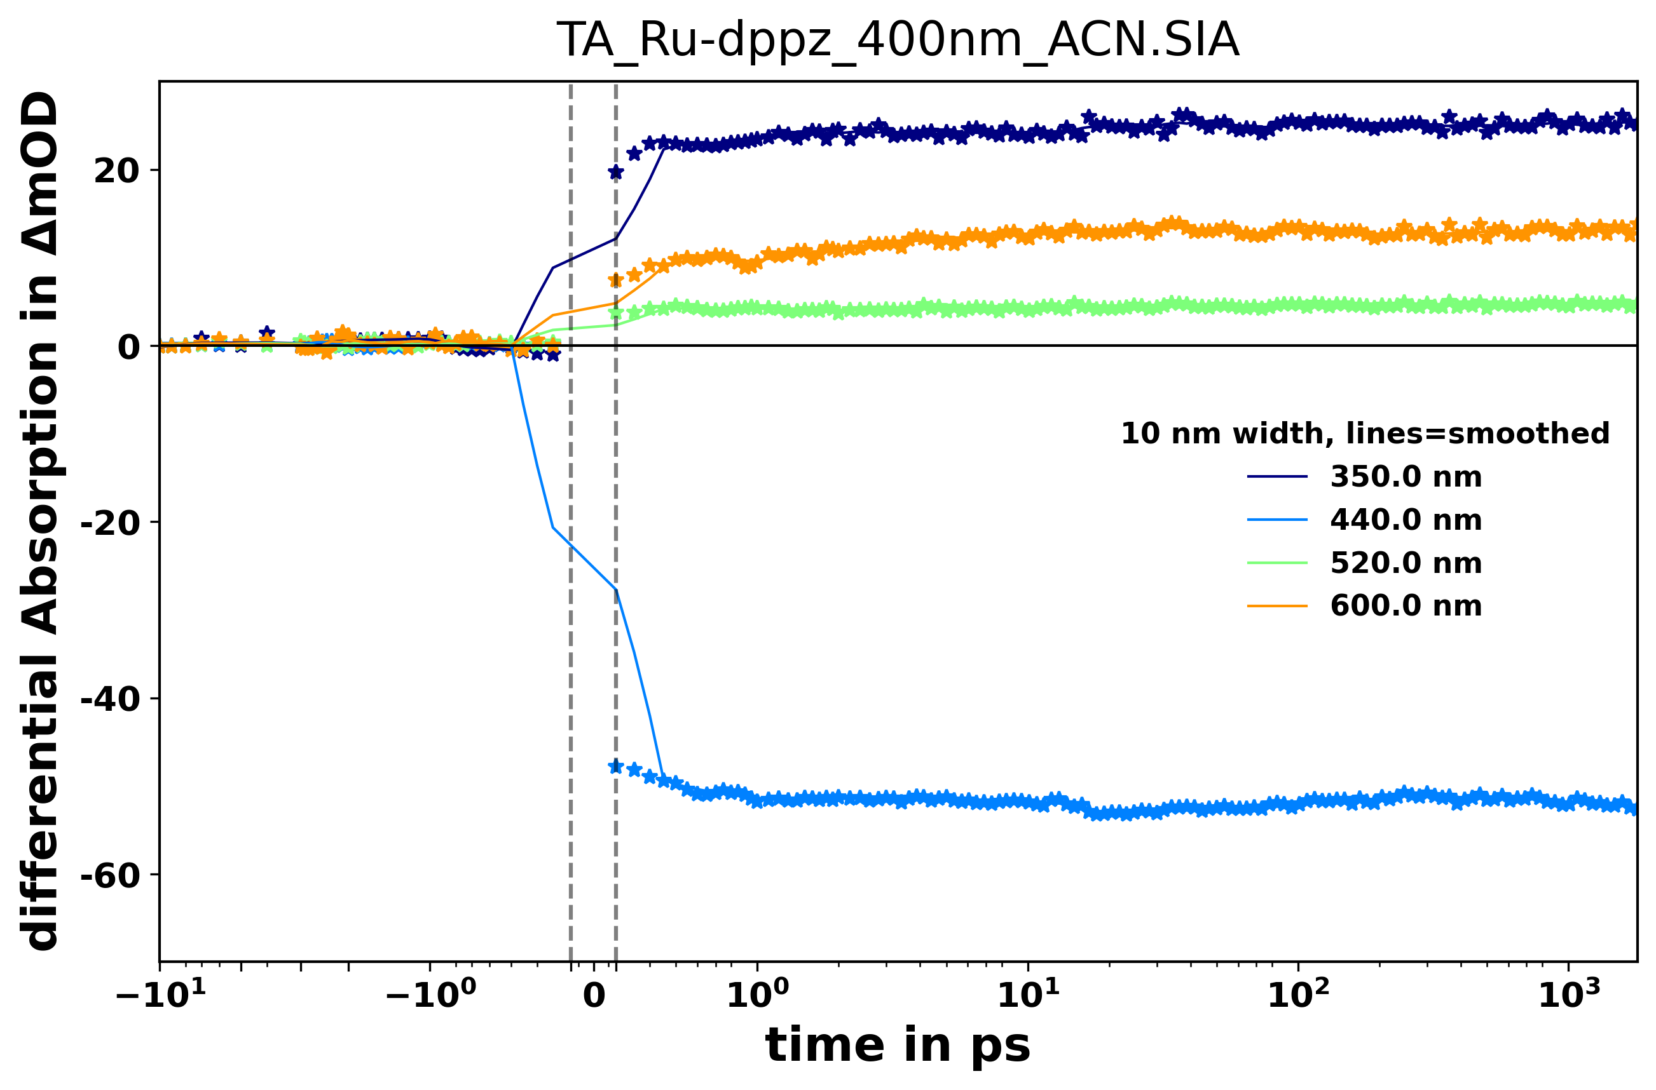
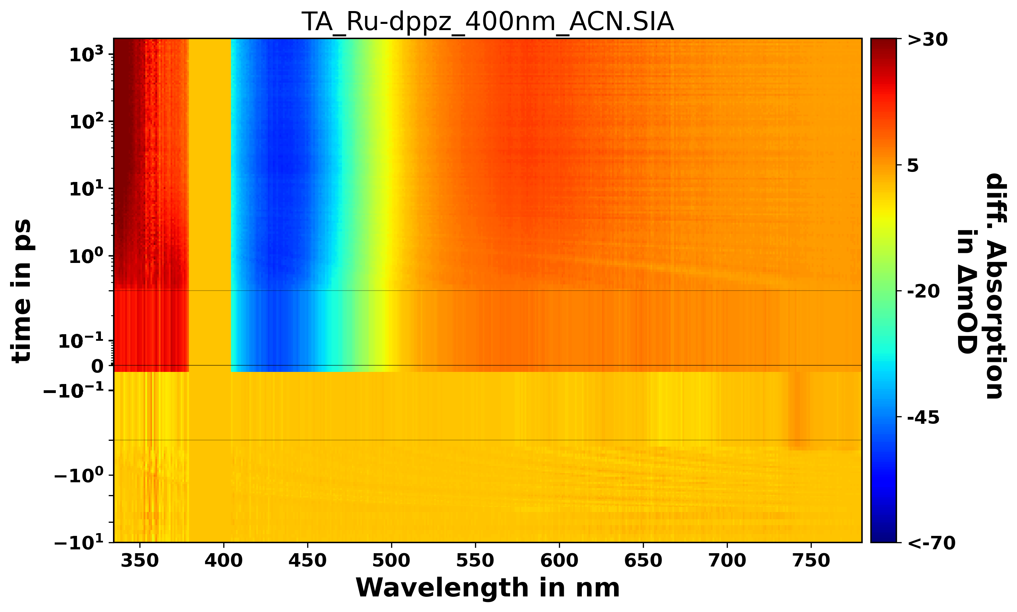
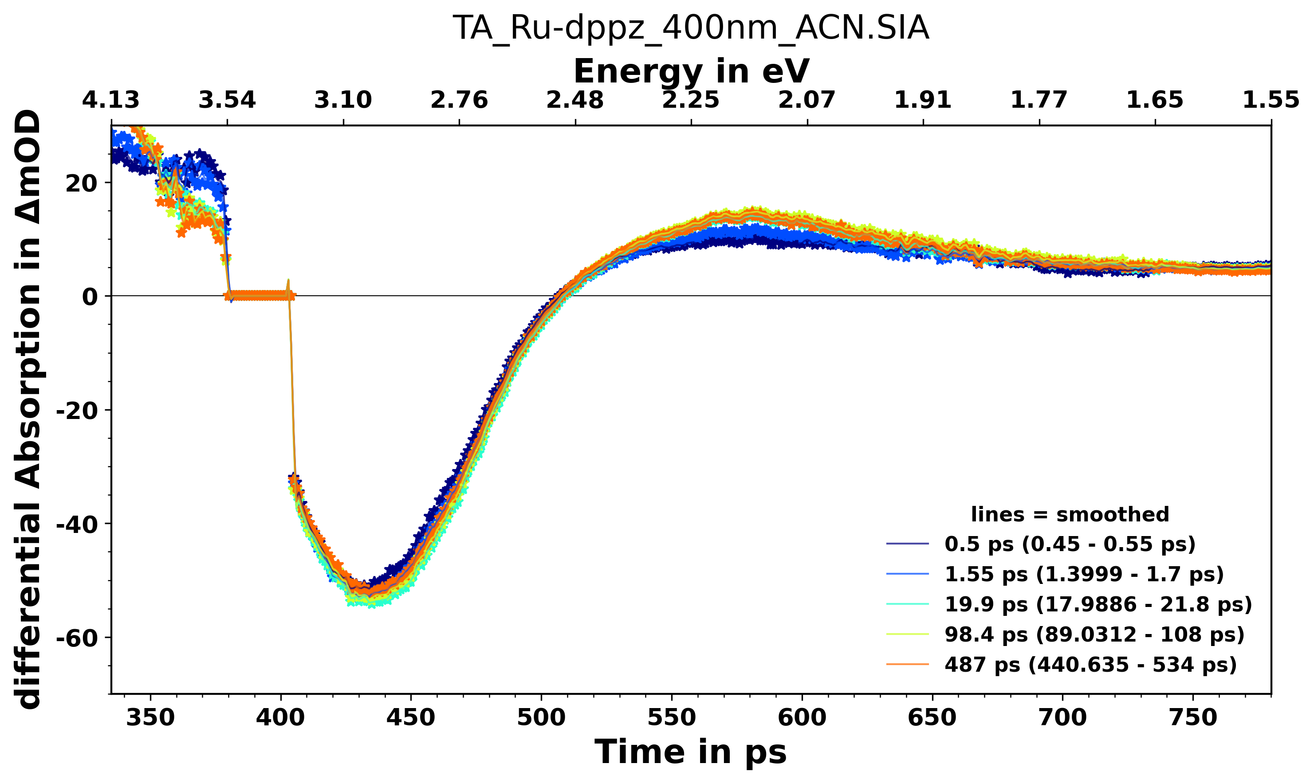
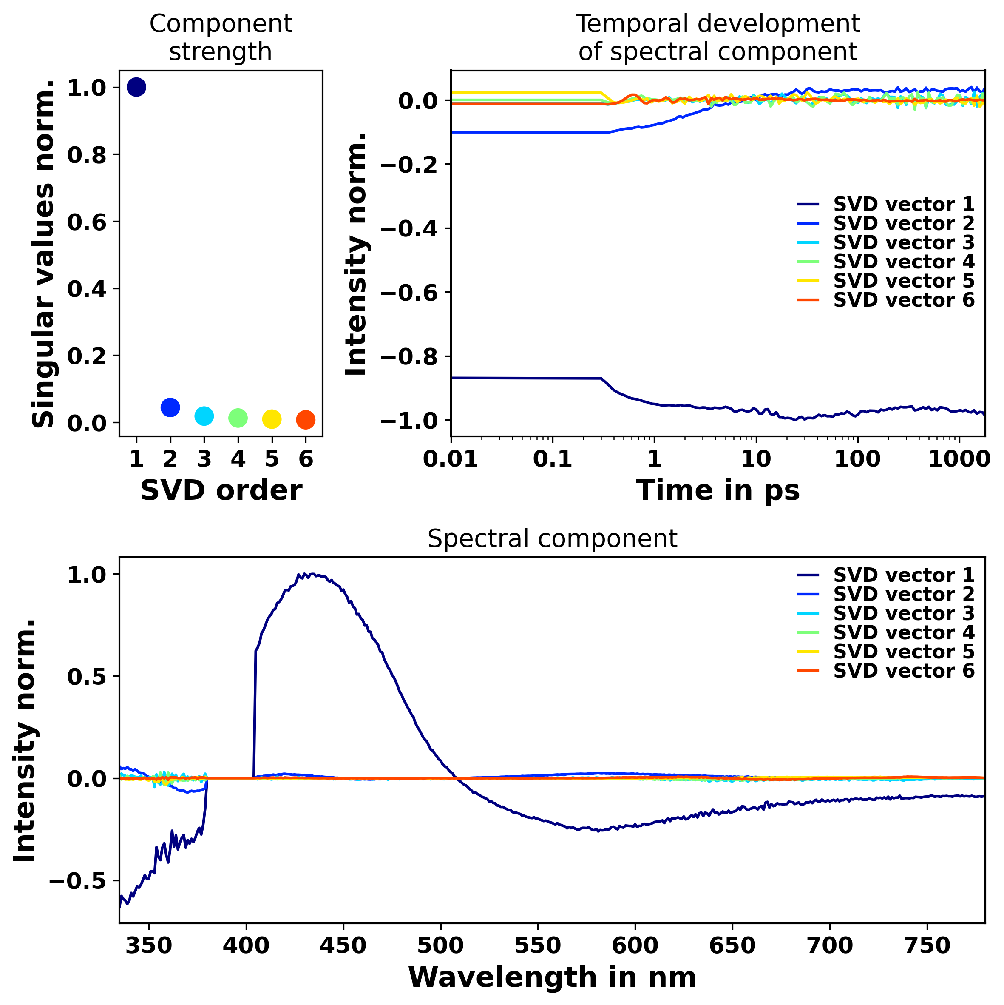

Slide 2
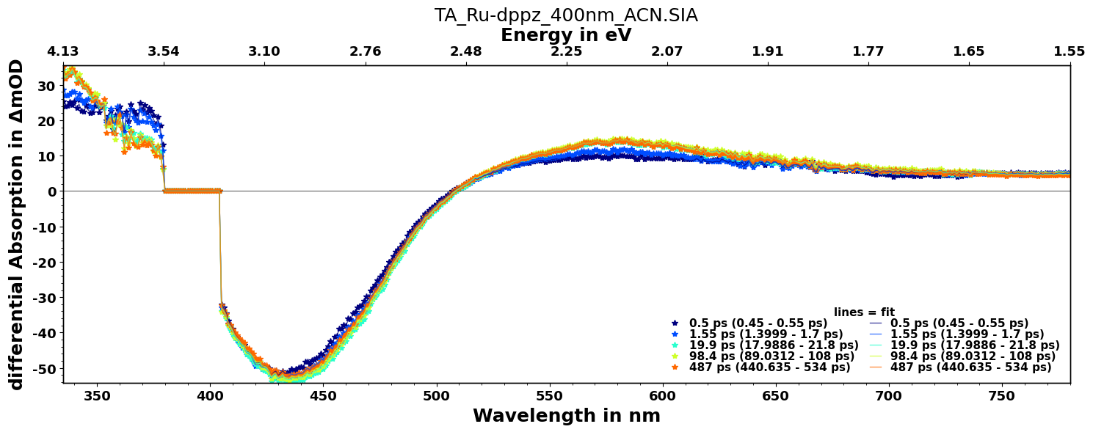
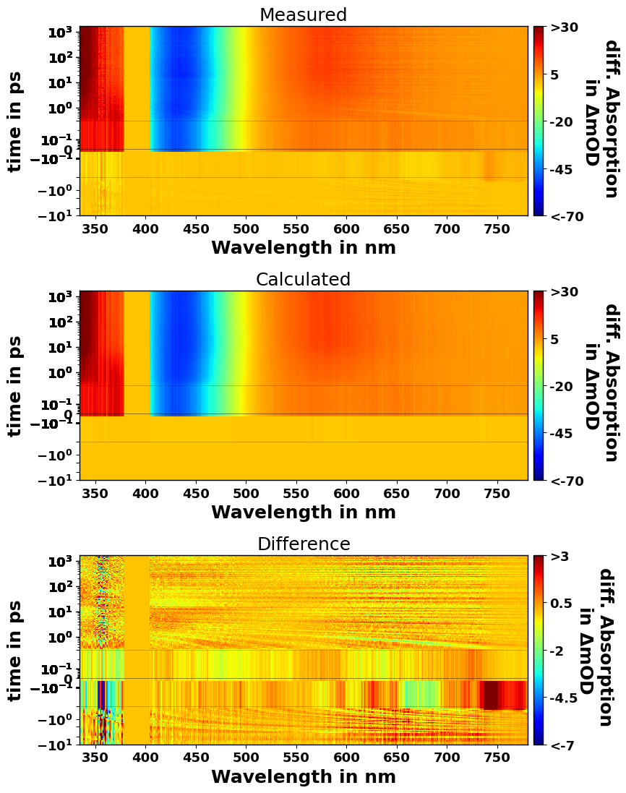
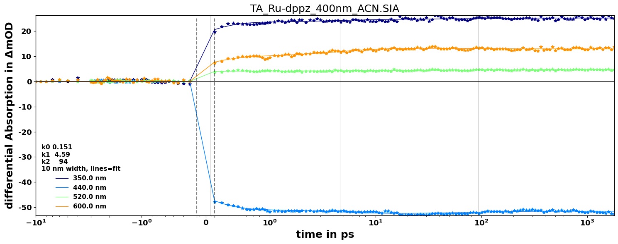
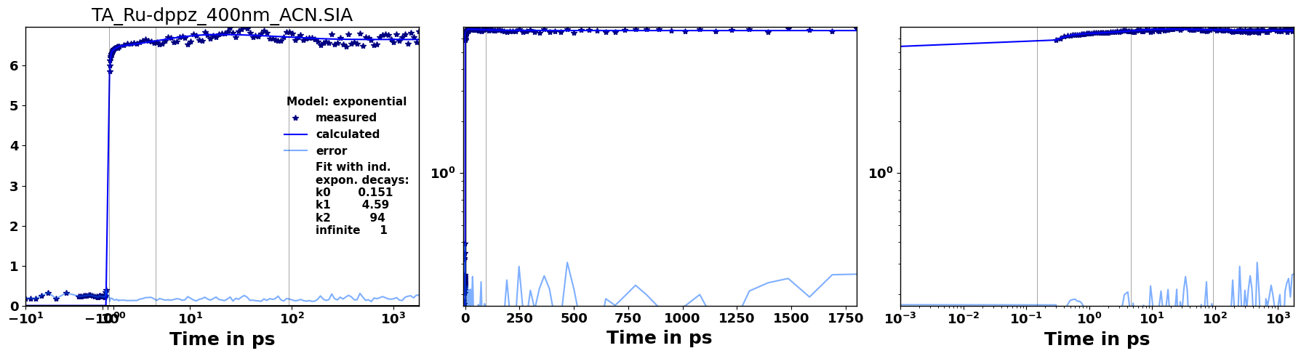
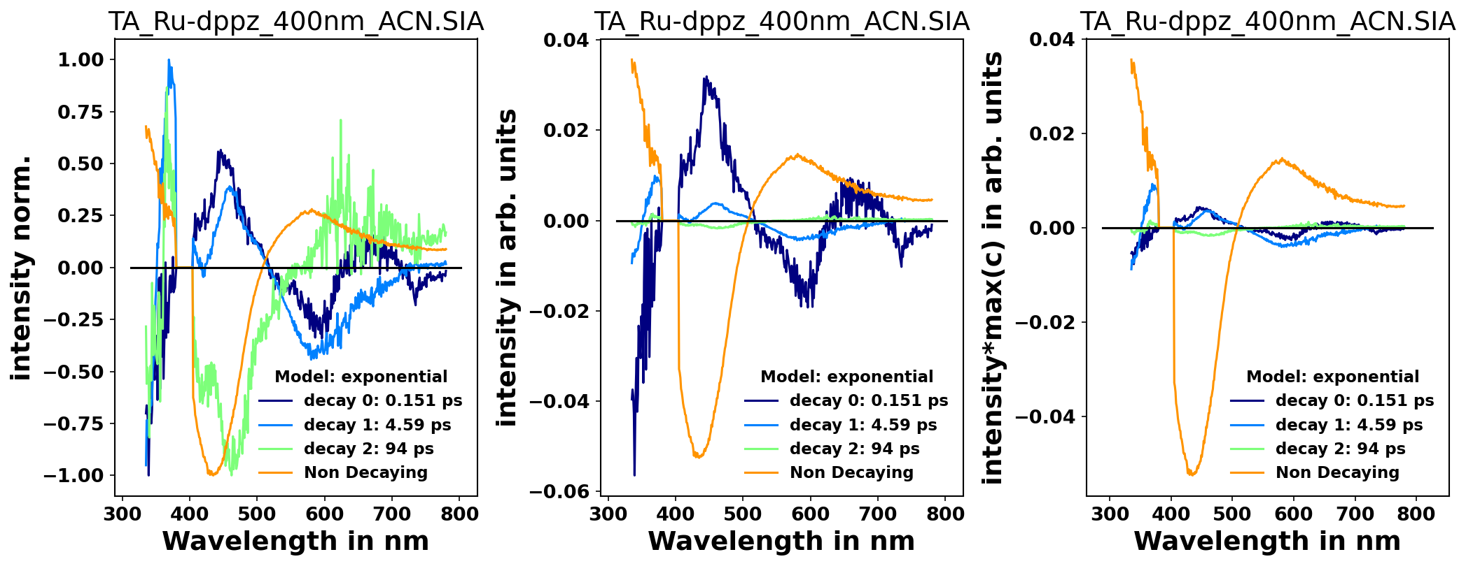
Fit Results:
Model Used: exponential
the time between -0.300 ps and 0.300 ps
was excluded from the optimization
The minimum error is:3.15044519e-02
The minimum R2-value is:9.98732179e-01
In Rates
value init_value vary min max expr
k0 6.636982 2.0 True 0 inf None
k1 0.217671 1.0 True 0 inf None
k2 0.010638 0.2 True 0 inf None
infinite 1 1 False -inf inf None
t0 0.000809 0.0 True -0.5 0.5 None
resolution 0.12 0.12 False 0.04 0.2 None
The rates converted to times with unit ps
value init_value vary min max expr
k0 0.150671 0.5 True 0.0 inf None
k1 4.594095 1.0 True 0.0 inf None
k2 94.005351 5.0 True 0.0 inf None
infinite 1 1 False -inf inf None

