Slide 1
Background
.
This data-pipeline follows the logic from the Seurat Tutorial, found here: https://satijalab.org/seurat/articles/pbmc3k_tutorial.html
The purpose of these slides is to show exactly how the data is pre-processed.

Slide 2
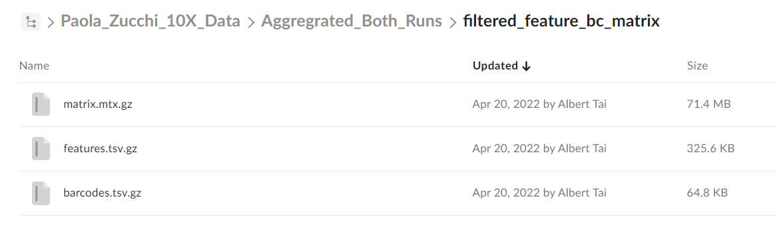
Data – 3 files from CellRanger pipeline

Slide 3

Creating the Seurat Object
cnc stands for “colonocyte”
Other parameters (taken from the documentation)
min.cells
Include features detected in at least this many cells. Will subset the counts matrix as well. To reintroduce excluded features, create a new object with a lower cutoff.
min.features
Include cells where at least this many features are detected.

Slide 4

Pre-Processing (remove dying/low quality cells)
See https://www.ncbi.nlm.nih.gov/pmc/articles/PMC4758103/ for more information on commonly used quality control metrics
Remove cells with:
Unique feature counts (genes) over 2500 or under 200
Greater than 5% mitochondrial counts (mitochondrial contamination)

Slide 5
Normalization
Uses a log-normalization method described here
One short line of code
Very important to do this before any dimensionality reduction!!

Slide 6
Feature Selection (identifying most highly variable features)
Look for features that exhibit high cell-to-cell variation: highly expressed in some cells, lowly expressed in others.
See documentation here . There are 3 different selection methods, default is “vst”.
By default, returns the 2000 most variable features (genes) in our dataset.
Note: This does NOT remove less variable features from the dataset, but allows for better sorting downstream (see Scaling slide)

Slide 7


Scaling
Standard step before running dimensionality reduction (such as PCA)
For our data, two options: scale with ALL genes in mind, or just the 2000 most variable ones (found in the last step)
All genes:
Only the 2000 most variable (this will run more quickly!)

Slide 8
Dimensionality Reduction: PCA
The purpose of PCA is to determine the dimensionality of the dataset.
We can choose to do PCA on the most variable features or a different subset. Note: make sure scaling has been done on the features chosen!
By default, choose most variable features:

Slide 9
Non Linear Dimensionality Reduction

Slide 10
Visualizing PCA
The goal of PCA visualization, ultimately, is to determine how many PC’s we will choose as input to our clustering function. This is because clustering occurs in the PC space (i.e around 5-20 dimensions)
On the way, however, we can look at the features (genes) most highly correlated with different PC’s:
The VizDimLoadings function shows graphs for each PC and the most highly correlated features.

Slide 11
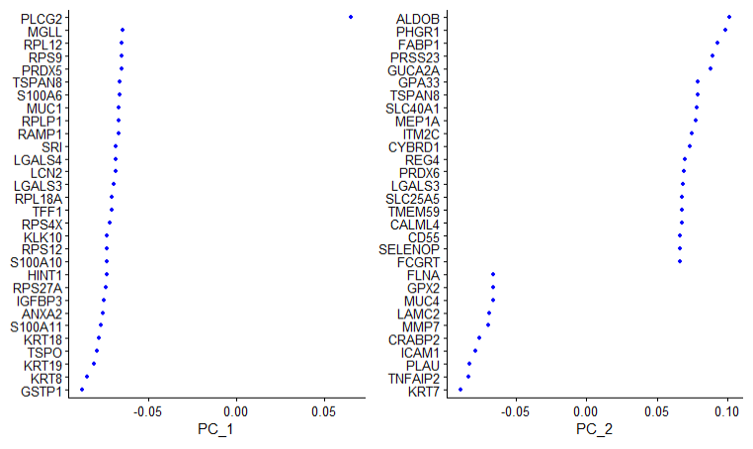
Visualizing PCA (continued)
VizDimLoadings function shows us the most highly correlated genes with each principal component

Slide 12
Determining Dataset Dimensionality
Multiple different ways:
Heuristics (elbowplot)
By significance (p-values)
Heatmap
Dimensionality tells us which PC’s to include for clustering and the UMAP/t-SNE algorithms.
By using PCA, we can keep the majority of the variance explained by the dataset but reduce it to less than 5% of it’s original size.

Slide 13
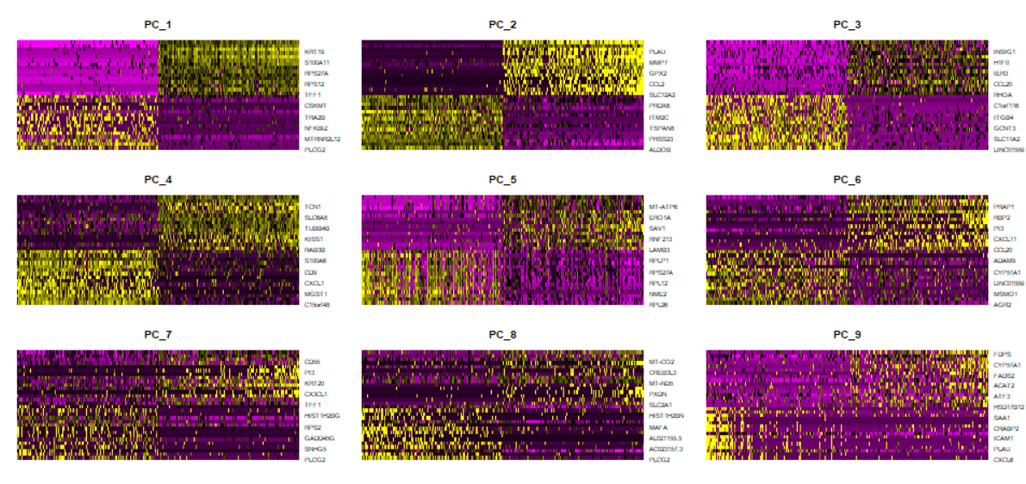
Heatmap
See explanation here (scroll down to heatmap)

Slide 14
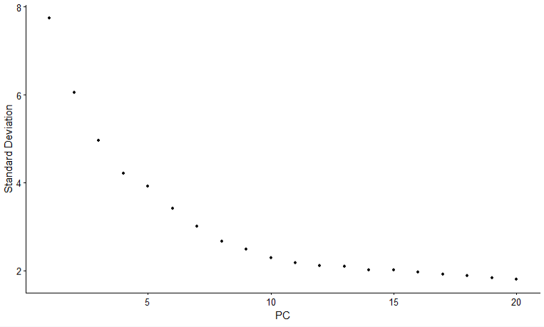
Elbow Plot
Heuristic: choose # of PC’s before the “bend” of the elbow
Based on this plot, choose between 10-15 PC’s

Slide 15
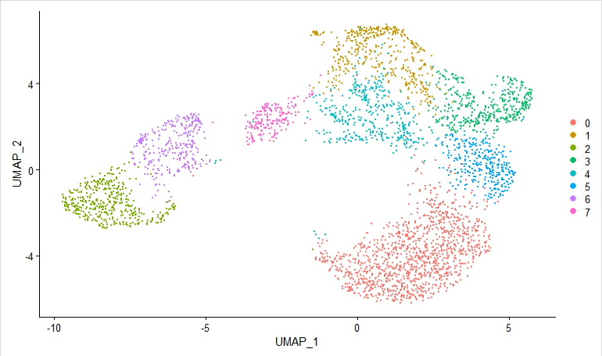
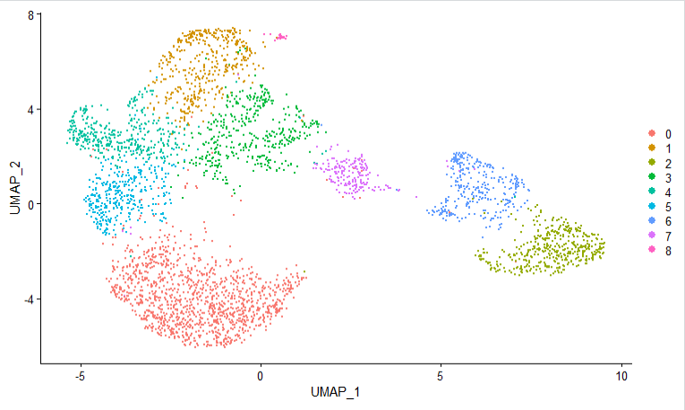
UMAP w/ 15 & 20 PCs
Main difference: in the graph using 20 PCs (right), we have one more cluster (light pink, middle-top of screen)
Otherwise, the visualization and also the clustering is relatively similar
Note one image is a mirror of the other!

Slide 16
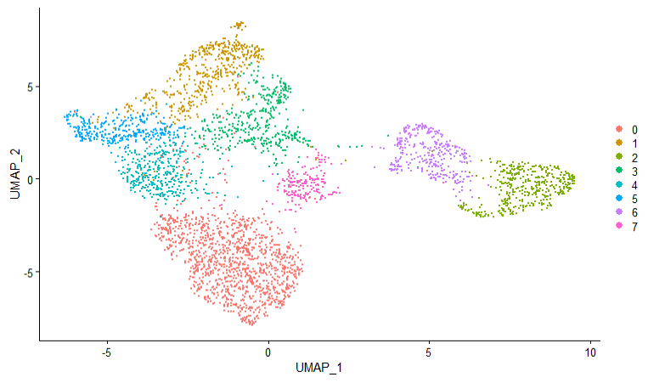
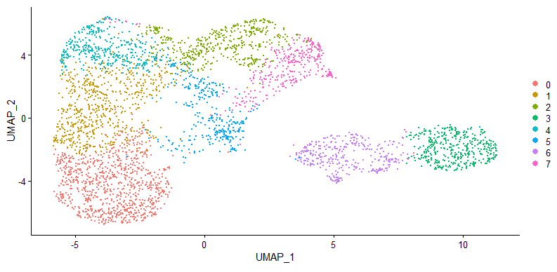
UMAP w/ 5 and 10 PC’s – start with 10 Pc’s
There is a larger difference between using 5 and 10 PC’s than there is using 15 and 20 PC’s. This is to be expected, as the PC’s 6-10 account for a higher percentage of explained variance than 16-20.
That said, some underlying structure remains preserved. Note there are two clusters on the right and 6 other ones on the left, with some space in between.

Slide 17
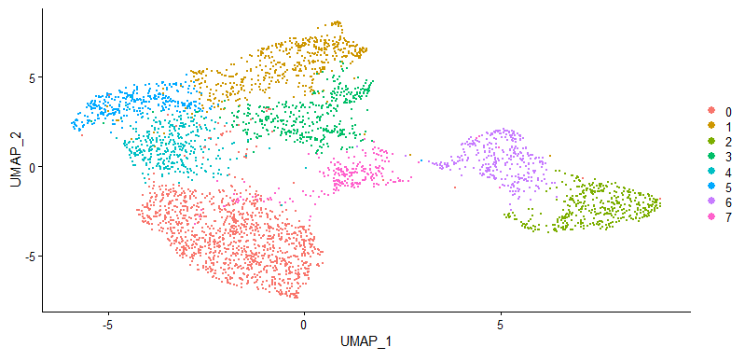
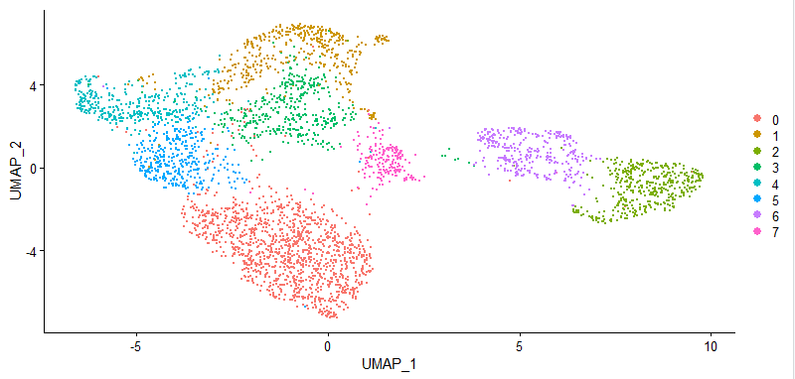
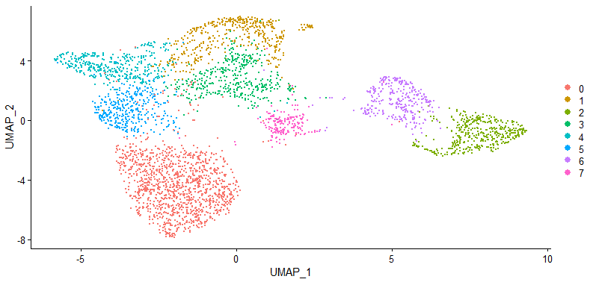
Using 9-12 PC’s: very similar representations
Why this many? → Elbow Plot heuristic!

Slide 18
Next Steps
Using a UMAP representation having been clustered with 9-12 PC’s, find the most differentially expressed biomarkers per cluster.
Then, use these biomarkers to identify cell types in each cluster.

