Slide 1

Introducing Sahayak: Your Desktop AI Assistant
Sahayak is a desktop AI assistant designed to simplify your daily tasks and enhance your interaction with technology.

Slide 2
The Challenge and Solution
Answering Questions
Weather Information
Quickly finding accurate answers is time-consuming.
Checking the weather manually requires opening a dedicated app.

Slide 3
The Challenge and Solution (Continued)
Playing Songs
Searching for News
Searching for songs manually takes time.
Finding reliable news sources can be difficult.

Slide 4
The Challenge and Solution (Continued)
Telling Jokes & Stories
Providing Date & Time
Finding engaging jokes or stories manually takes effort.
Checking the system clock can be inconvenient.

Slide 5
The Challenge and Solution (Continued)
Opening Google, ChatGPT, YouTube
Manually opening and navigating through different websites is time-consuming.

Slide 6
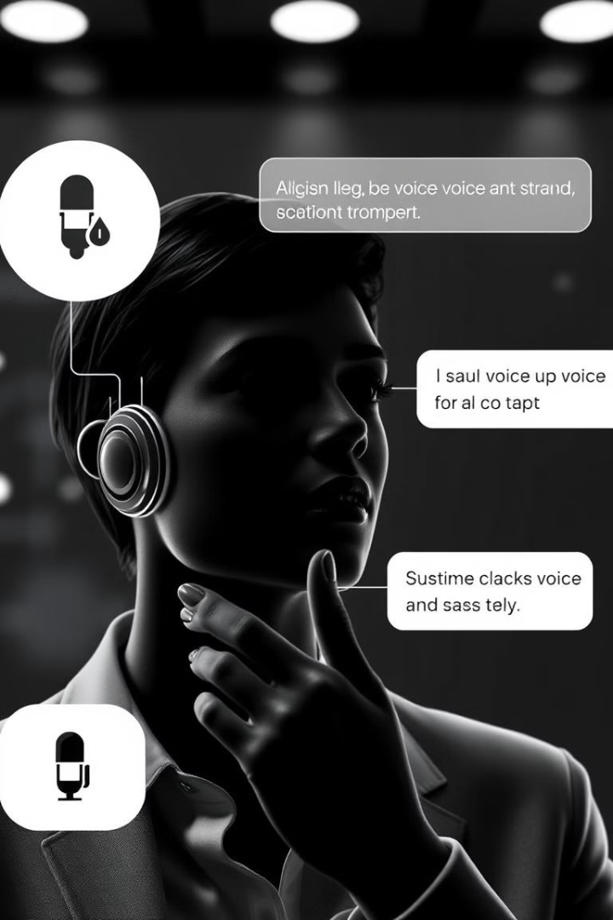
Features & Functionalities
1
Voice & Text Commands Support
2
Understanding Spoken Commands
3
Speaking Responses

Slide 7
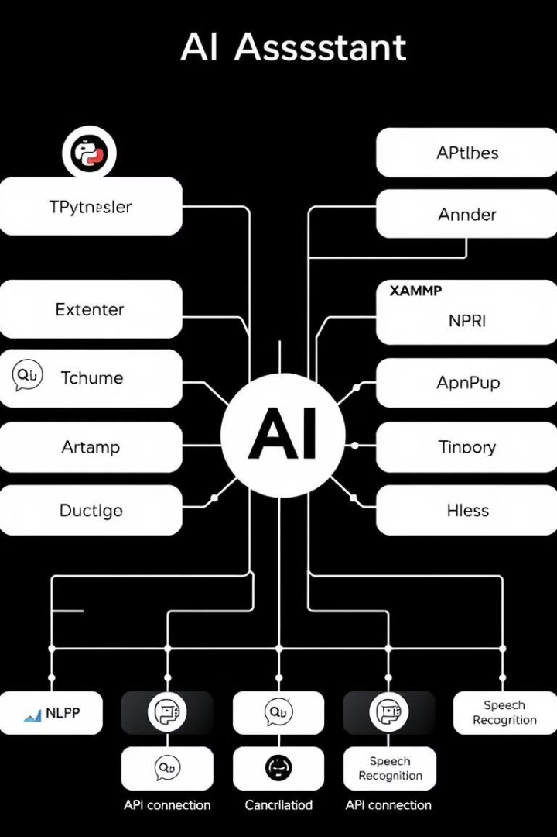
Technical Details
Python
Programming language
Tkinter
GUI framework
MySQL
Database management
XAMPP
Server environment

Slide 8




Future Scope
Adding AI-powered chat
Multi-language support
Mobile & Web version development

Slide 9
Conclusion
Sahayak simplifies daily tasks by responding to voice and text commands.
It helps users by answering queries, providing weather updates, playing music, fetching news, and more.
This makes interactions with technology more efficient and convenient.

