Slide 1
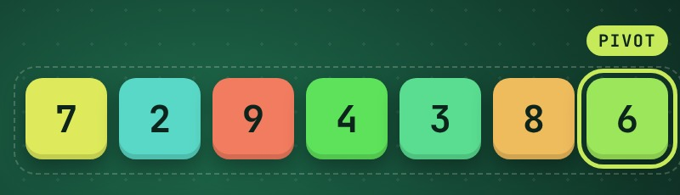
DIVIDE AND CONQUER
Quick Sort
Design and Analysis of Algorithms
Generated using Claude
Notes:
Quick Sort: a divide-and-conquer sorting algorithm. Generated using Claude.

Slide 2
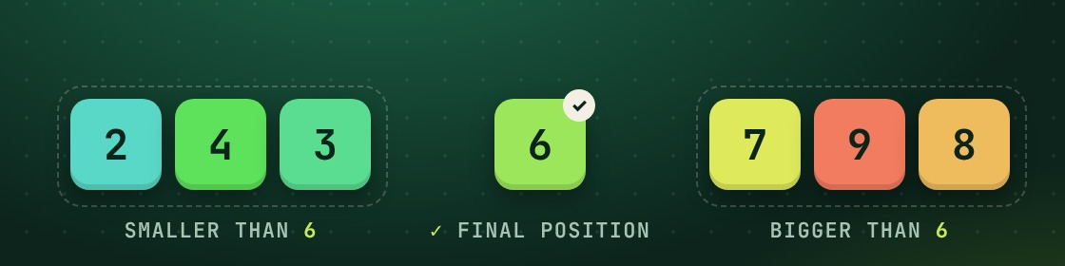
Pick a pivot, partition around it, repeat
THE IDEA
1
Divide
Partition of 7 2 9 4 3 8 6 around pivot 6
Choose a pivot and partition: smaller elements go left, larger go right. The pivot lands in its final position.
2
Conquer
Recursively Quick Sort the left part and the right part.
Work happens in the divide step. Merge Sort is the opposite: trivial split, work in the merge.
3
Combine
Nothing to do. The parts are already in place, so the whole array is sorted.

Slide 3
Pseudocode with Lomuto partition
ALGORITHM
QUICKSORT(A, lo, hi)
if lo < hi
p = PARTITION(A, lo, hi)
QUICKSORT(A, lo, p - 1)
QUICKSORT(A, p + 1, hi)
PARTITION(A, lo, hi)
pivot = A[hi]
i = lo - 1
for j = lo to hi - 1
if A[j] <= pivot
i = i + 1
swap A[i], A[j]
swap A[i + 1], A[hi]
return i + 1
1
Pivot
Take the last element A[hi].
2
Scan
i marks the end of the "≤ pivot" zone; j walks lo … hi−1.
3
Place
Swap the pivot to i+1: its final index.
4
Recurse
Sort A[lo..p−1] and A[p+1..hi]. Initial call: QUICKSORT(A, 1, n).

Slide 4
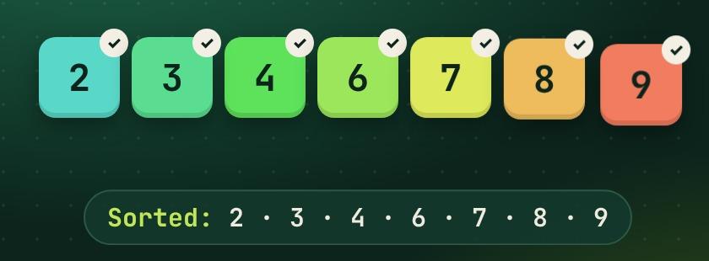
Sorting 7 2 9 4 3 8 6
WORKED EXAMPLE
Subarray | Pivot | Result
7 2 9 4 3 8 6 | 6 | [2 4 3] 6 [7 9 8]
2 4 3 | 3 | [2] 3 [4]
7 9 8 | 8 | [7] 8 [9]
Done | — | 2 3 4 6 7 8 9
Final sorted array
Every pivot ends in its final position, so after the recursion finishes no merge step is needed.
Note: the slide and video keep each side in its original order for clarity. In-place Lomuto PARTITION actually produces 2 4 3 | 6 | 9 8 7 — the pivot still lands at the same index and the final result is the same.

Slide 5
Fast on average, quadratic at worst
COMPLEXITY
Case | Time | When it happens
Best | O(n log n) | Pivot splits the array into equal halves: T(n) = 2T(n/2) + Θ(n)
Average | O(n log n) | Random input or random pivot (≈ 1.39 n log₂ n comparisons)
Worst | O(n²) | Pivot always min or max (e.g. sorted input, last-element pivot): T(n) = T(n−1) + Θ(n)
O(log n)
In-place
Not stable
Extra space (average recursion stack); O(n) worst case unless you recurse on the smaller side first
Only swaps inside the array; no auxiliary array
Long-range swaps can reorder equal keys

Slide 6
Pros, cons and when to use it
IN PRACTICE
Pros
Cons
Avoid the worst case
Fast in practice: small constants, cache-friendly sequential scans
In-place: O(log n) extra stack on average
Simple to implement
O(n²) worst case on bad pivots
Not stable
Recursive; deep stack in the worst case
Randomized pivot: expected O(n log n) on any input
Median-of-three (first, middle, last) as pivot
Switch to insertion sort for tiny subarrays; introsort falls back to heapsort

Slide 7
Thank you
Quick Sort · Design and Analysis of Algorithms
Generated using Claude

