Slide 1
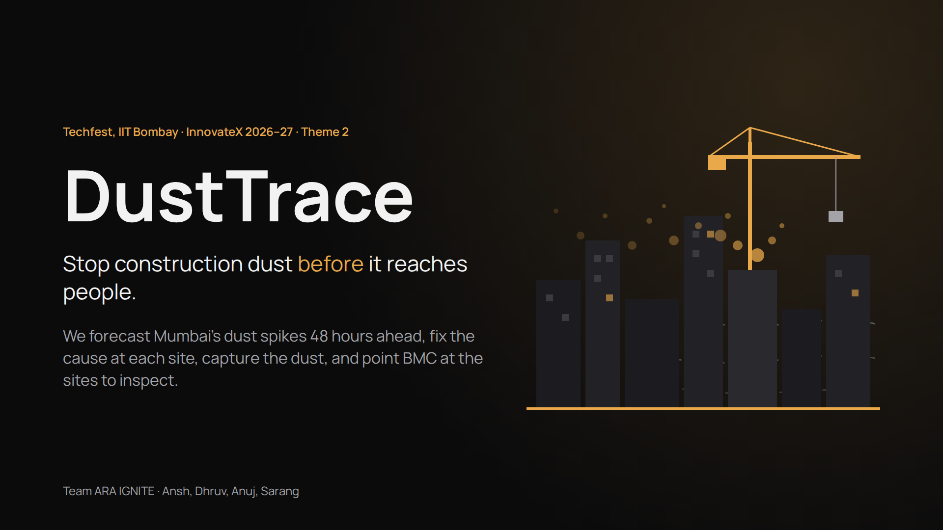
Notes:
[0:00 · 20 s]
Good morning. We're team ARA IGNITE, Ansh, Dhruv, Anuj and Sarang, and this is DustTrace, our entry for Theme 2, Rising AQI.
In one line: we stop construction dust before it reaches people. We forecast spikes 48 hours ahead, move dusty work to safer hours, and tell the BMC exactly which sites to inspect.
We build on the sensors Mumbai already has, and add our own low-cost sensors only where there are none.

Slide 2
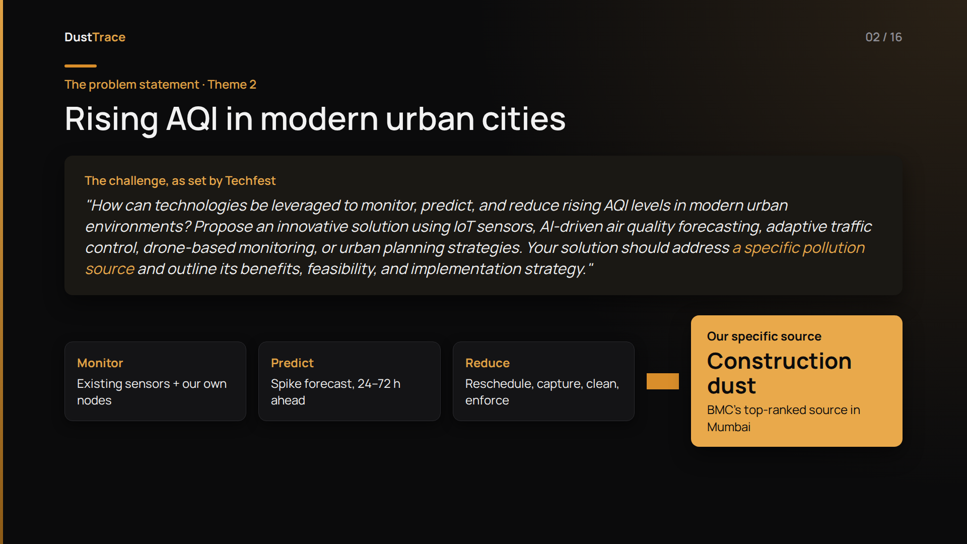
Notes:
[0:20 · 30 s]
Our theme is Rising AQI in modern cities. The brief asks how technology can monitor, predict and reduce rising AQI, and it asks for one thing specifically: address a specific pollution source.
Mumbai's air has many sources: vehicles, industry, road dust, burning, construction. We chose construction dust, and our solution monitors it, predicts it and reduces it. Here's why we chose it.

Slide 3
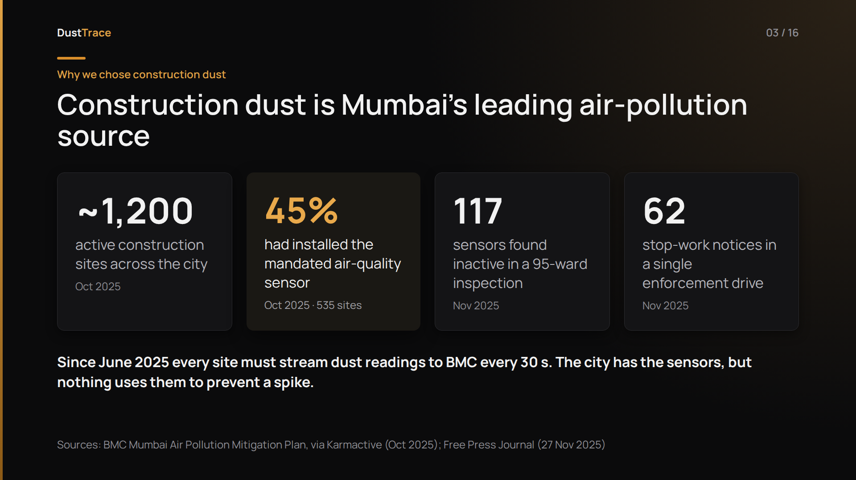
Notes:
[0:50 · 35 s]
Construction dust is Mumbai's leading air-pollution source. That's not our claim; it's from BMC's own Air Pollution Mitigation Plan.
The city has about twelve hundred active construction sites. After a High Court order, every one of them has to run an air-quality sensor. But by October 2025, only 45 percent had one.
In November, a 95-ward inspection found 117 sensors switched off or inactive, and BMC issued 62 stop-work notices in a single drive.
Since June 2025, every one of those sensors has to stream to BMC every thirty seconds. So Mumbai has the IoT. What it can't do is trust it, see past it, or use it to prevent a spike.
BACKUP:
If a judge asks about the share of construction: estimates vary by method. SAFAR (2022) put construction at about 8% of city particulate matter, with Metro works alone at 3.2% of suspended dust; NEERI found construction plus natural dust at 27% of PM10 at Dharavi. Hyperlocally, near active sites, it dominates.
Before the zonal: check whether BMC has published newer 2026 compliance figures.

Slide 4
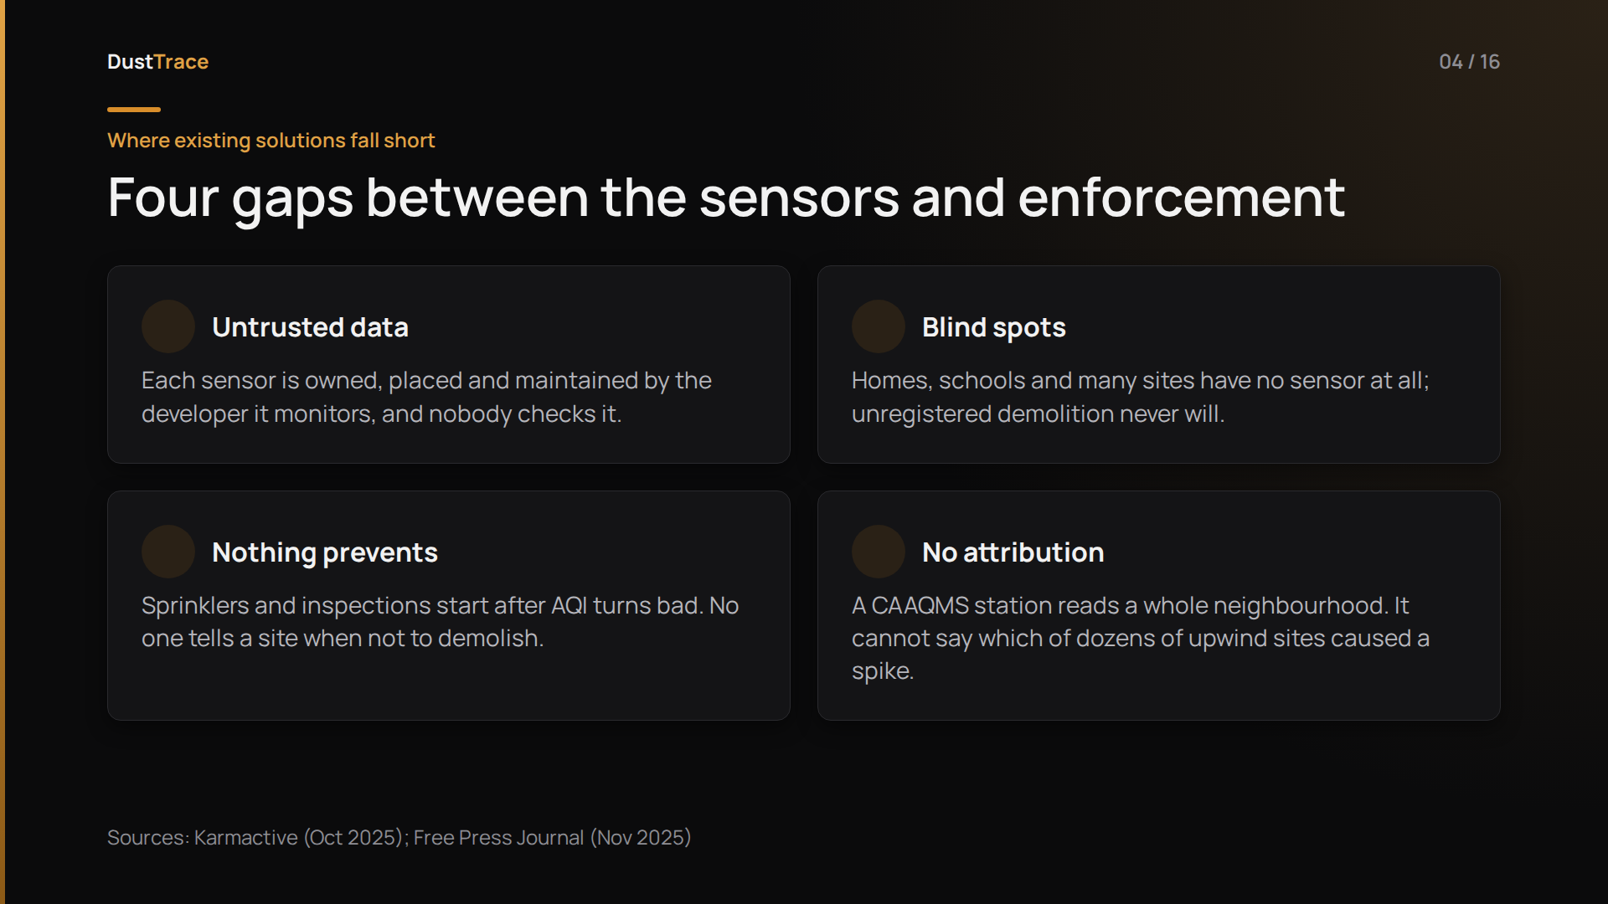
Notes:
[1:25 · 30 s]
So where does it break? Four gaps.
One: untrusted data. The sensor is owned, placed and maintained by the very developer it's supposed to monitor.
Two: blind spots. The homes and schools around sites have no sensor at all, and unregistered demolitions never will.
Three, and most important: nothing prevents. Sprinklers and inspections start after the air turns bad, and no one tells a site when not to demolish.
Four: no attribution. A monitoring station reads a whole neighbourhood. It can't tell you which of dozens of sites upwind caused the spike.

Slide 5
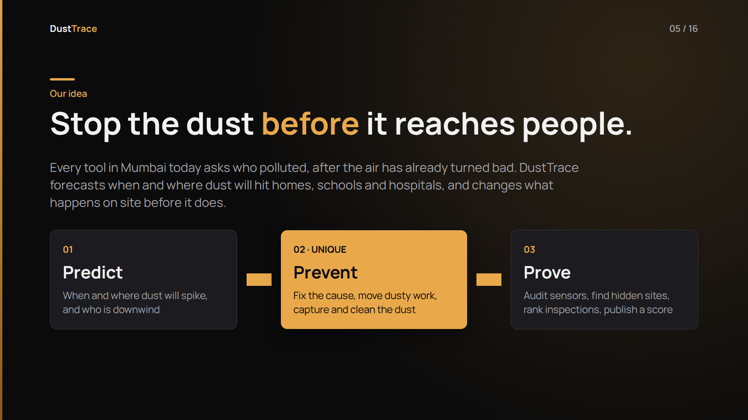
Notes:
[1:55 · 25 s]
So here's our idea. Every tool in Mumbai today asks one question: who polluted? And it asks it after the air has already turned bad.
We flip it. DustTrace asks: when and where will dust hit people tomorrow, and what can we change on site today to stop it?
That gives us three layers: Predict, Prevent, Prove. Prevent is the part nobody does today, and it's where our two unique elements live.

Slide 6
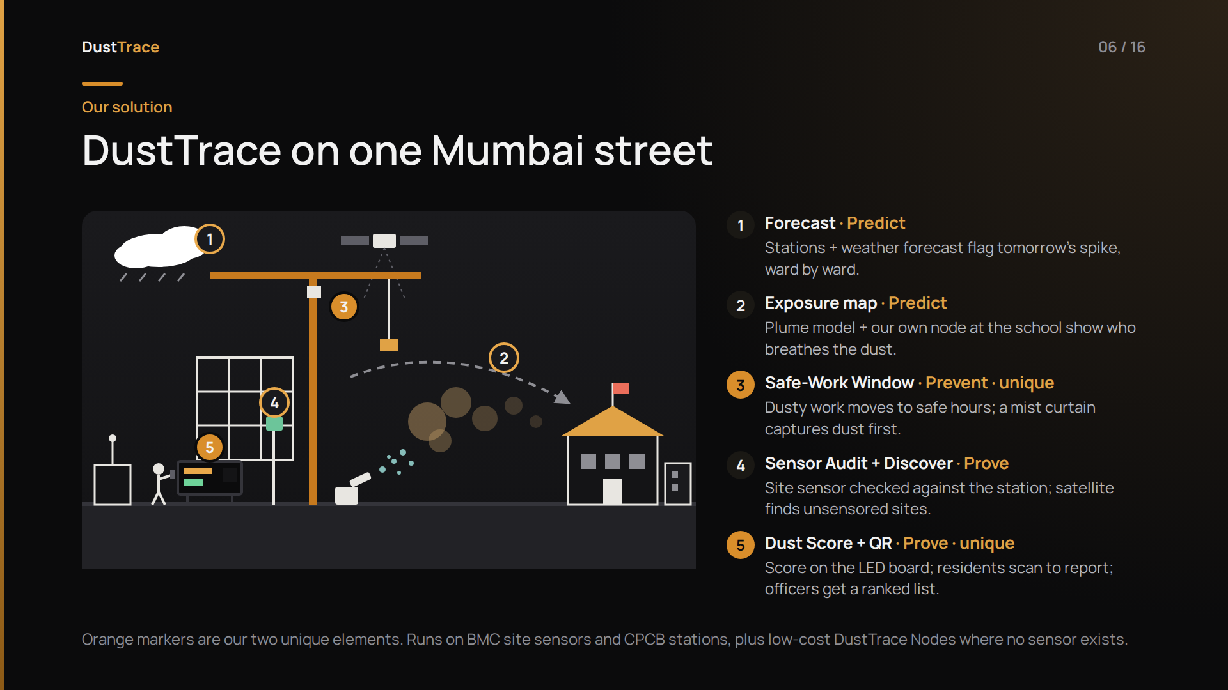
Notes:
[2:20 · 40 s]
Here's DustTrace on one Mumbai street.
One: the forecast, built from CPCB stations and weather, flags tomorrow's spike.
Two: our plume model follows the wind from the site and finds who's downwind, here a school, and our own sensor node at the school measures what the children actually breathe.
Three, our first unique element: the site gets its Safe-Work Window, so demolition moves to the afternoon and the mist cannon starts before the spike.
Four: the site's own sensor is checked against the station and its neighbours, and the satellite finds the site next door that has no sensor.
Five, our second unique element. Every site already has to show an LED board with its live dust readings. We add two things to it: a Dust Score out of 100 that tells passers-by how well this site controls its dust, and a QR code. A resident who sees dust scans it, snaps a photo, and the report goes straight to that site's record. Those reports and scores feed the officer's ranked inspection list for the next morning.
Most of this runs on hardware Mumbai already has: the board, the site sensor and the stations. Where there is no sensor at all, we add our own low-cost nodes, which is next.

Slide 7
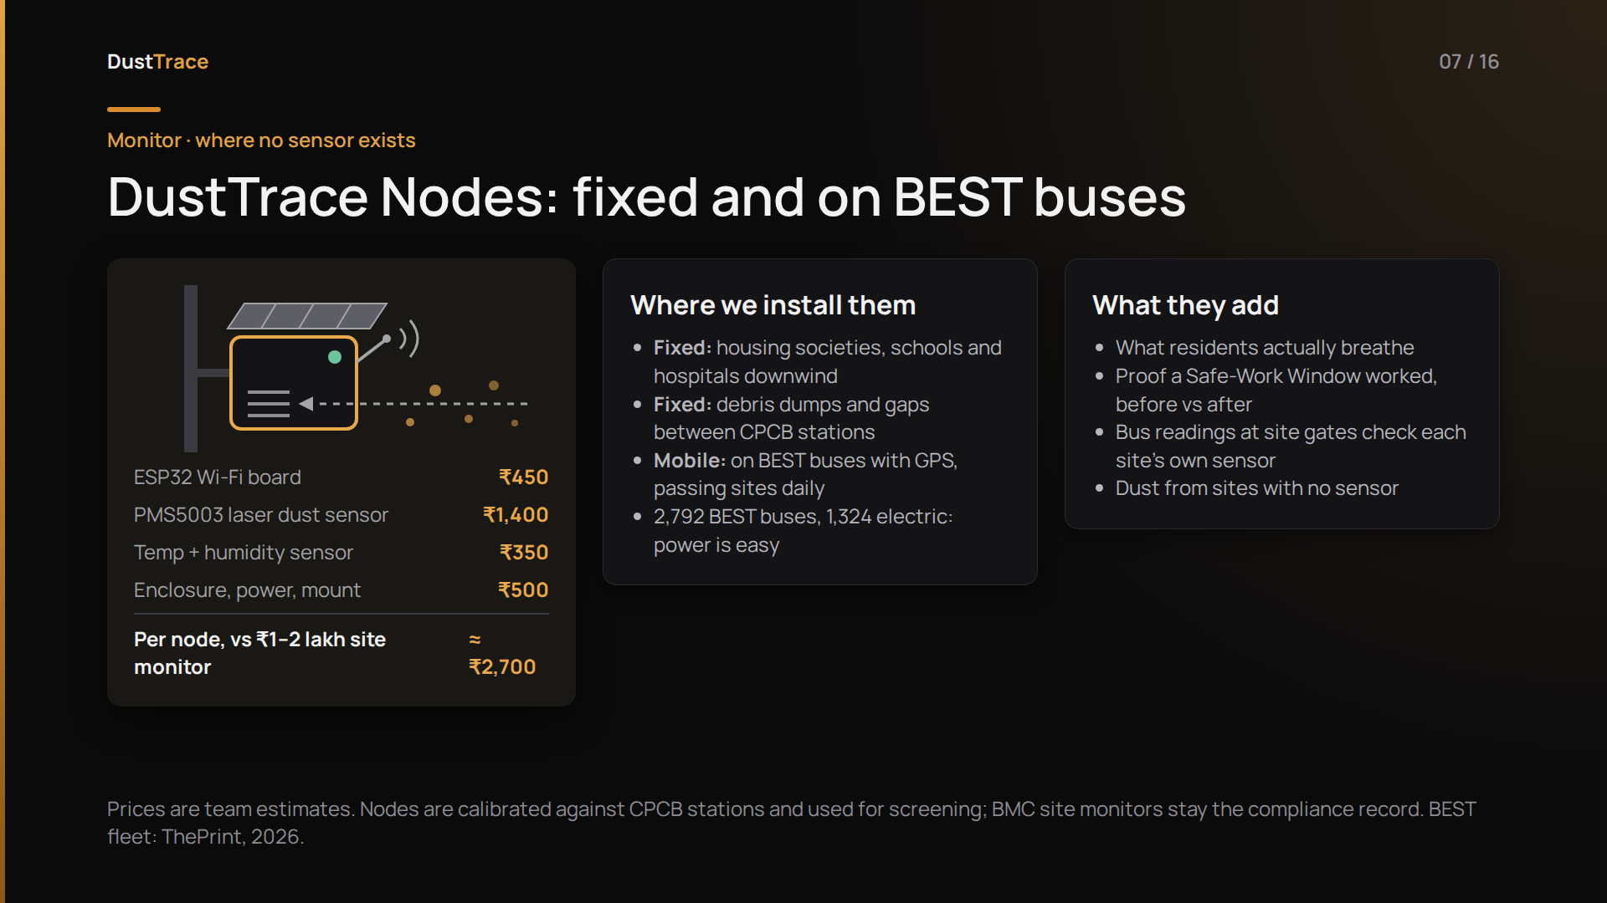
Notes:
[3:00 · 35 s]
Where Mumbai has no sensors, we add our own. A DustTrace Node is an ESP32 board, a laser dust sensor and a humidity sensor in a weatherproof box. It costs about 2,700 rupees, against one to two lakh for a site monitor.
Fixed nodes go where people live and breathe: housing societies next to sites, schools and hospitals downwind. And the same node, with GPS, rides on BEST buses. Mumbai runs 2,792 of them, 1,324 electric, and they pass construction sites every day, so we get readings at sites with no sensor, and a check on sites whose own sensor says everything is fine.
They measure real exposure. They prove whether a Safe-Work Window actually cut the dust at the school. And they give every developer's sensor an independent neighbour to be checked against. We calibrate them against CPCB stations, and the official site monitors stay the compliance record.

Slide 8
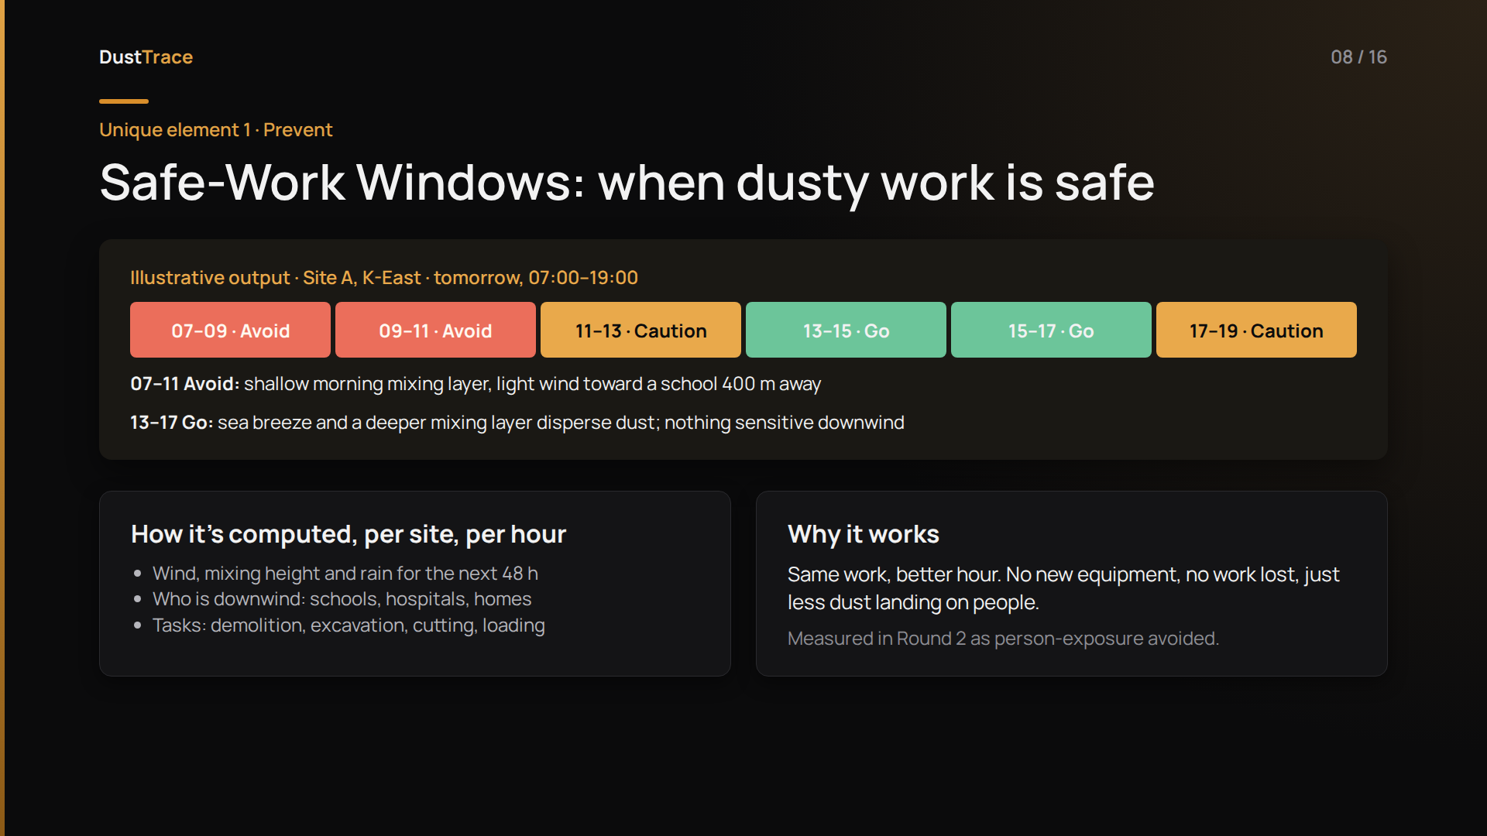
Notes:
[3:35 · 35 s]
Our first unique element: Safe-Work Windows.
The same demolition does very different harm depending on when it happens. On a winter morning, the air near the ground is shallow and still, and if the wind is blowing toward a school, that dust lands on children. By afternoon, the sea breeze and a deeper mixing layer spread it out.
So for every site, for every hour of the next two days, we combine the wind forecast, mixing height, rain and who is downwind, and output Go, Caution or Avoid for the dustiest tasks.
The site does the same work, just at a better hour. No new equipment, no work lost. This example is illustrative. In Round 2 we compute it on real wind data for about forty sites and measure how much exposure it avoids.
BACKUP: Inputs are Open-Meteo forecasts (wind, boundary-layer height, rain) and OpenStreetMap schools and hospitals plus ward population. Dispersion uses a simple Gaussian plume approximation.

Slide 9
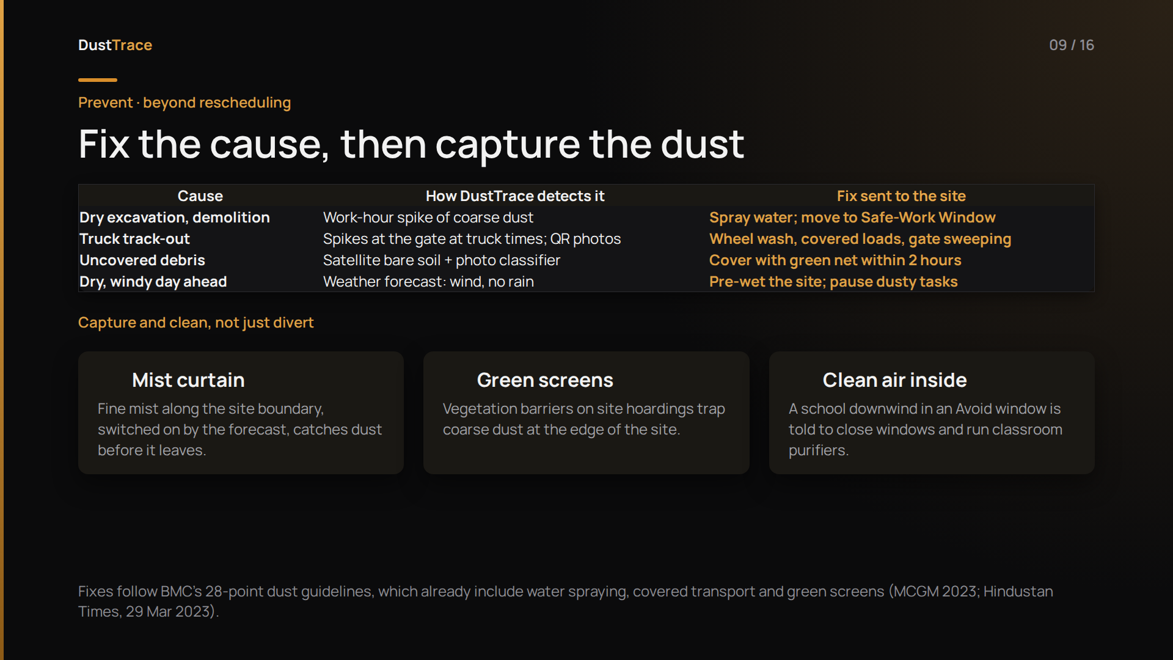
Notes:
[4:10 · 40 s]
Rescheduling is only one lever. DustTrace also finds the cause and sends the fix. A work-hour spike of coarse dust, where PM10 jumps far more than PM2.5, points to dry excavation, so the site is told to spray water or shift to its safe window. Spikes at the gate at truck times point to track-out: wheel wash and covered loads. Satellite and photos catch uncovered debris. And a dry, windy forecast means pre-wet the site.
We also don't just divert dust; we capture and clean it. A mist curtain along the boundary switches on from the forecast, green screens on the hoardings trap coarse dust, and when a school is downwind, it's alerted to close windows and run classroom purifiers.

Slide 10
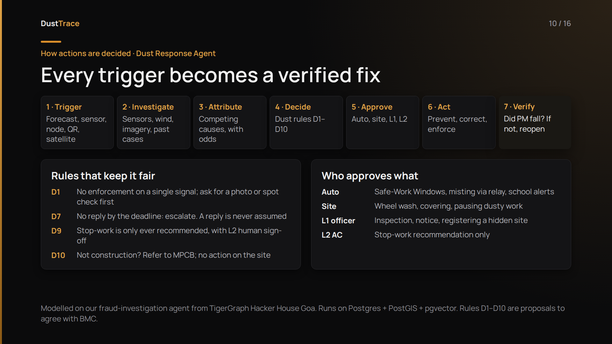
Notes:
[4:50 · 35 s]
So who decides what happens? Our Dust Response Agent. It's built the same way as the fraud-investigation agent one of us built for TigerGraph's Hacker House in Goa.
Every trigger, whether a forecast, a sensor spike, a node reading, a QR report or a satellite find, becomes a case. The agent gathers evidence, weighs competing causes, and picks actions under written dust rules, each with an approval route: automatic, site manager, ward officer or Assistant Commissioner.
Two rules matter most for fairness: no enforcement on a single signal, and stop-work is only ever a recommendation a human signs. And the last step is new: it checks whether the dust actually fell. If not, the case stays open.

Slide 11
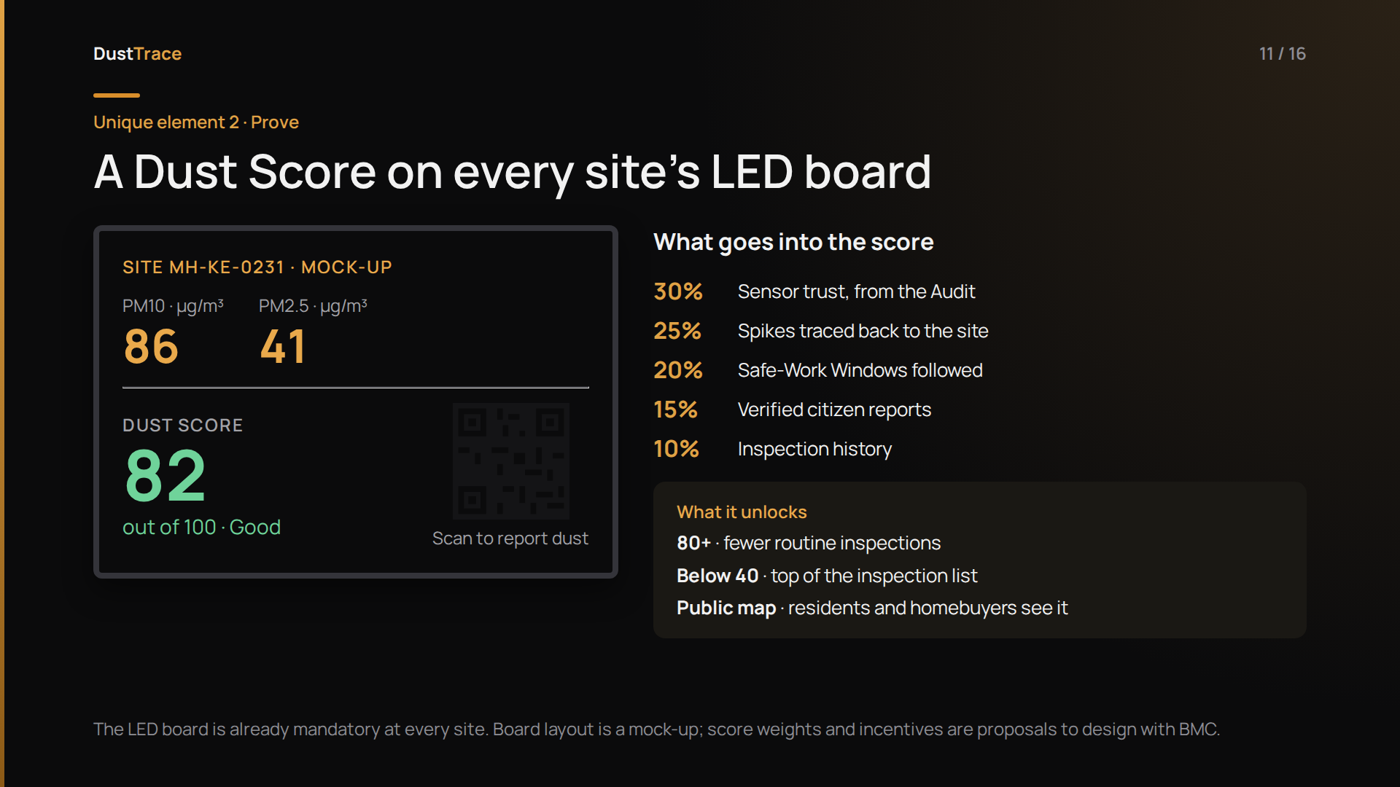
Notes:
[5:25 · 30 s]
Our second unique element uses something every site already has: the LED board the High Court made compulsory.
Next to the PM readings, we show a Dust Score out of 100. It combines how trustworthy the site's sensor is, how often spikes trace back to it, whether it followed its Safe-Work Windows, verified citizen reports, and inspection history.
There's a QR code on the board. A resident scans it and reports dust in thirty seconds, already tagged to that exact site.
And the score has consequences. We propose that high scorers earn fewer routine inspections and low scorers go to the top of the list. That rewards compliance instead of only punishing violations. The weights and incentives are proposals to design with BMC.

Slide 12
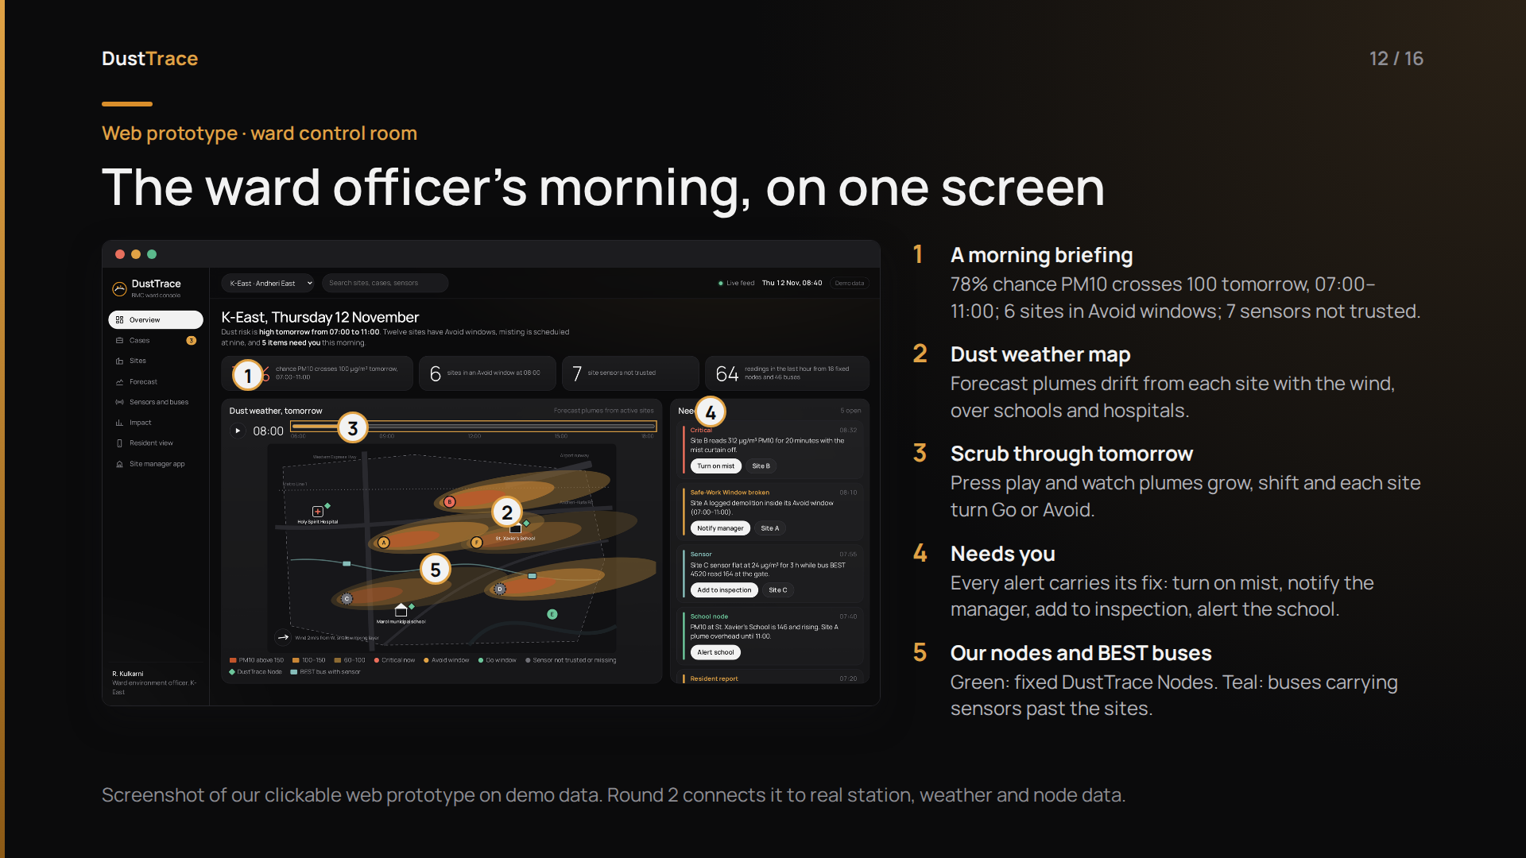
Notes:
[5:55 · 35 s]
This is our working web prototype, not a mock-up. It's what a BMC ward officer in K-East opens at 8:40 in the morning.
One: a briefing in plain words. A 78 percent chance PM10 crosses 100 tomorrow morning, six sites in Avoid windows, seven sensors we don't trust.
Two: the dust weather map. Each orange shape is a forecast plume from a construction site, drifting with the wind over the school and the hospital.
Three: press play and you watch tomorrow happen, hour by hour, as plumes grow and sites switch between Go and Avoid.
Four: the Needs you queue. Every alert comes with the fix as a button: turn on the mist at Site B, tell Site A's manager they're demolishing in the wrong window, send a flat sensor to inspection, warn the school.
Five: green diamonds are our own nodes, and the teal markers are BEST buses carrying sensors past the sites.

Slide 13
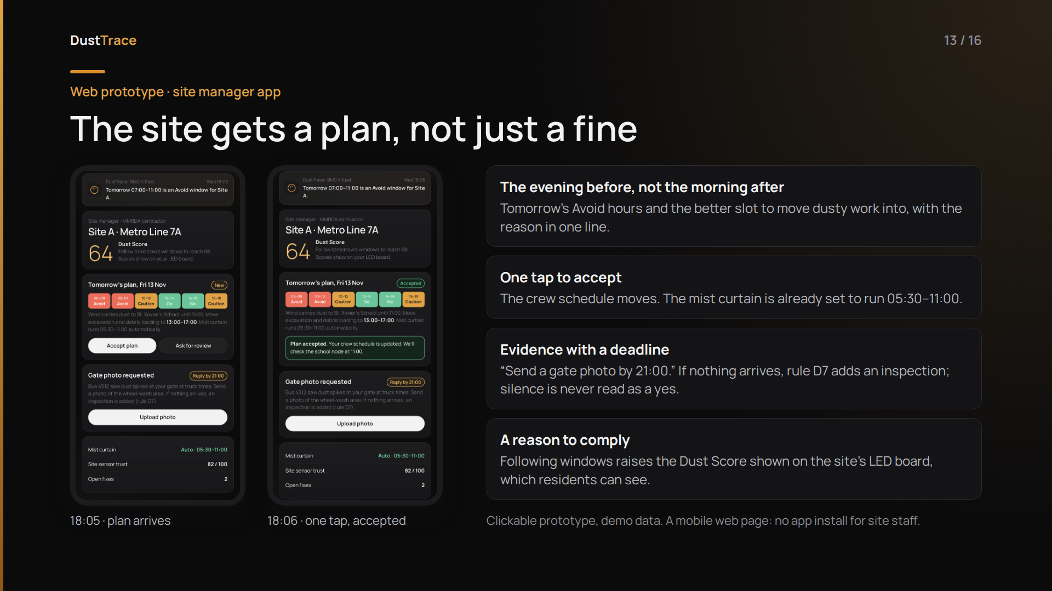
Notes:
[6:30 · 20 s]
And this is what the contractor sees. At six in the evening, a plan, not a penalty: tomorrow morning is an Avoid window, move excavation to the afternoon. One tap to accept. If we need evidence, like a gate photo, it comes with a deadline, and if nothing arrives, the agent adds an inspection. Following the plan raises their Dust Score, which their neighbours can see.

Slide 14
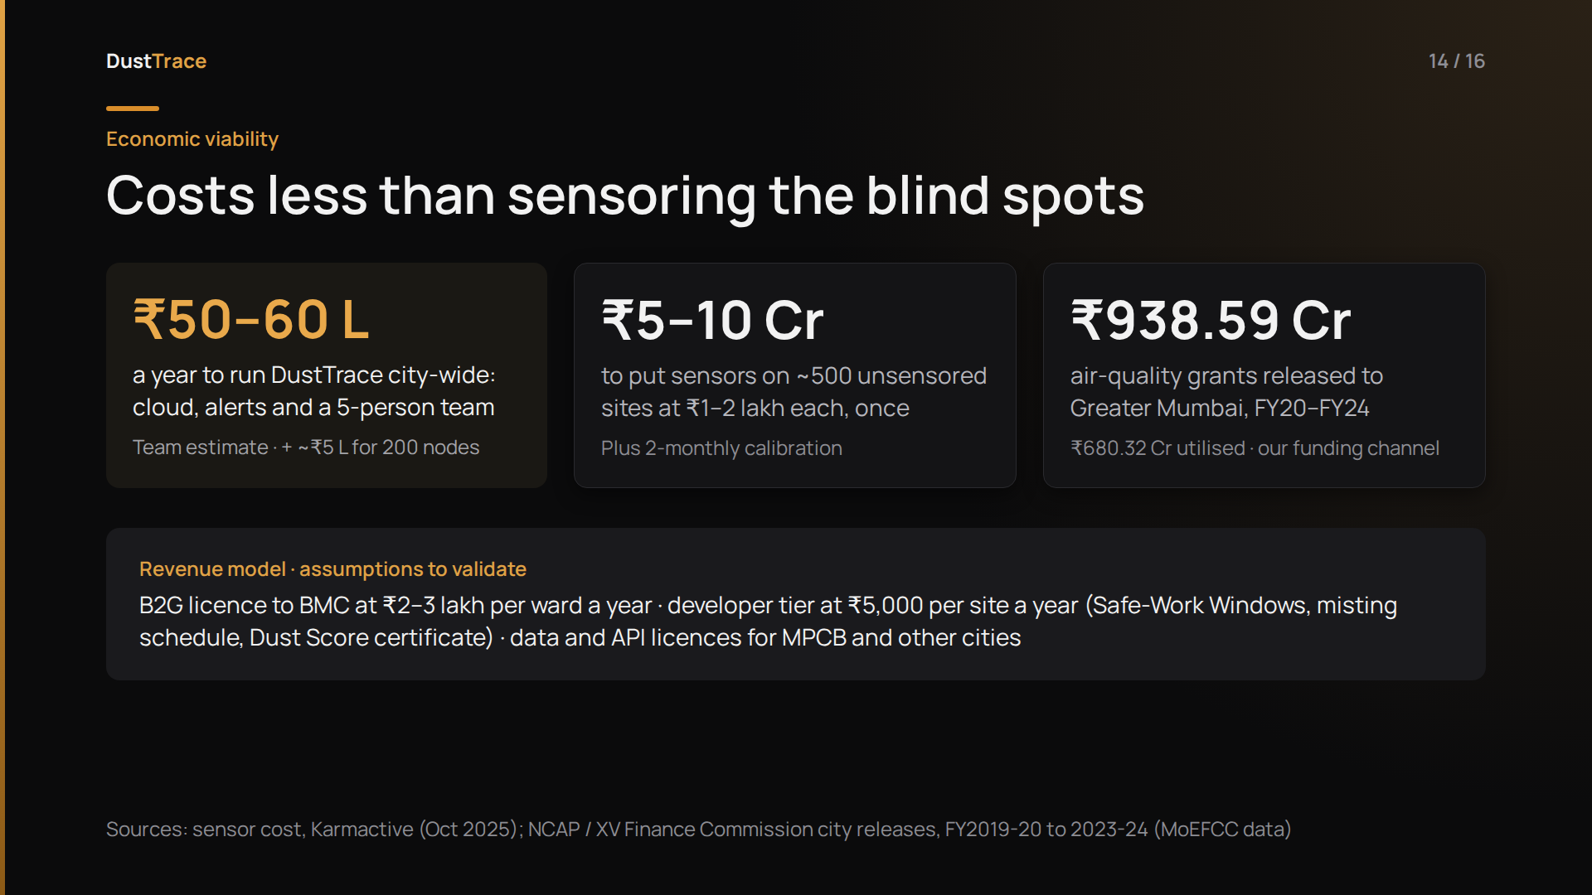
Notes:
[6:50 · 30 s]
Now the money. Developers are already paying one to two lakh rupees per sensor. Across twelve hundred sites, that's twelve to twenty-four crore of hardware the city isn't using well.
Running DustTrace city-wide costs an estimated fifty to sixty lakh a year, plus about five lakh once for two hundred of our own nodes. Compare that with five to ten crore just to put sensors on the five hundred unsensored sites, which still wouldn't audit or forecast anything.
And the funding already exists: Greater Mumbai has received over 938 crore in NCAP air-quality grants.
We'd sell per-ward licences to BMC and data access to MPCB. Developers pay for Safe-Work Windows and a verified Dust Score, because following a window costs nothing and a stop-work notice halts the whole site.
BACKUP: Developers are already paying ₹1–2 lakh per sensor, roughly ₹12–24 crore across ~1,200 sites if all comply. That hardware is under-used. Our running cost is an estimated ₹50–60 lakh a year city-wide, with no capex, versus ₹5–10 crore just to put sensors on the ~500 unsensored sites, which still wouldn't audit or forecast anything. Funding exists: Greater Mumbai received ₹938.59 crore in NCAP / Finance Commission air-quality grants through FY24. Revenue: a per-ward licence to BMC, a paid early-warning tier for developers, and data licences. All prices are our assumptions to validate.

Slide 15
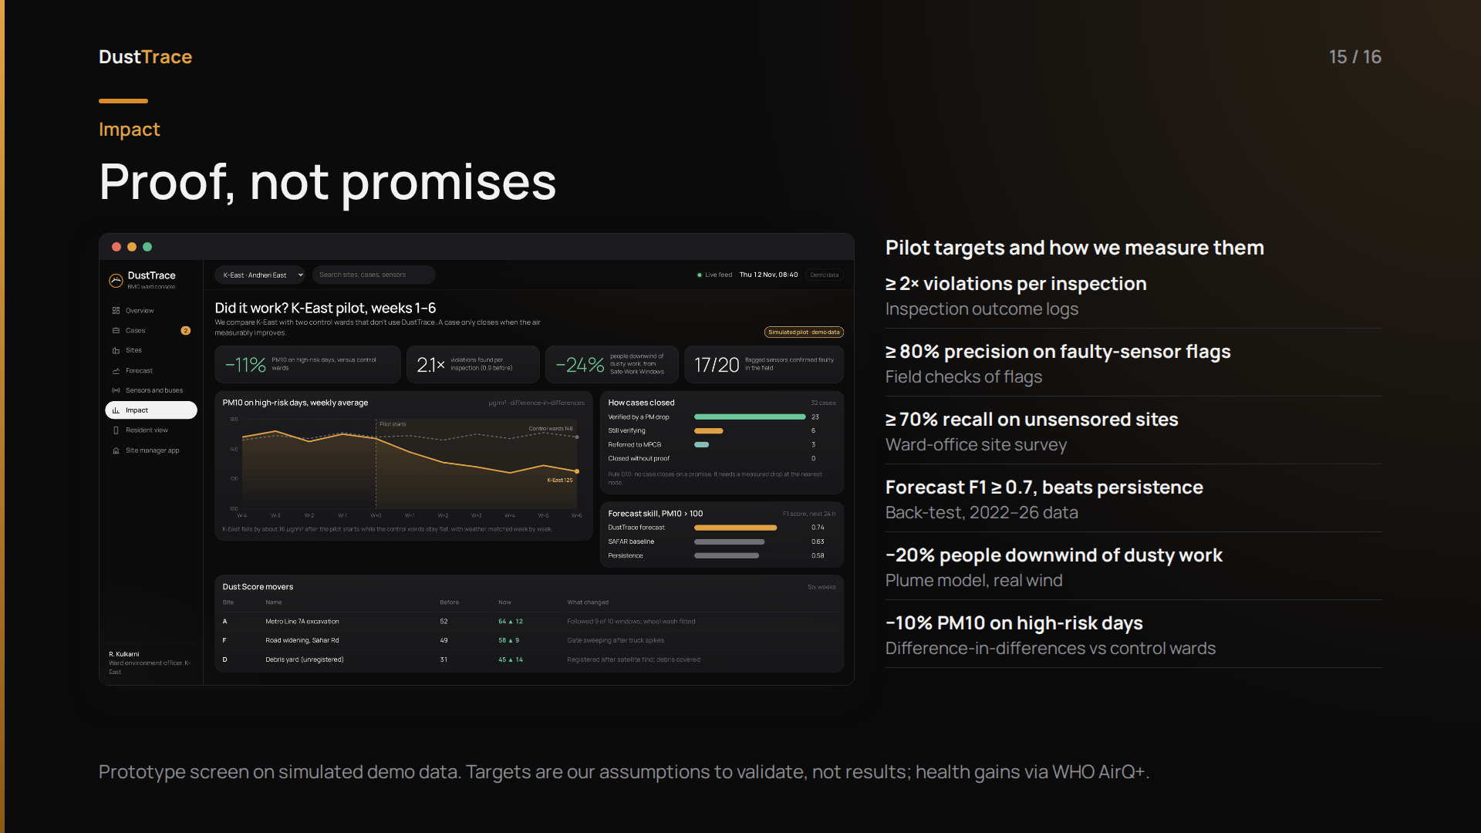
Notes:
[7:20 · 25 s]
We don't want to claim impact; we want to measure it, and the product is built to do that. This screen shows the pilot view on simulated data: K-East against two control wards, and every case closes only on a measured drop. These are our pilot targets: at least double the violations found per inspection, 80 percent precision on flagged sensors, 70 percent recall on unsensored sites, a forecast that beats persistence, twenty percent fewer people downwind during dusty work, and a 10 percent PM10 drop on high-risk days compared with control wards.
We'll measure it with a proper difference-in-differences design over one winter. The people who benefit first are residents next to sites, and the construction workers who breathe this dust all day.

Slide 16
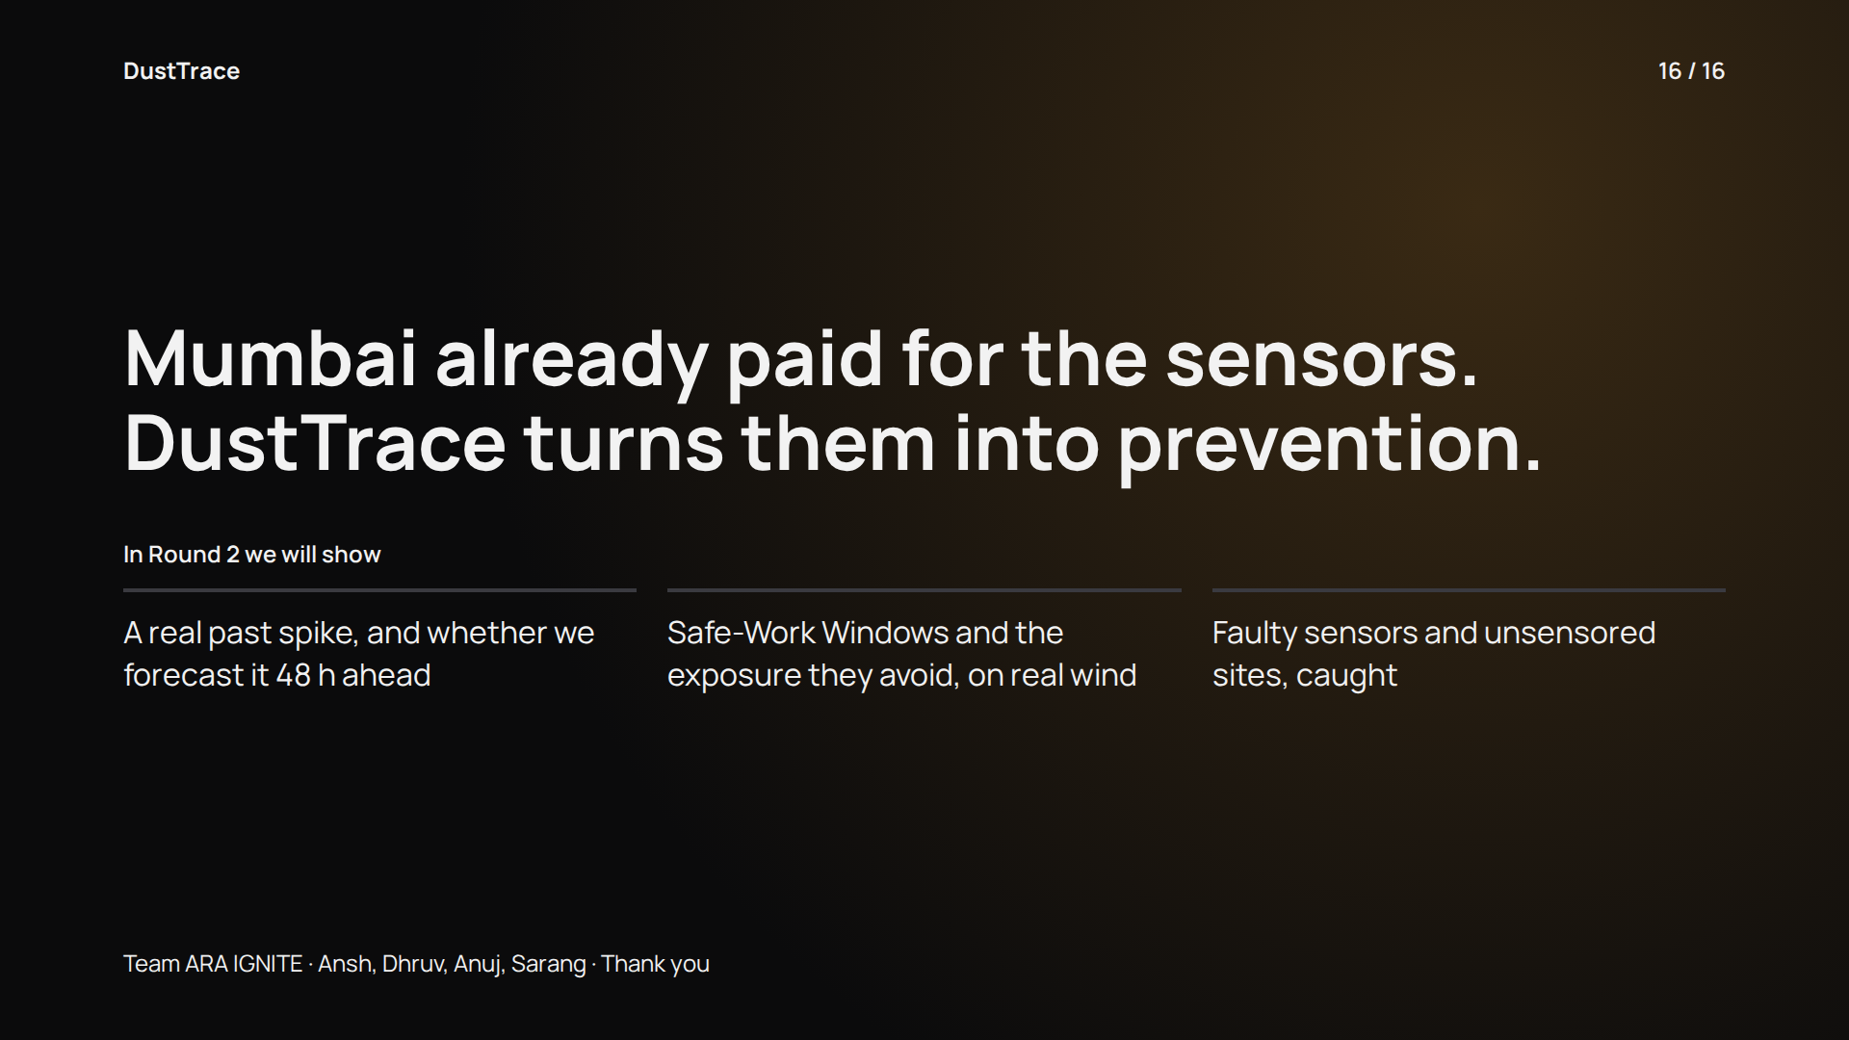
Notes:
[7:45 · 25 s, then Q&A]
So here's where we land. Mumbai already paid for the sensors. DustTrace turns them into prevention.
In Round 2 we'll show you three things: a real past spike and whether we forecast it 48 hours ahead; Safe-Work Windows and how much exposure they avoid, on real wind data; and faulty sensors and hidden sites, caught.
Thank you. We'd love your questions.
Q&A PREP:
Why only dust, when the theme is AQI? The brief asks for a specific pollution source, so we went deep on Mumbai's biggest one. It's also the only source with a court-mandated sensor network, and the only one where the timing of emissions can be moved. The engines extend to any source that stays in one place: RMC plants, bakeries, waste burning, road dust (appendix A6).
Why would developers follow Safe-Work Windows? Following one costs nothing; it raises their Dust Score and lowers their chance of a stop-work notice. BMC could also make it a condition of approval.
Can you really switch on sprinklers? Some BMC-approved monitors, such as Oizom AQBot, already have relay outputs for sprinklers and mist cannons. Sites without relays get the alert on WhatsApp instead.
Where's the IoT? The BMC site-sensor network and CAAQMS stations (appendix slide A1; architecture A3, models A4); plus our own DustTrace Nodes at schools, housing societies and unsensored areas (slide 7).
Why not smog towers, or filters on buses? The evidence says they barely move city air. Delhi's pollution committee told the NGT its smog towers were ineffective: IIT Bombay measured about 50% cleaner air within 20 m but only 12 to 13% at 100 to 200 m, at Rs 25 crore to build and Rs 15 lakh a month to run each tower. A roof filter on a UK bus removed 65 g of particulates in 100 days; even 2,500 such buses would remove about 588 kg of PM10 a year, against Mumbai's roughly 87,000 tonnes. So we put sensors on buses, not filters, and capture dust at the source with mist curtains.
Isn't this just diverting dust? No. We fix the cause at the site, capture dust with forecast-triggered mist curtains and green screens, and protect people indoors at downwind schools (slide 9).
How do you get BMC data? It's simulated for now; we've requested an RTI and vendor samples, and there's an MoU path. The product still works on public data without it (appendix A2).
How is this different from BMC's dashboard? See appendix A5: their dashboard shows readings; we add prevention, trust checks, discovery and ranking.
Is construction really the main source? BMC's plan ranks it first. Estimates vary by study: SAFAR puts it at about 8% city-wide, and NEERI found construction plus natural dust at 27% at Dharavi. Near active sites it dominates, and that's where we act.

Slide 17
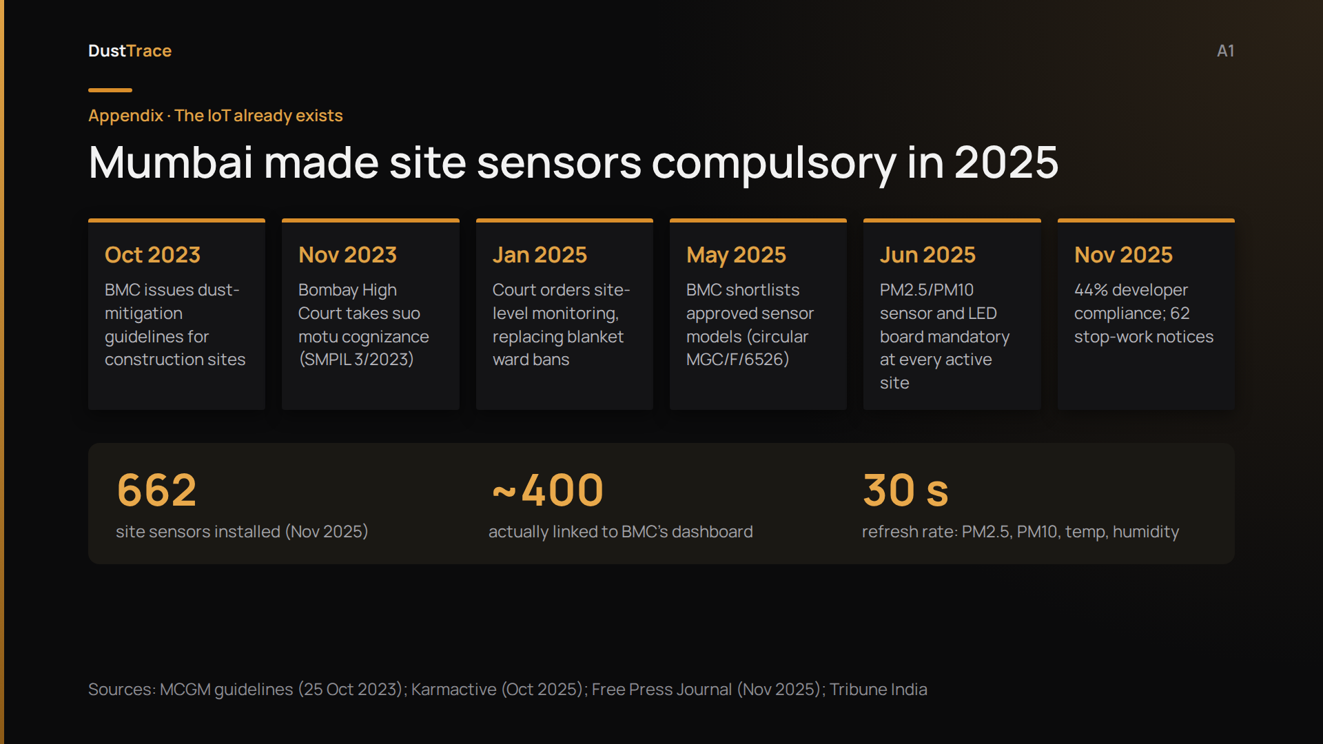
Notes:
[Backup · show if asked "where's the IoT?"]
Here's what most people don't know: Mumbai already has an IoT network for this problem.
In 2023, BMC issued dust guidelines and the High Court stepped in. In January 2025, the court ordered site-level monitoring instead of blanket ward bans.
Since June 2025, every active site must install a BMC-approved PM2.5 and PM10 sensor, with an LED board at the gate, reporting every 30 seconds to BMC's Command and Control Centre.
By November, 662 were installed. But only about 400 actually reached the dashboard.
So when someone asks "where's the IoT?", this is it. The hardware exists. The intelligence on top of it doesn't.

Slide 18
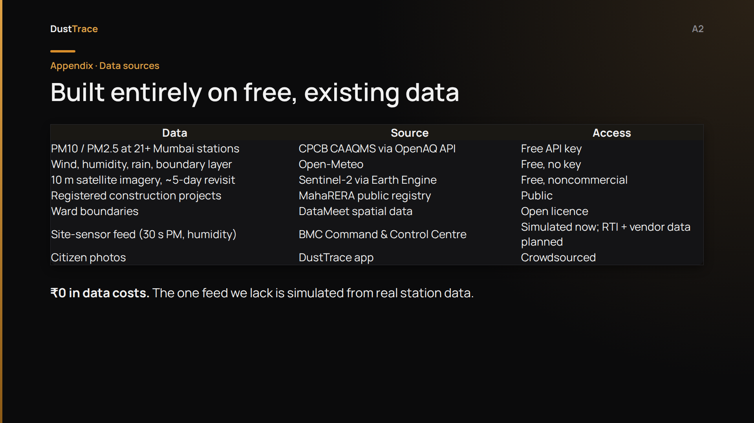
Notes:
[Backup · show if asked about data access]
Is this feasible? Every input is free and public. OpenAQ gives us history for 21-plus CPCB stations in Mumbai. Open-Meteo gives wind and weather. Sentinel-2 gives 10-metre imagery every five days. MahaRERA lists every registered project.
The one feed we can't access yet is BMC's site-sensor data, so we simulate it from real station data, and we're pursuing an RTI and vendor samples to validate it.
Total data cost: zero.

Slide 19
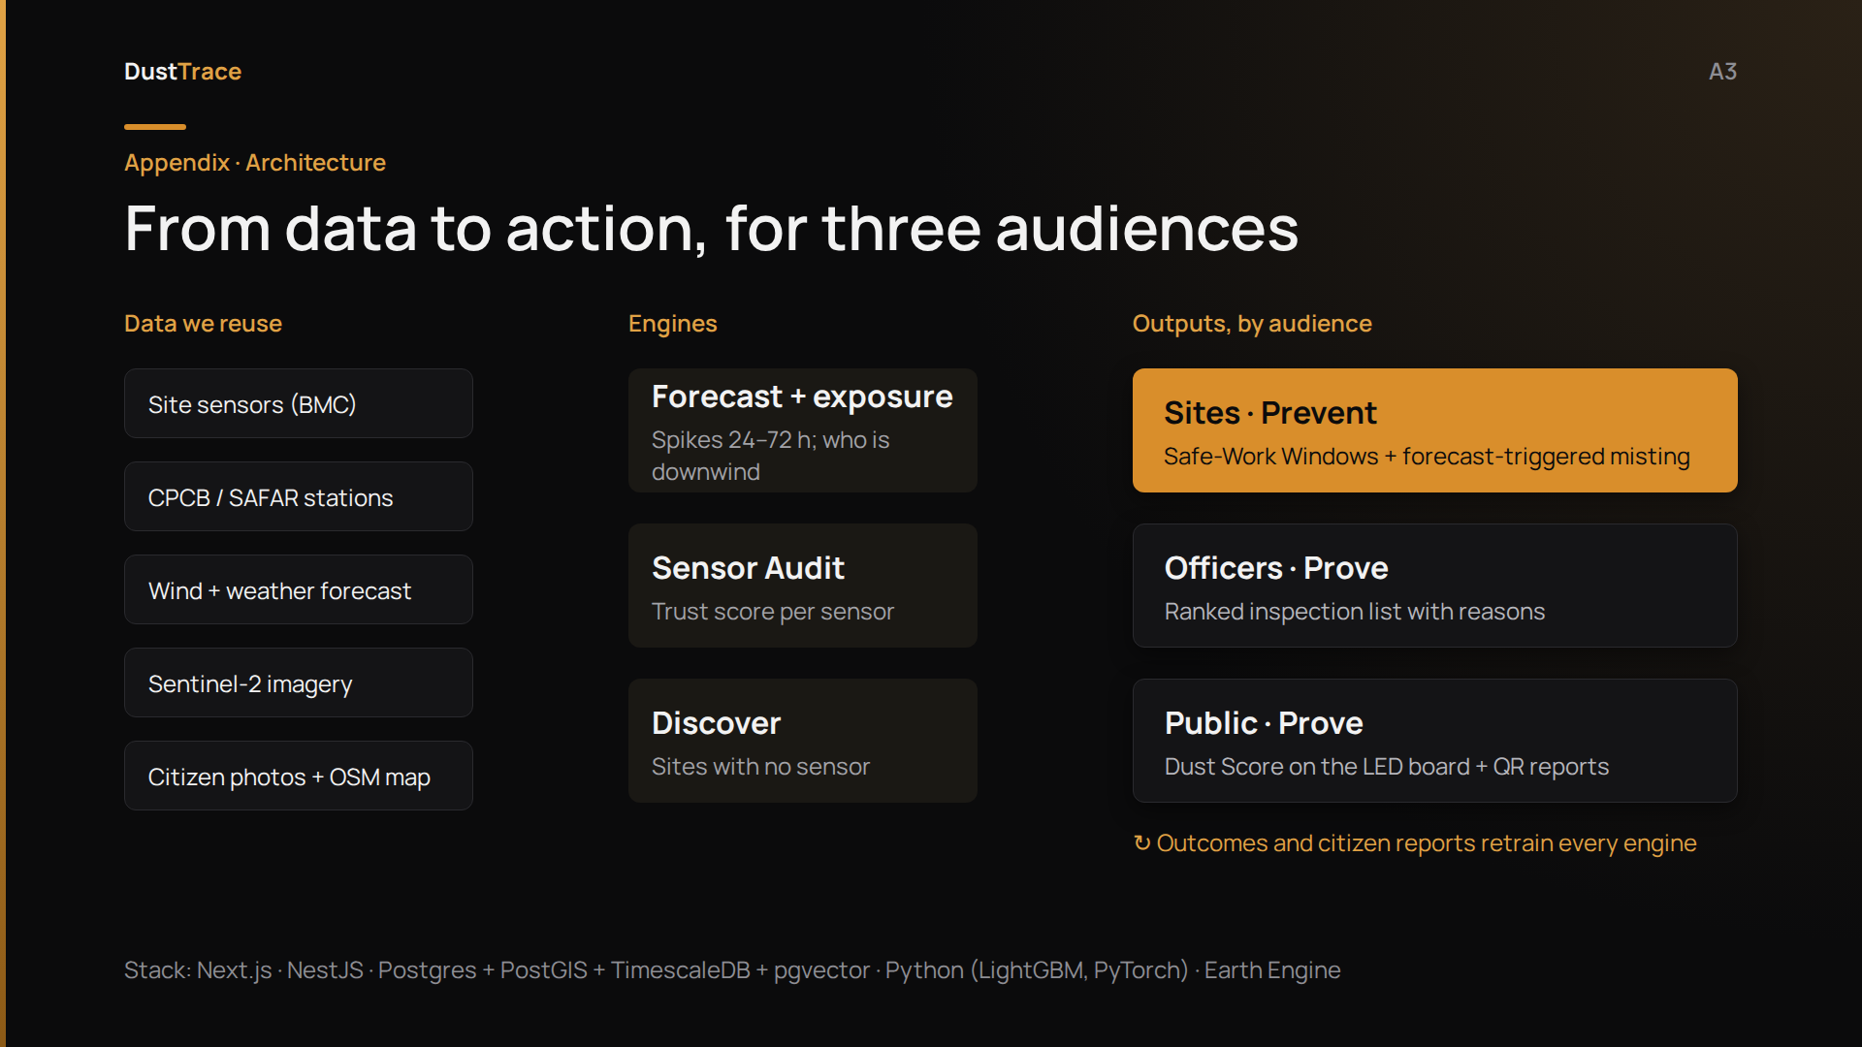
Notes:
[Backup · show if asked about architecture or tech stack]
Under the hood: five inputs that already exist, three engines, and three outputs, one for each audience. Sites get Safe-Work Windows and misting triggers. Officers get the ranked list. The public gets the Dust Score and the QR code. Inspection outcomes and citizen reports flow back and retrain the models.

Slide 20
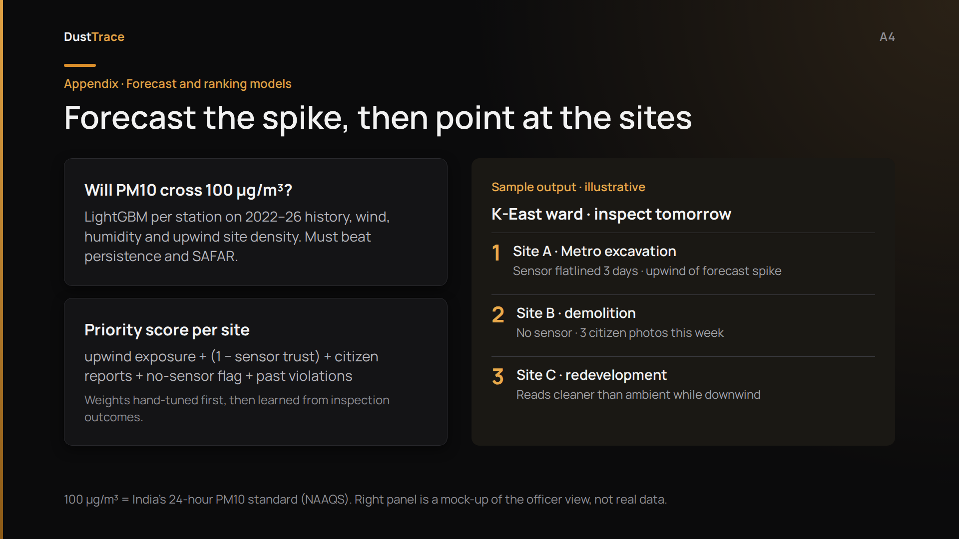
Notes:
[Backup · show if asked about the models]
Forecast asks one question: will PM10 cross the national 24-hour standard of 100 micrograms in the next 24, 48 or 72 hours?
We train a gradient-boosted model per station on four years of real data, and it has to beat two baselines: "tomorrow looks like today", and SAFAR's own forecast.
Prioritise then scores every upwind site. On the right is what an officer would see: three sites, each with its reasons. This panel is a mock-up; the real one is what we build for Round 2.

Slide 21
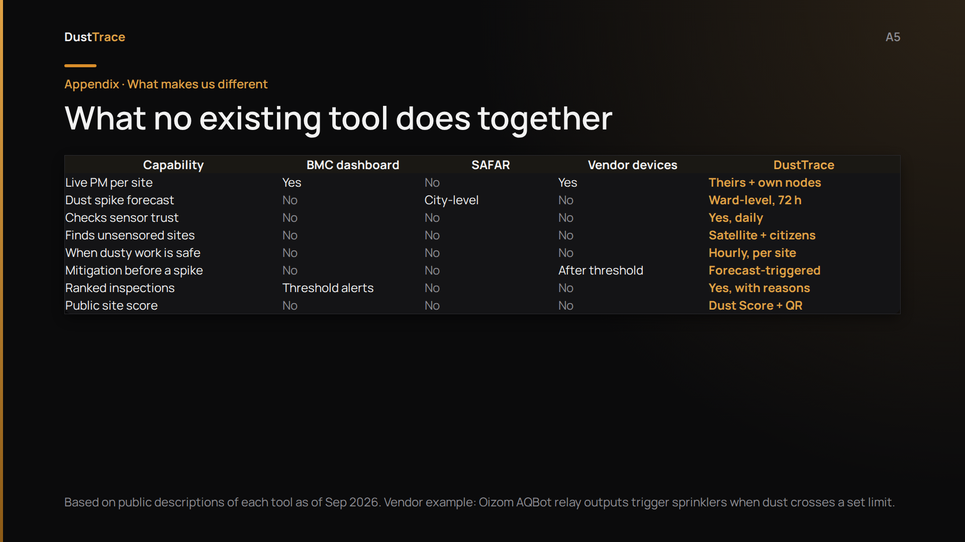
Notes:
[Backup · if asked how we differ]
How is this different from what exists? BMC's dashboard shows live site readings and threshold alerts. SAFAR forecasts air quality at city level. Vendor devices can switch on sprinklers, but only after a threshold is crossed.
None of them checks whether a sensor can be trusted, finds sites with no sensor, or tells a site when dusty work is safe. DustTrace does all of that on top of their data, not instead of it.

Slide 22
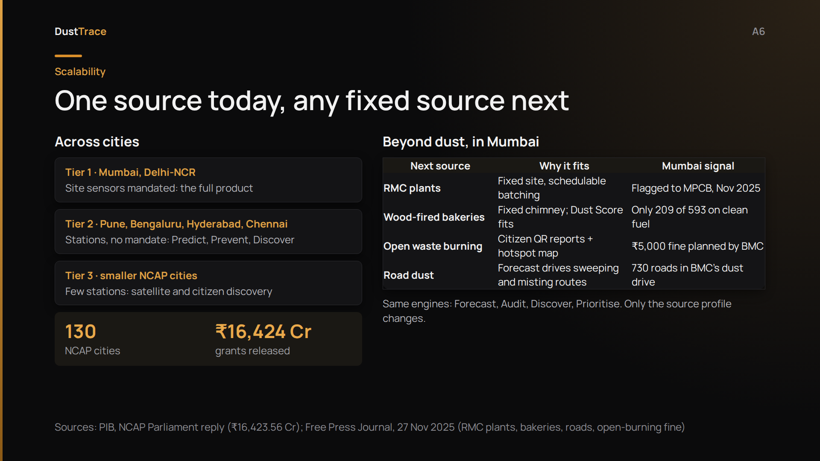
Notes:
[Backup · show if asked how this scales beyond Mumbai or beyond dust]
It scales in two directions. Across cities: Mumbai and Delhi already mandate site sensors, so they get the full product. Cities with stations but no mandate still get Predict, Prevent and Discover. NCAP covers 130 cities and has released over sixteen thousand crore, so every city already has a funded buyer.
And beyond dust: the engines work for any source that stays in one place. In Mumbai, the next ones are RMC plants, wood-fired bakeries (only 209 of 593 were on clean fuel last November), open waste burning, and road dust. We went deep on one source because the brief asked us to, and we picked the biggest one.

Slide 23
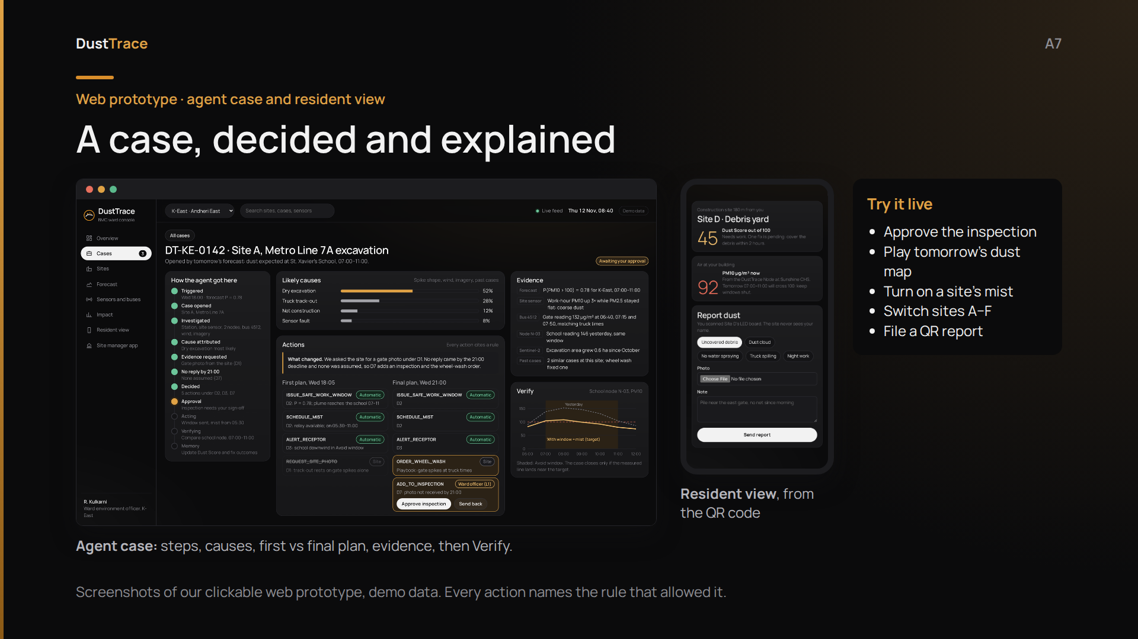
Notes:
[Backup · show if asked how the agent decides a case]
Here's the agent at work. Case 142: tomorrow's forecast says dust will reach St. Xavier's School from Site A. On the left, every step it took. In the middle, its likely causes: dry excavation first. Then the plan. Its first plan asked the site for a gate photo; no reply came by nine, and it never assumes one, so the final plan adds an inspection. That needs a ward officer's approval, and every action shows the rule behind it.
On the right, what a resident sees after scanning the QR code: the site's Dust Score, the air at their building from our node, and a thirty-second report.

