Slide 1
Smart Lighting System
Made By-
Ansh Trehan(11716522)
Ranveer singh(11716367)
Abhishek Choudhary(11715838)

Slide 2
Introduction
Smart lighting is a lighting technology designed for energy efficiency. This may include high efficiency fixtures and automated controls that make adjustments based on conditions such as occupancy or daylight availability.
No need to spend energy lighting the room if-
It’s already bright enough from natural light,
There’s nobody in the room
Idea is to detect these things, and turn off lights when not needed.

Slide 3


Components Required
Arduino Uno
PIR Sensor
LDR Sensor
LCD Display
ESP8266
Breadboard
Relay
LED Bulb
Resistors
Potentiometer

Slide 4
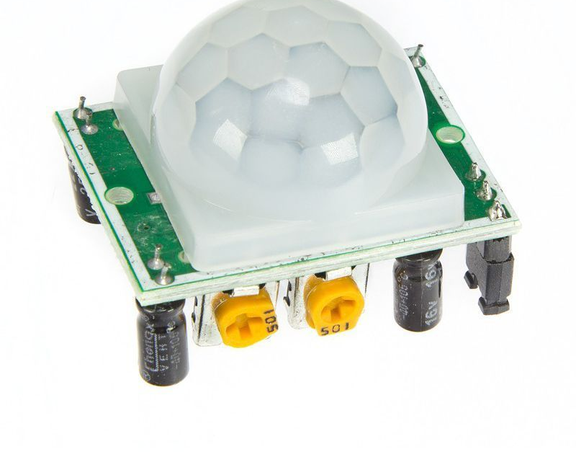
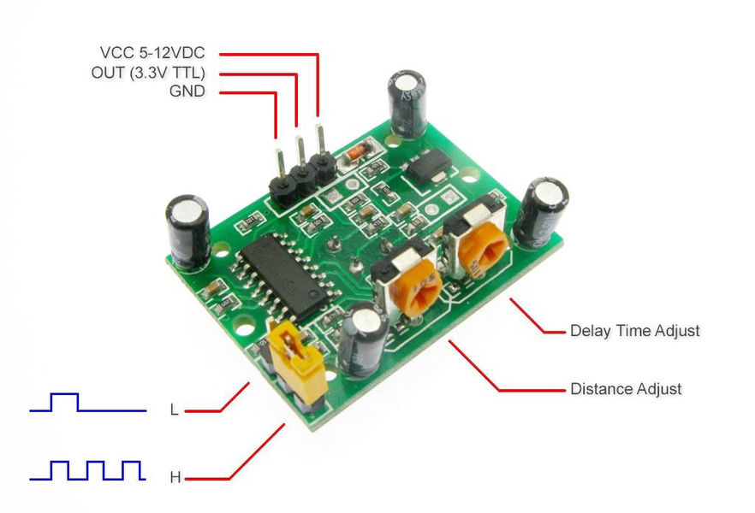



Passive Infrared (PIR) Sensor HC-SR501

Slide 5
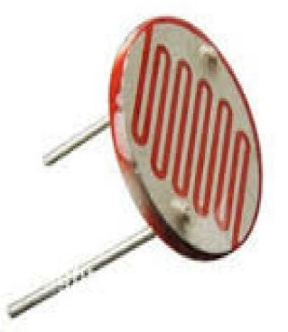
Photoresistor or Light Dependent Resistor (LDR)

Slide 6
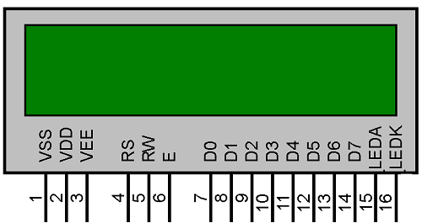
LCD Display 16X02

Slide 7
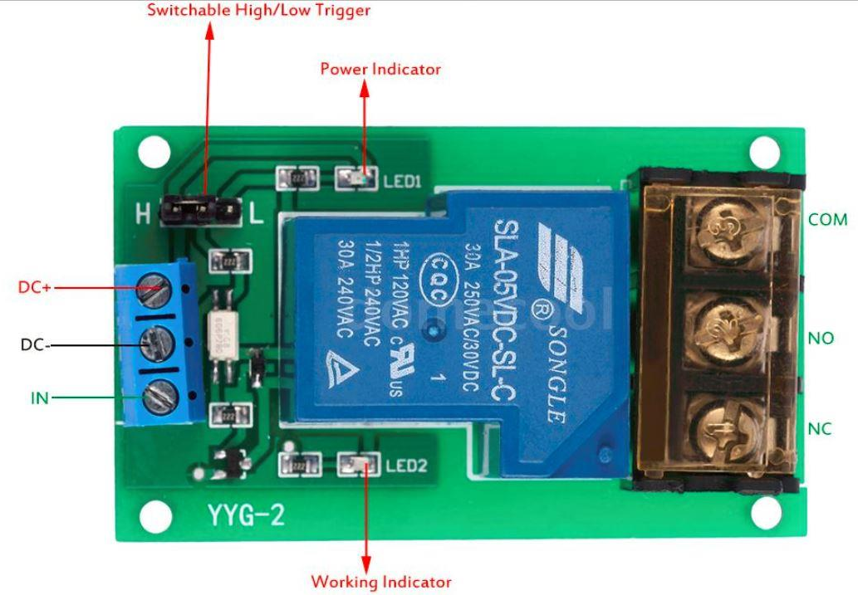
RELAY

Slide 8
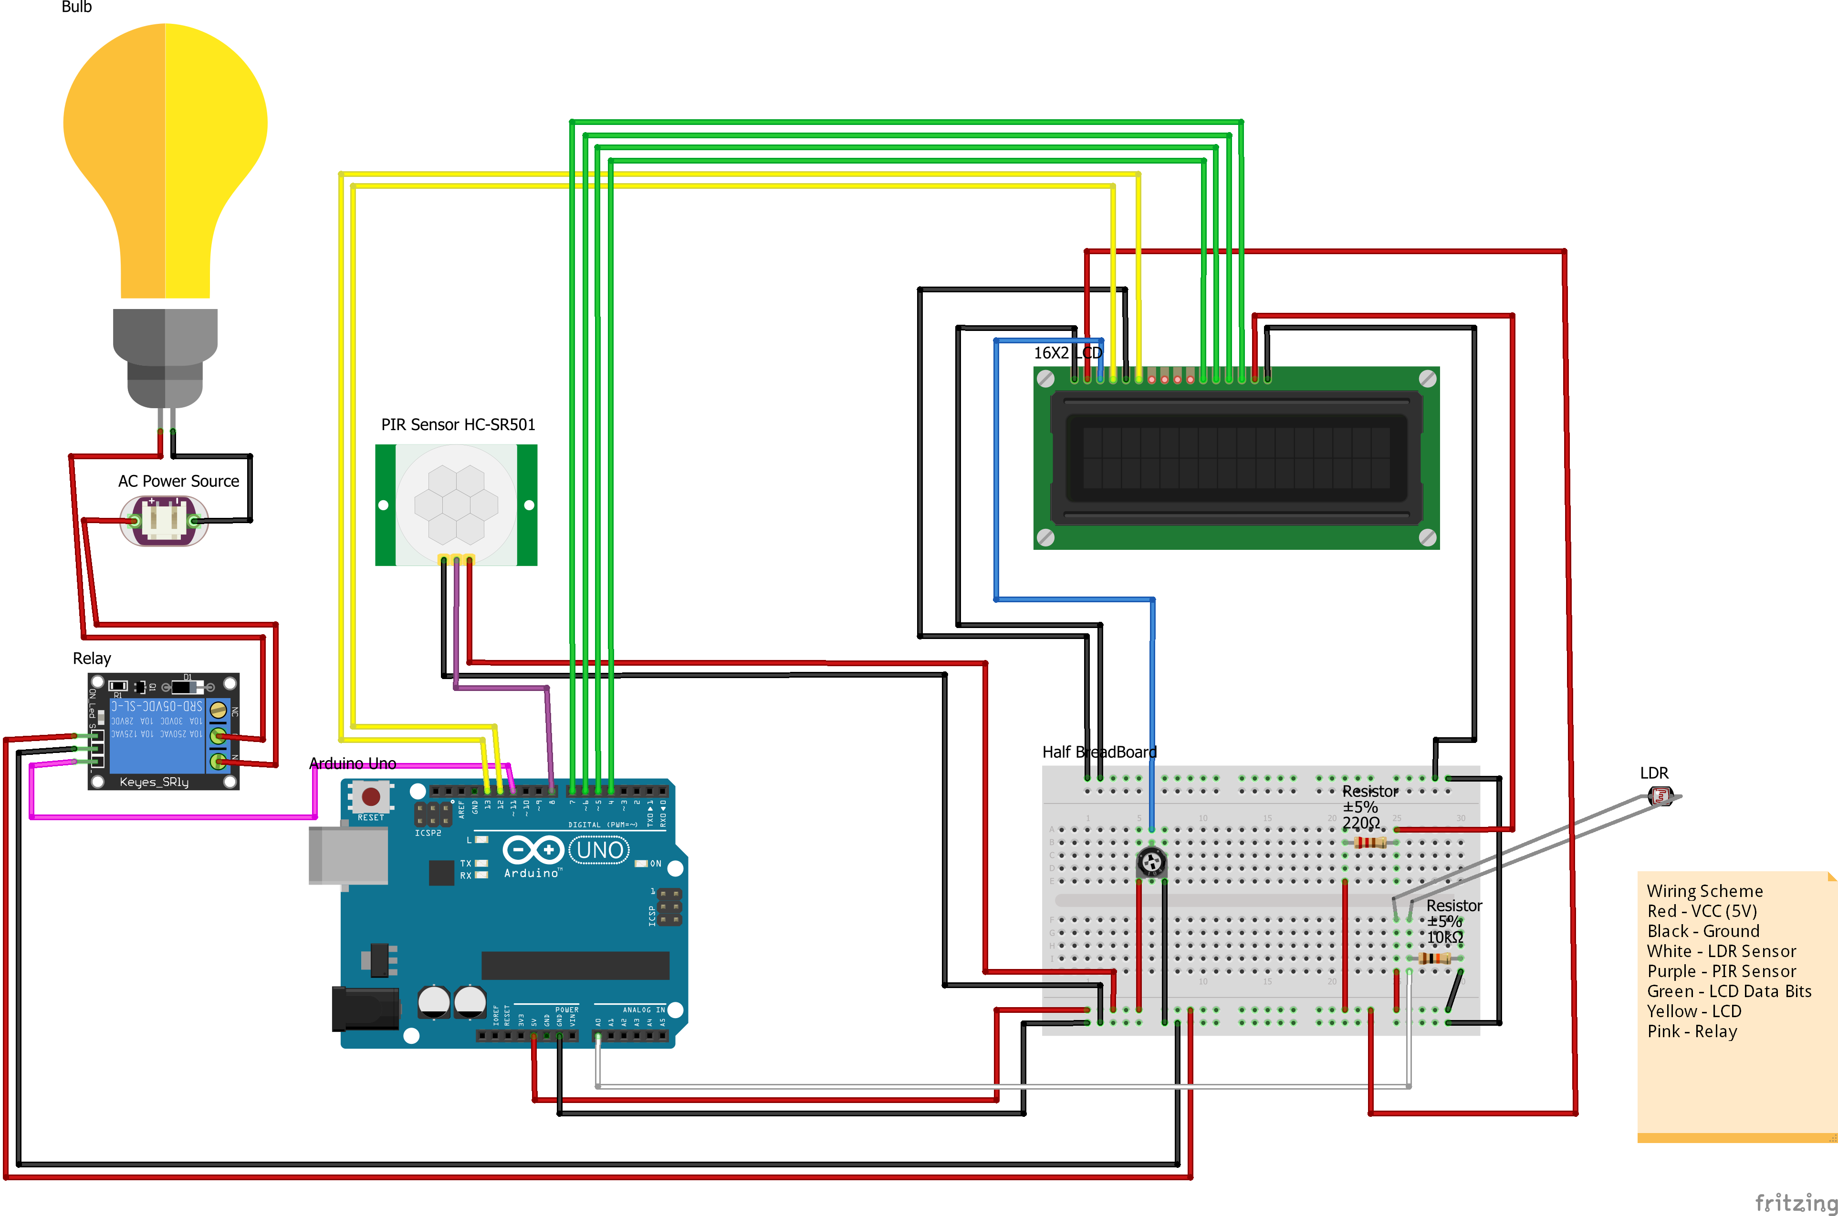

Slide 9
Logic and Working
In case , high voltage is encountered for PIR(passive infrared sensor) and a low voltage for LDR(light dependent resistor) the led will glow up.
Other then this there will be an mobile application with use of ESP8266 and BLYNK for providing the input, its input can override the values and states of LDR.

Slide 10
Truth Table
INPUT |  |  | OUTPUT
APP | LDR | PIR | LED
LOW | LOW | LOW | LOW
LOW | LOW | HIGH | LOW
LOW | HIGH | LOW | LOW
LOW | HIGH | HIGH | LOW
HIGH | LOW | LOW | LOW
HIGH | LOW | HIGH | HIGH
HIGH | HIGH | LOW | LOW
HIGH | HIGH | HIGH | HIGH

Slide 11
Applications
Long Term Energy Savings
Smart Homes
Enhanced Security
Health
Location Services

Slide 12
Conclusion
Switching the lights on or off remotely
Scheduling the home lighting
Motion detectors
Light as notification
Energy savings

