Slide 1
Internship Report
GenAI Powered Data Analytics
Virtual Internship
Tata Group Job Simulation via Forage | June 2026 – September 2026
Name: Anant Bharti
Roll Number: 2410030173
Batch: 2024-2028
B.Tech (Computer Science and Engineering)
School of Computer Science and Engineering, IILM University, Greater Noida, U.P.

Slide 2
Introduction & Organization Profile
Introduction
Organization Profile
Virtual job simulation completed on the Forage platform with the Tata Group
Domain: data analytics powered by Generative AI
Applied to a real-world business problem: predicting delinquency and shaping a collections strategy
Completed as part of the B.Tech (CSE) curriculum at IILM University
Forage: global virtual work-experience platform offering free, self-paced job simulations with leading companies
Tata Group: one of India's largest multinational conglomerates, investing heavily in data and AI-driven solutions
Certificate of Completion issued by Forage on September 20, 2026
Anant Bharti | 2410030173 | IILM University

Slide 3
Problem Statement & Objectives
Problem Statement
Project Objectives
Students learn analytics and machine learning in theory, but rarely see the full workflow on a business problem: exploring raw data, predicting which customers may miss payments, and turning results into a collections strategy that non-technical stakeholders can act on.
Perform exploratory data analysis and risk profiling
Use AI to predict customer delinquency
Interpret model outputs and link them to business drivers
Communicate findings through a business report and data storytelling
Design an AI-driven collections strategy
Anant Bharti | 2410030173 | IILM University

Slide 4
Scope of the Project & Tools Used
Scope
Technologies & Tools
End-to-end workflow: data exploration, risk profiling, prediction, reporting, strategy
Virtual, simulation-based learning environment
No deployment on any live client or production system
Language: Python
Analysis: Pandas, NumPy
Visualization: Matplotlib, Seaborn
Machine Learning: Scikit-learn
Generative AI assistants for analysis and strategy
Platform: Forage Virtual Work Experience
Anant Bharti | 2410030173 | IILM University

Slide 5
System Architecture
Data
Processing
Analysis
Modelling
Insight
Strategy
Client customer and account data
Clean, merge, transform
EDA and risk profiling
AI-based delinquency prediction
Interpret drivers of risk
Report and collections plan
Each layer feeds the next, moving from raw data to a business-ready collections strategy.
Anant Bharti | 2410030173 | IILM University

Slide 6
Methodology: Task-wise Approach
Task | Module | Description
1 | Exploratory Data Analysis & Risk Profiling | Explored client data to find patterns and profile customer risk
2 | Predicting Delinquency with AI | Used AI-driven modelling to estimate which customers are likely to become delinquent
3 | Business Report & Data Storytelling | Turned findings into a clear report for collections strategy stakeholders
4 | AI-driven Collections Strategy | Proposed and implemented a strategy that applies the predictions to collections
Anant Bharti | 2410030173 | IILM University

Slide 7
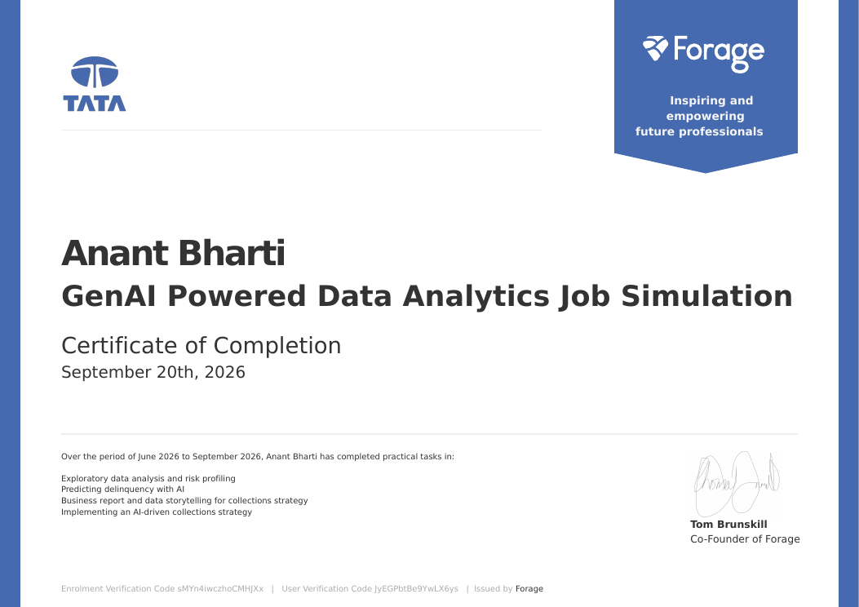
Outcomes & Certificate of Completion
Frame a business problem as a data-driven question
Explore data and profile risk using Python
Apply AI to predict delinquency
Interpret model results for business decisions
Communicate insights and recommend a collections strategy
Certificate of Completion issued via Forage
Anant Bharti | 2410030173 | IILM University

