Slide 1














Scanx AI
https://scanixai.netlify.app/

Slide 2
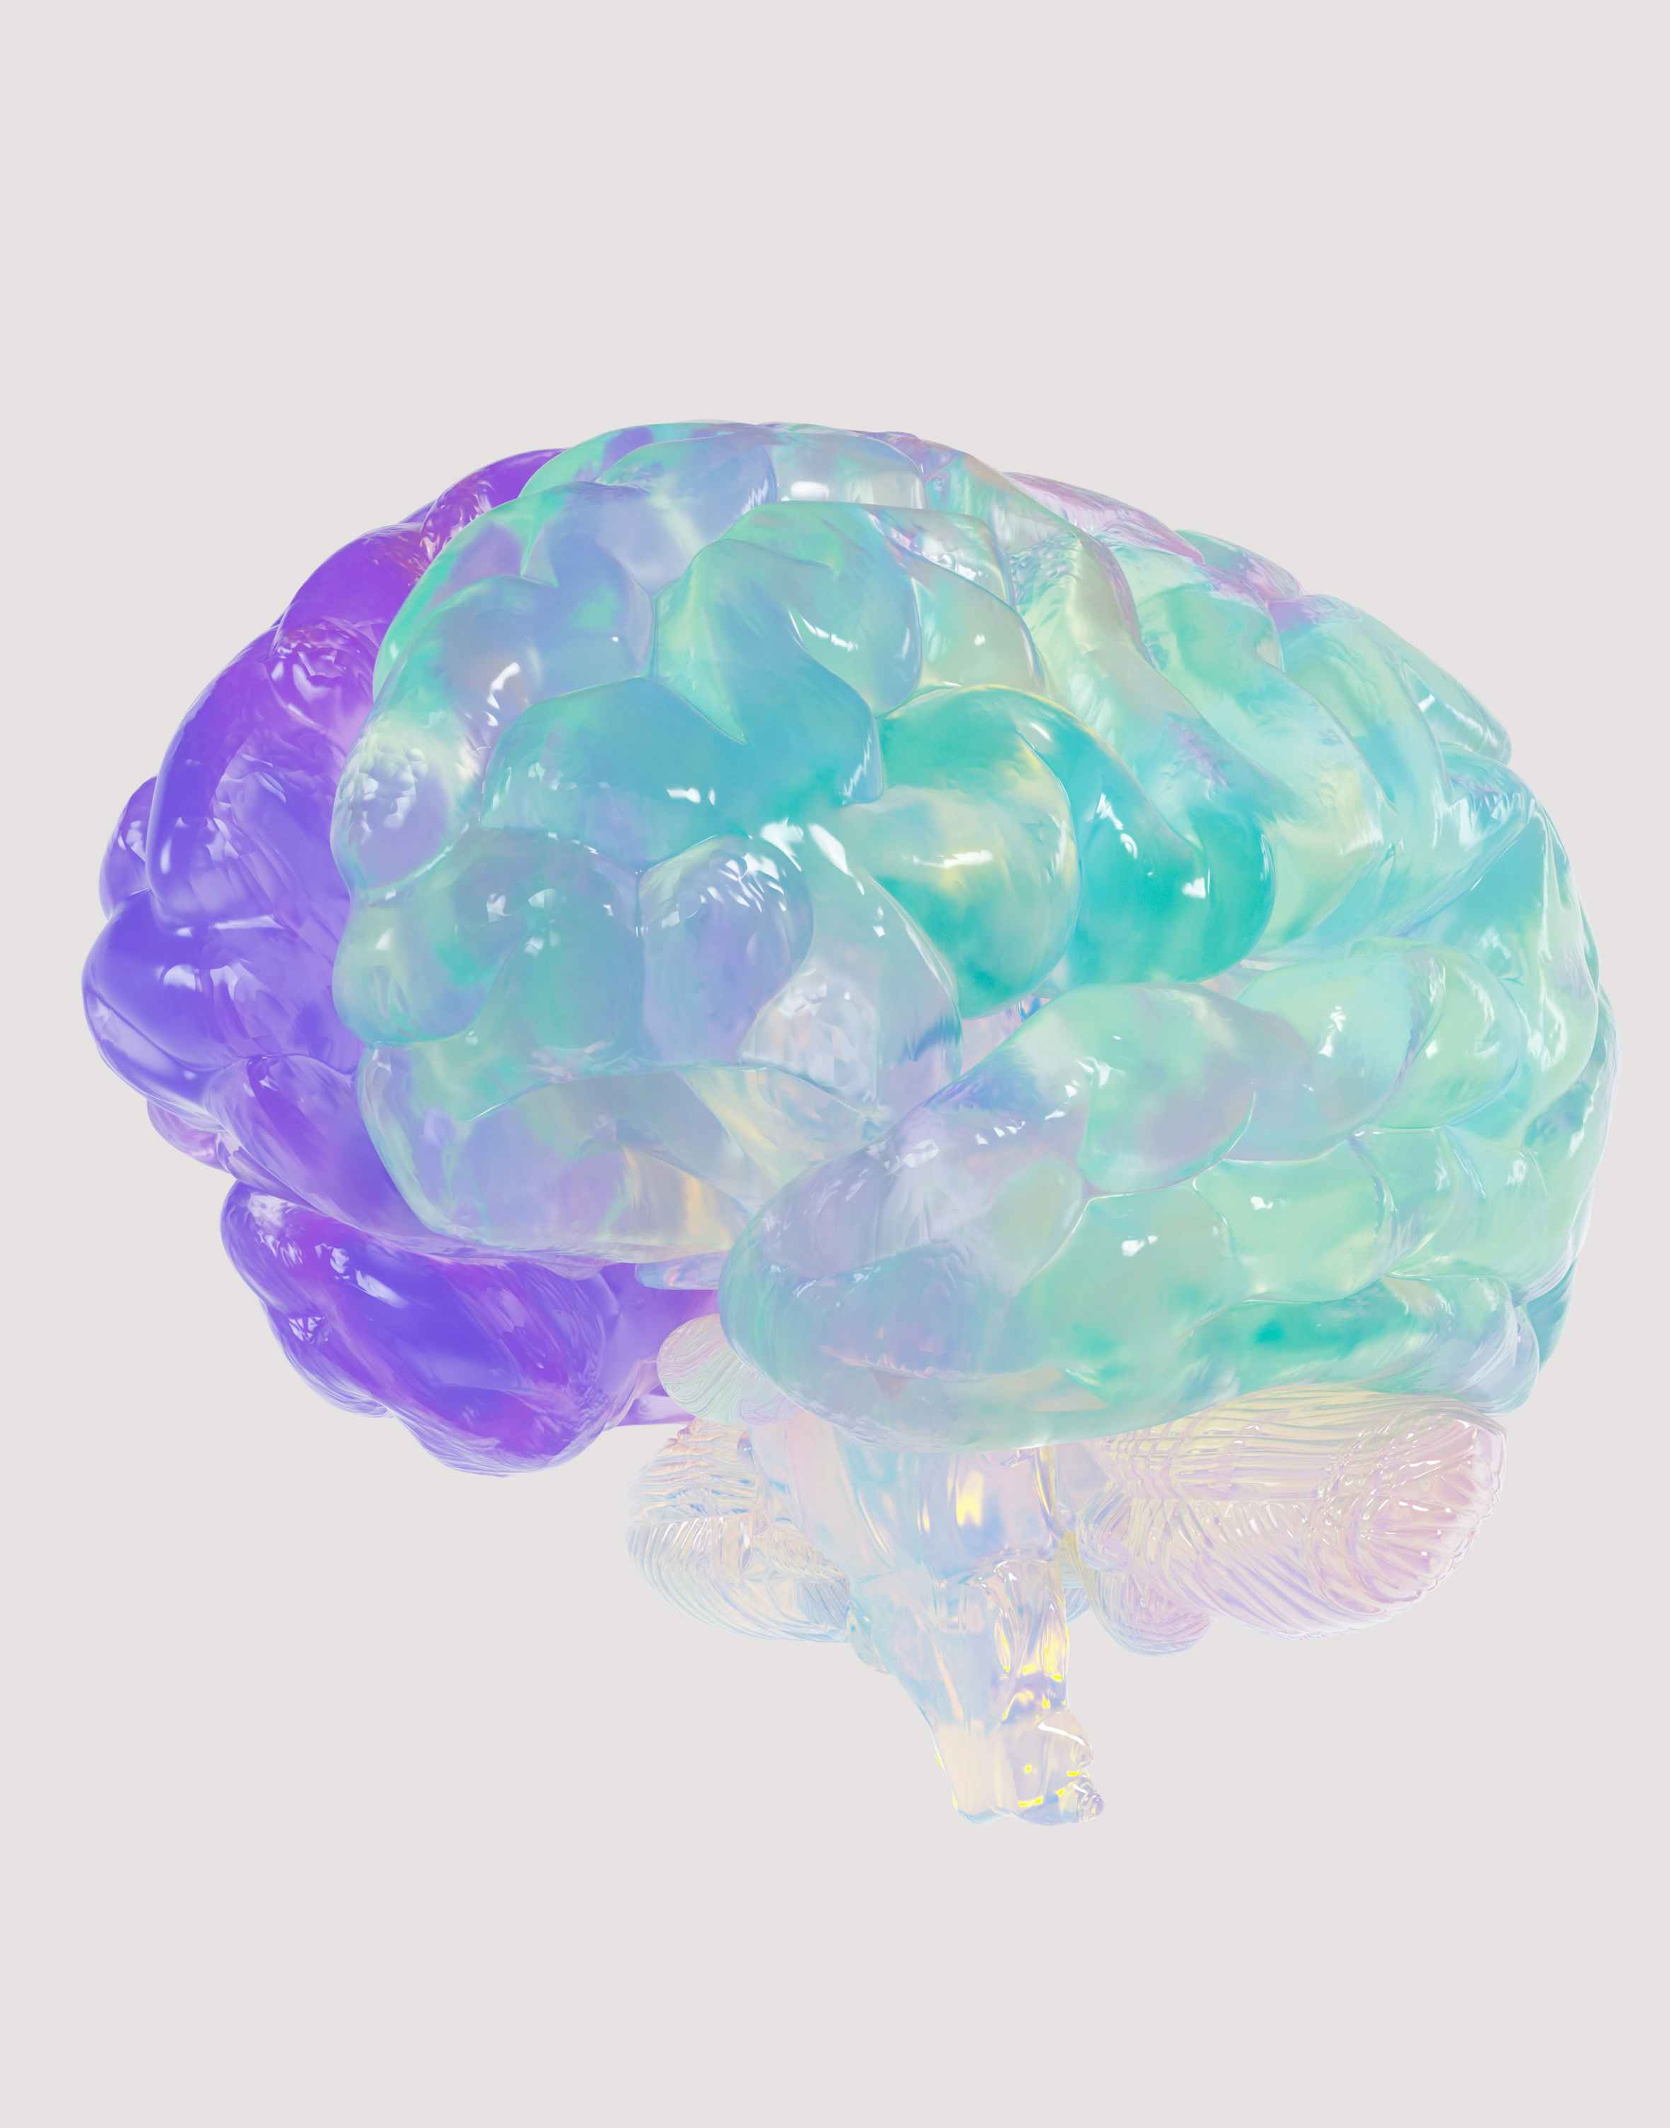
Problem Statement
Access Issues: Early detection of brain tumors often faces delays due to the limited availability of neurologists or radiologists, particularly in remote or underserved areas.
Patient Experience: Many patients undergo multiple visits to general practitioners or receive an emergency diagnosis only after severe symptoms manifest—62% of cases are diagnosed in emergency settings (Technology Networks).
Tumor Progression: Tumors can advance dangerously before they are detected.
Survival Rates: In numerous instances, less than 20% of malignant brain tumor patients survive beyond five years, with glioblastoma survival rates being less than 7% (The Sun, SEER, Cancer Research UK).
Incidence in India: Approximately 28,000 new brain tumor cases are reported annually in India, with a prevalence of around 8–10 per 100,000 people (The Times of India).
Conclusion: One in five brain tumors is diagnosed too late, often significantly limiting treatment options.

Slide 3
Millions of people worldwide lack access to timely brain tumor diagnosis due to limited specialists, cost, or geographic barriers. NeuroScan AI aims to solve this disparity by bringing intelligent screening directly to the user.
Project vision and mission
01.
By using AI to identify tumors from brain CT scans, we enable faster awareness and earlier medical action—crucial factors in improving recovery rates and reducing complications.
02.
We envision a future where early brain tumor detection is accessible to everyone, regardless of location or resources. NeuroScan AI aims to bridge the gap between advanced diagnostics and underserved communities through intelligent, affordable technology.
Our long-term vision is to support healthcare systems across all regions by providing a scalable, low-cost diagnostic assistant that complements clinical care and reaches underserved populations.
03.

Slide 4
Process
01
02
03
04
Upload Brain CT Scan
The user uploads a brain CT image through the app interface.
Accepted formats: .jpg, .png, .jpeg, .dcm.
Image Processing
The image is automatically cleaned, resized, and normalized.
This ensures consistent quality for accurate model predictions.
AI Analysis
A trained CNN (Convolutional Neural Network) model analyzes the scan.
It detects patterns and highlights possible tumor regions with a confidence score.
Results
The image is automatically cleaned, resized, and normalized.
This ensures consistent quality for accurate model predictions.

Slide 5
98%
Accuracy & precision
Scanix AI achieves 98% accuracy in brain tumor detection using an advanced machine learning model trained on over 6,000 medical brain scan images. Our optimized Logistic Regression algorithm minimizes false positives and negatives, ensuring reliable results that healthcare professionals can trust.
The 98% accuracy rate represents extensive testing across diverse patient demographics and scan types, making it a dependable tool for preliminary screening. With confidence scores provided alongside each prediction, medical professionals can make informed decisions and potentially improve patient outcomes through early detection.

Slide 6

Weaknesses
Threats
The current model relies on Logistic Regression rather than more advanced deep learning techniques like CNNs, which may limit its ability to detect complex tumor patterns. The system requires high-quality medical scans and may struggle with poor image quality or unusual scan formats.
Established medical imaging companies with extensive resources and regulatory experience pose significant competition in the healthcare AI market. Strict medical device regulations and lengthy approval processes could delay market entry and increase development costs.
Strengths
Opportunities
Scanix AI leverages cutting-edge machine learning technology with 98% accuracy, providing healthcare professionals with a reliable and fast diagnostic tool. The application's intuitive interface and real-time processing capabilities make it accessible to medical staff with varying technical expertise.
The growing demand for AI-assisted medical diagnosis presents a significant market opportunity, especially in regions with limited access to specialized radiologists. Integration with hospital management systems and electronic health records could streamline workflows and increase adoption rates.

Slide 7




workflow
Scanix AI
finding the best and solution
Tech stack
App Features
Team Roles
React 19.1.0
Python 3.9
Flask 2.3.3
Scikit-learn 1.3.0
Vite 7.0.4
Vercel (backend)
Netlify (frontend)
AI-Powered Detection
Instant Results
Easy Upload
High Accuracy
Secure Processing
Responsive Design
Fast Performance
Manan Panchal
Python Developer
AI model training(tumor detection)
Ansh Dhanani
Flask Backend with React Frontend
Vercel (backend) Netlify (fronted)
PARMAR KRISH HITESHKUMAR
Presentation Expert
Resource provider
Varun Pansheriya
UI/UX designer
App Workflow Tester

Slide 8

Final reflections and future steps
Scanix AI successfully demonstrates practical healthcare AI with good accuracy using simple Logistic Regression and modern web technologies. The intuitive interface makes advanced medical analysis accessible to healthcare professionals without requiring complex deep learning architectures.
Next development should upgrade to CNNs for better pattern recognition and expand beyond binary classification to tumor type identification. Pursuing FDA approval and hospital system integration will be essential for clinical adoption and market penetration.

Slide 9
Thank you very much!
https://scanixai.netlify.app/

