Slide 1
SLIDE 1
Business Problem
Revenue has grown every year from 2014 to 2017, but a meaningful share of orders is unprofitable — and management does not currently know why.
What we investigated
Where profit is leaking out of the business, whether discounting is helping or hurting, and which regions, segments, and products deserve more or less investment.
Why it matters now
1,871 of 9,994 order lines (about 1 in 5) lost money. Fixing even part of this, without losing sales volume, is pure margin recovery.

Slide 2
SLIDE 2
Data & Methodology
Dataset: Sample Superstore — 9,994 US retail order lines, 2014–2017, across Region, Segment, Category and Discount/Profit fields.
1
2
3
4
Cleaned & typed the data
(dates, ZIP codes)
Engineered Margin %,
Ship Days, Discount Bands
Grouped by Region /
Category / Segment / Discount
Tested hypotheses with
correlation & aggregation
Tools: Python (pandas, matplotlib) run in an AI-assisted analysis workflow; see README for full methodology and AI-usage notes.

Slide 3
SLIDE 3
Key Findings
Discounting above ~20% turns orders unprofitable
Tables & Bookcases lose money — but only because of discounts
Correlation of -0.86 between discount level and margin %
Tables earn +$13,276 profit at 0% discount vs. -$17,725 overall
Central region lags on margin, not just sales
Highest-revenue customer isn't the most profitable
7.9% margin vs. West's 14.9%, on similar sales scale
Top customer by sales is net -$1,981 in profit overall

Slide 4
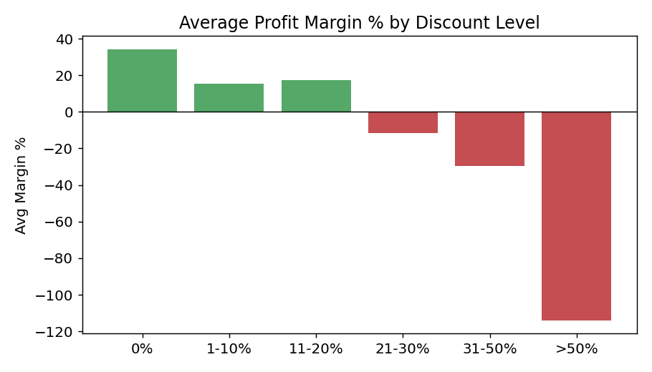
SLIDE 4
Deep-Dive Insight: The 20% Discount Cliff
What the evidence shows
Average profit margin stays positive through the 0–20% discount range, then flips sharply negative above 20% — reaching an average of -$89 profit per order line beyond 50% discount.
Why it matters
This is not a product problem — it is a pricing-discipline problem. The same products are profitable at lower discount levels.

Slide 5
SLIDE 5
Recommendations
1
Cap discretionary discounts near 20% on Furniture (Tables, Bookcases) without manager approval
2
Audit Central region's discount/pricing practices against West region's playbook
3
Shift a portion of promotional spend toward the higher-margin Home Office segment
4
Track customer-level profit (not just revenue) and flag high-revenue, negative-profit accounts

Slide 6
SLIDE 6
Expected Business Impact
What could improve
How we'd measure success
• Recovered margin on ~1,400 order lines currently discounted above 20%
• Narrowed profit gap between Central and West regions
• Higher share of revenue from the more profitable Home Office segment
• Fewer high-revenue accounts that are secretly loss-making
• Furniture category margin %, tracked monthly
• Central region margin % vs. West benchmark
• Avg. profit per order line, by segment
• Count of high-revenue/negative-profit accounts, per quarter

Slide 7
SLIDE 7
Limitations & Next Steps
What management should be cautious about
• No cost/COGS data — Profit is taken as given; we can't yet separate a pricing problem from a cost problem
• Data covers 2014–2017 only — patterns should be validated against current transactions before acting
• Discount–margin correlation is historical, not causal — some discounts may have driven volume or retention a pure margin view misses
What should be analyzed next
• Pull current-year transactions to confirm the 20% discount threshold still holds
• Add product cost data to build a true margin (not just Sales-minus-Profit) view
• Build the customer-level profitability dashboard recommended in Slide 5

