Slide 1

Capstone project - 3
Credit Card Default
Prediction
By
Ansh Srivastava

Slide 2

Content
● Introduction
● Problem Statement
● Data Summary
● Approach Overview
● Exploratory Data Analysis
● Modelling Overview
● Feature Importances
● Conclusion

Slide 3
Introduction
Credit Card - A credit card is a financial instrument issued by bank with a pre-set credit limit, helping you make cashless transactions. the credit card issuer determines the credit limit based on your credit score, credit history and your income.
What is Credit Card default?
Missing credit card payments once or twice does not count as a default. A payment default occurs when you fail to pay the Minimum Amount Due on the credit card for a few consecutive months. Usually, the default notice is sent by the card issuer after 6 consecutive missed payments. However, the final call rests with the bank.

Slide 4
Problem Statement
This project is aimed at predicting the case of customers default payments in Taiwan. From the perspective of risk management, the result of predictive accuracy of the estimated probability of default will be more valuable than the binary result of classification - credible or not credible clients. We can use the K-S chart to evaluate which customers will default on their credit card payments
Title : Predicting whether a customer will default on his/her credit card

Slide 5
Data Summary
● X1 - Amount of credit(includes individual as well as family credit)
● X2 - Gender
● X3 - Education
● X4 - Marital Status
● X5 - Age
● X6 to X11 - History of past payments from April to September
● X12 to X17 - Amount of bill statement from April to September
● X18 to X23 - Amount of previous payment from April to September
● Y - Default payment

Slide 6
Approach Overview
Question framing ( Based on problem statement)
Data Cleaning
Exploratory Data Analysis
Model implementation
(Logistic , SVM , Random Forest , XGBoost)
Conclusions

Slide 7
Overview
● Dataset for Taiwan.
● Data for 30000 customers.
● 6 Months payment and bill data available.
● No null data.
● 9 Categorical variables present.

Slide 8
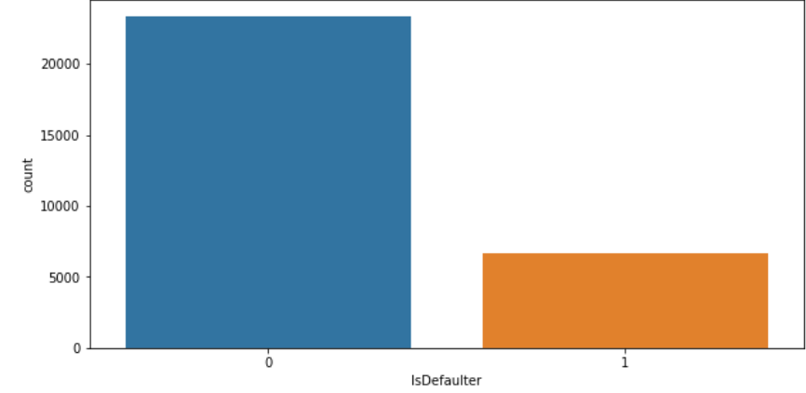
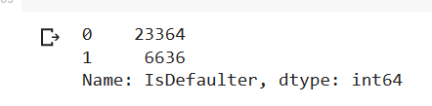
Defaulter Distribution
Yes = 1
NO = 0

Slide 9
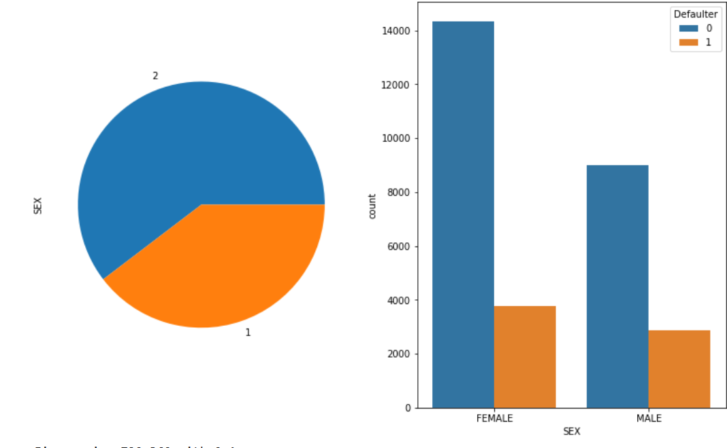

Gender Distribution

Slide 10
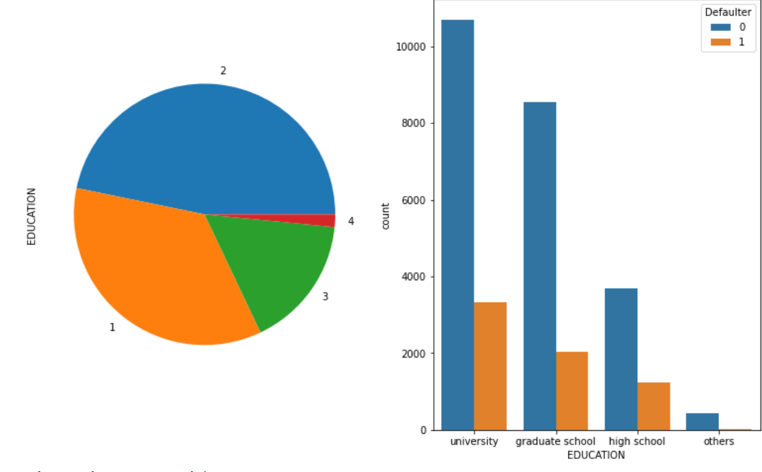
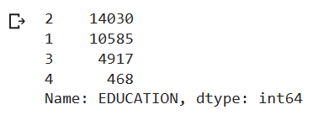
Education Distribution
1 = graduate school
2 = university
3 = high school
4 = others

Slide 11
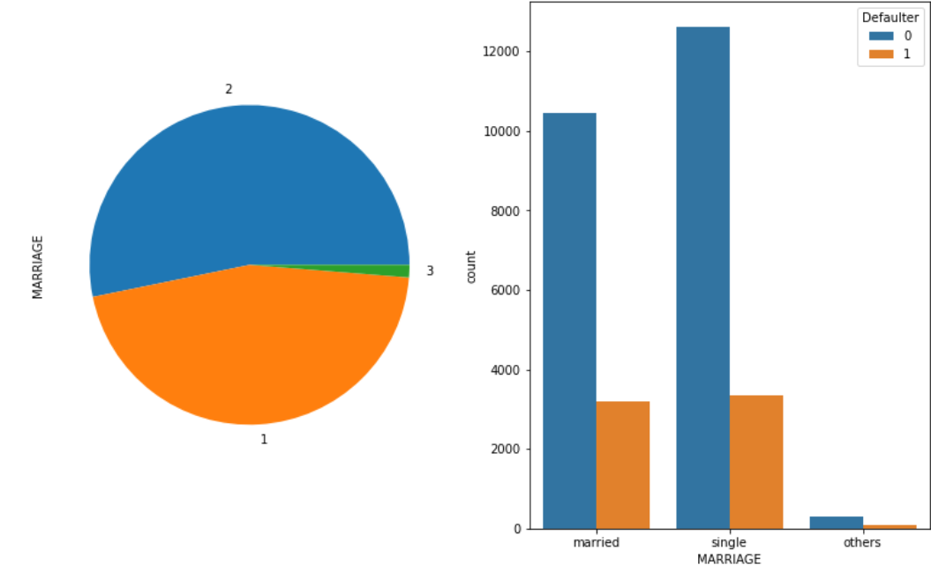
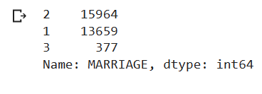
Marital Distributions
1 = married
2 = single
3 = others

Slide 12
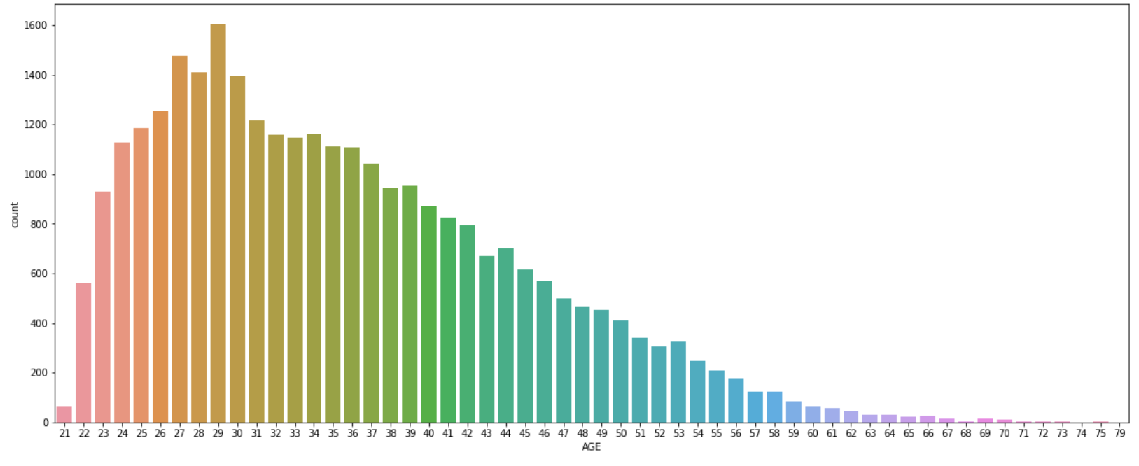
Age Distribution

Slide 13
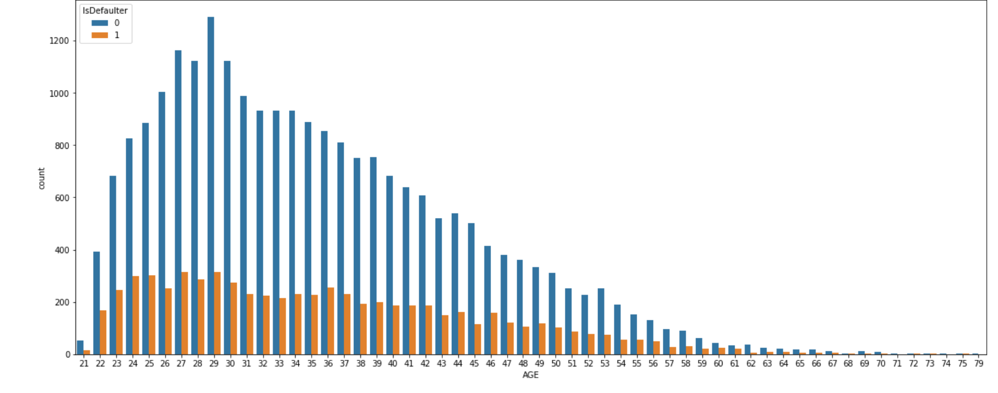

Slide 14
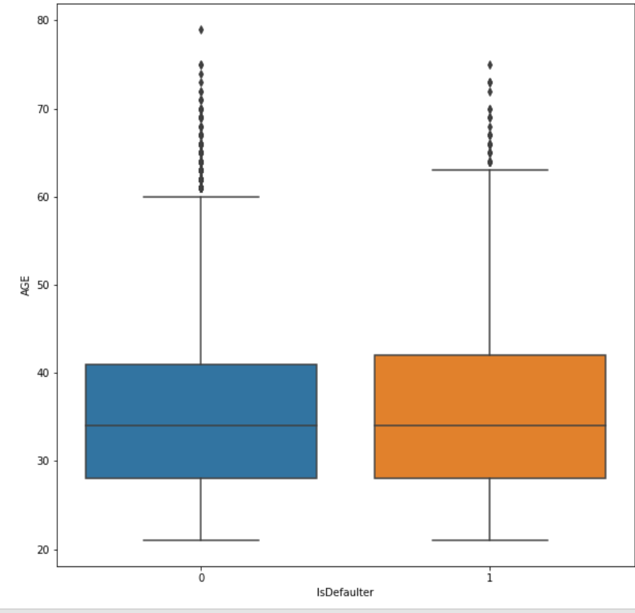
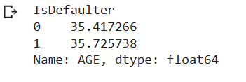

Slide 15
Modeling Overview
● Supervised learning/Binary Classification
● Imbalance data with 78% non-defaulters and 22% defaulters
Models Used:
● Logistic Regression
● Decision Trees
● Random Forest
● SVM
● XGBoost
● Hyperparameter Tuning

Slide 16
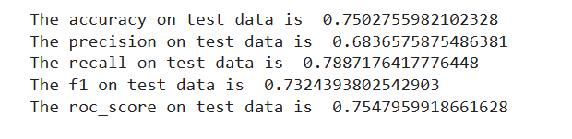
Logistic Modelling
Parameters:
C = 0.1
Penalty = L2

Slide 17
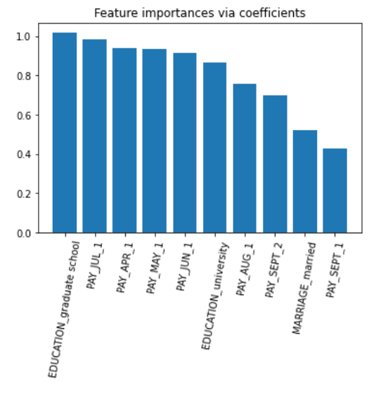
Logistic Feature Importances

Slide 18
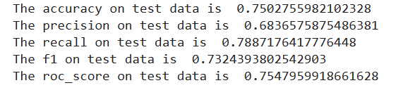
SVM Modelling
Parameters :
C = 10
Kernel = ‘rbf’

Slide 19
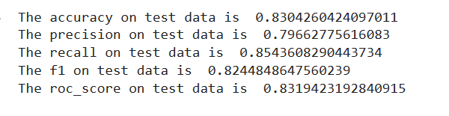
Random Forest Metrics
Parameters:
max_depth=30
n_estimators=200

Slide 20
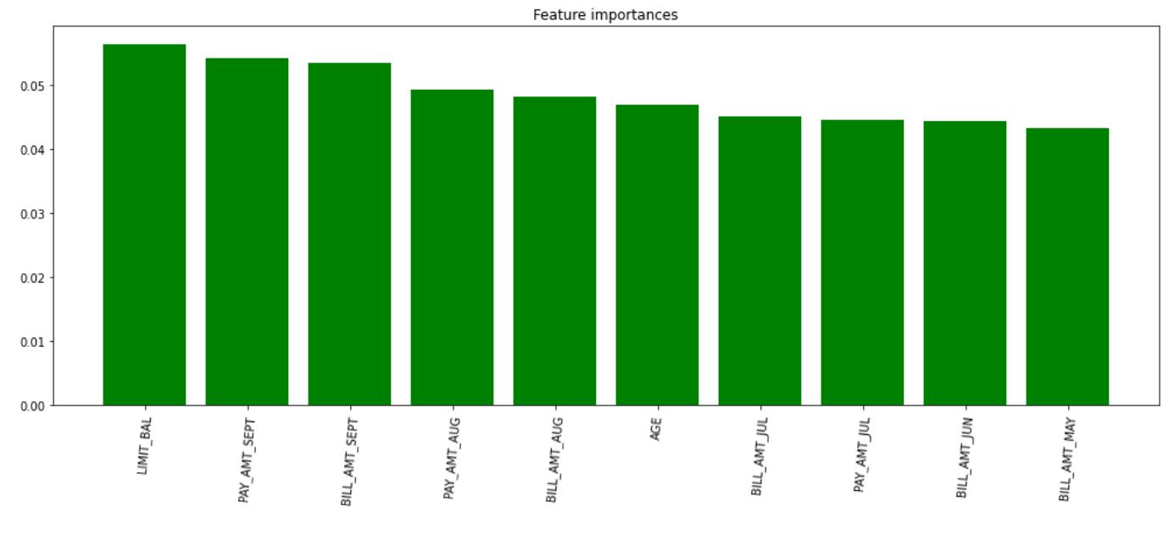
Random Forest feature importances

Slide 21
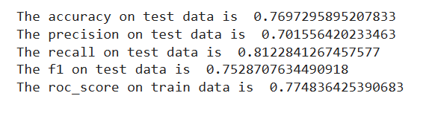
XGBoost Modelling
Parameters:
max_depth= 7
min_child_weight= 8

Slide 22
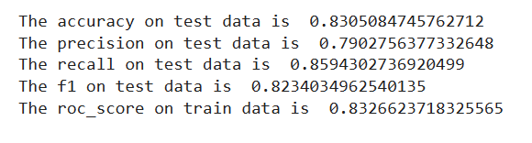
Hyperparameter Tuning
Parameters:
Max_depth = 5
N_estimators = 140

Slide 23
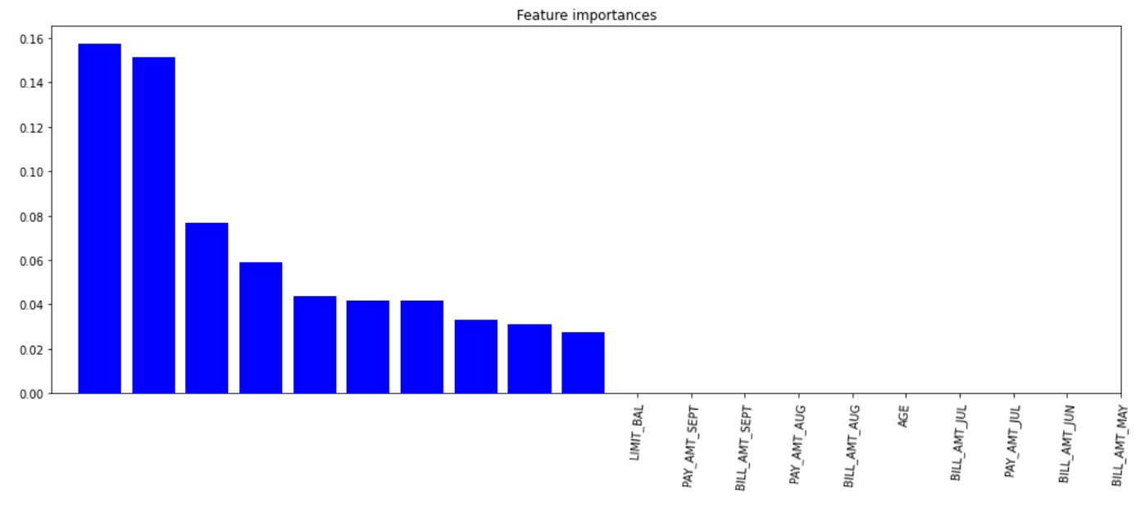
Hyperparameter Tuning Features Importance

Slide 24
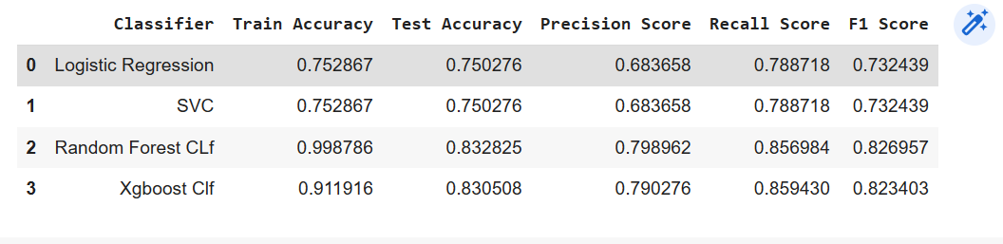
Evaluating the Models

Slide 25
Conclusion
From the project we can conclude that the default rate is higher for males, increases as the education increases, and also increases as the age of a person increases. i.e clients whose age over 60 was higher than mid-age and young people. In all of these models, our recall revolves in the range of 78 to 86%.with the best fit model as random forest.
From all baseline model, Random forest classifier shows highest train accuracy, test accuracy and F1 score .
After cross validation and hyperparameter tunning, XG Boost shows highest test accuracy score of 83.03%.
Cross validation and hyperparameter tunning certainly reduces chances of overfitting and also increases performance of model.

Slide 26
THANK YOU

