Slide 1


Capstone project - 2
Yes Bank Stock Closing Price
Prediction
By
Ansh srivastava

Slide 2
Problem Statement
‘Yes Bank’ is an Indian private sector bank headquartered in Mumbai, India and was founded in 2004. It offers a wide range of differentiated products for corporate and retail customers through retail banking and asset management services.
Since 2018, it has been in the news because of the fraud case involving ‘Rana Kapoor’. Owing to this fact, it was interesting to see how that impacted the stock prices of the company.
So, this particular project is all about how different machine learning algorithm assisted to create models to predict the stock closing price of this particular bank.

Slide 3
Continued…
Yes Bank is a well-known bank in the Indian financial domain. Since 2018, it has been in the news because of the fraud case involving Rana Kapoor. Owing to this fact, it was interesting to see how that impacted the stock prices of the company and whether Time series models or any other predictive models can do justice to such situations. This dataset has monthly stock prices of the bank since its inception and includes closing, starting, highest, and lowest stock prices of every month. The main objective is to predict the stock’s closing price of the month.

Slide 4
Data Briefing
The dataset is comparatively a compact one in terms of size & also has fewer features or variables to work with.
• Dataset initially had 185 rows & 5 columns.
Now, regarding the extraction of the data information from the dataset, I used “info()” method which gave me the information about data types(dtypes), count of non-null values & memory usage by the dataset.
• There were 4 columns with float64 dtypes & 1 column with object dtype (object dtype was later converted into datetime dtype).
• No null values were present in the dataset.
To inspect the case of missing values in the dataset , I used “isna” method & found out that there were no missing values in the dataset

Slide 5
Steps
Question framing ( Based on problem statement)
Data inspection & pre-processing
Exploratory data analysis (EDA)
Model implementation
(Linear Regression, Lasso Regression, Ridge Regression, KNN)
Conclusions

Slide 6
Feature Overview
In this particular dataset, we have 5 features. They are :-
1. Date – Stores month & year data for each value of stock.
2. Open – Stores the price at which a stock started trading each month.
3. High – Stores the maximum price of the stock for each month.
4. Low – Stores the minimum price of the stock for each month.
5. Close – Stores the final trading price of the stocks for each month.
Independent or input variables → ‘Open’, ‘High’, ‘Low’
Dependent or target variable → ‘Close’
‘Date’ is only useful for EDA purpose & do not have any influence for closing price prediction

Slide 7
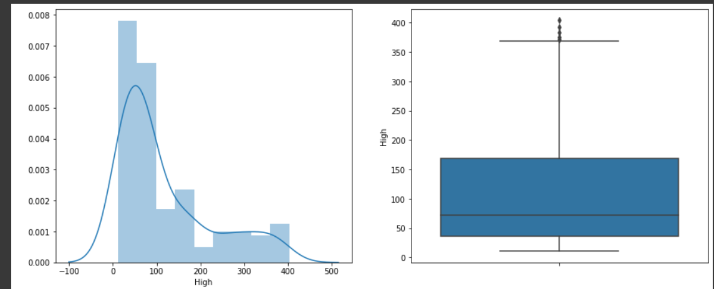
Exploratory data analysis (EDA)

Slide 8
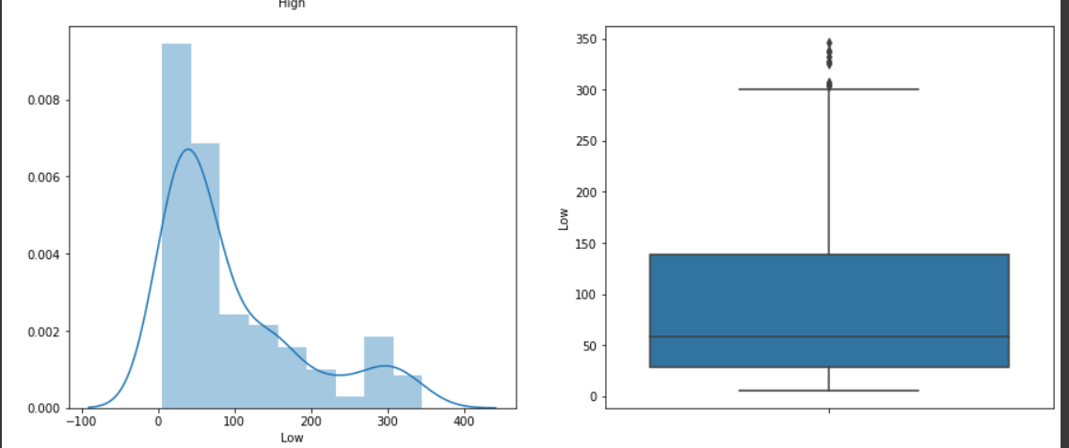
Continued…

Slide 9
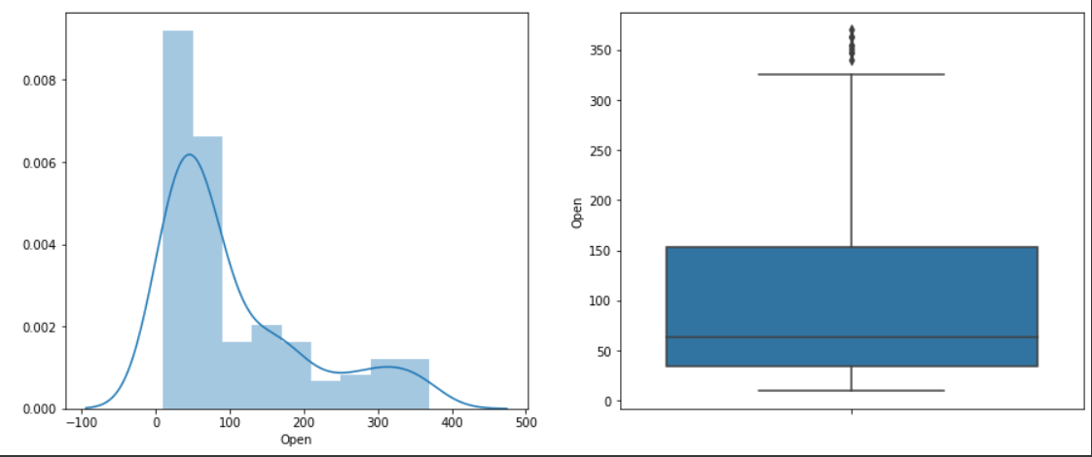
Continued…

Slide 10
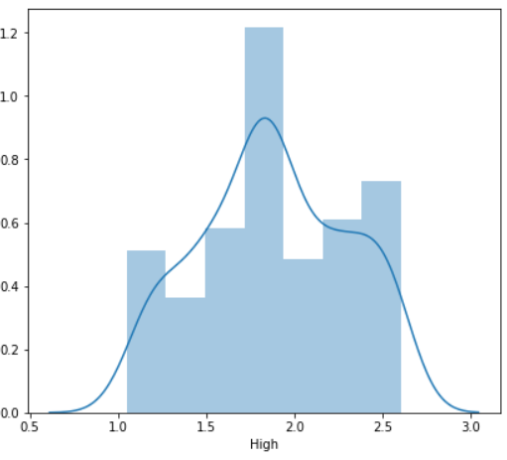
Univariate Analysis
On visualising the first independent variable (High) was also right skewed which can be seen in the left hand plot and upon applying log transformation the variable got normally distributed to some extent which the right hand plot clearly depicts.

Slide 11
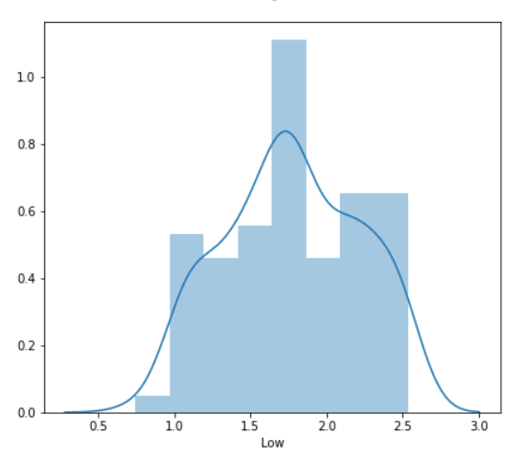
Continued…
This independent variable (Low) was also right skewed and can be visualised by the left hand side plot. Applied log transformation and this particular variable also got normally distributed to some extent as shown in the right hand plot.

Slide 12
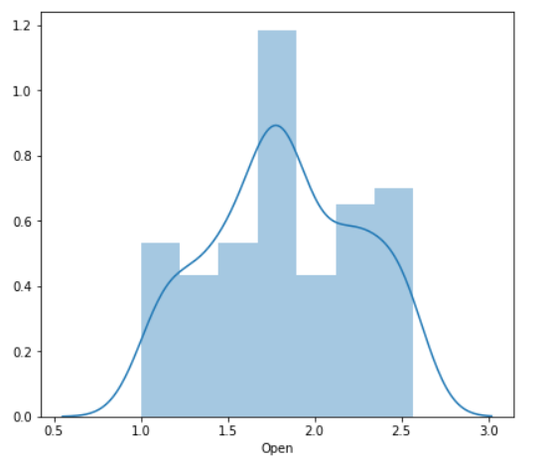
Continued…
On visualising this independent variable (Open) on the left hand side, I found out that its right skewed and upon applying log transformation, the plot is transformed into a normally distributed variable to some extent which is clearly visible in the right plot.

Slide 13
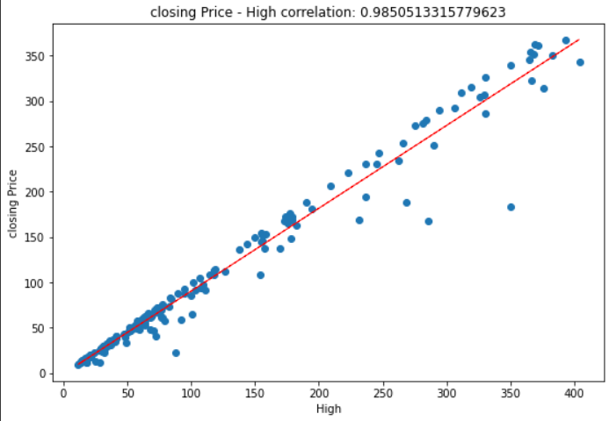
Bivariate Analysis
This plot shows the correlation between high values of stocks & stock closing price.
Here also a linear trend is clearly visible between these two variables by the black straight line which shows a positive correlation between the two variables.
The two variables are almost 98% correlated to each other.

Slide 14
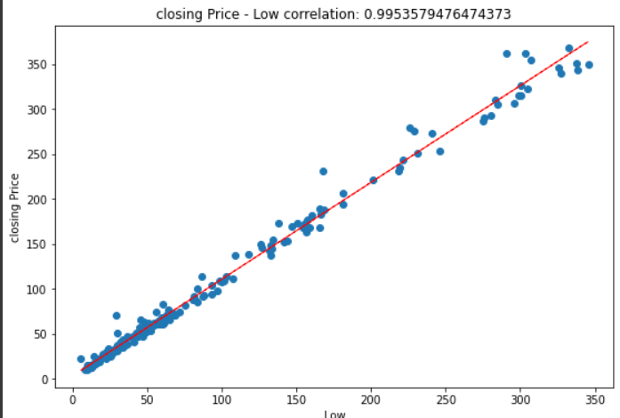
Continued…
This plot shows the correlation between low values of stocks & stock closing price.
Same as above cases, a linear trend is visible by the black line which means that the two variables are positively correlated to each other.
The two variables are almost 99% correlated to each other.

Slide 15
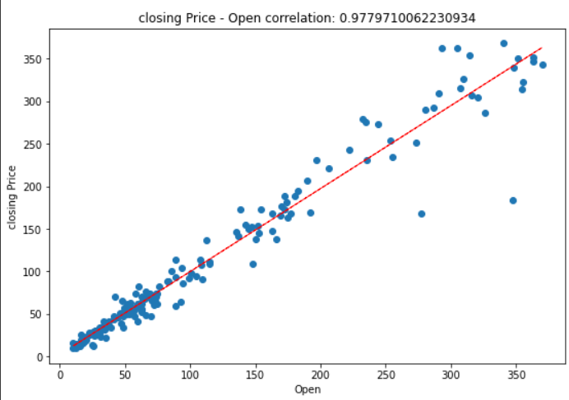
Continued…
Plot on the right shows the correlation between stock opening price & stock closing price.
Here, a linear trend is clearly visible depicted by the black straight line which shows a positive correlation between two variables.
The two variables are almost 97% correlated to each other.

Slide 16
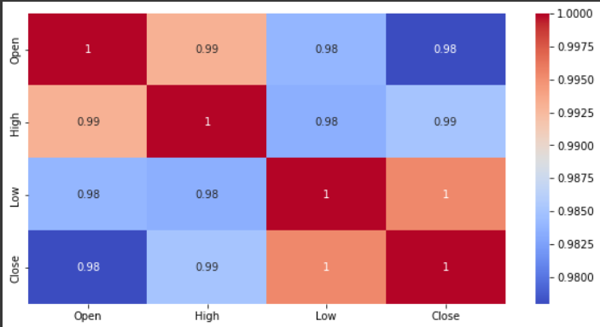
Correlation

Slide 17
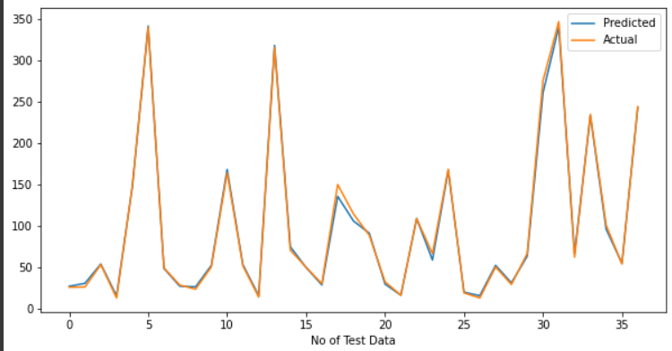
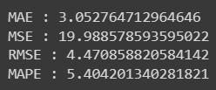
Linear Regression

Slide 18
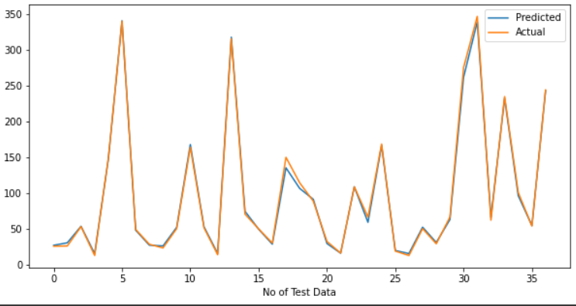
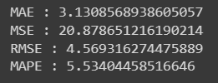
Lasso Regression

Slide 19
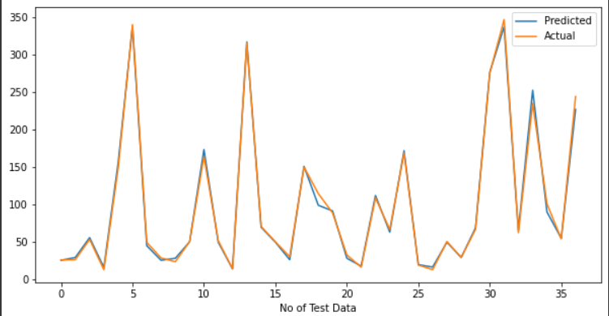
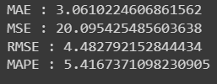
Ridge Regression

Slide 20
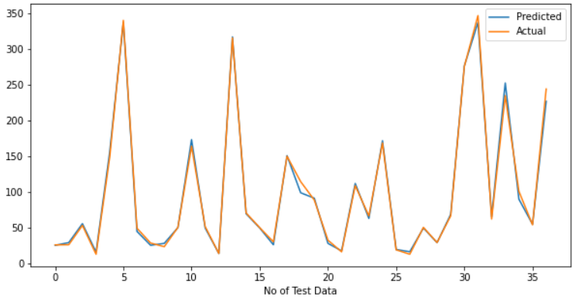
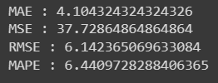
KNN

Slide 21
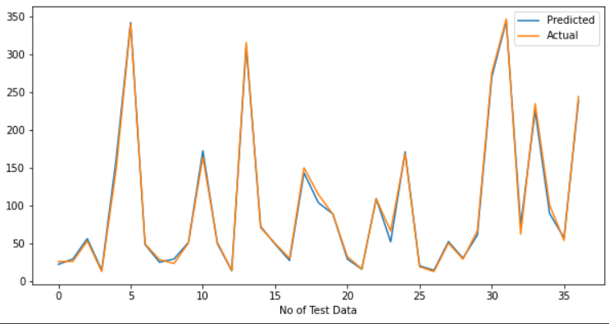
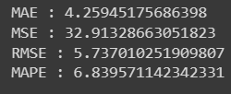
XGBOOST

Slide 22
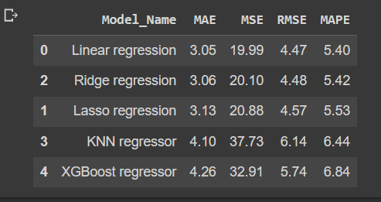
METRIC EVALUATION
Above table contains the evaluation metrics for each model implemented in this project sorted in ascending order.
‘Linear Regression’ model has got lowest values for MSE ,RMSE.
‘KNN’ model has got the highest values for MSE, RMSE.

Slide 23
Conclusion
1. Target variable is highly dependent on input variables.
2. Linear Regression has given the best results with lowest MAE, MSE, RMSE and MAPE score.
3. Ridge regression shrunk the parameters to reduce complexity and multicollinearity, but ended up affecting the evaluation metrics.
4. Lasso regression did feature selection and ended up giving up worse result than ridge which again reflects to the fact that each feature is important(as previously discussed).
5. KNN AND XGBoost have given similar results.
6. The accuracy for each model is more than 90%.

Slide 24
THANK YOU

