Slide 1

Mini Project-I (K24MCA18P) Odd Semester Session 2024-25
Restaurant Management System
Abhishek Mishra 2426MCA637
Ambikeshwar Dutt Dwivedi 2426MCA807
Anubhav Verma 2426MCA217
Project Supervisor:
Supervisor Name: Divya Sighal
Designation: Assistant Professor

Slide 2
Content
Introduction (1 slide)
Literature Review (2 slides)
Objective of the Project (1 slide)
Technology
Hardware Requirements (Development Environment, Server requirement (if required), Client requirement (if required).
Software Requirements (Language and Platforms like Frameworks, VS code, Android Studio and Jupyter notebook etc. )
Modules (2-3 slides)
Workflow (1 slide)
Reports (For Example: Project : Student Monitoring System, so reports like: Student Marks, Subjects, companies visit, and student appears in placement etc.)
References (1 slide)
Notes:
Font Styles: Times New Roman + Font Size: 25

Slide 3
Introduction
As students, we recognized the challenges restaurants face in managing their operations efficiently. Our project, the Restaurant Management System, aims to address these challenges by providing a user-friendly application that streamlines key functions such as user authentication, menu management, order processing, table management, and billing.
Utilizing HTML, CSS, JavaScript, and Bootstrap, we developed a responsive and visually appealing interface that enhances user experience across devices. This project not only strengthened our technical skills but also fostered teamwork and collaboration. Through this experience, we gained hands-on knowledge in web development, learning how to create a functional application that improves the dining experience for both staff and customers. We are excited to present this project as a practical solution that reflects our understanding of real-world application management.
Notes:
Font Styles: Times New Roman + Font Size: 25

Slide 4
Literature Review
Restaurant Management Systems:
Overview of Existing Systems
Restaurant management systems (RMS) have evolved to address operational inefficiencies in the hospitality industry.
Key functionalities include:
Point of Sale (POS): Streamlines order processing and payment handling.
Inventory Management: Tracks stock levels, reducing waste and ensuring ingredient availability.
Customer Relationship Management (CRM): Enhances customer engagement through loyalty programs and feedback mechanisms.
Technological Trends:
Many RMS solutions utilize cloud computing for real-time data access and scalability.
The integration of mobile applications allows staff to manage orders and tables on-the-go, improving service speed and accuracy.
Notes:
Font Styles: Times New Roman + Font Size: 25

Slide 5
Literature Review (Contd.)
Benefits and Challenges:
Efficiency:
Many RMS solutions utilize cloud computing for real-time data access and scalability.
The integration of mobile applications allows staff to manage orders and tables on the go, improving service speed and accuracy.
Data-Driven Decisions:
Provides insights through analytics, helping restaurants optimize menus and pricing strategies.
Enhanced Customer Experience:
Quick order processing and personalized service lead to higher customer satisfaction.
Challenges:
Training Needs: Staff must be trained to use new systems effectively, which can require time and resources.
Cost of Implementation: Initial setup and ongoing maintenance can be expensive, particularly for small businesses.
Notes:
Font Styles: Times New Roman + Font Size: 25

Slide 6
Objective of the Project
Streamline Operations
User Authentication
Menu Management
Order Processing
Table Management
Payment system
Responsive Design
Practical Learning Experience
Notes:
Font Styles: Times New Roman + Font Size: 25

Slide 7
Technology (Hardware Requirements)
Server Requirements:
Processor: Dual-core processor (Intel i3 or equivalent)
RAM: Minimum 8 GB
Storage: 100 GB SSD (for faster access and performance)
Network: Ethernet connection or Wi-Fi for connectivity
Client Requirements:
Processor: Dual-core processor (Intel i3 or equivalent)
RAM: Minimum 4 GB
Storage: 20 GB available space
Display: Minimum 1366 x 768 resolution
Network Requirements:
Router: Reliable router with adequate coverage for the restaurant area
Internet Connection: High-speed broadband connection
Backup Device:
External Hard Drive: For regular data backups (recommended)
Notes:
Font Styles: Times New Roman + Font Size: 25

Slide 8
Technology (Software Requirements)
Operating System:
Windows 10 or later
Web Development Tools:
Text Editor/IDE: Visual Studio Code, Sublime Text, or any preferred code editor
Version Control: Git for version control and collaboration (GitHub or GitLab
Frontend Technologies:
HTML: For structuring web pages
CSS: For styling and layout
JavaScript: For interactive elements and functionality
Bootstrap: For responsive design and UI components
Database:
MongoDB (NoSQL) or MySQL (SQL) for data storage and management (optional)
Web Browser:
Latest version of Google Chrome, Firefox, or Safari for testing and running the application
Backend Technologies:
Firebase for data storage and real-time synchronization.
Notes:
Font Styles: Times New Roman + Font Size: 25

Slide 9
Modules
Module 1: Menu and Order Management
User Interface Design: Create the layout using HTML, CSS, and Bootstrap.
Menu Display: Build the component to show menu items.
Order Form: Design the order-taking form for staff.
Module 2: User Authentication and Payment System
Firebase Authentication: Set up user sign-up and login using Firebase.
Profile Management: Create a simple profile page for users to view their details.
Payment System: Create a dummy payment system.
Notes:
Font Styles: Times New Roman + Font Size: 25

Slide 10
Modules (Contd.)
Module 3: Database Management
Database Setup: Create the structure in Firebase for storing menu items and orders.
Basic CRUD Operations: Implement Create, Read, Update, Delete functionalities for menu items.
Billing Calculation: Set up the logic for calculating total order costs.
Testing: Test database interactions and fix any issues.
Notes:
Font Styles: Times New Roman + Font Size: 25

Slide 11
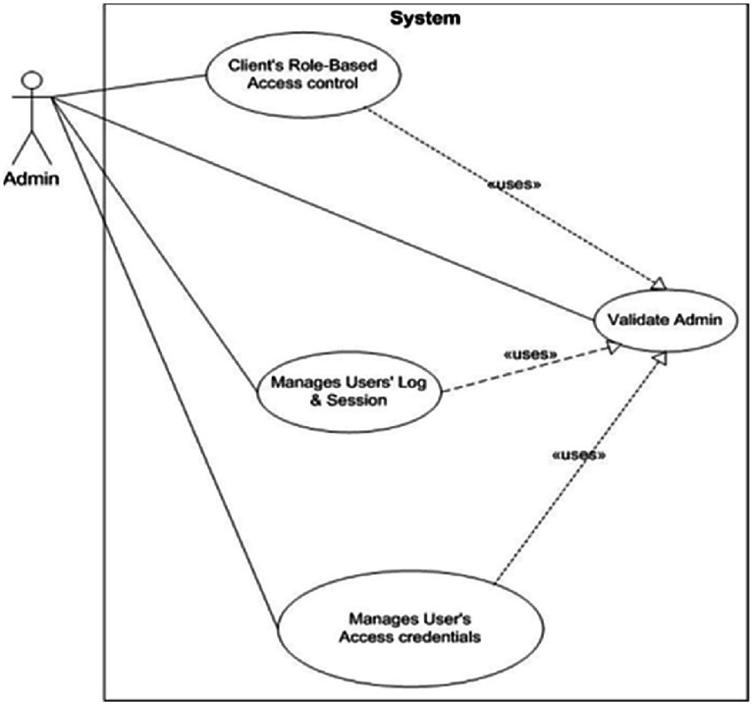
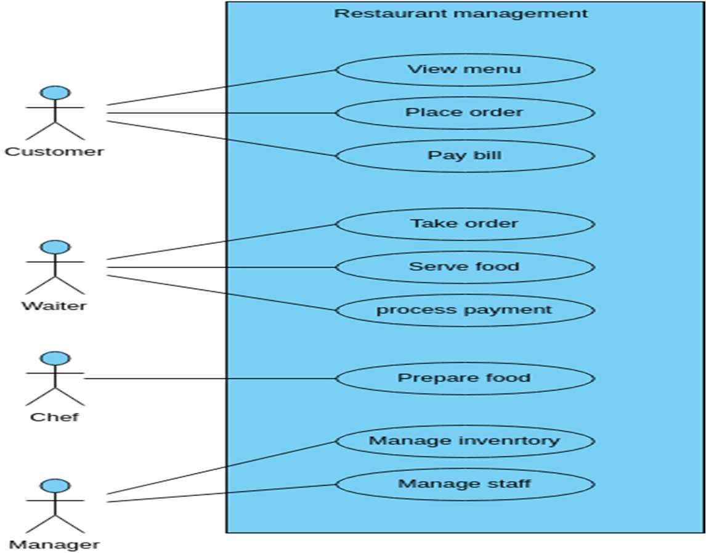
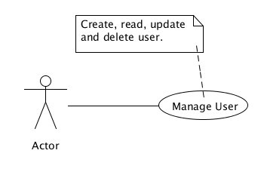
Workflow/Gantt Chart
User Authentication:
Order Processing:
Enables Staff to record and manage customer orders.
Actors: Staff
Allows the Admin to add, edit, or delete menu items.
Actor: Admin
Functional Requirements: CRUD operations
Notes:
Font Styles: Times New Roman + Font Size: 25

Slide 12
Reports
Restaurant Management System (RMS) Project Report
Introduction: The Restaurant Management System (RMS) aims to enhance the efficiency of restaurant operations by providing a streamlined interface for order management, real-time data synchronization, and secure user authentication. Utilizing Firebase for backend services, this system facilitates better customer service and operational workflow.
Objectives:
User-Friendly Interface: Develop an intuitive interface for staff and customers to easily navigate the system.
Real-Time Data Management: Implement real-time updates for menu items and order processing to ensure accurate information.
Secure User Authentication: Enable secure sign-up and login processes to protect user data and manage roles effectively (Admin, Staff).
Efficient Order Processing: Taking and managing orders, including billing calculations.
Responsive Design: Ensure accessibility across various devices, improving user experience.
Technologies Used:
Frontend: HTML, CSS, JavaScript, Bootstrap for a responsive design.
Backend: Firebase for Firestore database, user authentication, and hosting (python+Django,Optional).
System Design:
Modules:
Menu and Order Management: Create the user interface for displaying menus and processing orders.
User Authentication: Implement secure login and registration features.
Database Management: Store and manage data in real-time using Firebase.
Notes:
Font Styles: Times New Roman + Font Size: 25

Slide 13
References
Firebase Documentation Google. (n.d.). Firebase Documentation. Retrieved from https://firebase.google.com/docs
Bootstrap Documentation Bootstrap. (n.d.). Bootstrap Documentation. Retrieved from https://getbootstrap.com/docs
Introduction to Restaurant Management Systems Kaur, P. (2020). An Overview of Restaurant Management Systems. Retrieved from ResearchGate
Notes:
Font Styles: Times New Roman + Font Size: 25

