Slide 1

1
SELLER DATABASE MANAGEMENT SYSTEM
DATABASE PROJECT REPORT
SUBMITTED BY
Name: Priyanshu Kumar
USN: 1MS21IS077
Name: Ritesh Saykar
USN: 1MS21IS083
As part of the Course Database Systems– IS45
SUPERVISED BY
Faculty
Mushtaq Ahmed
ASSISTANT PROFESSOR
DEPARTMENT OF ISE
DEPARTMENT OF INFORMATION SCIENCE & ENGINEERING

Slide 2
2
RAMAIAH INSTITUTE OF TECHNOLOGY
NOV 2022 – JAN 2023
Department of Artificial Intelligence and Data Science
Ramaiah Institute of Technology
(Autonomous Institute, Affiliated to VTU)
Bangalore – 54
CERTIFICATE
This is to certify that Name: Deepak Dhakad(USN: 1MS21AD020), Name: Deepak Kumar Singh(USN:1MS21AD021),Name:VibhaShree H S(1MS21AD057) have completed the “Company Database” as part of Database Project. We declare that the entire content embodied in this B.E. 3rd Semester report contents are not plagiarized.
Submitted by:
Name: Deepak Dhakad
USN: 1MS21AD020
Name: Deepak Kumar Singh
USN: 1MS21AD021
Name:VibhaShree H S
USN:1MS21AD057
Guided by
VINAY T R
ASSISTANT PROFESSOR
DEPARTMENT OF AI&DS

Slide 3
3
Department of Artificial Intelligence and Data Science
Ramaiah Institute of Technology (Autonomous Institute, Affiliated to VTU)
Bangalore – 54
Evaluation Sheet
Sl. N o | USN | Name | Research Content understanding and Coding (10) | Demo & Report submission (10) | Total Marks (20)
1. | 1MS21AD020 | Deepak Dhakad
2. | 1MS21AD021 | Deepak Kumar Singh
3. | 1MS21AD057 | VibhaShree H S
Evaluated By
VINAY T R
ASSISTANT PROFESSOR
DEPARTMENT OF AI&DS

Slide 4
4
CONTENTS
Sl. No. | TITLE | Page no
1. | Content’s Abstract | 5
2. | Introduction | 6
4. | Background, Motivation and Scope | 7-8
5. | Methodology | 9
7. | Requirements | 10
8. | Relational Database Design | 11
9. | E-R Diagram | 12
10. | Queries performed | 13-15
12. | Conclusion | 16

Slide 5
5
Content Abstract
In our project we are making a database which is storing the user details of product purchased. We will be using general Queries to retrieve and update various details and For GUI we are using tkinter by python. In the project we have used MySql for creating databases and for executing queries. We have a database with various tables in it related to product details and user details from which using relational algebra queries we will be retrieving and altering data as per the user request.

Slide 6
6
Introduction
A database is a collection of information that is organized so that it can easily be accessed, managed, and updated. Our database project is a project that involves the creation, design, and implementation of a database. This typically involves creating the database schema, which defines the structure of the database, as well as creating and populating the database with data. A database project can be used to store and manage a wide variety of data, such as customer information, product inventory, financial records, and more. The ultimate goal of a database project is to create a system that allows users to efficiently store, retrieve, and manipulate data.

Slide 7
7
Background Motivation And Scope
The motivation for building a mobile selling company database is to efficiently store and manage information about the company's products, customers, orders, and other business data. A well-designed database can help the company to:
Quickly and easily retrieve information about products, customers, and orders
Analyze sales data and other business metrics to make informed decisions
Improve customer service by having easy access to customer information and order history
Streamline internal processes and reduce the risk of errors
The scope of the database will depend on the specific needs and goals of the company. Some possible things that might be included in the database are:
Product information (e.g., brand, model, price, rating, etc.)

Slide 8
8
Customer information (e.g., name, contact details, E-Mail, etc.)
Order information (e.g., products ordered, quantities, total price, seller_id, etc.)
Seller(e.g. seller_id, Location, etc.)
By carefully considering the motivation and scope of the database, you can ensure that it meets the needs of the company and supports its business goals.

Slide 9
Methodology
9
Conceptual phase:-For the database of a mobile selling
company with respect to the employee, the identified entities are user,seller,orders,products.The relation between entities
are that a seller sells one or many products, a user buys one or many products,a user can place multiple orders
Logical phase:-Pg.no. 10 consists of the ER diagram established using the above entities and relation between them.
Physical Phase:-Pg.no.12 consists of the queries that can be used by an employee to fetch the required data from the database.

Slide 10
Requirements
10
MySQL 8.0
MySQL Workbench 8.0 CE
tkinter

Slide 11
Relational Database Design
11
Below the tables used in the database:-
seller(seller_id(PK), company_name, url, location)
products(product_id(PK), brand_name, seller_id(FK), price, rating, color)
p_user(email, fname, lname, user_id(PK), seller_id(FK), address, city, zipcode, phone)
p_order(order_id(PK), user_id(FK), quantity, price)

Slide 12
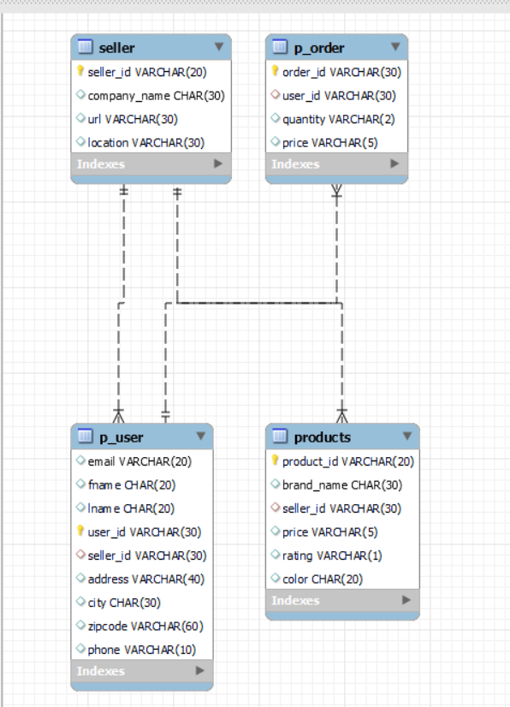
12
ER Diagram

Slide 13
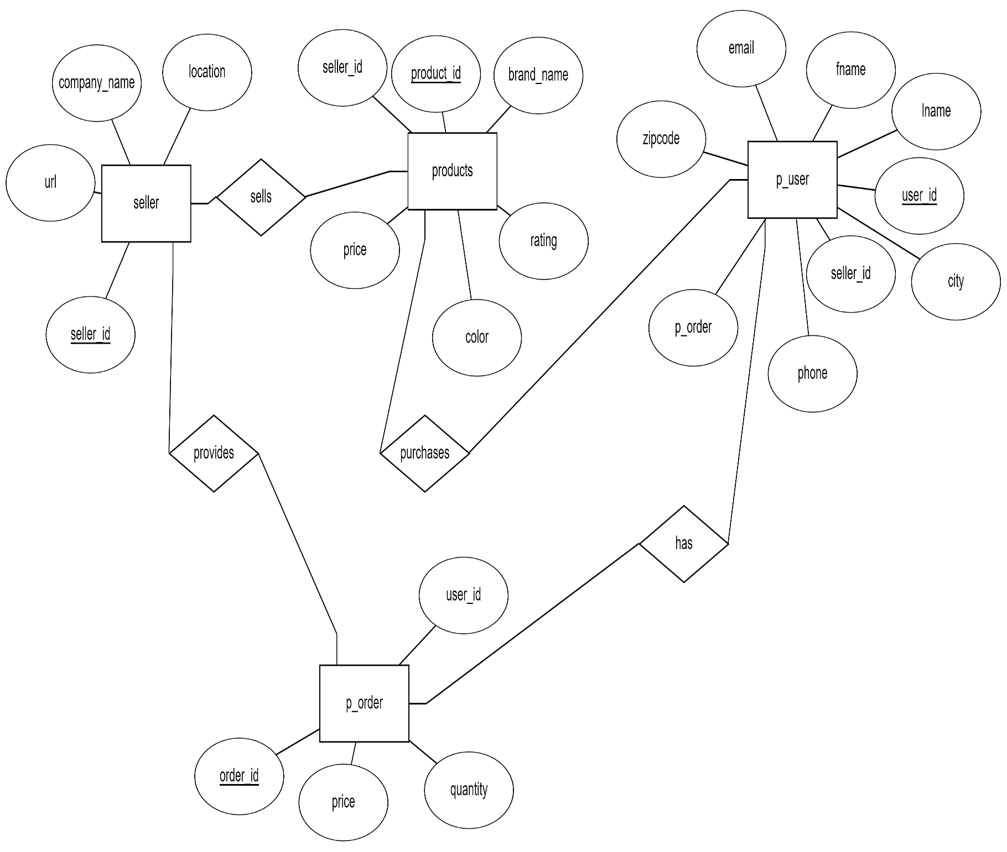
ER DIAGRAM Contd.

Slide 14
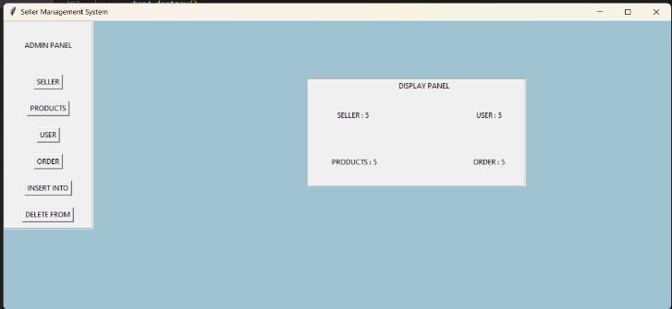
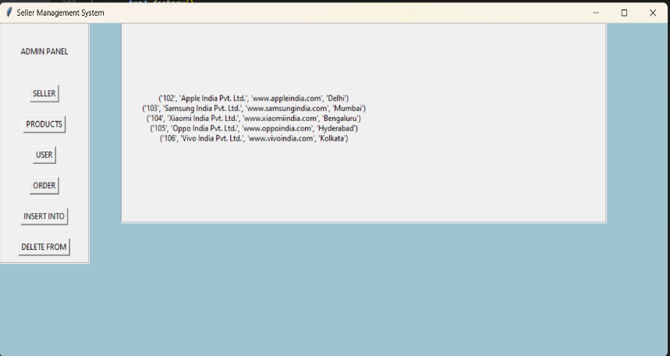
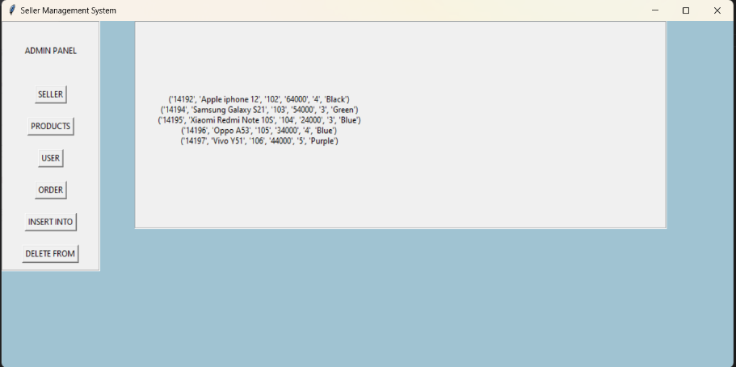
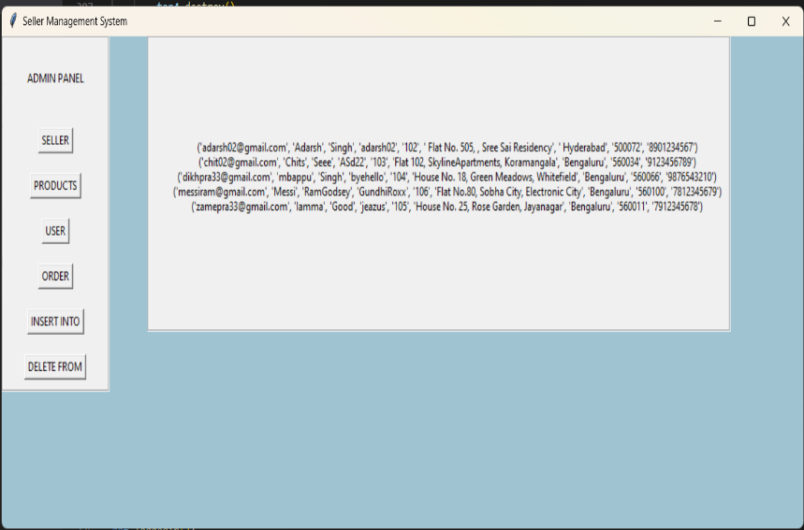
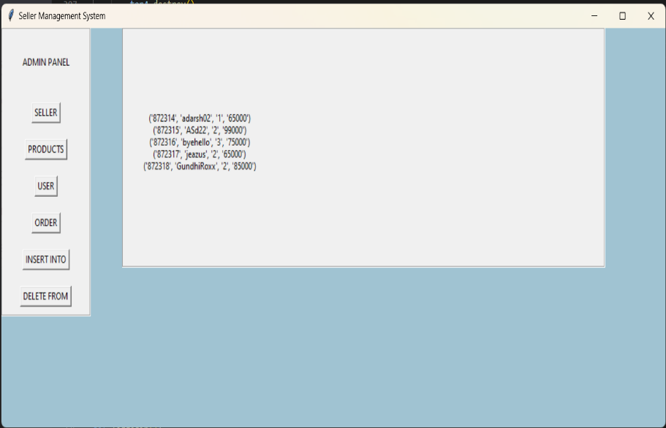
13
Queries performed
Display Of Respective No. Of Entries
Display Of seller table
Display Of products table
Display Of p_user table
Display Of p_order table

Slide 15
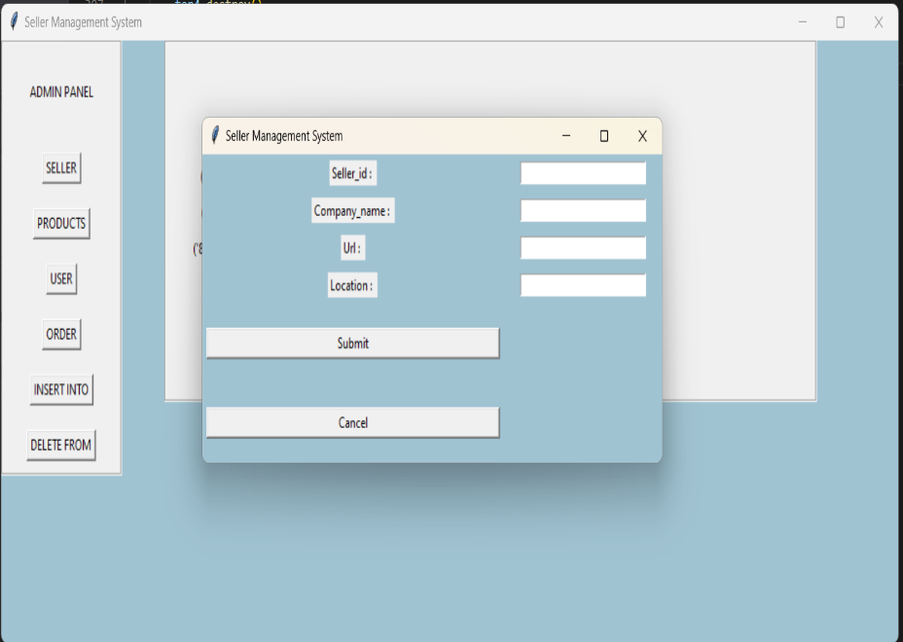
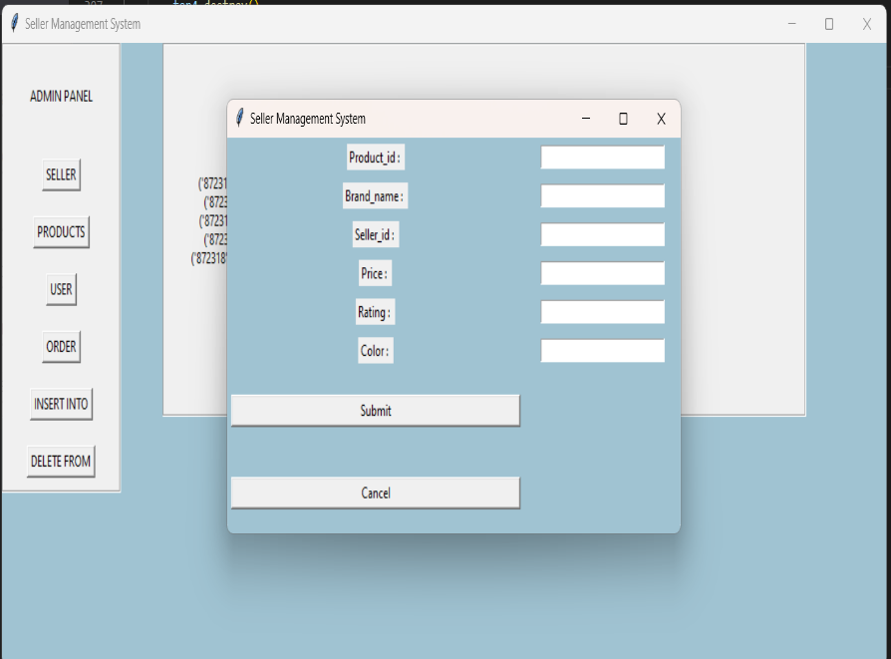
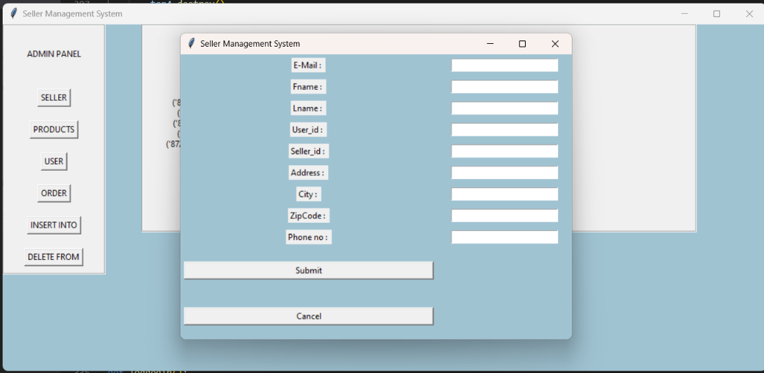
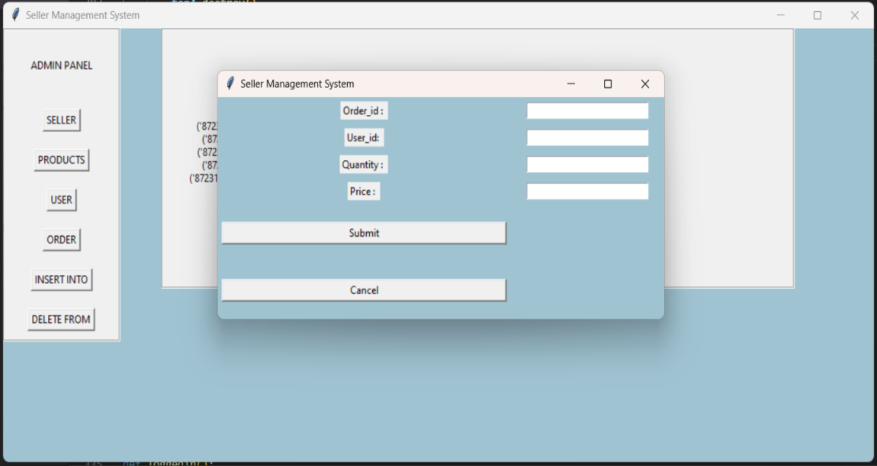
14
Insert Into seller table
Insert Into products table
Insert Into p_user table
Insert Into p_order table

Slide 16
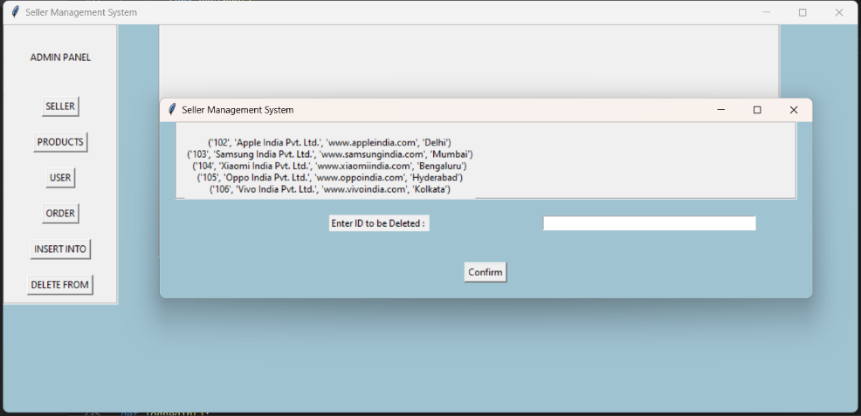
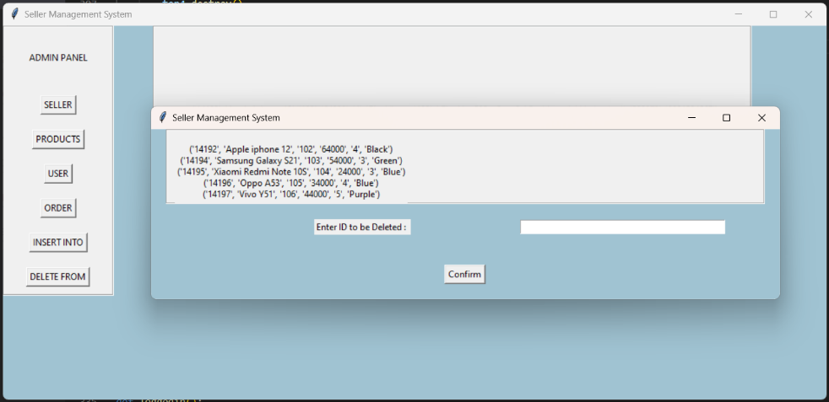
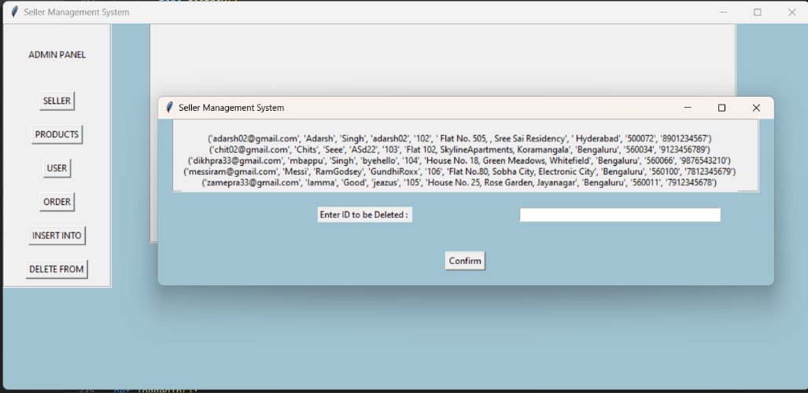
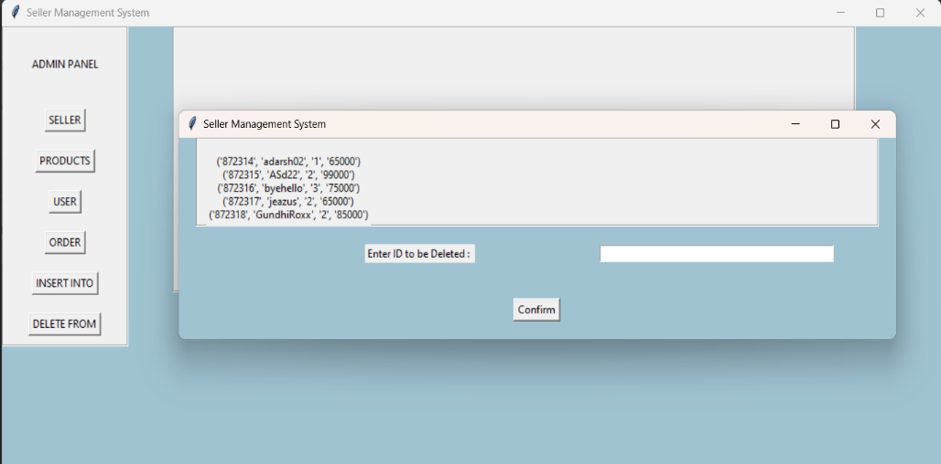
15
Delete From seller table
Delete From products table
Delete From p_user table
Delete From p_order table

Slide 17
16
Conclusion
At last through this Company Database we have established a way of entering all product details like price, brand_name, ratings and much more. And then using queries we have tried to alter the details and get only relevant details according to user needs in which we have used logical operators, modulo functions and various keywords.
We learnt the followings things from this project-
Creation of a database.
(2) Retrieval of information from the database.
(3) Updating the database.
(4) Managing a database.
It provides us with the many functionalities and is more advantageous than the traditional file system in many ways listed below:
Processing Queries and Object Management:
In traditional file systems, we cannot store data in the form of objects. In practical-world applications, data is stored in objects and not files. So in a file system, some application software maps the data stored in files to objects so that can be used further. We can directly store data in the form of objects in a database management system. Application level code needs to be written to handle, store and scan through the data in a file system whereas a DBMS gives us the ability to query the database.
2) Efficient memory management and indexing:
DBMS makes complex memory management easy to handle. In file systems, files are indexed in place of objects so query operations require entire file scans whereas in a DBMS , object indexing takes place efficiently through database schema based on any attribute of the data or a data-property. This helps in fast retrieval of data based on the indexed attribute.

Slide 18
3) Access Control and ease in accessing data:
A DBMS can grant access to various users and determine which part and
how much of the data can they access from the database thus removing
redundancy. Otherwise in file system, separate files have to be created
for each user containing the amount of data that they can access.
Apart from the above mentioned features a database management also provides the following:
-Multiple User Interface
-Data scalability, expandability and flexibility: We can change schema
of the database, all schema will be updated according to it.
-Overall the time for developing an application is reduced.
-Security: Simplifies data storage as it is possible to assign security
permissions allowing restricted access to data.

