Slide 1
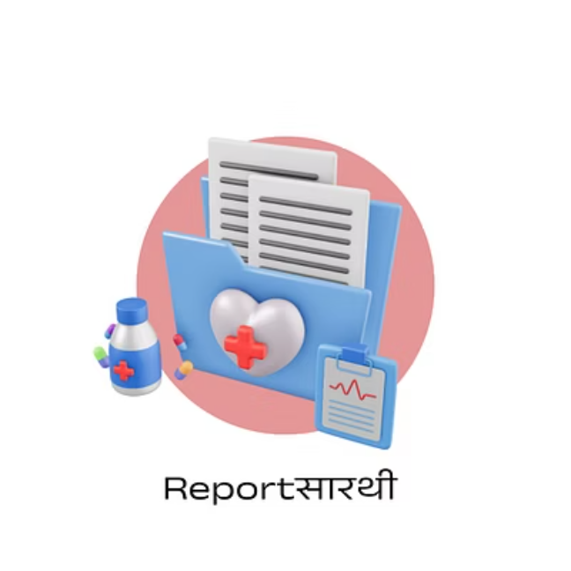

CLINICAL AI PLATFORM
Reportसारथी:
Multi-Modal AI Diagnostics Hub
AI-Powered Unified Clinical Intelligence Platform by XIE BOTS
A unified AI platform analysing heart, brain, and kidney reports in real time — transforming medical diagnostics with intelligent automation.

Slide 2
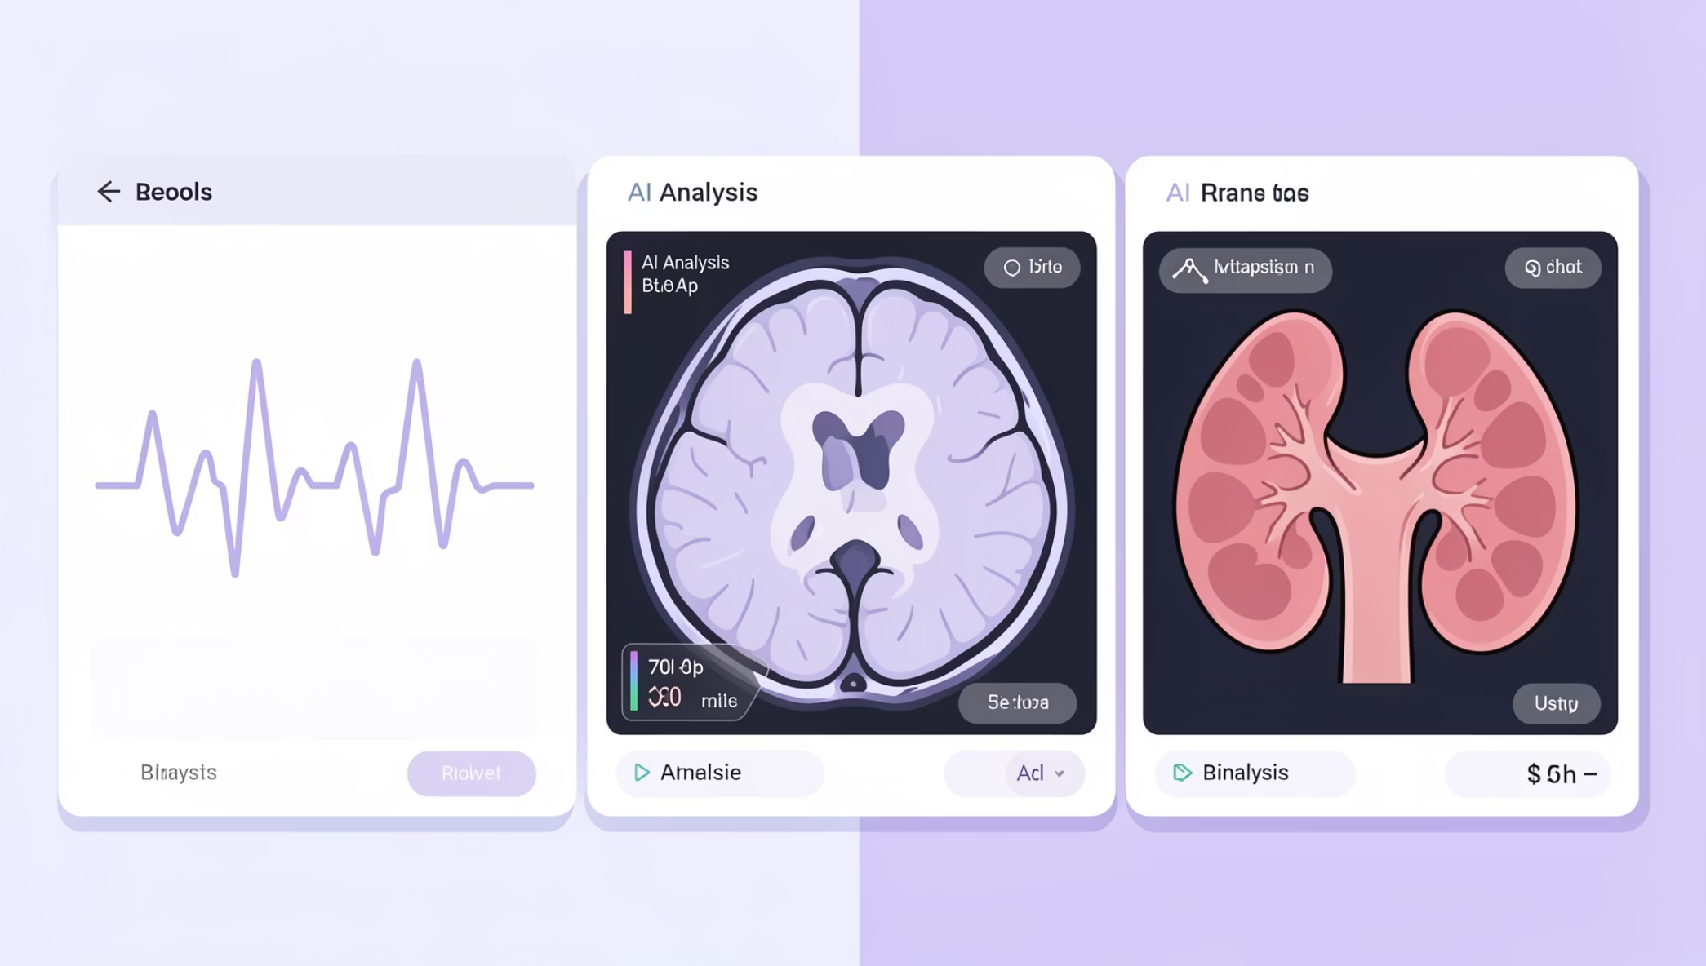
PLATFORM VISION
One Platform. Every Specialty.
The Multi-Modal AI Diagnostics Hub unifies three high-stakes clinical domains under a single intelligent interface — eliminating silos, accelerating decisions, and empowering clinicians with AI-driven confidence at every level of care.
Unified Dashboard
Real-Time Analysis
Interpretable Output
All specialties. One view.
Results in seconds, not hours.
Clinician-readable insights.

Slide 3
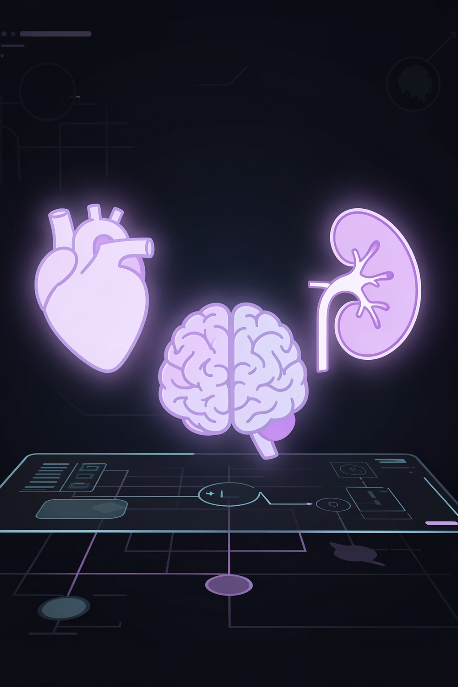

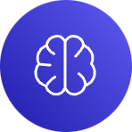

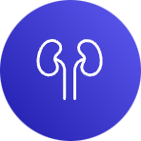
DIAGNOSTICS ENGINE
Specialised AI Models for Every Organ
Cardiac AI
Neuro AI
RandomForest model trained on 13 cardiac features — including BP, cholesterol, and ECG patterns — for heart disease risk classification.
MRI report NLP pipeline using TF-IDF + Logistic Regression to extract and classify neurological findings from unstructured clinical text.
Renal AI
Dedicated kidney_model.pkl evaluating 24 renal markers — Creatinine, GFR, Albumin — for chronic kidney disease staging.

Slide 4

DATA PROCESSING
Intelligent Data Ingestion Pipeline
What the Engine Handles
PDF Extraction
Automated parsing via pdfplumber — handles scanned reports, lab printouts, and clinical letters.
PDF Extraction
Multimodal Input
Heuristic Engine
Smart Heuristic Engine
Regex-based extraction identifies clinical values, units, and reference ranges with high accuracy.
Flexible Input Modes
Accepts PDF uploads, free-text paste, and structured form entry — meeting clinicians where they are.
From raw clinical documents to structured, model-ready data — the pipeline handles every input format with zero manual pre-processing.

Slide 5

CLINICAL INTELLIGENCE
Real-Time Risk Profiling & Emergency Response
Risk Profiling
Probability Scoring
Stratifies patients as High / Moderate / Low risk — enabling triage prioritisation at the point of care.
Each prediction carries a statistical confidence score, giving clinicians measurable trust in AI outputs.
Interpretable AI
Emergency Triggers
Human-readable clinical explanations accompany every result — not just predictions, but reasoning.
Critical findings auto-trigger doctor call alerts and live video consultation workflows instantly.

Slide 6
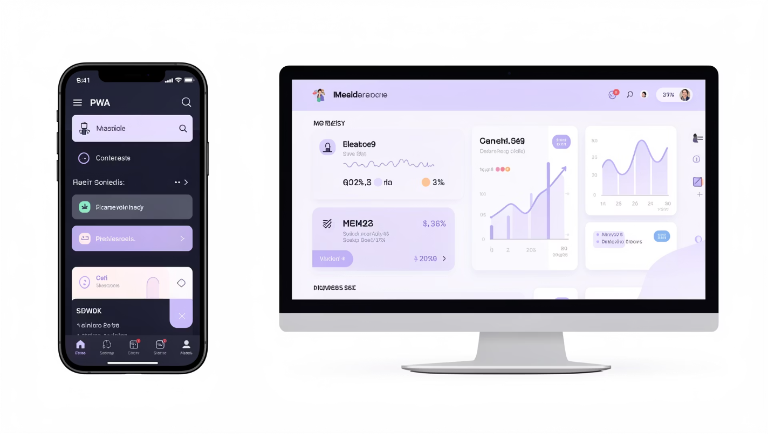
TECHNOLOGY STACK
Built for the Modern Clinical Environment
Frontend & Infrastructure
PWA
Installable app with full offline support — accessible even in low-connectivity clinical settings.
Next.js 15
Server-side rendering for fast, SEO-optimised, and highly responsive page loads.
Security
Clerk-powered secure authentication with role-based access for clinical staff.
UI/UX
Tailwind CSS, Lucide Icons, Glassmorphic Dark Mode — clinician-first design system.

Slide 7
MEASURABLE IMPACT
Outcomes That Move the Needle
3x
24+
Faster Diagnostics
Renal Markers
AI-assisted analysis cuts report-to-insight time dramatically across all three specialties.
The most comprehensive kidney risk model in the platform, covering every key biomarker.

Slide 8
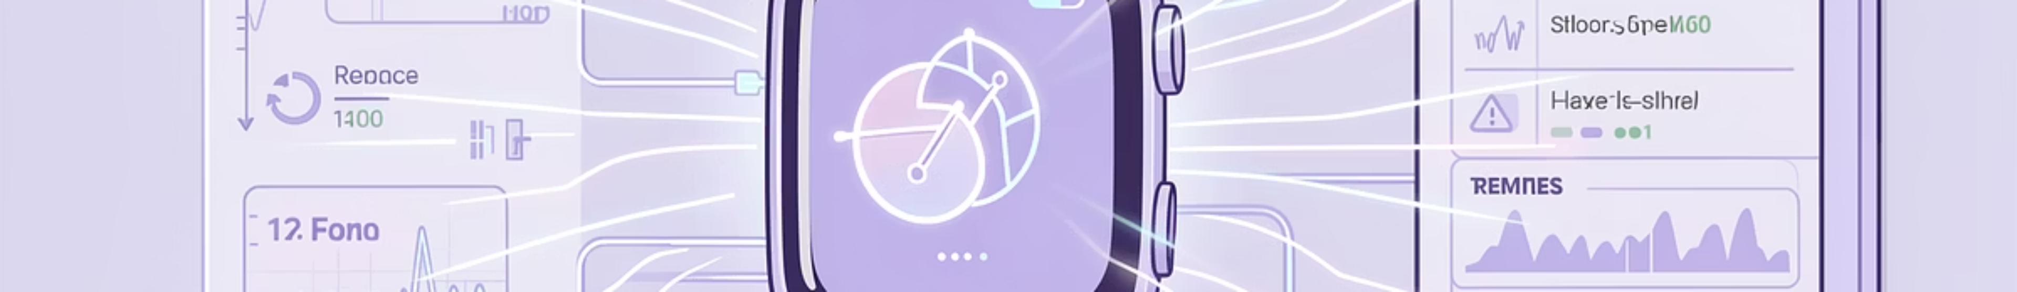
FUTURE ROADMAP
What Comes Next
Phase 1 — Now
Phase 3 — Strategic
Heart, Brain & Kidney AI models live on unified dashboard with PDF ingestion and risk profiling.
EMR / Hospital System compatibility via HL7 FHIR APIs — enabling seamless integration with existing clinical workflows.
1
2
3
4
Phase 2 — Near Term
Phase 4 — Vision
IoT + Wearables integration: continuous vitals from smartwatches and remote monitoring devices feed directly into risk models.
Multi-specialty expansion: Oncology, Pulmonology, Endocrinology — a true whole-body AI diagnostics ecosystem.

Slide 9
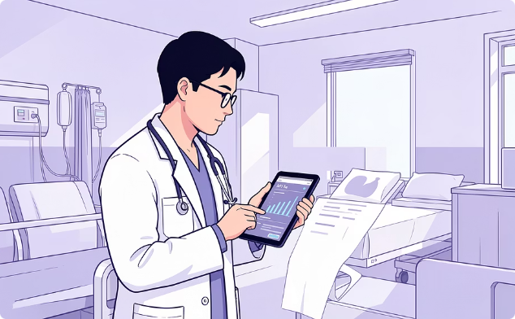

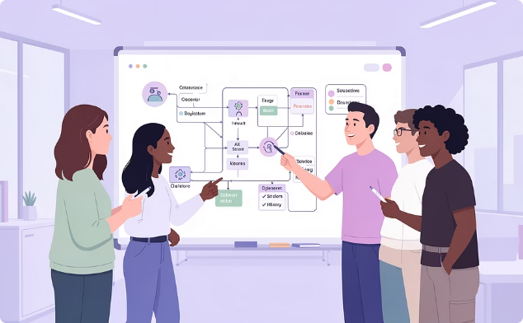
WHY IT MATTERS
Designed for Every Stakeholder
Clinicians
Health Executives
Product & Tech Teams
Spend less time on report interpretation and more on patient care — with AI surfacing critical findings instantly.
Reduce diagnostic costs, improve throughput, and demonstrate measurable outcomes with a scalable AI investment.
A modular, API-first architecture that integrates cleanly into existing systems and extends with new models.

Slide 10
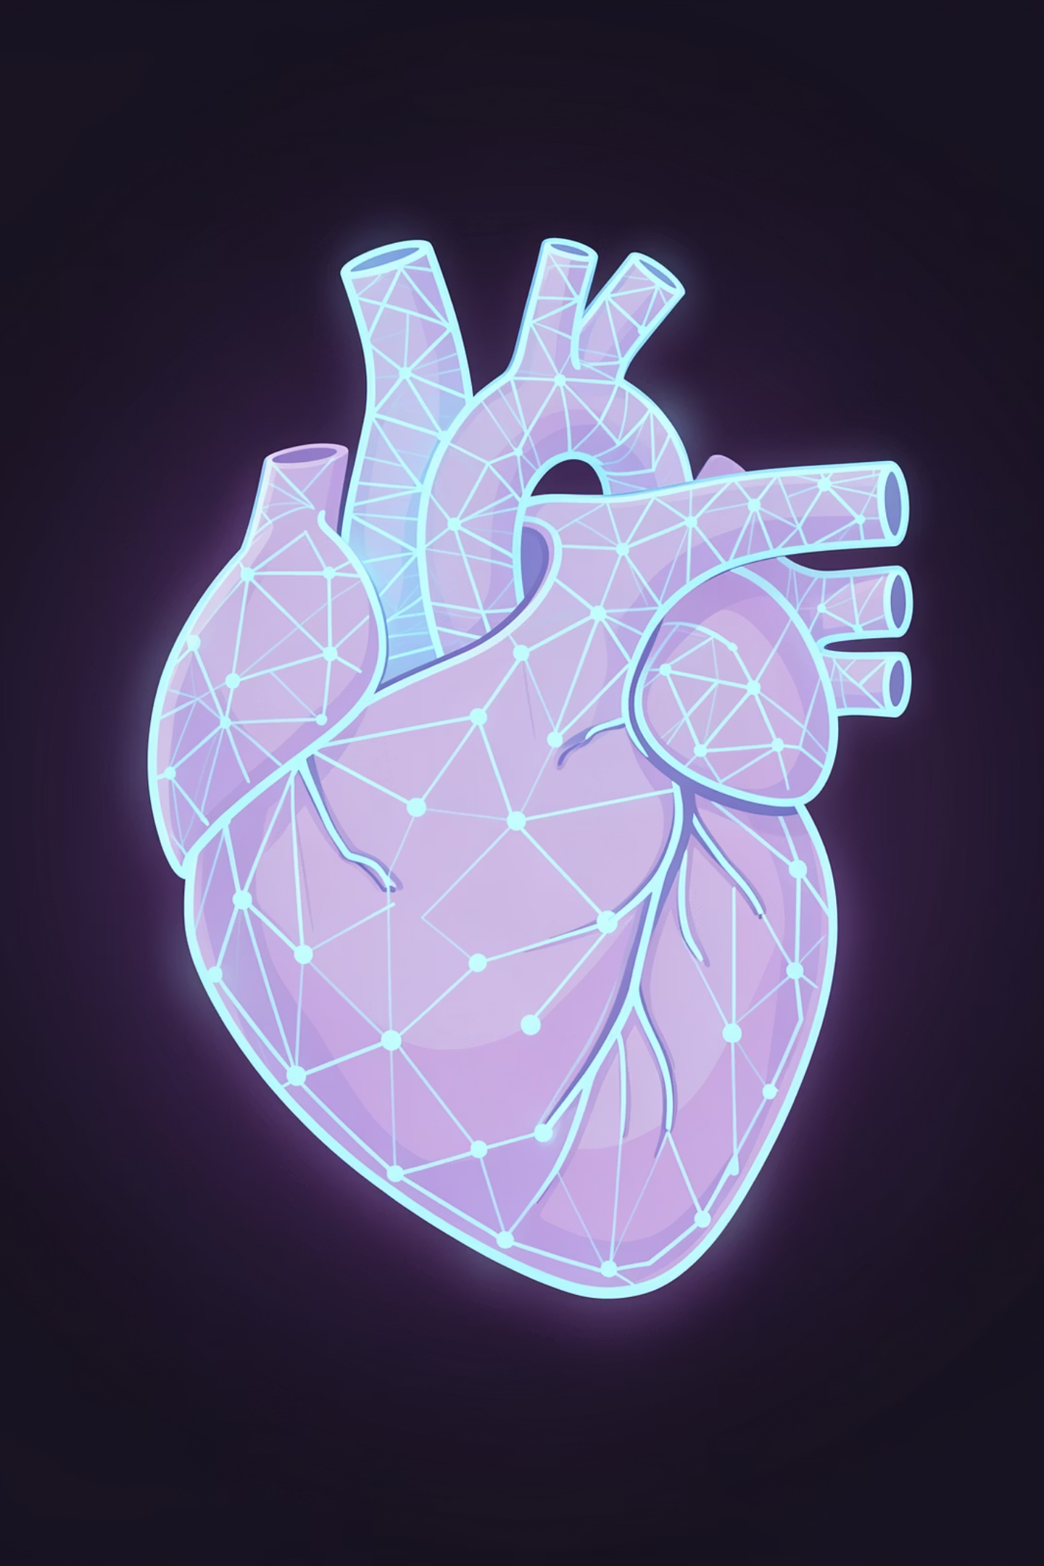
AI-Driven Healthcare.
Unified. Intelligent. Scalable.
The Multi-Modal AI Diagnostics Hub is not a product — it is a clinical operating system for the intelligent hospital of tomorrow. Built to adapt, designed to last, and engineered to save lives.
🫀 Cardiac AI
🧠 Neuro AI
13-feature RandomForest risk engine
NLP-powered MRI report analysis
🩺 Renal AI
24-marker kidney disease staging

