Slide 1
Improving E-Commerce Sales & Customer Satisfaction
Brazilian E-Commerce Analysis: Identifying Growth Opportunities & Operational Improvements
99,441
9
Orders Analyzed
Data Sources
2016–2018 Olist dataset
Related CSV datasets joined
26
3
Final Columns
Core Focus Areas
After cleaning & feature engineering
Categories, Delivery, Geography
This analysis surfaces five key business findings from 99,441 Brazilian e-commerce orders to guide strategic decisions in logistics, merchandising, and regional growth.

Slide 2



Data & Methodology
Dataset Overview
Analysis Workflow
Source
Brazilian E-Commerce Public Dataset by Olist (Kaggle)
Scope
99,441 orders · 9 CSV datasets · 2016–2018 · 26 engineered columns
Coverage
Raw Data
Cleaning
Joining
Feature Eng.
EDA
Complete order, customer, product, and delivery information per record
Tools & Technologies
Python
Google Colab
Pandas & NumPy for data processing
Cloud analysis environment
Google Sheets
Looker Studio
Data validation
Interactive dashboard

Slide 3

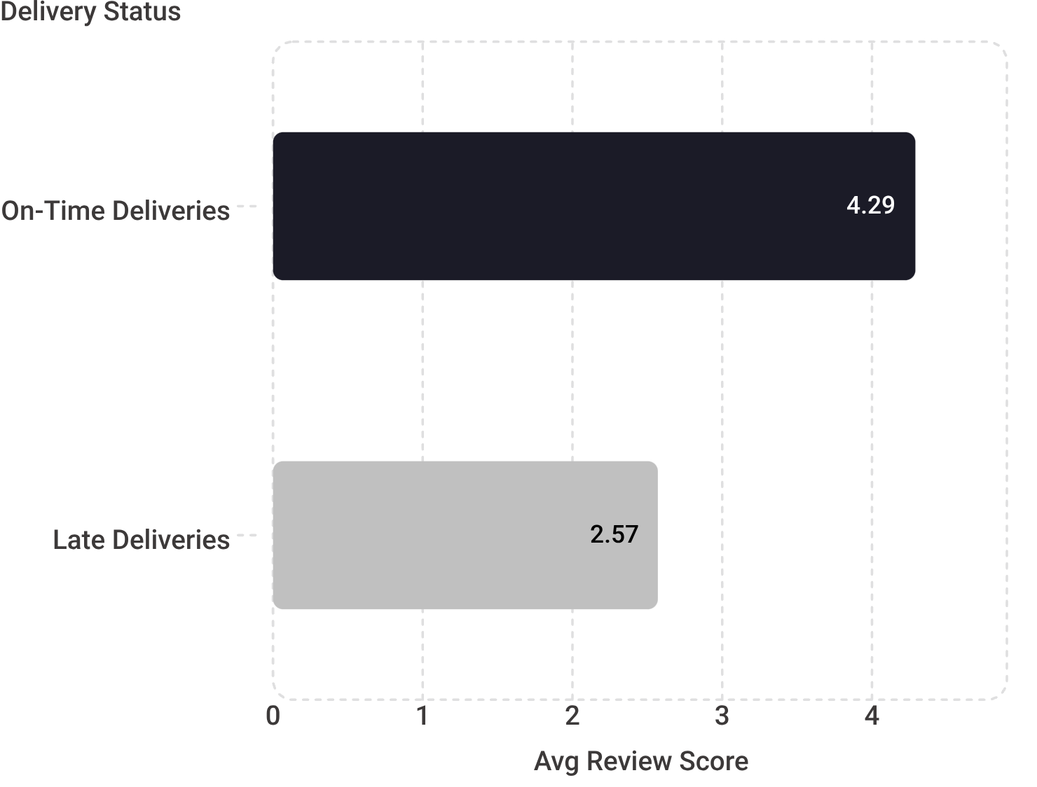


Key Business Findings
Category Concentration & Geographic Distribution
Delivery Performance vs. Customer Satisfaction
Category Concentration
Geographic Concentration
Top 5 product categories contribute 39.74% of total product sales value — a meaningful concentration risk and opportunity signal.
São Paulo alone accounts for 41,746 orders (42%). The top 3 states — São Paulo, Rio de Janeiro, and Minas Gerais — represent 66.5% of all orders.
Late Delivery Rate
Sales Growth Trend
Only 8.11% of delivered orders were late — but this minority is strongly associated with a 40% drop in customer satisfaction scores.
Sales increased substantially during 2017 and remained strong through most of 2018, confirming a growing and active market.
A 1.72-point gap in review scores — 40% lower satisfaction for late orders. Delivery reliability is a critical customer experience driver.

Slide 4
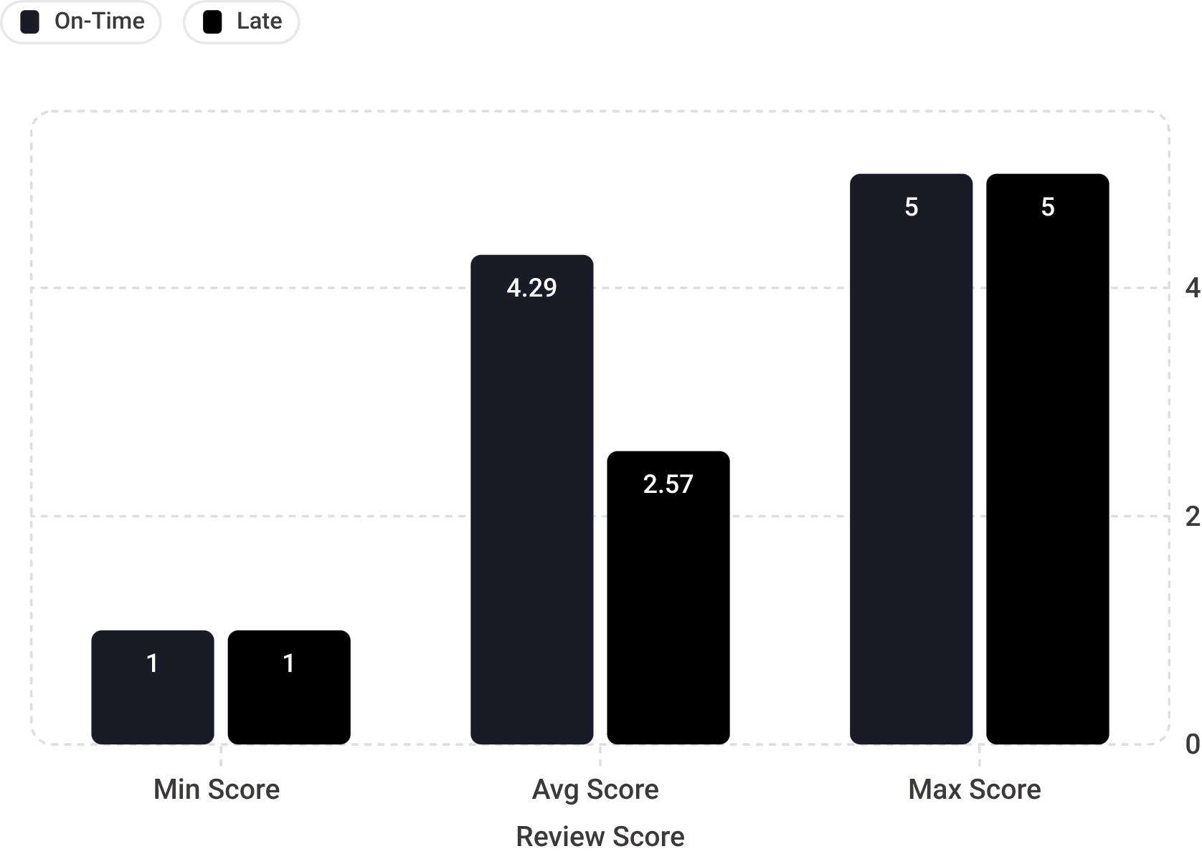



Deep Dive: Delivery Performance & Customer Satisfaction
On-Time Deliveries
Late Deliveries
Avg Review Score: 4.29 / 5.0
Avg Delivery Time: 10.88 days
Customer Sentiment: Highly satisfied
Avg Review Score: 2.57 / 5.0
Avg Delivery Time: 31.52 days
Customer Sentiment: Significantly dissatisfied
Review Score Distribution by Delivery Status
Delivery Time Comparison
10.88
Days (On-Time)
Average delivery duration for orders delivered as expected
31.52
Days (Late)
Average delivery duration for orders that arrived after the estimated date
Note: This analysis demonstrates a strong association between delivery performance and customer ratings — not causation. Other factors may also influence review scores.

Slide 5

High-Priority Recommendations
1
2
3
HIGH PRIORITY
HIGH PRIORITY
MEDIUM PRIORITY
Reduce Late Deliveries
Prioritize High-Performing Categories
Optimize Key Geographic Markets
Action: Identify and address problematic sellers, regions, and product categories with disproportionately high late-delivery rates. Implement seller performance standards and logistics monitoring.
Owner: Logistics & Operations
Success KPIs: Late-delivery percentage · Average review score across all orders
Action: Focus inventory allocation, marketing spend, and seller recruitment on strong-performing categories — particularly Health & Beauty and Watches & Gifts, which anchor the top 5 contributing 39.74% of sales value.
Owner: Merchandising / Marketing
Success KPIs: Product sales value · Category contribution percentage
Action: Strengthen logistics infrastructure and tailor regional strategies in São Paulo, Rio de Janeiro, and Minas Gerais — which together represent 66.5% of all orders. Prioritize on-time delivery performance in these high-volume markets.
Owner: Regional Operations / Marketing
Success KPIs: Sales volume · Order count · On-time delivery rate by state

Slide 6




Expected Business Impact
Target Success Metrics
Operational Impact
Late-Delivery Rate
Fewer late deliveries and improved logistics efficiency
More reliable and predictable delivery performance
Reduced operational friction and customer service costs
Reduce from current baseline of 8.11% through targeted seller and logistics interventions
Avg Review Score
Increase overall customer review score across all order types as delivery reliability improves
Customer Impact
Higher average customer review scores
Improved customer satisfaction and retention rates
Better word-of-mouth and repeat purchase frequency
Category Sales Share
Grow sales contribution from priority categories above the current 39.74% concentration
Commercial Impact
On-Time Delivery by State
Better inventory allocation to high-performing categories
Stronger sales growth in priority product segments
More effective regional marketing and seller strategies
Improved competitive positioning in key markets
Improve on-time delivery performance specifically in SP, RJ, and MG — 66.5% of all orders

Slide 7
Limitations & Next Steps
Analysis Limitations
Recommended Next Steps
Historical Data
01
Dataset covers 2016–2018 and may not reflect current customer behavior or market conditions.
Root-Cause Investigation
Drill down into late deliveries by seller, region, and product category to identify systemic causes and prioritize interventions.
Missing Business Data
No cost, profit-margin, marketing-spend, or customer-acquisition data was available, limiting ROI analysis.
02
Profitability Data Collection
Data Completeness
Collect cost, margin, and customer-acquisition data to enable deeper ROI analysis and resource prioritization.
Some orders have missing sales, delivery, or review information that could affect aggregate results.
03
Extreme Values
Current-Period Monitoring
Extreme delivery durations were retained as they may represent genuine operational edge cases.
Track live customer satisfaction and delivery performance metrics to validate findings against current conditions.
Association vs. Causation
04
All delivery-satisfaction findings reflect statistical association only — causation has not been established.
Broader Satisfaction Drivers
Perform deeper analysis to identify additional factors influencing review scores beyond delivery performance.
05
Predictive Modelling
Develop models to forecast delivery delays and customer churn risk, enabling proactive operational responses.

