Slide 1

Flight Delay Analysis: Predictive Modeling & Actionable Insights
Project Objective
Predict if a flight will be delayed (Yes/No) and estimate delay duration (minutes) to support proactive airline operations.
Dataset
179,338 records, 21 features (2015–2023).
Features: flight counts, delay causes, airport/carrier info, delay durations.
Methodology
Data cleaning and EDA
Feature engineering (removal of leakage, correlation checks)
Model development: Random Forest, XGBoost, Logistic Regression
Advanced analytics: SHAP (explainability), OAI (operational focus)
Tools
Python, scikit-learn, XGBoost, SHAP, Matplotlib, Seaborn

Slide 2
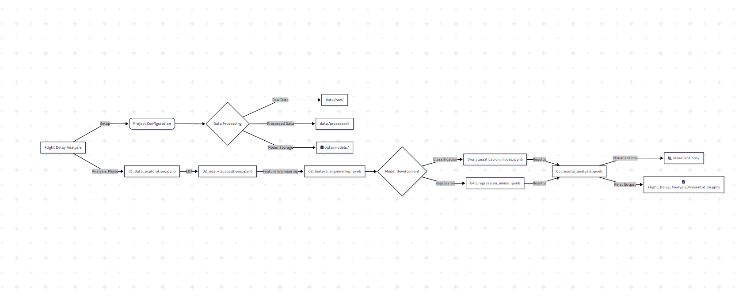
Project Flow
**zoom in for better quality

Slide 3
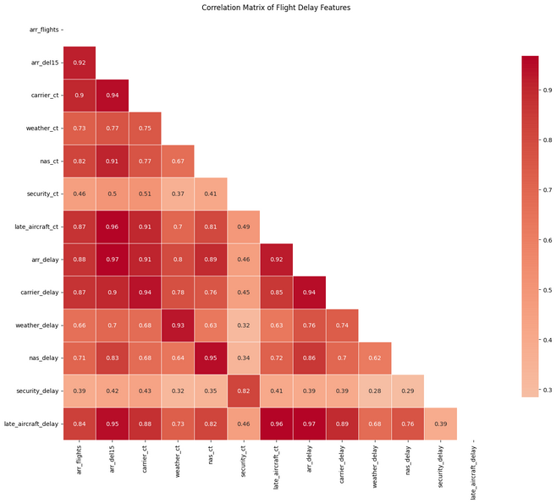
Key EDA Insights
Exploratory Data Analysis: Patterns & Drivers of Delay
Delay Rate
95% of flights experienced a delay (≥15 min).
Average delay: 3,856 min (all flights), 4,059 min (delayed only).
Top Delay Causes:
Late Aircraft (38.9%), Carrier (34.3%), NAS (21.2%), Weather (5.4%), Security (0.2%)
Temporal Patterns:
Delays peak in July/August; lowest in November.
Most delayed airports: ORD, DFW, ATL.
Most delayed carriers: WN, AA, B6.
Data Quality
Minor missing values, no negative flight counts, some extreme outliers handled
Visuals
Correlation heatmap (delay features)
Temporal patterns chart (delay by month)
Root cause bar/pie chart (delay causes)

Slide 4
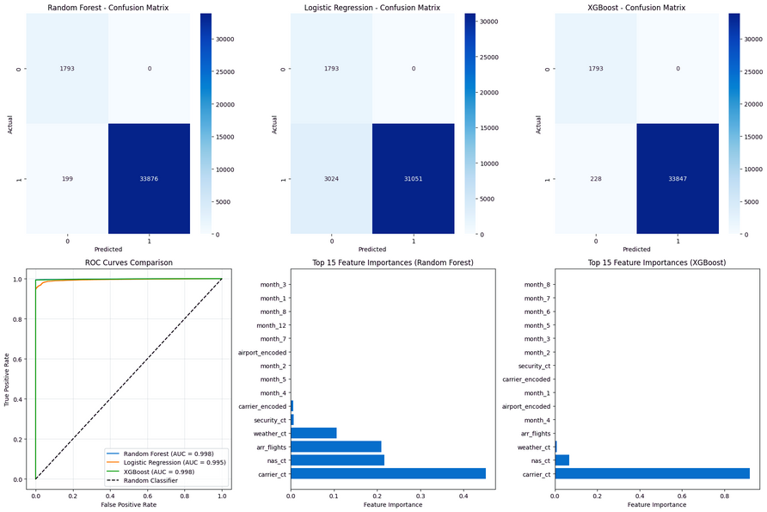
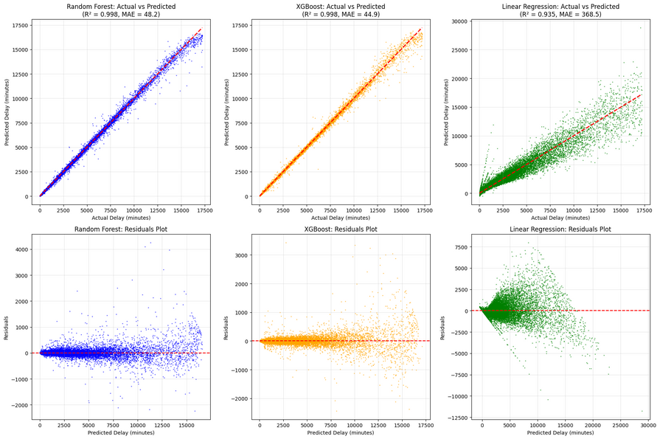
Model Development & Evaluation
Modeling Approach & Performance
Classification Task
Predict delayed flight (Yes/No)
Models: Random Forest (best), XGBoost, Logistic Regression
Imbalanced data handled by class weighting
Regression Task
Predict delay duration (minutes)
Models: XGBoost (best), Random Forest, Linear Regression
Outliers and leakage features removed
Hyperparameter Tuning:
GridSearchCV, 3–5 fold stratified CV, limited grid for efficiency
Visuals
Model workflow diagram
Table of best hyperparameters for each model

Slide 5
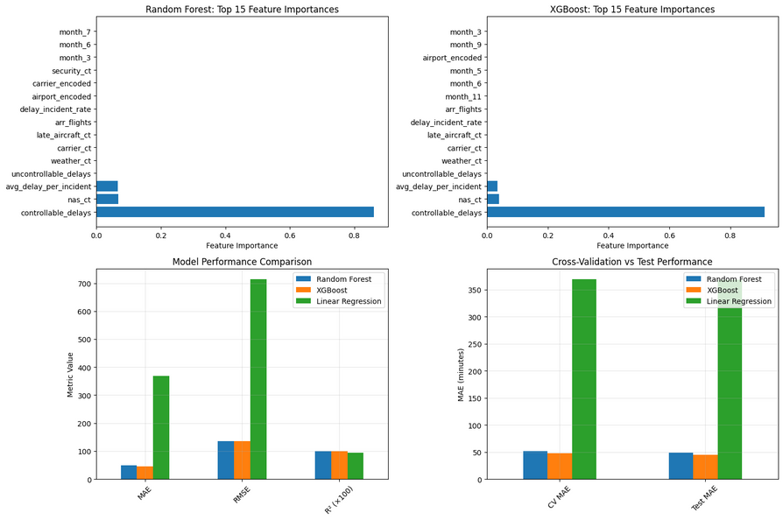
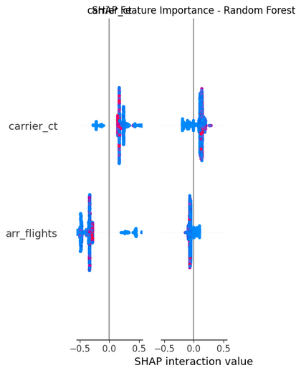
Model Performance & Explainability
Model Results & Explainability
Classification (Random Forest)
Accuracy: 99.45%, F1: 0.9971, AUC-ROC: 0.9983
Regression (XGBoost)
MAE: 44.86 min, RMSE: 135.16 min, R²: 0.9977
Explainability (SHAP)
Top features for delay: carrier_ct, late_aircraft_ct, total_delay_incidents
Top features for duration: carrier_delay, late_aircraft_delay, total_delay_minutes
OAI Metrics
Classification OAI AUC: 0.9778 (focuses on controllable delays)
Regression OAI-weighted MAE: 62.81 min
Visuals
ROC curve for classification
SHAP summary plot (feature importance for XGBoost)
Feature importance bar chart

Slide 6
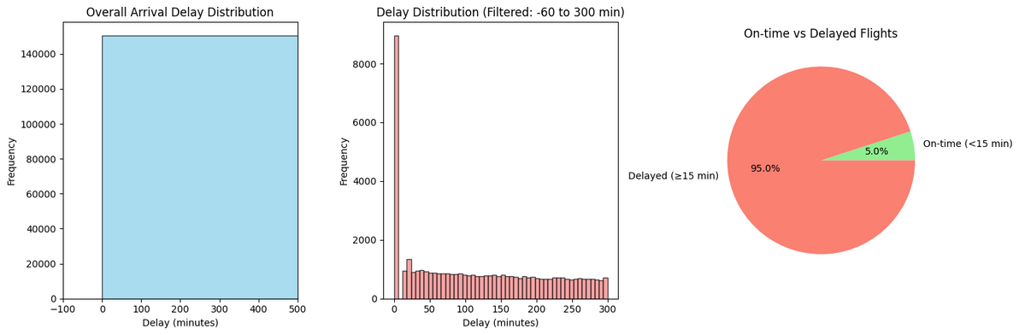
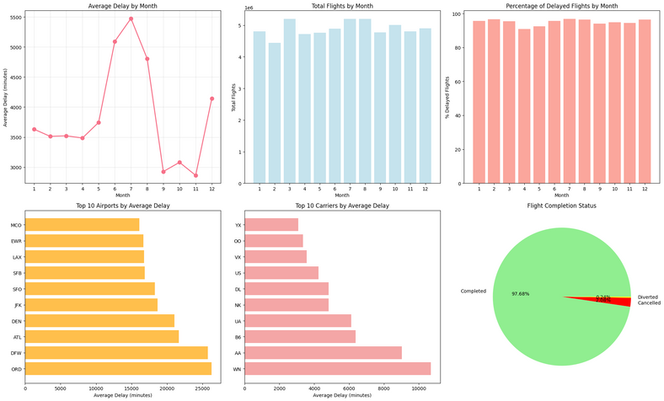
Project Impact & Scenario Analysis
Project Impact & Scenario Analysis
Current Baseline
Delay rate: 95%
Average delay: 4,059 min
Potential Impact
5% improvement: delay rate drops to 90.25%, saves ~200 min/flight
10% improvement: delay rate 85.50%, saves ~400 min/flight
15% improvement: delay rate 80.75%, saves ~600 min/flight
Operational Focus
OAI shows largest gains by targeting carrier and late aircraft delays
Visuals
Bar chart/table: scenario analysis (delay rate, avg delay, savings)
Pie chart: controllable vs uncontrollable delays

Slide 7
Actionable Recommendations
Actionable Recommendations & Next Steps
Immediate (0–3 months)
Integrate the best-performing model (Random Forest/XGBoost) into an interactive dashboard or notebook for ongoing analysis and demonstration.
Focus further analysis and model refinement on controllable delay causes (carrier and late aircraft), as identified by SHAP and OAI metrics.
Short-term (3–6 months)
Optimize feature engineering, especially around aircraft turnaround and scheduling, to further improve model generalization.
Experiment with additional ensemble and boosting algorithms, and compare results for robustness.
Long-term (6+ months)
Integrate external data sources (e.g., weather forecasts) to enhance predictive power and real-world applicability.
Explore dynamic modeling approaches (e.g., time series, real-time prediction) for future work or competitions.

