Slide 1
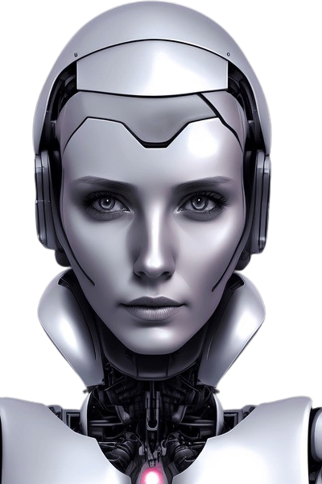
MIRA VIRTUAL ASSISTANT
(GROUP NO. – 10 )
SUPERVISED BY :- SUBMITTED BY :-
MR.SAMEER AWASTHI Ajit Kumar (2304221530008)
HOD (CSE-AI &AIML) Ansh Mishra (2304221530016)
Ashutosh Kushwaha (2304221530024)

Slide 2
MIRA VIRTUAL ASSISTANT
Mira is a smart virtual assistant designed to make everyday tasks easier. With a friendly and easy-to-use interface, Mira helps users with things like setting reminders, answering questions, and finding information. It learns from each user's preferences, becoming more helpful over time. Whether you need help organizing your schedule or looking for the latest news, Mira is always ready to assist. This innovative assistant shows how technology can improve our daily lives and make tasks more manageable.
Mira Virtual Assistant enables voice-forward control of Android apps. Using Assistant, users can launch apps, perform tasks, access content, etc.

Slide 3
WHAT DO MIRA VIRTUAL ASSISTANT
Opening any application (Any social media app)
Problem solving
Answering your questions in human understable language
Ensure Real Time and Date
Statewise wheather Report
Map Reporting
Find any location (from -to- to reach )
Open any image Easily .

Slide 4
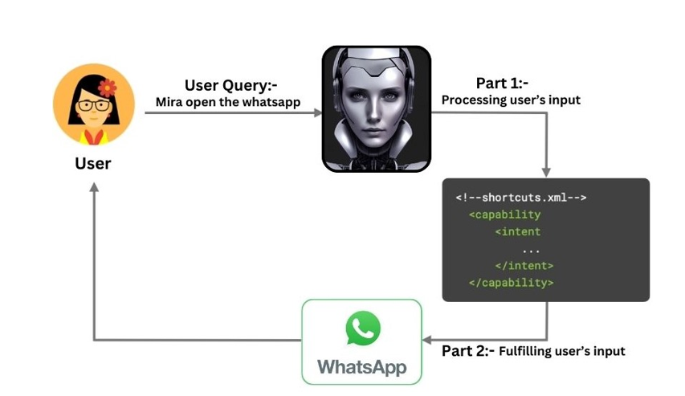
HOW MIRA WORK ?

Slide 5
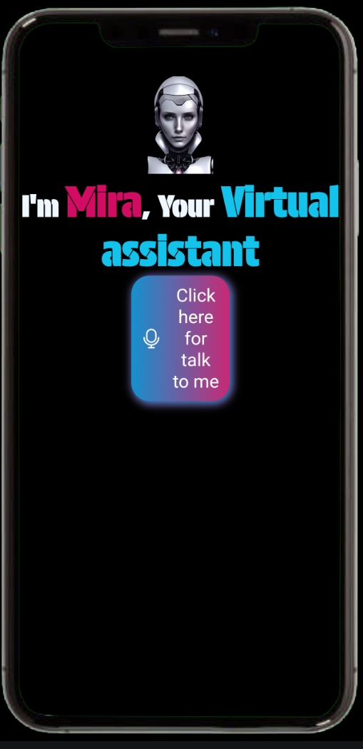
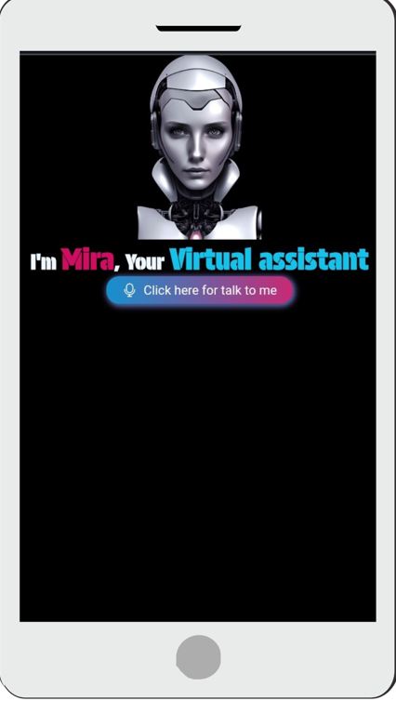
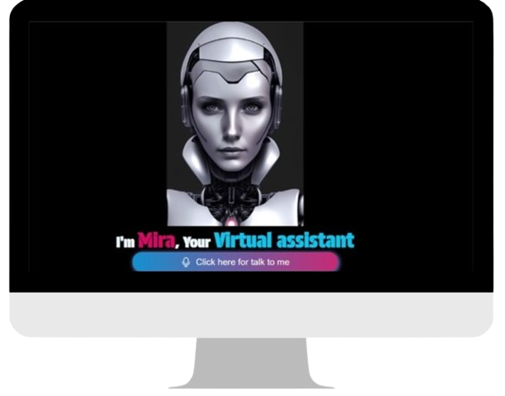
USER INTERFACE

Slide 6
Advantages
Hands-free control
Multi-device compatibility
Accessibility
Continuous learning
Language support
Wheather forecast
Real Time Information

Slide 7
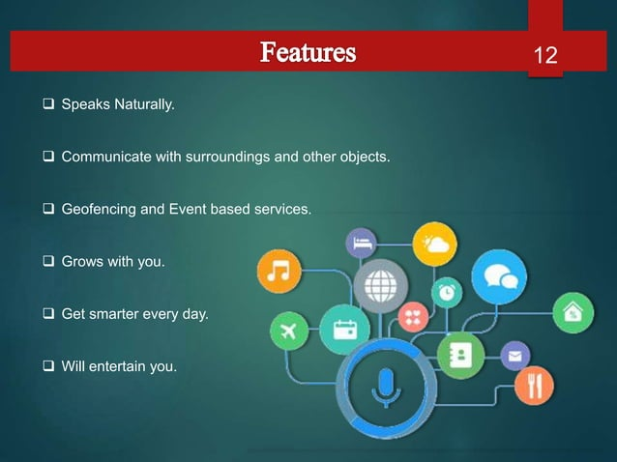

Slide 8
Conc
l
us
i
on
Conclusion
In conclusion, utilizing a virtual assistant can significantly enhance productivity and efficiency in various tasks and projects.
By fostering clear communication, defining tasks, and building a positive working relationship, you can maximize the benefits they offer. With the right approach, a virtual assistant can help you manage your time better, improve organization, and ultimately contribute to the success of your goals. Embracing this support can lead to a more streamlined workflow and allow you to focus on the aspects of your work that matter most. Overall, they can make your life easier .

Slide 9


