Slide 1


Project
Fake Speech Detection
(Conformer)

Slide 2
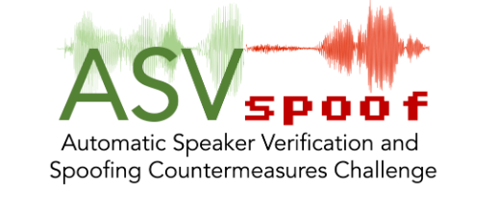
DatASET
ASVspoof 2019 Dataset :- The 3rd Automatic Speaker Verification Spoofing and Countermeasures Challenge database.
It Contains a 363k files of .flac files
ASVspoof 2019 tfrecord Dataset:- It is simple Subset of the dataset.
It contains a 30 files of .tfrec format.
(http://www.asvspoof.org)

Slide 3
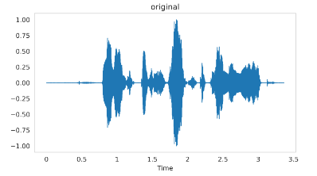
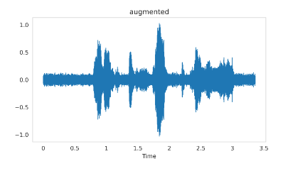
Data Augmentation
Two types of Augmentations are used here
AudioAug
SpecAug

Slide 4
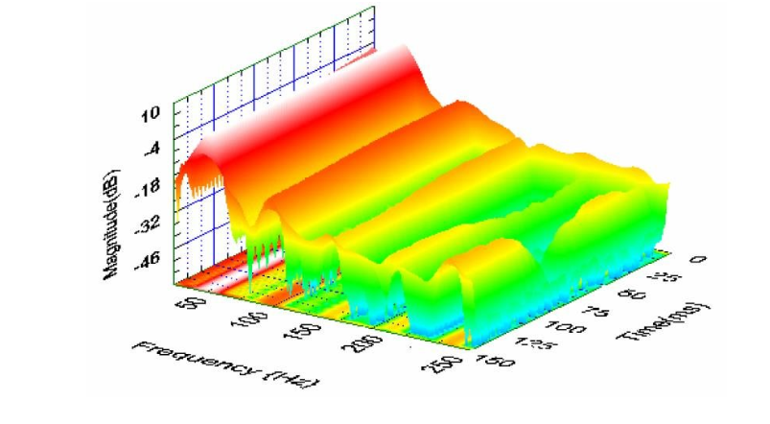
Feature Extraction
We'll feed Mel-Spectrogram feature to our model as input.
Spectrogram feature is extracted from audio sample using Short Time Fourier Transform (STFT).
The fast Fourier transform is a powerful tool
that allows us to analyze the frequency
content of a signal.

Slide 5
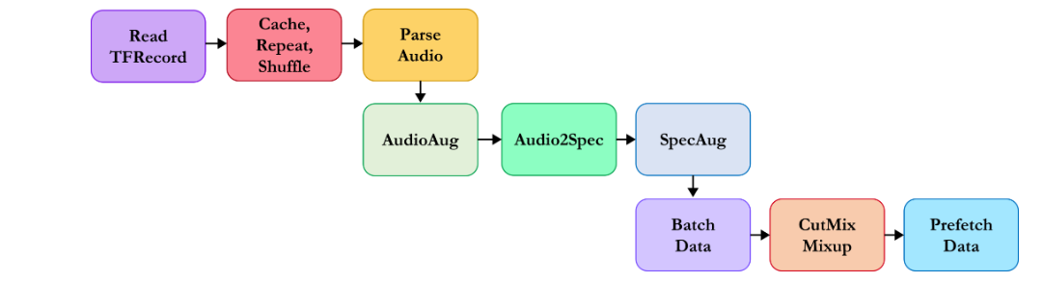
Data Pipeline
We can build complex input pipelines from simple, reusable pieces using tf.data API.
https://www.tensorflow.org/guide/data

Slide 6
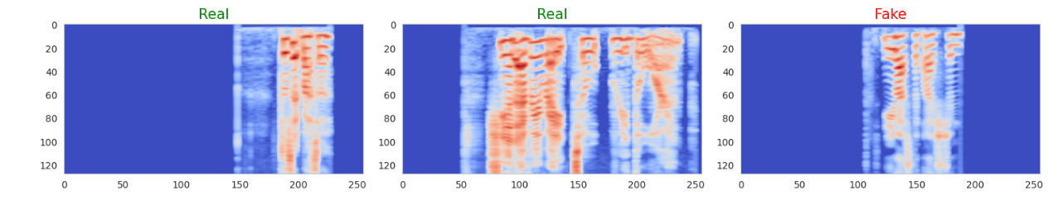
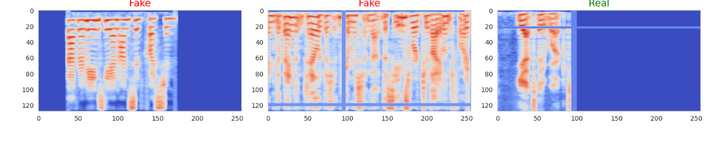
Visualization
spectrogram and its associate label.
Without Augmentation
With Augmentation

Slide 7
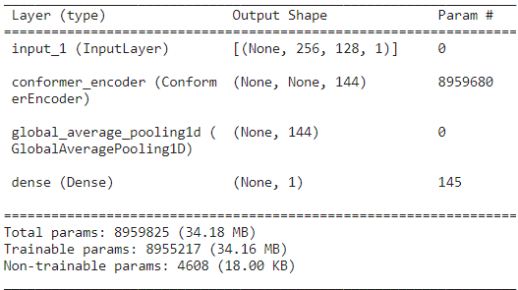

Model (Conformer)
A Neural net for speech recognition that was published by Google Brain in 2020.
I used as a transfer learning concept to train on the data.
Here is the Model Summary as well as Number of trainable parameters

Slide 8
Traning and matrix
Here is the training Status and Confusion Matrix.
We used Wandb for the looking of current Status.

Slide 9
Conclusion and Future scope
In the battle against audio manipulation, Conformers have become heroes.
Studies on datasets like ASVspoof showcase their impressive accuracy.
They can be used as a Ensumble Learning as well as other techniques for the Betterment of result.
Currenlty, It is in research field and widely used in Domestic Stations.

Slide 10
References
View Project at https://wandb.ai/anony-moose-214705333058967856/fake-speech-detection?apiKey=55191f42f262408d6d22cec5d9c08fc9e9af0fd4
View Run at https://wandb.ai/anony-moose-214705333058967856/fake-speech-detection/runs/u5htw2se?apiKey=55191f42f262408d6d22cec5d9c08fc9e9af0fd4
Dataset at http://www.asvspoof.org
Papers:
Conformer: Convolution-augmented Transformer for Speech Recognition https://arxiv.org/abs/2005.08100
Synthetic Voice Detection and Audio Splicing Detection using SE-Res2Net-Conformer Architecture https://ieeexplore.ieee.org/abstract/document/10037999
SpecRNet: Towards Faster and More Accessible Audio DeepFake Detection https://ieeexplore.ieee.org/abstract/document/10063734

