Slide 1
Difference Between a Traditional file system and DBMS
Traditional File System
Database management system
Data Kept in separate files (text,csv,etc.)
Redundancy is HIGH-same data may be repeated in multiple files.
Handled individually for each file.
Data can be accesed through custom programs written by developer.
Hard to maintain across files.
EXAMPLE:- A Shop keeps its customer list in an Excel file. Anyone with the file can open it and change all customer details.
Data Stored in structured table inside one database.
Redundancy is LOW-centralized storage reduces duplication.
Built-in user authentication and permissions.
Data can be accesed through SQL Queries provided by DBMS.
Automatically maintained by DBMS.
EXAMPLE :- The same shop starts keeping its customer list in a databse. Now the cashier can only view customer names,while the manager can add or edit customer details.

Slide 2
DATA ABSTRACTION
Data abstraction means hiding the details of how data os stored and showing only the part the user needs.
It has Three levels: -
Physical Level - how data is physically stored on disk (hidden from user).
Logical Level - what data is stored and the relationships between data (visible to DBA).
VIEW LEVEL – what each user sees; a customized “view” of the data.

Slide 3
Data Independence
Data independence means you can change one level of the database without affecting the others.
These are of two types :-
Physical Data Independence:-changes in physical storage (e.g.,moving to a new disk)do not affect the logical schema or user views.
Logical Data Independence:- changes in logical schema (e.g., adding a new coloumn) do not affect existing user views or programs

Slide 4
TYPES OF SQL COMMANDS:-
1)DDL :- Data Definition Language
Defines and manages the structure of the database(tables,views,indexes).
EXAMPLES:-
*CREATE TABLE Students(…)-creates a new table.
*Alter Table Students ADD PhoneNo VARCHAR(15)-modifies an existing table.
*DROP TABLE Students- deletes a table completely.
USE CASE:- setting up the database structure at the beginning of a project.

Slide 5
DML-Data Manipulation Language
Used to insert, update,delete, or fetch the actual data inside the table.
EXAMPLE:-
*INSERT INTO Students (ID,Name)VALUES(1,’Ansh’)-inserts a new record.
*UPDATE Students SET Name=‘hansika’WHERE ID=1-updates existing data.
*DELETE FROM Students WHERE ID=1-deletes a record.
*SELECT *FROM Students-retrieves data.
USE DATA:- Day-to-day operations on data after the databases structure exists.

Slide 6
DCL-Data Control Language
Manages user permission and access control.
Examples:-
*GRANT SELECT ON Students TO teacher1- gives a user permission to view
data.
*REVOKE SELECT ON Students FROM teacher1-removes the permission.
USE CASE :- CONTROLLING WHO CAN READ OR MODIFY WHICH
TABLES IN A MULTI-USER ENVIROUMENT.

Slide 7
TCL-TRANSACTION CONTROL LANGUAGE
Controls transactions to maintain data integrity.
EXAMPLES:-
*COMMIT :- permanently saves the changes.
*Rollback:- undoes changes since the last commit.
*Savepoint :- sets of a point to which you can roll back.
USE CASES:- banking systems,order processing,or any place where multiple updates must be all-or-nothing.

Slide 8
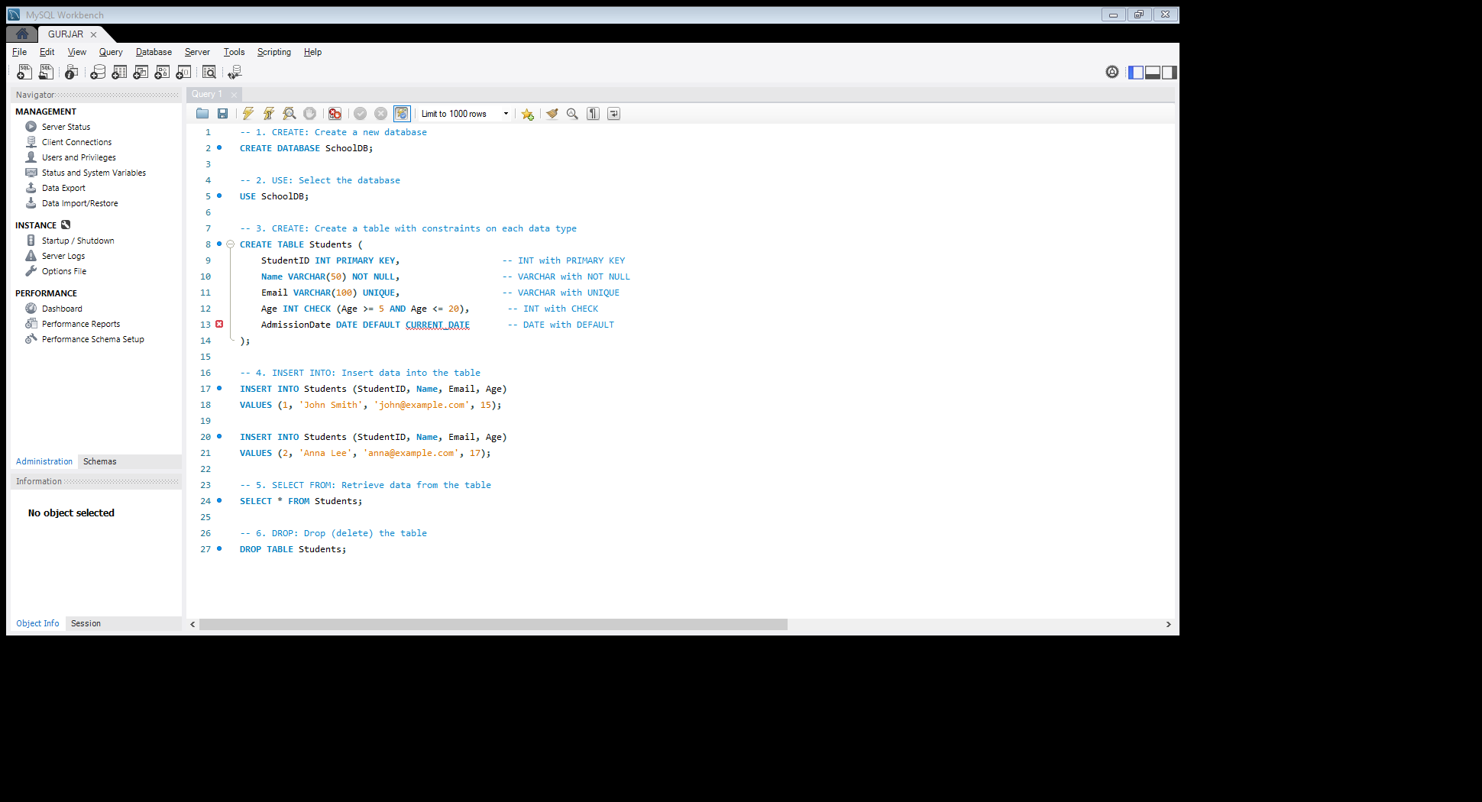
SQL ASSIGNMENT
Understanding DBMS Concepts and SQL Commands
Ansh Dedha
B.Sc Artificial Intelligence

