Slide 1




POWER BI PROJECT
GoodReads
Books
Data Source
GoodReads CSV Dataset
Tool Used
Microsoft Power BI Desktop
Uncovering Publishing Trends
& Author Insights with Power BI
Scope
Author, Book & Publishing Analysis
89,340 Books • 39.6K Authors
Data Analysis | Power BI | DAX | Power Query

Slide 2



PROJECT OVERVIEW
What Is This Project About?
This Power BI project analyzes 89,340 books from GoodReads. It identifies trends around author productivity, reader engagement (ratings & reviews), publication timelines, and genre patterns — delivered through an interactive, filterable single-page dashboard built entirely in Power BI Desktop.
Explore
Analyze
Measure
Discover
Author & Book Performance
Publishing Trends by Year & Month
Ratings & Reviews Engagement
Top Authors & Patterns

Slide 3




THE DATASET
GoodReads Books — Raw Data at a Glance
89,340
39,669
25M
589
0 – 5
Total Books
Unique Authors
Total Pages
Genre Tags
Rating Scale
Original Columns in the CSV
id
title
rating
rat_rev
page
year
author_detail
genre
desc
author_link
Kept as-is
Transformed
Dropped

Slide 4
DATA PREPARATION
Power Query — Cleaning & Feature Engineering
01
Columns Dropped
04
Page Count
Removed desc and author_link — no analytical value, reduced model size.
Parsed page list-string → extracted leading integer page number.
02
No. of Ratings
05
Publication Year
Parsed rat_rev string → extracted integer rating count (e.g., 26,044).
Parsed year list-string → extracted 4-digit year (e.g., 2006).
03
No. of Reviews
06
Publication Month
From same rat_rev field → extracted integer review count (e.g., 648).
From same year field → extracted month name for monthly trend analysis.

Slide 5
DAX MEASURES
8 Custom Measures Powering the Dashboard
Total Books
KPI Card
Total Authors
KPI Card
COUNTROWS('GoodRead_Books')
DISTINCTCOUNT([author_detail])
Total Pages
KPI Card
Total Genres
KPI Card
SUM([page])
DISTINCTCOUNT([genre])
Count of Month
Bar Chart
Count of Year
Bar Chart
COUNT([month])
COUNT([year])
Count of No.of Ratings
Clustered Bar
Count of No.of Reviews
Clustered Bar
COUNT([No.of ratings])
COUNT([No.of reviews])

Slide 6
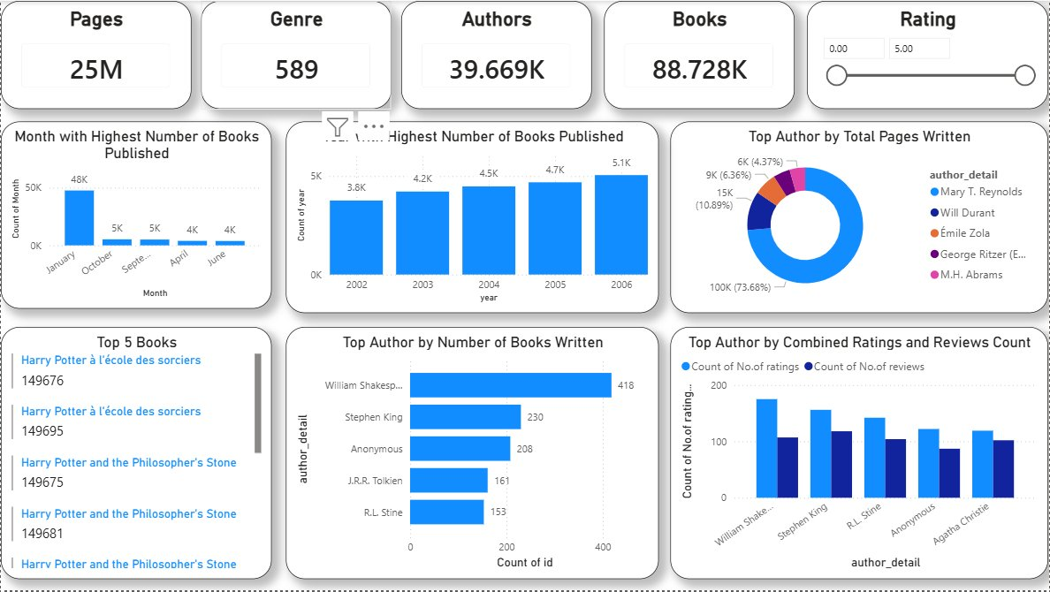
DASHBOARD SHOWCASE
The Final Power BI Dashboard
Single-page interactive dashboard • Rating slider filter • Cross-filtering enabled across all visuals

Slide 7


KEY FINDINGS
5 KPIs — Questions Answered
Author with Most Books Written
William Shakespeare
418 Books
Author with Most Pages Written
Mary T. Reynolds
~100K Pages
Author with Max Ratings & Reviews
William Shakespeare
Leads Both
Month with Most Books Published
January
~48,000 Books
Year with Most Books Published
2006
~5,100 Books

Slide 8
AUTHOR ANALYSIS
Top Authors by Books Written
418
Books by Shakespeare
(most prolific author)
230
Books by Stephen King
(top modern author)
~40K
Total unique authors
in the dataset

Slide 9
PUBLISHING TRENDS
When Were Books Published?
Top Publication Years (2002–2006)
Top 5 Publication Months

Slide 10

READER ENGAGEMENT
Ratings & Reviews by Top Authors
Most Engaged
William Shakespeare leads in both ratings and reviews across all authors.
Reviews vs Ratings
Higher review-to-rating ratio signals an actively commenting reader community.

Slide 11
KEY INSIGHTS
What the Data Tells Us
Shakespeare Dominates
Mary T. Reynolds — Volume
418 titles + leads both ratings and reviews. Driven by the large number of editions and collections cataloged on GoodReads.
Accounts for 73.7% of total pages among top authors — reflecting extremely high-volume long-form output.
January Publishing Spike
Growth Trend 2002–2006
~48K books in January — nearly 10x any other month. Likely reflects books with unknown month defaulting to Jan 1.
Consistent year-over-year growth from 3,800 in 2002 to 5,100 in 2006, reflecting expanding GoodReads cataloging.

Slide 12


Project Summary
89,340 books from GoodReads CSV
THANK YOU
Power Query: 6 transformation steps
GoodReads Books
Power BI Project
8 DAX measures created from scratch
6 interactive dashboard visuals
5 business KPIs fully answered
Powered by Microsoft Power BI Desktop
Data Analysis | Power BI | DAX | Power Query | GoodReads Dataset

