Slide 1
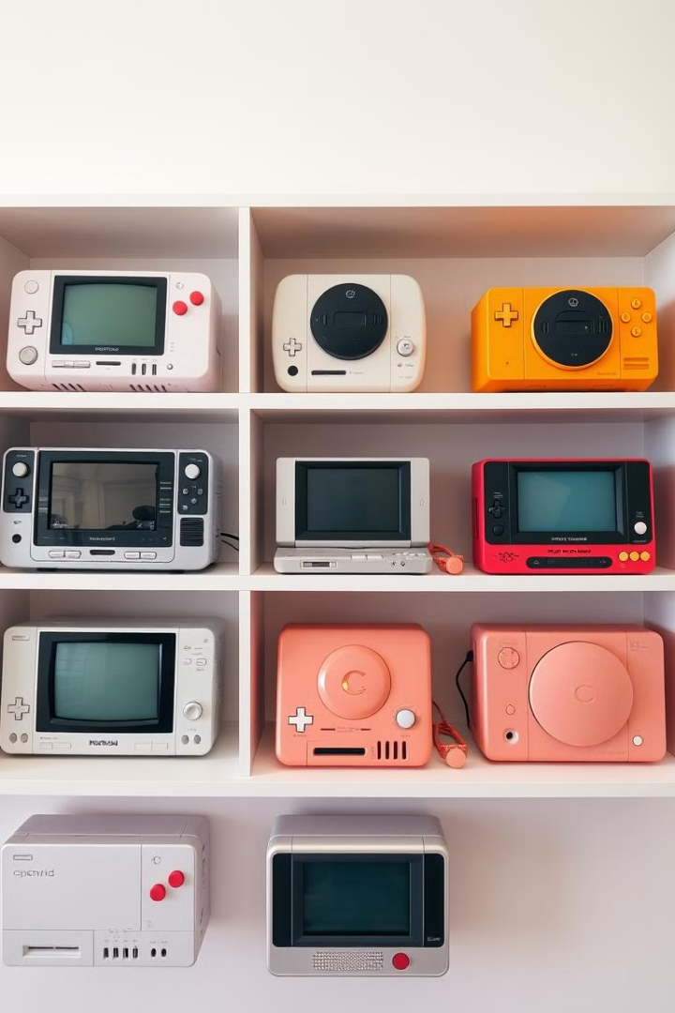
Fun Games : Your Next Favorite Gaming App
Welcome to the Fun Games !! This engaging app includes six interactive games designed to provide hours of entertainment for users of all ages. The collection features a simple, intuitive user interface, ensuring a seamless and enjoyable gaming experience. Dive in and explore a variety of challenges, from memory games to strategy classics.
Each game is crafted with attention to detail, offering smooth animations and responsive touch controls. Whether you're looking to sharpen your memory, test your color recognition skills, or engage in strategic gameplay, this collection has something for everyone. Get ready to embark on a fun-filled gaming adventure!
-By
Ansh Gadoya [ 13 ]
Bansil Pabari [ 18 ]

Slide 2
1. Functional Requirements
General App Functionalities:
The app should allow users to select a game from the main menu.
Each game should load properly when selected.
The app should track and display scores (if applicable).
A user should be able to restart or exit a game at any time.
If a game has levels (like Color Hunt), the app should progress through levels accordingly.
If a game involves lives (like Color Hunt), the app should update the heart icons accordingly.
The app should return to the main menu after a game is over.
Game-Specific Functionalities:
Sound Memory (Simon Says): The app should play a sequence of sounds that the user must repeat correctly.
Color Hunt: The app should highlight the correct color based on the difficulty level. Lives should decrease when the user selects the wrong color.
Card Memory: The app should display a grid of face-down cards that flip when tapped, checking for matching pairs.
Tic-Tac-Toe: The app should allow two players to play alternately, checking for win/draw conditions.
Word Search: The app should generate a grid of letters with hidden words that the user must find

Slide 3
2. Non-Functional Requirements
Performance Requirements:
The app should load games within 2-3 seconds after selection.
The animations and transitions should be smooth and not laggy.
The response time for user interactions should be less than 1 second.
Usability Requirements:
The app should have an intuitive and easy-to-navigate UI.
The text and UI elements should be readable and clear on all screen sizes.
The color scheme should be visually appealing and not strain the eyes.
Reliability Requirements:
The app should not crash when switching between games.
Security Requirements:
The app should not require any sensitive user data.
Any saved game data should be stored securely.
Portability & Compatibility Requirements:
The app should run smoothly on Android devices with Android 11.0 (Red Velvet Cake) and above.

Slide 4
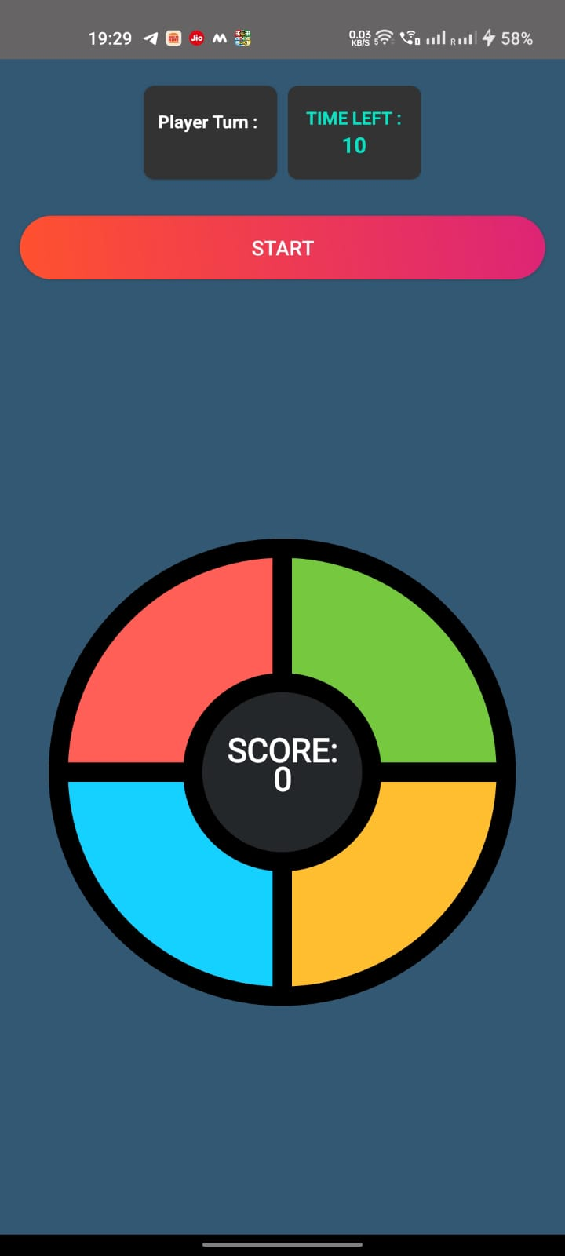
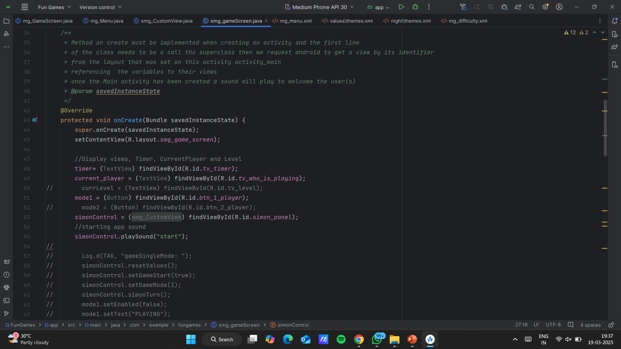
User Interface Design:
Sound Memory
Features a minimalist design with a grid of hidden sound icons. Players match unique sounds to win, with an interface designed for ease of use.
Both games feature touch responsiveness and smooth animations for a seamless user experience. The design prioritizes clarity and simplicity.

Slide 5
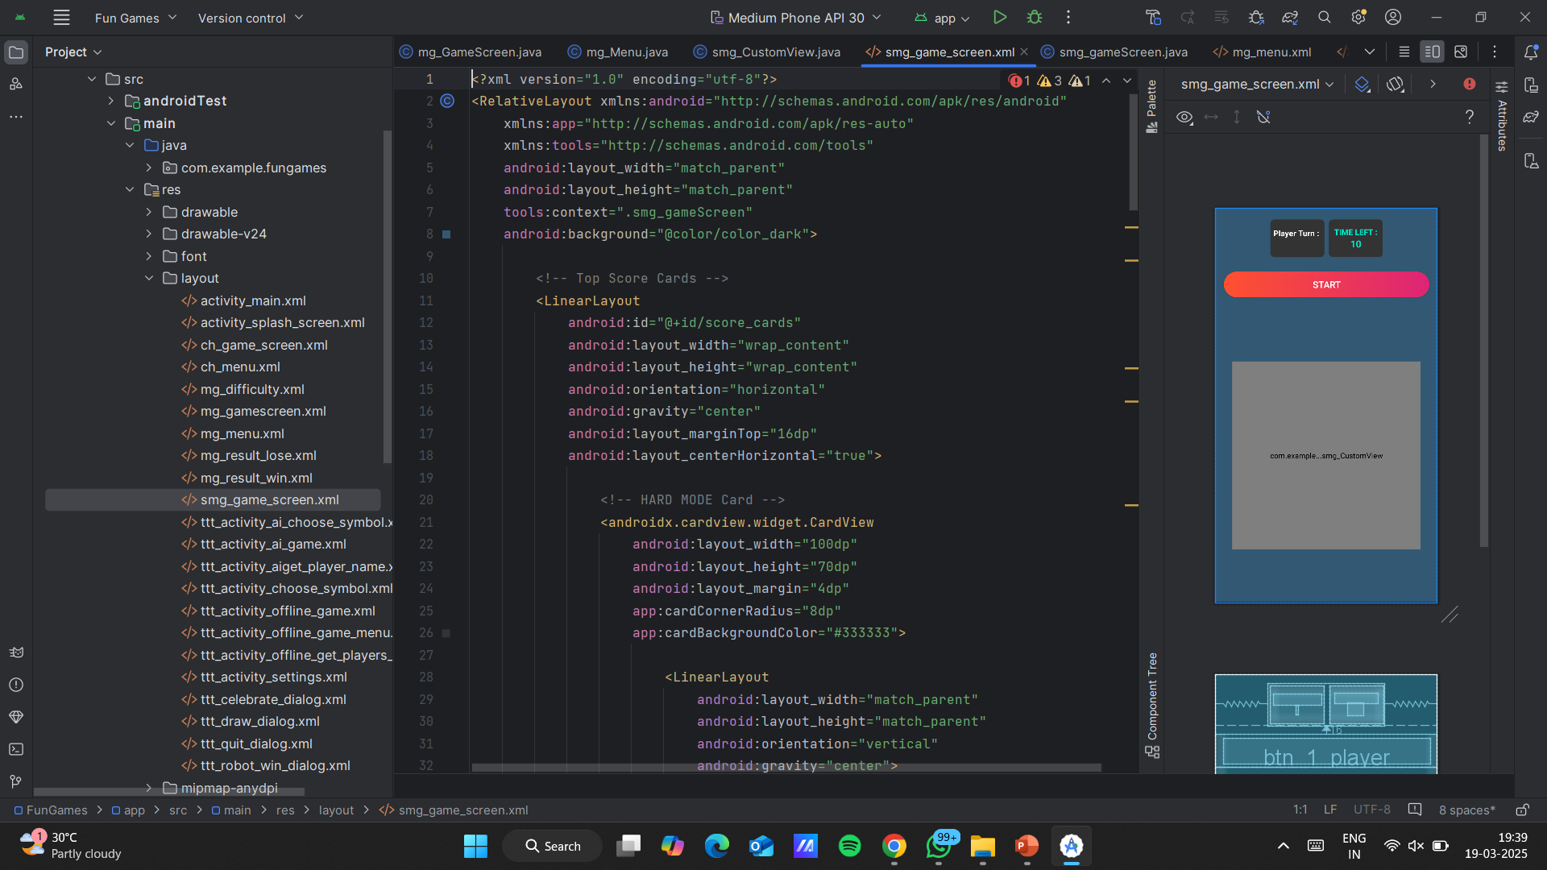
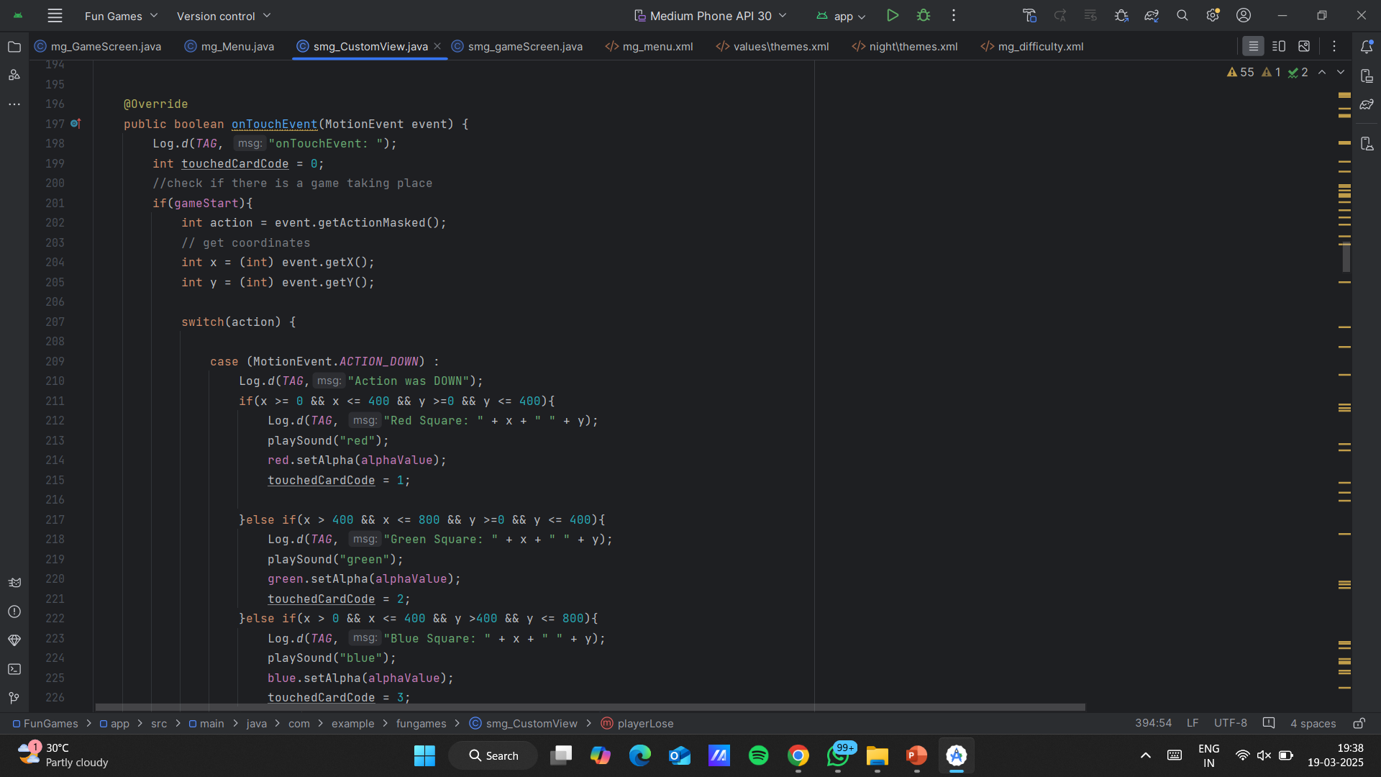
Sound Memory
XML code snippet:
JAVA code snippet:

Slide 6
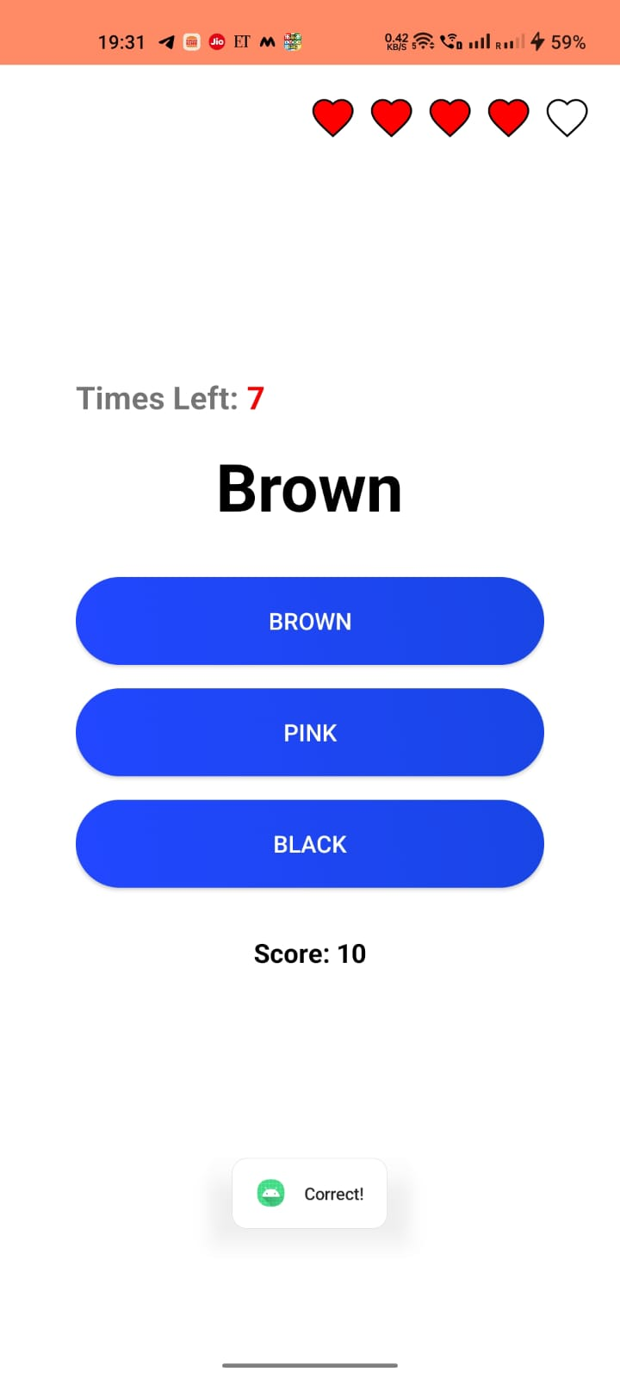
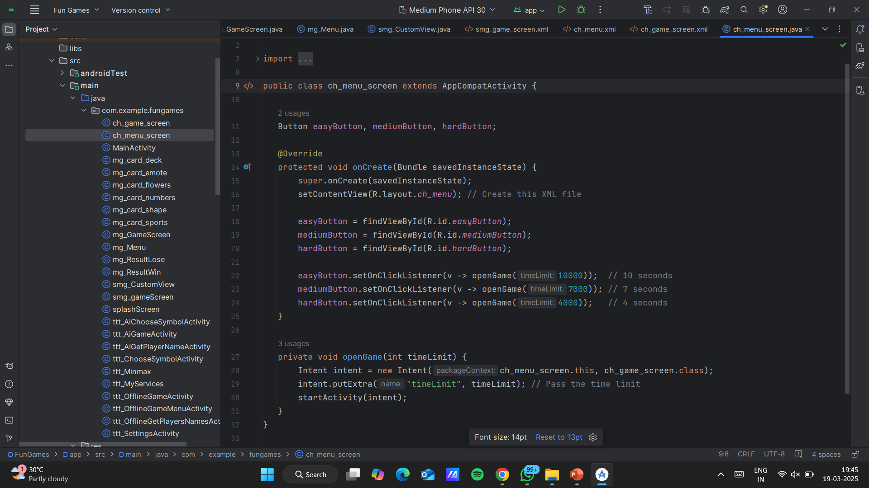
Color Hunt
Color Hunt features vibrant color blocks set in a timed challenge. Players must identify the correct color sequence within a limited time, testing their color recognition skills.

Slide 7
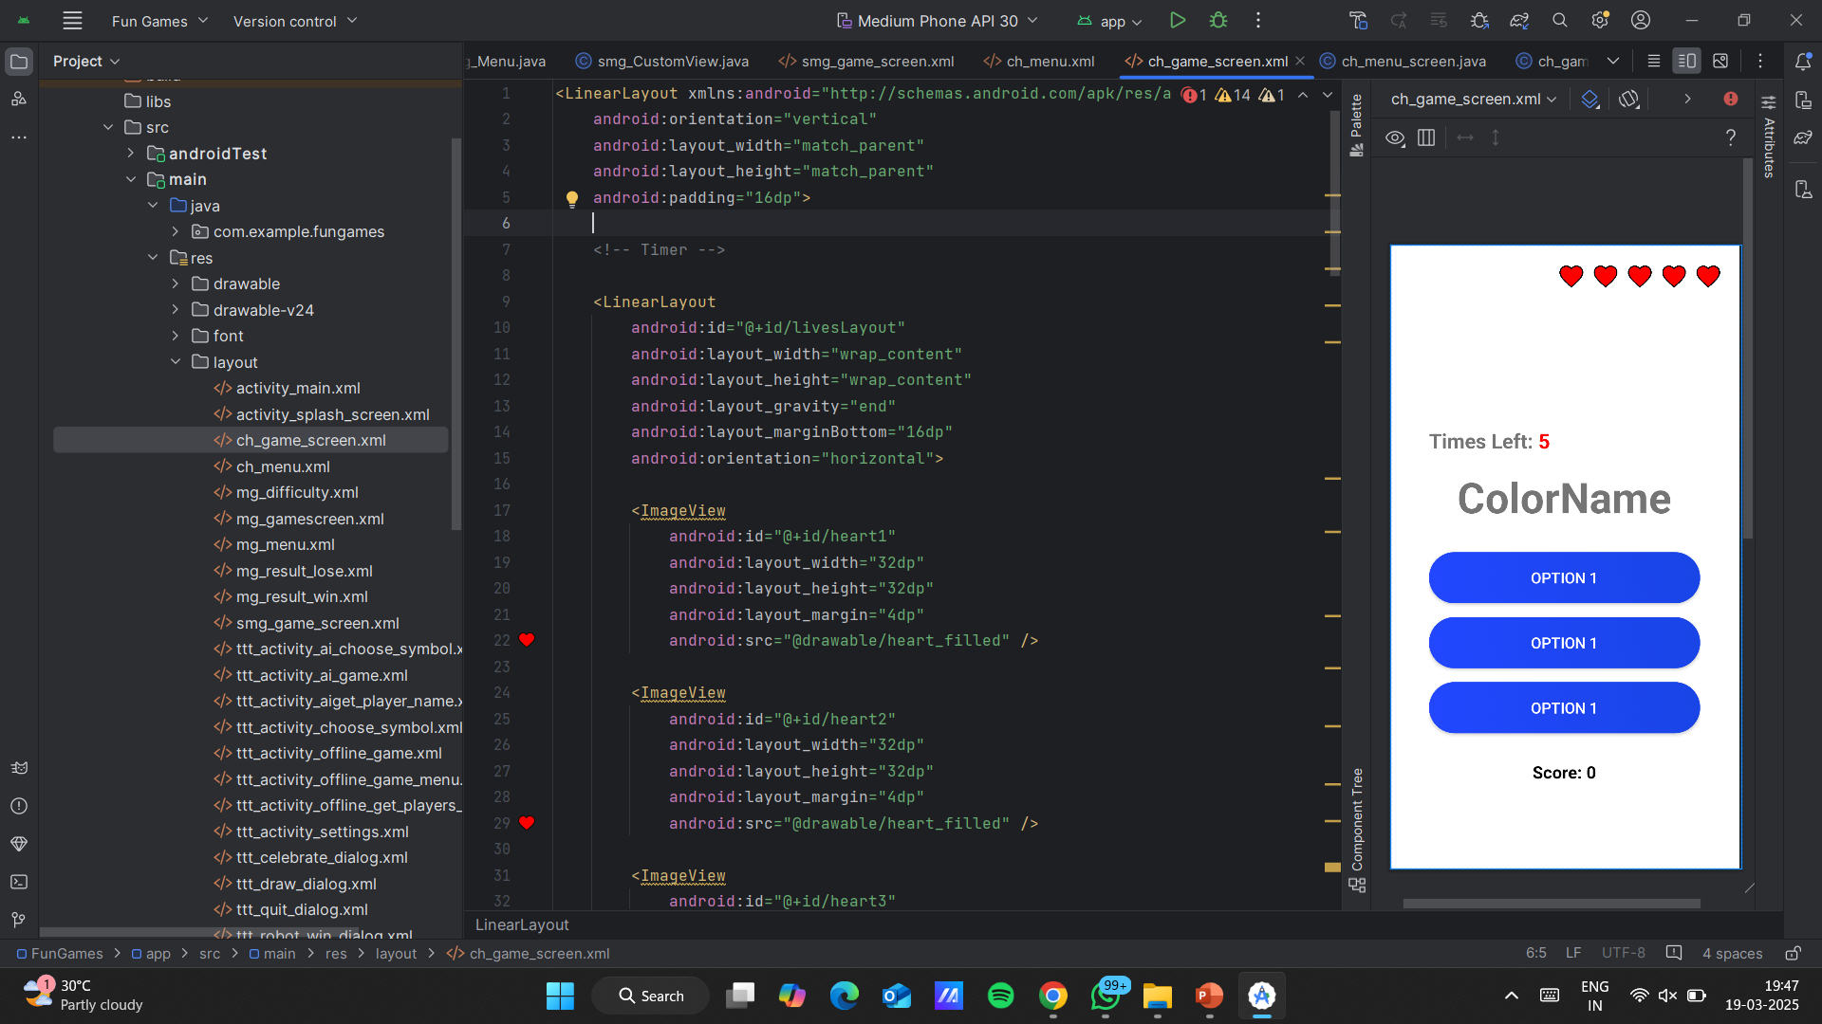
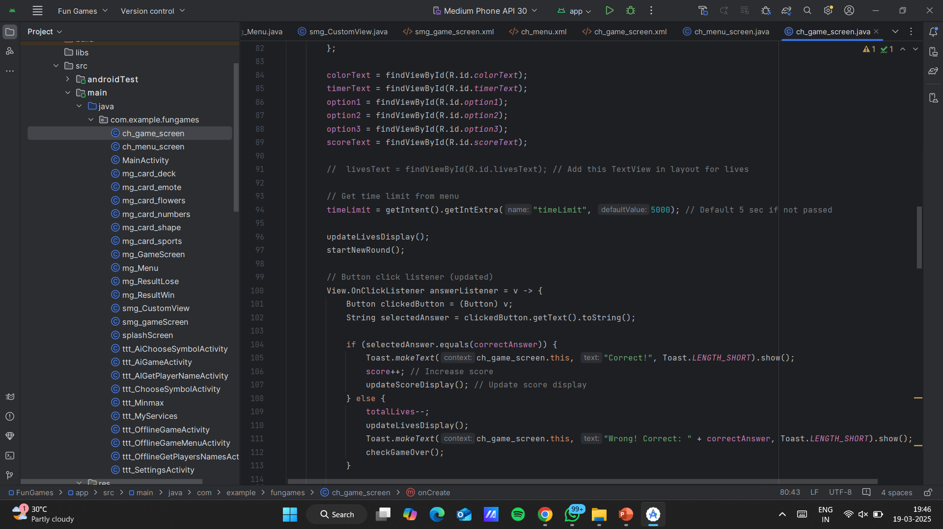
Color Hunt
XML code snippet:
JAVA code snippet:

Slide 8
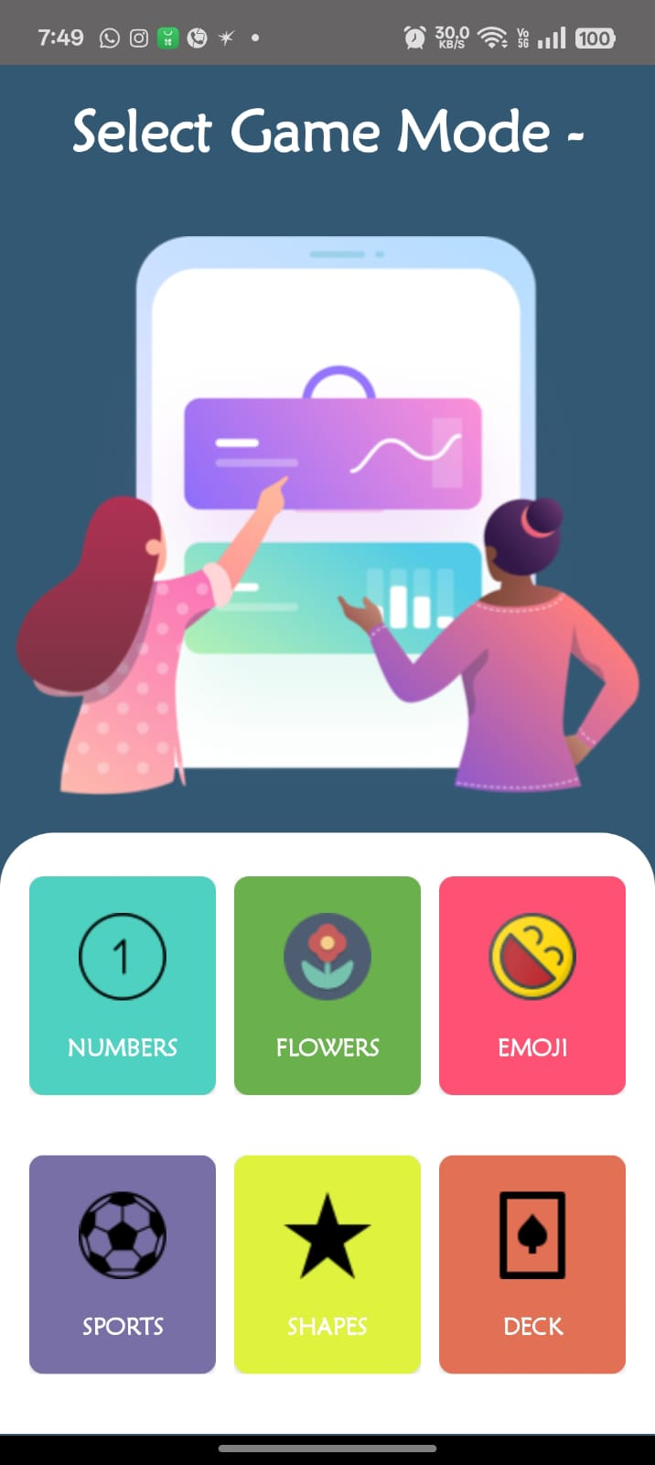
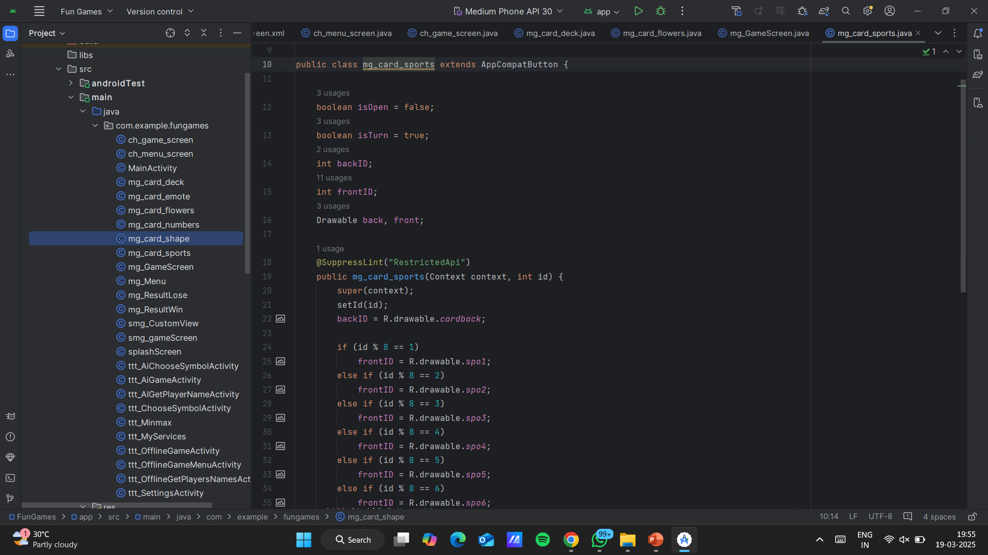
Card Memory
A classic card layout with colorful graphics. Players match pairs to clear the board. The visual appeal enhances the gaming experience.

Slide 9
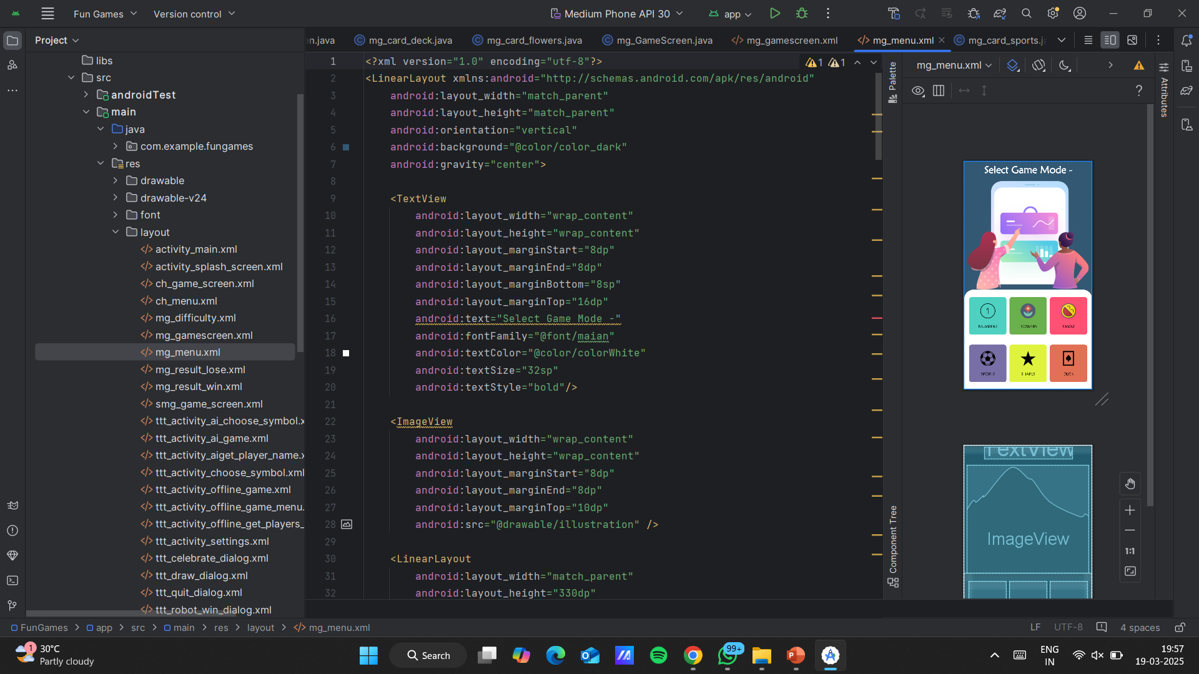
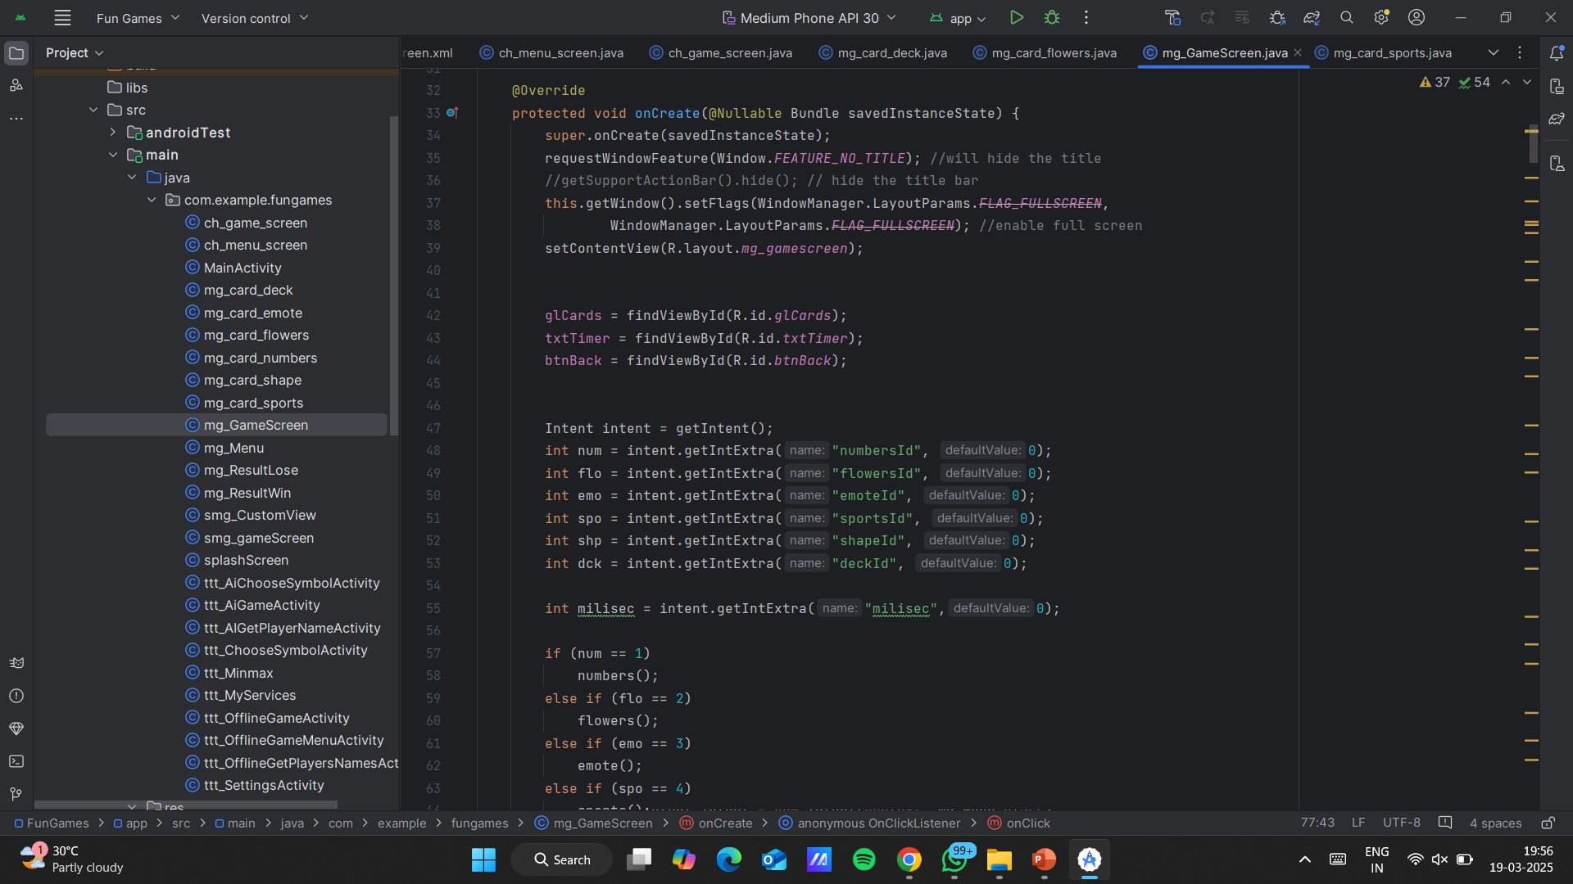
Card Memory
XML code snippet:
JAVA code snippet:

Slide 10
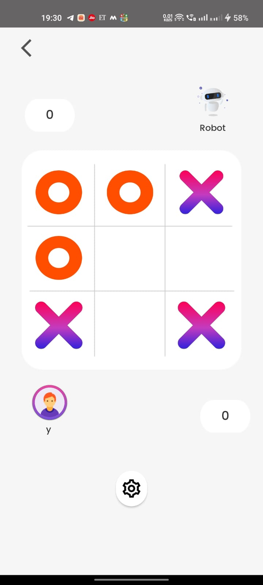
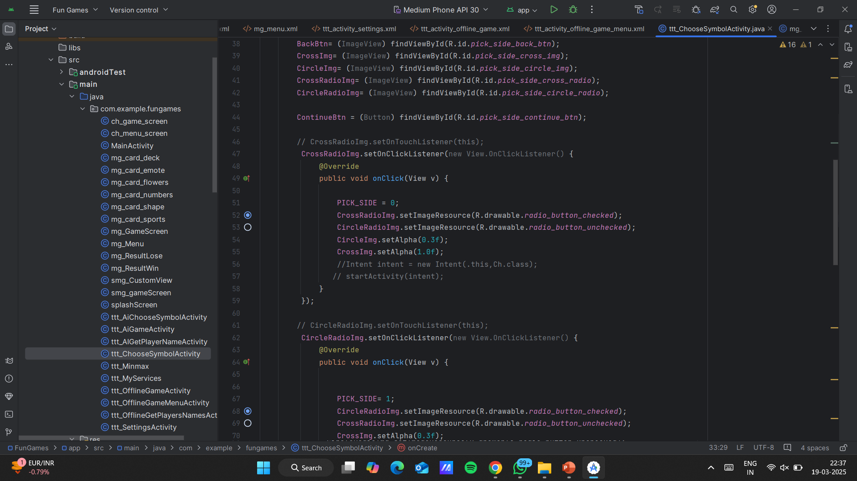
Tic Tac Toe
Tic-Tac-Toe showcases a classic 3x3 grid with clear "X" and "O" visuals. The design is straightforward, making it easy for players to understand and enjoy the game.
The UI adapts seamlessly to various screen sizes and resolutions, ensuring consistent usability.

Slide 11
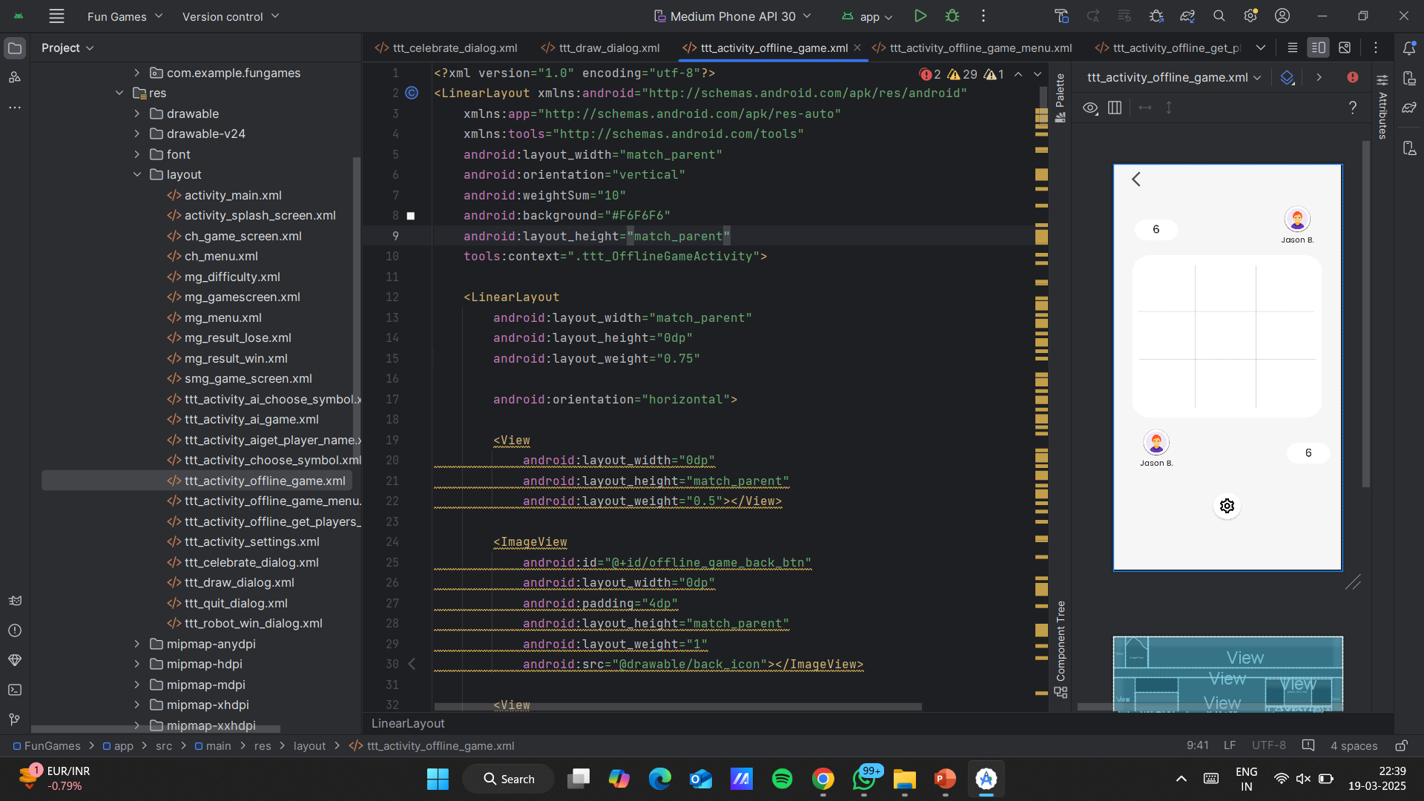
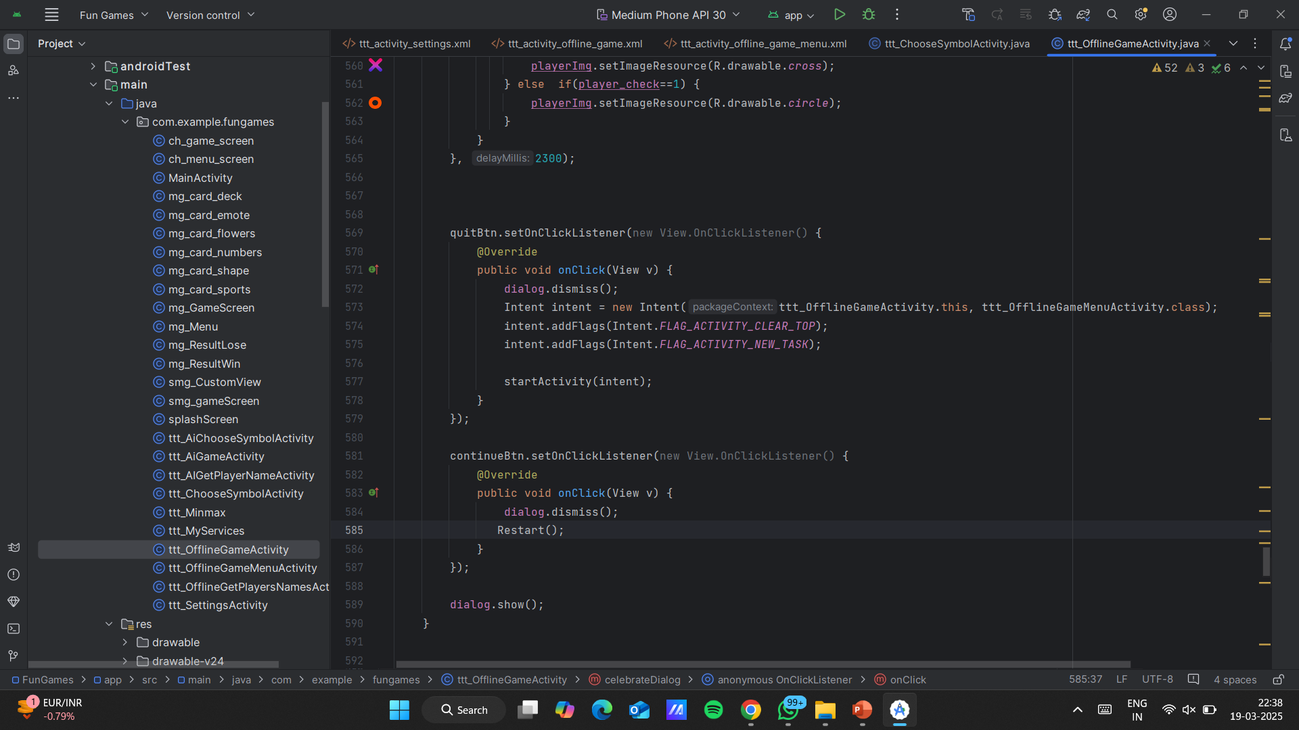
Tic Tac Toe
XML code snippet:
JAVA code snippet:

Slide 12
Game Logic: Java Implementation
Sound Memory
1
Uses drawable<Integer, Integer> Raw file for matching sounds. Each sound is assigned a unique ID and mapped to its pair.
2
Card Memory
Employs ArrayList<Integer> cardList to track card pairs. Collections.shuffle(cardList) randomizes card positions at the start.
Tic-Tac-Toe
3
Uses a 2D array board to track moves. Winning conditions are checked after each move.
4
Color Hunt
Generates random color sequences using Random random = new Random(). Increases score for each correct sequence identified.
Sudoku
5
Working on it …!!!
6
Ludo
Working on it …!!!
All game logic is handled in Java using in-app memory, eliminating the need for an external database. This approach ensures smooth and efficient gameplay.

Slide 13





Live Demo
Sound Memory
1
Match sound pairs
Card Memory
2
Match card pairs
Tic-Tac-Toe
3
Classic grid game
Color Hunt
4
Identify color sequences
Sudoku
5
Complete the grid
Watch a live gameplay demonstration on an Android device showcasing the touch responsiveness and intuitive controls of each game. Experience a quick walkthrough of a typical game session, highlighting the engaging and interactive nature of the collection.

Slide 14
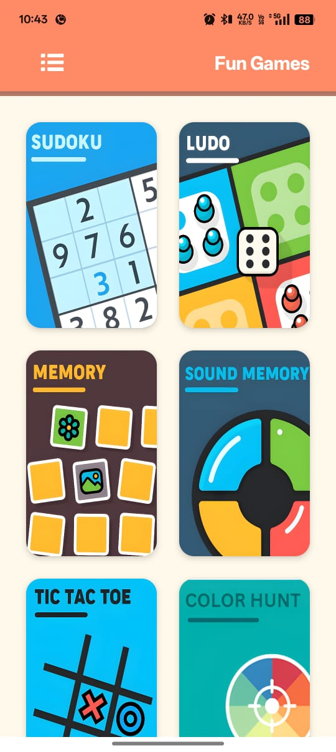
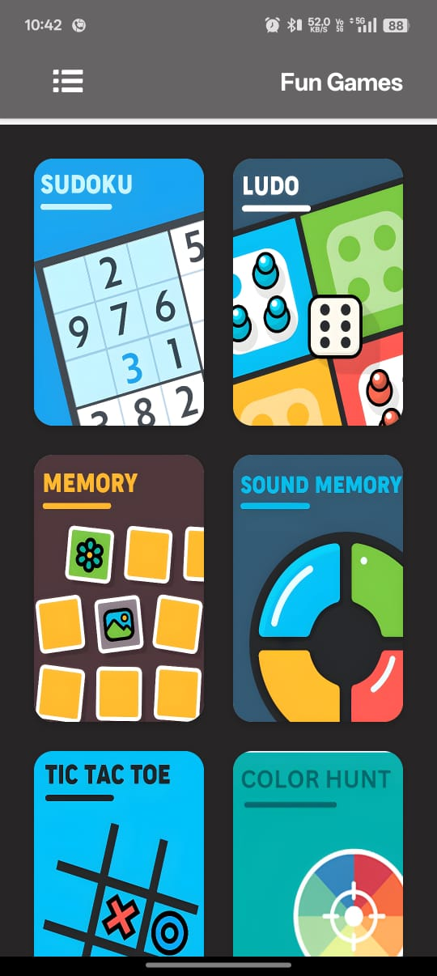
Day Mode ⛅
Night Mode 🌜

Slide 15




Conclusion: Fun Games Collection
Engaging and Interactive
Simple and Intuitive
A collection of six games designed to provide hours of entertainment.
Easy-to-use interface ensures a seamless gaming experience.
Java-Based Logic
Smooth gameplay powered by efficient Java implementation.
The Fun Games offers a diverse range of interactive experiences, all within a single app. With its intuitive design and Java-based game logic, the collection provides smooth and engaging gameplay.

