Slide 1
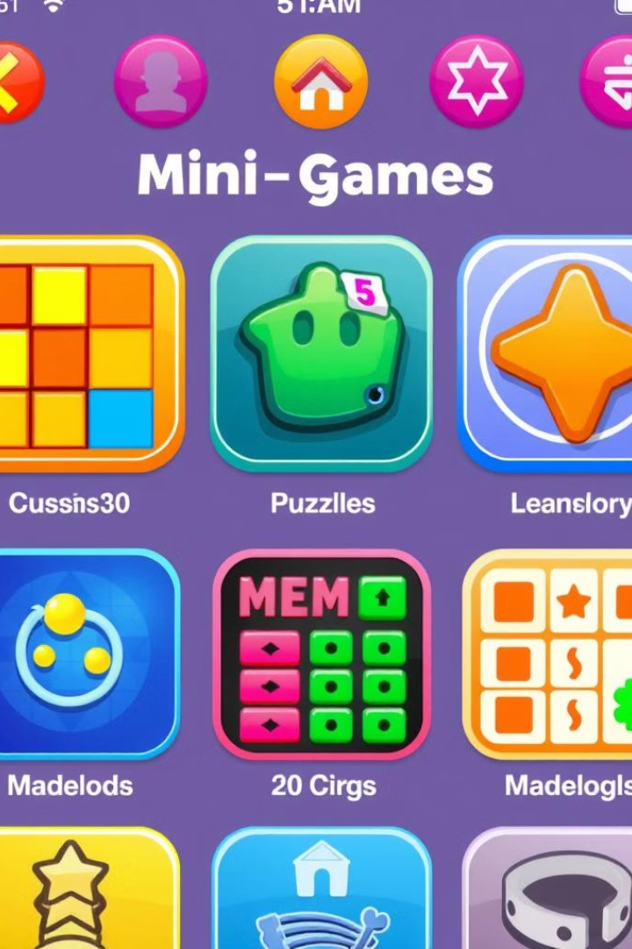

Fun Games: Your Next Favorite Android Gaming App
Welcome to Fun Games, the ultimate destination for casual gaming on Android! Our app is designed to bring you a diverse collection of fun and engaging games, all in one convenient place. Get ready to explore a world of entertainment, cognitive challenges, and user-friendly design.
by Use App0002

Slide 2
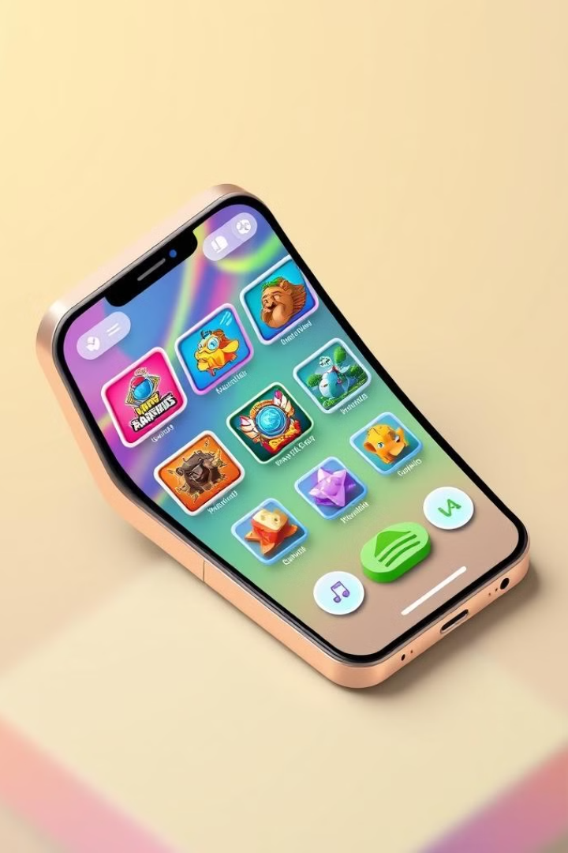
Overview: Dive into the World of Fun Games
Fun Games is a mobile gaming app featuring a variety of casual games designed for quick and enjoyable play sessions. With an intuitive user interface and seamless navigation, Fun Games offers something for everyone. Whether you're a puzzle enthusiast or a reflex-based gamer, our app guarantees hours of entertainment and mental stimulation.
1
Casual Gaming
2
Intuitive UI
Enjoy a wide range of casual games suitable for all ages.
Navigate effortlessly through our user-friendly interface.
3
Engaging Gameplay
Experience puzzles and reflex-based challenges.

Slide 3
All Offline Games in One Platform
One of the best aspects of Fun Games is that it is available for offline play. Enjoy access to many games without needing WiFi or service data. The app is designed to be lightweight and efficient, ensuring smooth performance on all Android devices. Download once, play anywhere, anytime!
We believe that gaming should be accessible to everyone, regardless of their internet connectivity. Our commitment to offline play ensures that you can enjoy Fun Games whenever and wherever you want, without any interruptions or limitations.
Offline Access
Lightweight Design
Play your favorite games without an internet connection.
Enjoy smooth performance on all Android devices.

Slide 4




Key Features: Casual Games, Scoring, and User-Friendly Design
Fun Games is packed with features designed to enhance your gaming experience. From a diverse selection of casual games to a comprehensive scoring system and an intuitive user interface, we've carefully crafted every aspect of our app to provide maximum enjoyment and engagement.
Our app isn't just about playing games; it's about creating an immersive and rewarding experience for our users. With Fun Games, you'll discover a world of entertainment and cognitive stimulation that keeps you coming back for more.
Casual Games
Scoring System
User-Friendly Design
Explore a variety of fun and engaging games.
Track your progress and compete with friends.
Enjoy seamless navigation and intuitive controls.

Slide 5

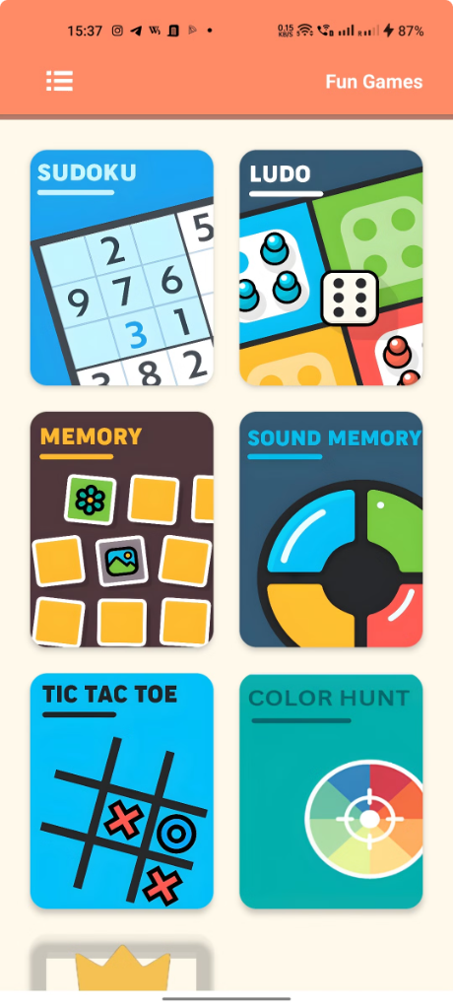
Engaging Gameplay: Puzzles and Reflex-Based Challenges
Fun Games offers a wide variety of engaging games that will challenge your mind and reflexes. From brain-teasing puzzles to fast-paced reflex-based challenges, there's always something new and exciting to discover. Perfect for quick breaks or longer play sessions, our games are designed to keep you entertained and mentally stimulated.
The engaging gameplay in Fun Games is designed to offer something for every type of player, making it a comprehensive package for entertainment and mental stimulation.
1
Puzzles
Test your problem-solving skills with our collection of brain-teasing puzzles.
2
Reflex-Based
Challenge your reflexes with fast-paced, action-packed games.
3
Variety
Enjoy a diverse range of gameplay experiences.

Slide 6
Tech Stack: Android Studio, Java, Firebase, and XML
Fun Games is built using a robust and reliable tech stack, ensuring optimal performance and scalability. We utilize Android Studio with Java for native Android development, Firebase for real-time data storage and user authentication, and XML for designing the user interface. This combination of technologies enables us to deliver a seamless and engaging gaming experience.
Our tech stack not only ensures the stability and functionality of Fun Games but also allows us to continuously improve and expand the app with new features and content.
Android Studio
Java
Integrated development environment for Android.
Programming language for building native Android applications.
Firebase
XML
Real-time database and authentication platform.
Markup language for designing user interfaces.

Slide 7




User Interface: Simple, Intuitive, and Smooth Navigation
We believe that a great user interface is essential for a positive gaming experience. That's why we've designed Fun Games with simplicity, intuitiveness, and smooth navigation in mind. Our UI makes it easy to discover new games, track your scores, and customize your settings, ensuring that you can focus on what matters most: having fun.
Simplicity is key, and our dedication to intuitive design means that every interaction is seamless and enjoyable. Prepare for a fun and entertaining experience.
Simple
Intuitive
Smooth
Easy-to-understand design.
Seamless user experience.
Effortless navigation.

Slide 8



Firebase Integration: Leaderboards and Score Tracking
To add a competitive edge to Fun Games, we've integrated Firebase for real-time leaderboards and score tracking. Compete with friends and players around the world to see who can achieve the highest scores and climb to the top of the leaderboard. Our Firebase integration ensures accurate and reliable score tracking, making every game even more exciting.
2
Leaderboards
1
Real-Time
Score Tracking
3

Slide 9
Compatibility: Optimized for All Android Devices
Fun Games is designed to be compatible with a wide range of Android devices, ensuring that everyone can enjoy our app regardless of their device specifications. Our team has worked tirelessly to optimize performance across different screen sizes and hardware configurations, so you can expect a smooth and responsive gaming experience on any Android device.
Regardless of if you have the newest Android device on the market or an older device, our team is dedicated to providing you with a quality gaming experience.
Wide Range
Optimized
Compatible with most devices.
Smooth experience for all players.

Slide 10
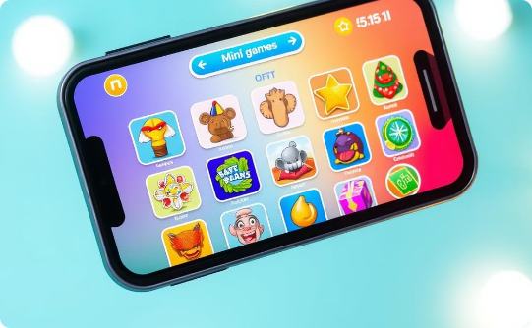
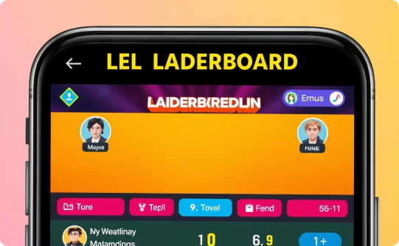
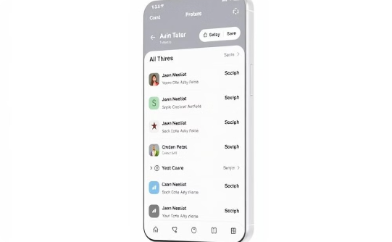
Launching Fun Games: Get Ready to Play!
Fun Games is poised to revolutionize the world of casual gaming on Android. With its diverse selection of games, intuitive user interface, and robust tech stack, our app is set to become your next favorite gaming destination. Get ready to experience hours of entertainment, cognitive challenges, and friendly competition. Launching soon—stay tuned for updates and prepare to play!
Casual Games
Leaderboards
Smooth UI

