Slide 1
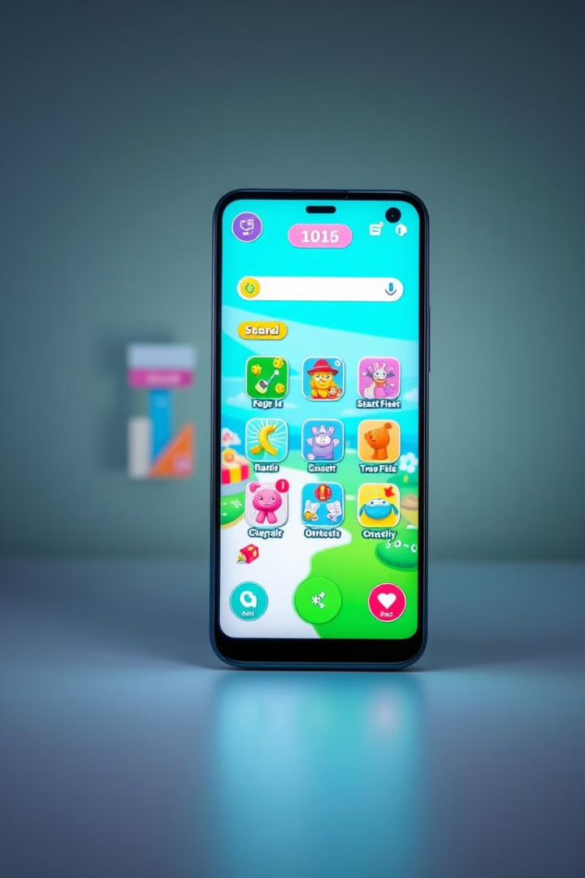

Fun Games: Your Next Favorite Gaming App
Welcome to Fun Games! Our app provides endless hours of casual gaming. Enjoy an intuitive user interface. Experience smooth navigation and rewarding scoring !!
by Use App0002

Slide 2
Filling the Need for Casual, Engaging Mobile Games
The Saturation of Complex Games
The Demand for Casual Entertainment
The mobile gaming market is flooded with complex games.
There's a growing demand for casual, engaging mobile games.
Many users seek simpler, more accessible experiences.
Users seek quick, fun entertainment on the go.

Slide 3
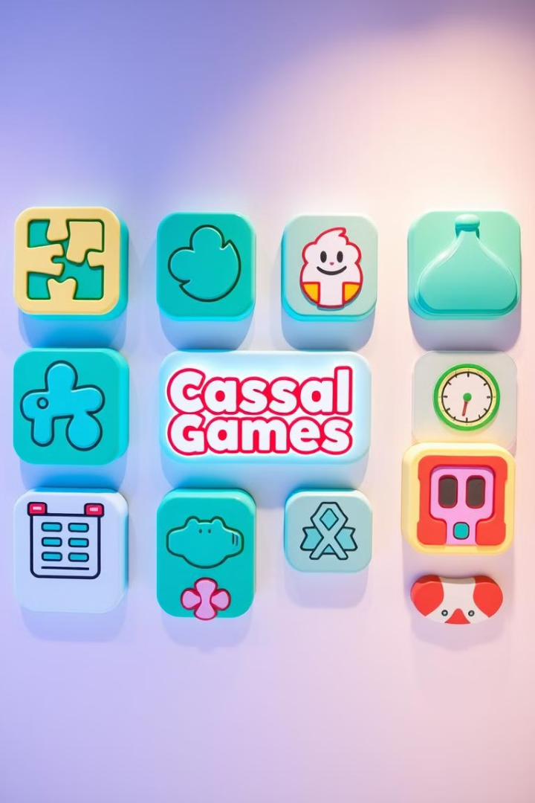
Fun Games: A Diverse Collection of Addictive Games
1
Diverse Game Selection
2
Addictive Gameplay
Offers a variety of casual games to suit different tastes.
Designed to be engaging and rewarding, keeping players hooked.
3
Mobile-First Design
Optimized for seamless performance on Android devices.

Slide 4




Pick-Up-and-Play Simplicity with Rewarding Gameplay
Easy to Learn
Rewarding
Accessible
Scoring system keeps users motivated.
Play anywhere, anytime on your phone.
Simple mechanics for immediate fun.

Slide 5
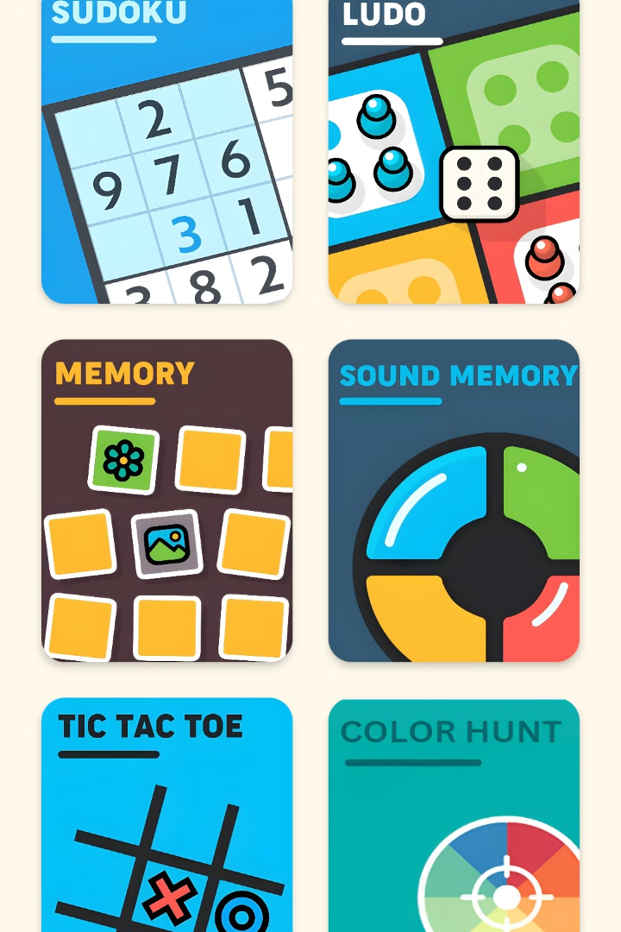
Game Variety: Puzzles, Reflex Challenges, and More to Come!
Puzzles
Brain-teasing challenges.
LUDO
Test your reaction time.
Tic Tac Toe
Plan your every move carefully.
More
Exciting new games are coming soon.

Slide 6
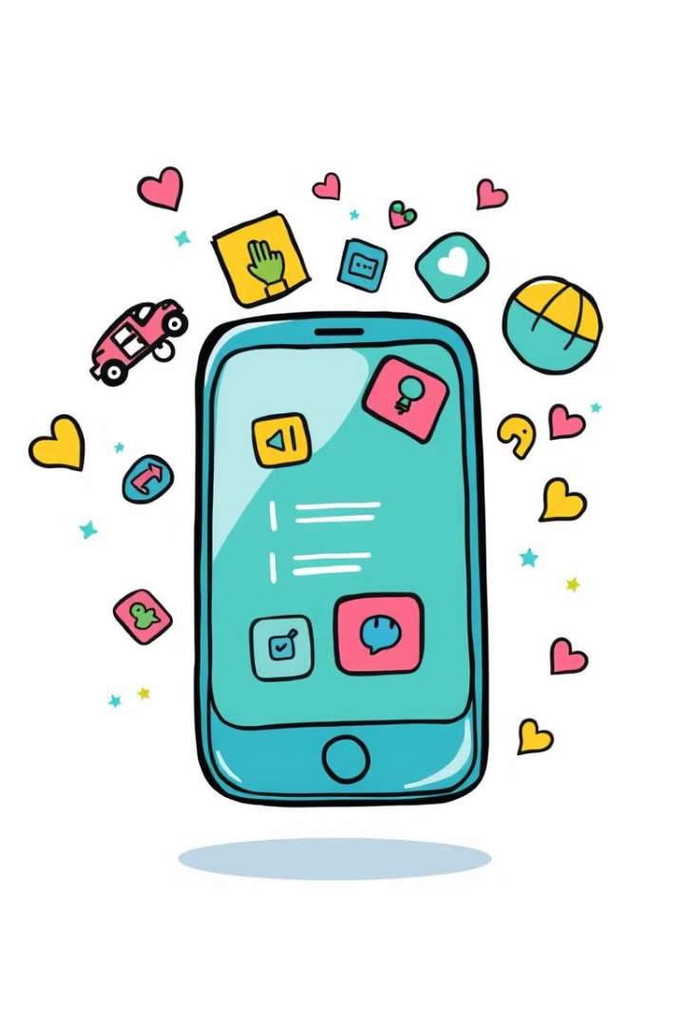



Android Studio, Java, Firebase - Powering a Seamless Experience
Android Studio
The official IDE for Android app development.
Java
A robust and versatile programming language.
Firebase
Google's mobile platform for analytics and more.

Slide 7

Intuitive Design for Effortless Navigation
Clean Layout
1
Easy-to-understand menu.
2
Smooth Transitions
Seamless flow between games.
User-Friendly
3
Optimized for all ages.

Slide 8



Balancing Fun with Sustainable Growth
2
Premium Content
1
In-App Ads
Strategic Partnerships
3

Slide 9
Expanding Content, Features, and Community Engagement
1
More Games
2
New Features
3
Community
We are dedicated to bringing you a fun experience.

Slide 10
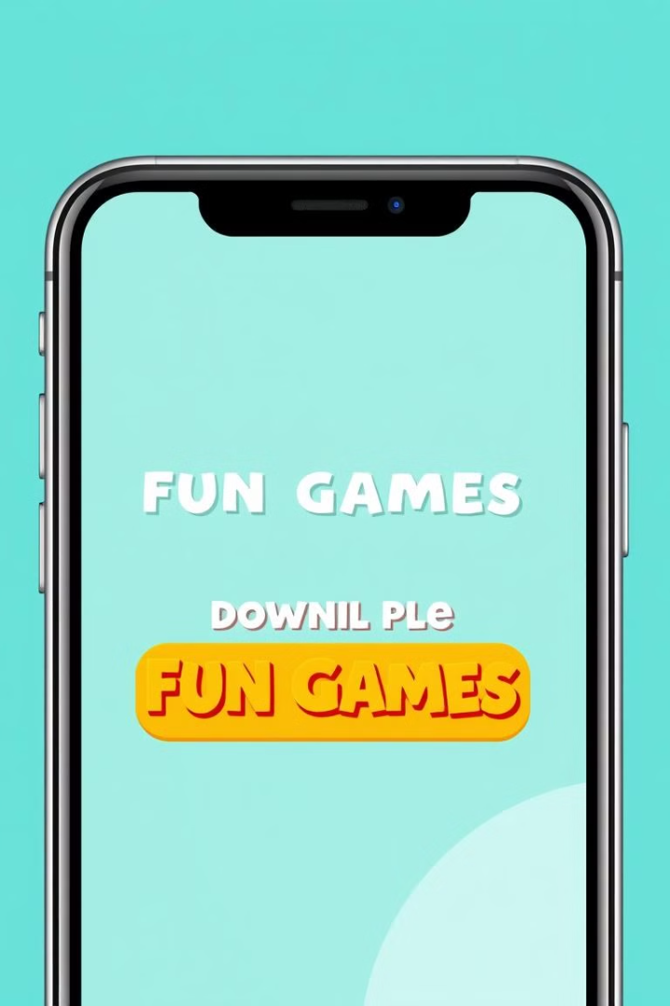
Download "Fun Games" Today!
Ready for hours of casual fun?
Download "Fun Games" now on the Google Play Store.
Start playing and discover your next favorite game!

