Slide 1
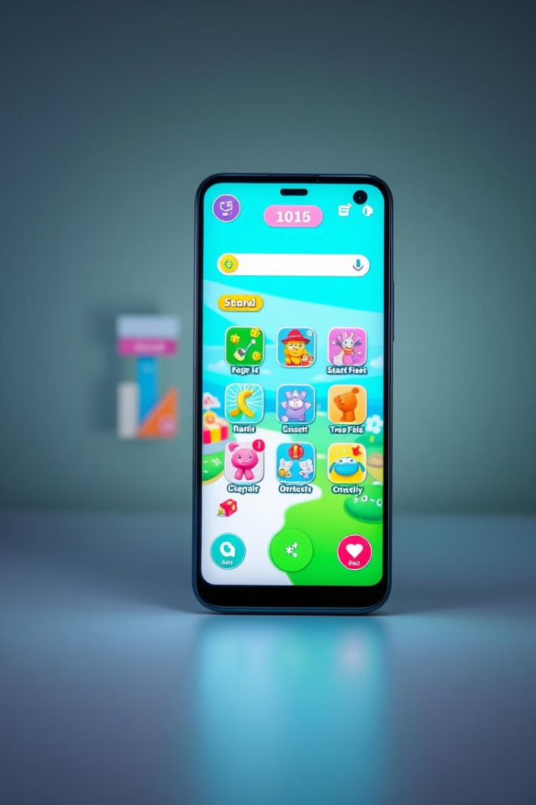
Fun Games: Your Next Favorite Gaming App
Welcome to Fun Games! Our app provides endless hours of casual gaming. Enjoy an intuitive user interface. Experience smooth navigation and rewarding scoring !!
Done by
Ansh Gadoya
Bansil Pabari

Slide 2
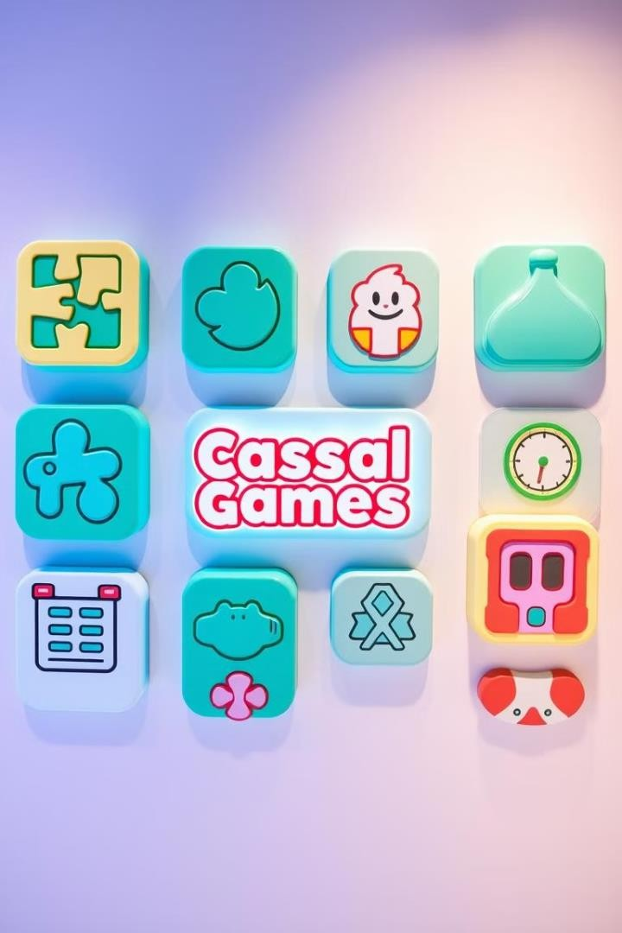
Fun Games: A Diverse Collection of Addictive Games
1
Diverse Game Selection
Offers a variety of casual games to suit different tastes.
2
Addictive Gameplay
Designed to be engaging and rewarding, keeping players hooked.
3
Mobile-First Design
Optimized for seamless performance on Android devices.

Slide 3




Pick-Up-and-Play Simplicity with Rewarding Gameplay
Fun Games is packed with features designed to enhance your gaming experience. From a diverse selection of casual games to a comprehensive scoring system and an intuitive user interface, we've carefully crafted every aspect of our app to provide maximum enjoyment and engagement.
Our app isn't just about playing games; it's about creating an immersive and rewarding experience for our users. With Fun Games, you'll discover a world of entertainment and cognitive stimulation that keeps you coming back for more.
Casual Games
Explore a variety of fun and engaging games.
Scoring System
Track your progress and compete with friends.
User-Friendly Design
Enjoy seamless navigation and intuitive controls.

Slide 4

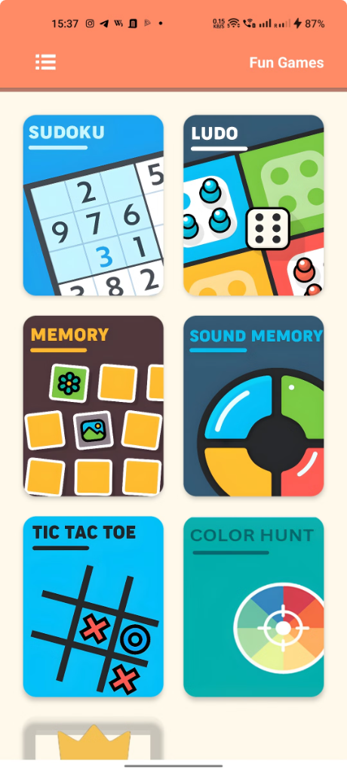
Game Variety: Puzzles, Reflex Challenges, and More to Come!
Puzzles
Brain-teasing challenges.
LUDO
Test your reaction time.
Tic Tac Toe
Plan your every move carefully.
More
Exciting new games are coming soon.

Slide 5


Android Studio, Java, Firebase - Powering a Seamless Experience
Android Studio
The official IDE for Android app development.
Java
A robust and versatile programming language.
Firebase
Google's mobile platform for analytics and more.

Slide 6

Intuitive Design for Effortless Navigation
We believe that a great user interface is essential for a positive gaming experience. That's why we've designed Fun Games with simplicity, intuitiveness, and smooth navigation in mind. Our UI makes it easy to discover new games, track your scores, and customize your settings, ensuring that you can focus on what matters most: having fun.
Simplicity is key, and our dedication to intuitive design means that every interaction is seamless and
enjoyable. Prepare for a fun and entertaining
experience.
Clean Layout
Easy-to-understand menu.
1
2
Smooth Transitions
Seamless flow between games.
User-Friendly
Optimized for all ages.
3

Slide 7
Compatibility: Optimized for All Android Devices Devices
Fun Games is designed to be compatible with a wide range of Android devices, ensuring that everyone can enjoy our app regardless of their device specifications. Our team has worked tirelessly to optimize performance across different screen sizes and hardware configurations, so you can expect a smooth and responsive gaming experience on any Android device.
Regardless of if you have the newest Android device on the market or an older device, our team is dedicated to providing you with a quality gaming experience.
Wide Range Optimized
Compatible with most devices. Smooth experience for all players.

Slide 8
Compatibility: Optimized for All Android Devices Devices
Fun Games is designed to be compatible with a wide range of Android devices, ensuring that everyone can enjoy our app regardless of their device specifications. Our team has worked tirelessly to optimize performance across different screen sizes and hardware configurations, so you can expect a smooth and responsive gaming experience on any Android device.
Regardless of if you have the newest Android device on the market or an older device, our team is dedicated to providing you with a quality gaming experience.
Wide Range Optimized
Compatible with most devices. Smooth experience for all players.

Slide 9
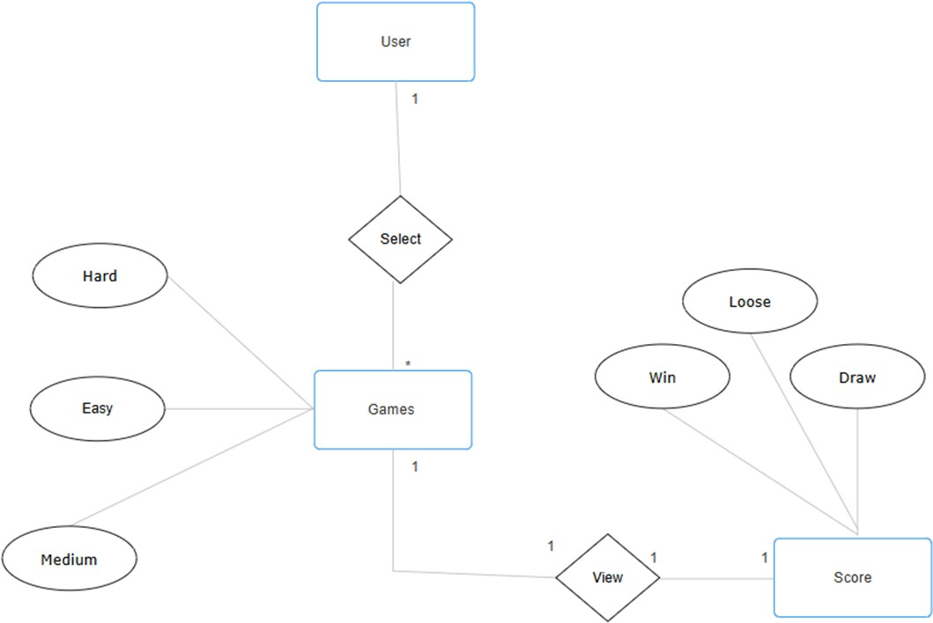
DIAGRAMS
ER Diagram:

Slide 10
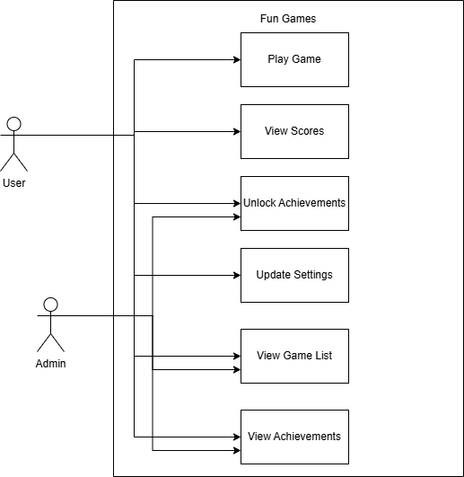
Use Case Diagram:

Slide 11
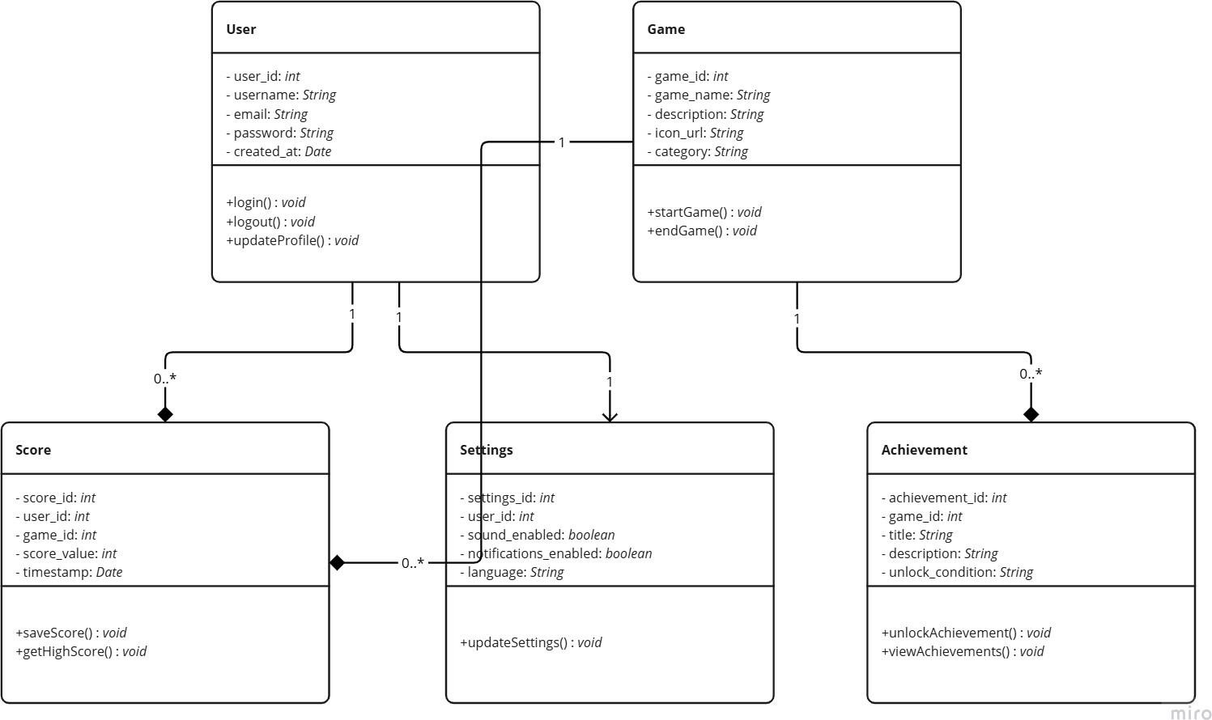
Class Diagram:

Slide 12
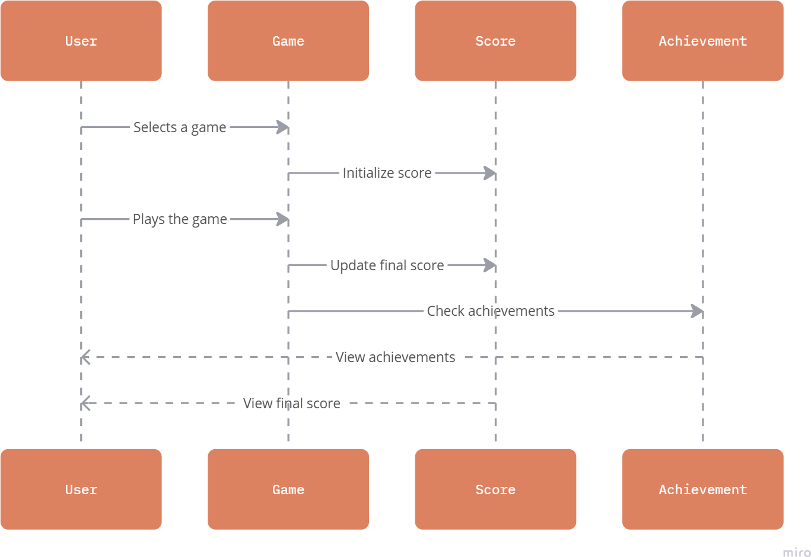
Sequence Diagram:

Slide 13
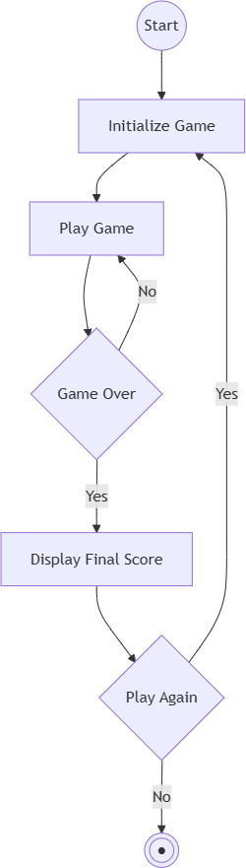
Activity Diagram:

Slide 14
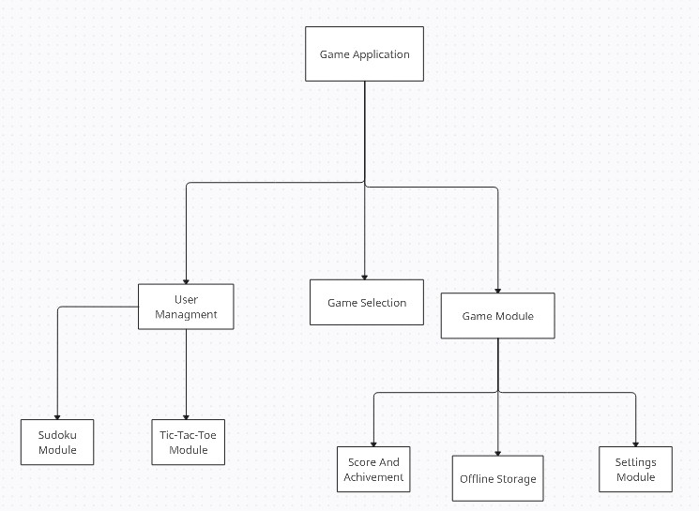
Module Hierarchy:

Slide 15
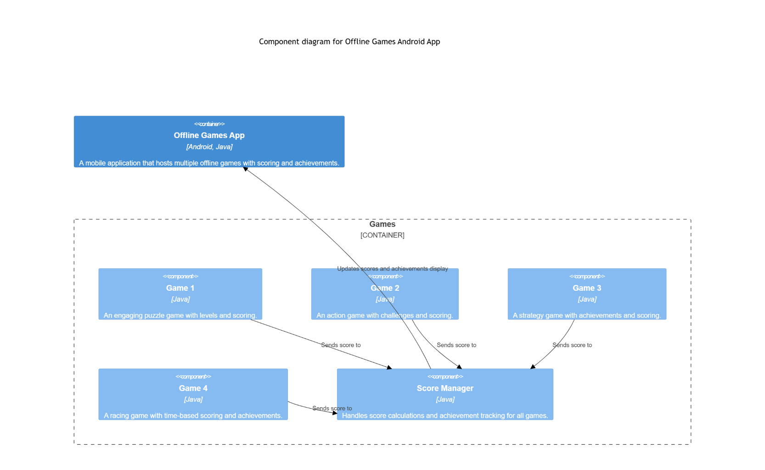
Components Diagram:

Slide 16
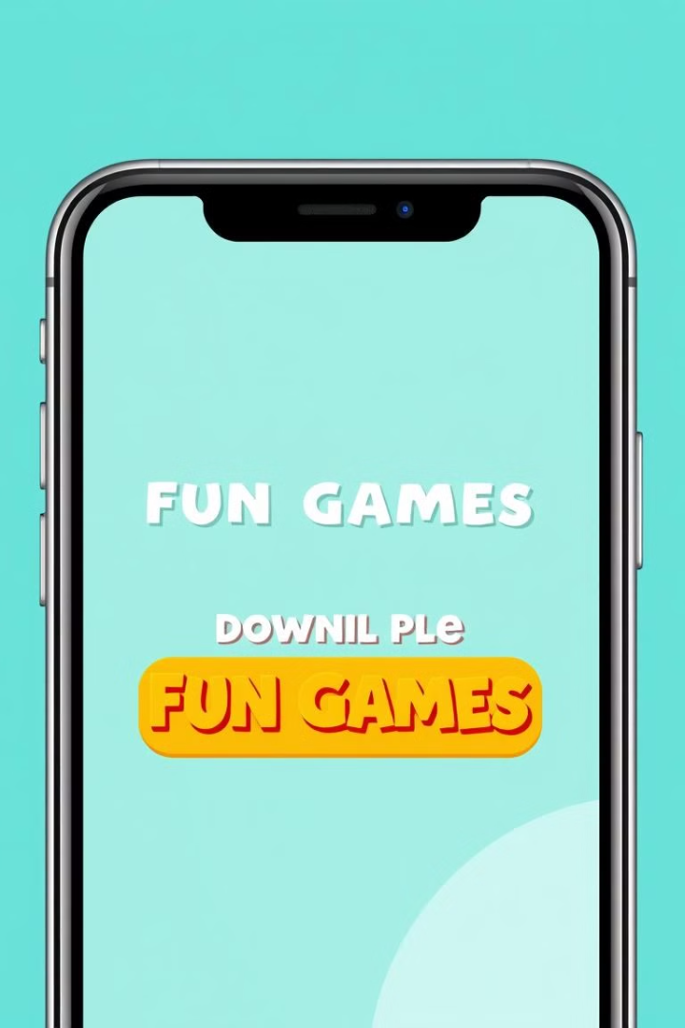
Launching Fun Games: Get Ready to Play!
Fun Games is poised to revolutionize the world of casual gaming on Android. With its diverse selection of games, intuitive user interface, and robust tech stack, our app is set to become your next favorite gaming destination. Get ready to experience hours of entertainment, cognitive challenges, and friendly competition.
Launching soon—stay tuned for updates and prepare to play!

