Slide 1
URBAN TRAFFIC INTELLIGENCE
DATA VISUALIZATION USING PYTHON · AID30050
DATASET AT A GLANCE
20,000
accident records
7
Indian states
Road Accident Patterns, Hotspots & Safety Analytics
2,987
fatal-labelled records
T.Y. B.Tech. AIDS | AY 2026–27
Group: Ansh Gupta 1272250887
Saish Mudliyar 1272250900

Slide 2




Project Overview
Transforming 20,000 raw accident records into interpretable road-safety insight.
Location
Time
Records across seven Indian states, mapped by city and coordinates.
Hour-of-day patterns from the date and time fields.
The study preprocesses the data, develops visualizations and provides an interactive Streamlit dashboard for exploring filtered records.
SCOPE
Descriptive accident analysis — not a live traffic or causal prediction system.
Road & weather
Severity
Road type, weather, visibility and traffic density.
Minor, major and fatal records, casualties and risk score.

Slide 3



Problem Statement & Objectives
Inspect data quality
Check missing values, duplicates, data types and valid ranges.
THE PROBLEM
Raw accident records are difficult to interpret without cleaning and aggregation.
Identify patterns
Explore severity, time, reported causes, weather and locations.
Build a dashboard
Filters, KPI cards, charts, map and data export in Streamlit.

Slide 4







Dataset Description
20,000
Fields in the dataset
City / State
Coordinates
Date & time
accident records
24
Road type
Weather
Visibility
columns
Traffic density
Reported cause
Severity
7
Casualties
Risk score
Indian states
Source: community-hosted GitHub repository (link in References). Verify provenance and data definitions before final submission.

Slide 5



Data Preprocessing
1
2
3
4
5
Inspect
Standardize
Parse & convert
Clean & validate
Derive
Shape, schema, sample rows and missing-value counts.
Consistent column names; trimmed categorical text.
Parse dates and convert numeric fields.
Drop exact duplicates; check hour, coordinates and non-negative counts.
Create year and month; document every cleaning decision.
Outcome: a cleaned and validated dataset of 20,000 records, ready for aggregation and visualization.

Slide 6
Severity Distribution
2,987
Fatal-labelled records
14.9% of all records (about 1 in 7)
≈ 6,000
Major records
about 30% of records
≈ 11,000
Minor records
about 55% of records — the most common category

Slide 7
Accidents by Hour of Day
02:00
Peak hour — 888 records
07:00 & 09:00
Lowest hours — 786 records each
≈ 13%
Gap between busiest and quietest hour

Slide 8
Reported Cause Categories
≈ 20% each
Five causes sit within about 1.4% of each other (≈ 3,970–4,025 records).
Overspeeding & distraction
Highest labels, tied at ≈ 4,025 records.
Interpretation caution
Near-equal splits indicate that cause labels should be treated as exploratory.

Slide 9
Severity by Weather
Severity distribution is consistent across weather conditions
Each condition holds ≈ 6,600 records, split ≈ 15% fatal, 30% major and 55% minor.
In this dataset, the weather label alone does not appear to influence severity.

Slide 10
State-wise Records and Fatal Share
Maharashtra has 25% of all records (raw count, not risk-adjusted); fatal share is similar everywhere, 14.0%–15.8%.

Slide 11
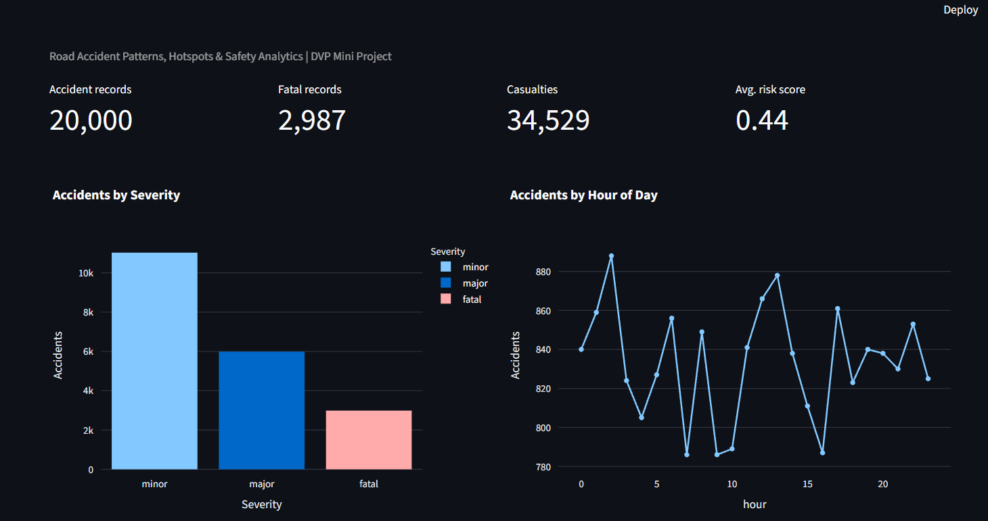


Interactive Streamlit Dashboard
Filters
State, severity and road type
KPI cards
Records, fatal-labelled, casualties, avg. risk score
Charts & map
Interactive Plotly charts and geographic map
Data tools
Quality panel, record preview, filtered CSV download
KPI cards and Plotly charts update with the sidebar filters.
Execution: streamlit run app.py

Slide 12
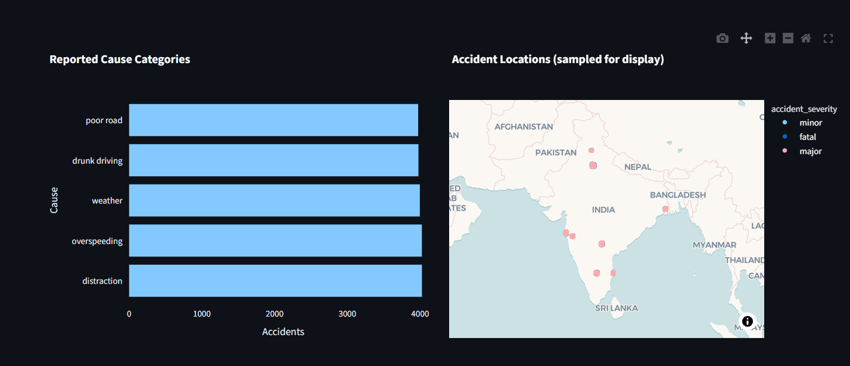
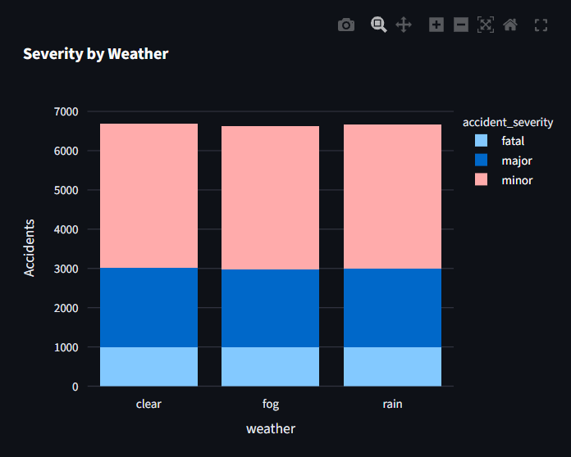
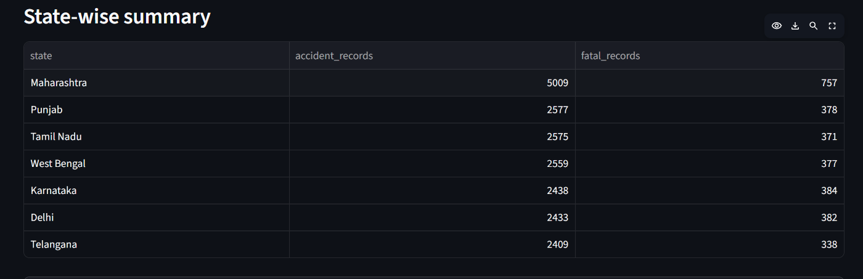
Dashboard Views
Geographic clusters appear around Delhi, Mumbai–Pune, Hyderabad, Bengaluru, Chennai and Kolkata.

Slide 13

Interpretation & Findings
≈ 55%
02:00
≈ 4,025
5,009
Minor is the most frequent severity
Peak recorded hour
Overspeeding & distraction lead
Maharashtra has the most records
Fatal-labelled: 2,987 records (14.9%)
888 records; lowest 786 at 07:00 and 09:00
Top reported causes, narrowly ahead of the rest
Raw count — 25% of all records
RECOMMENDATION
It is recommended to prioritise awareness and enforcement on overspeeding and distraction, monitor the late-night window, and normalise by traffic volume before ranking states.

Slide 14


Limitations & Ethics
Provenance
Raw counts
Not causal
Dataset provenance and collection methodology require verification.
Counts are not population- or traffic-volume-adjusted risk rates.
Observed associations do not establish causation.
DATA NOTE
The cause and weather distributions are unusually uniform; the data source should be verified before conclusions are drawn.
Field quality
No congestion claims
Reported cause and risk-score fields may have limitations.
Congestion analysis needs independent traffic speed and volume data.

Slide 15

Conclusion & Future Scope
What we demonstrated
Future scope
Data preprocessing
Traffic volume & speed
Add verified traffic-volume and speed data.
Exploratory analysis
Official records
Cross-check against official accident records.
Visualization
Time series
Add year-over-year and seasonal comparisons.
Interactive dashboarding

Slide 16

References
Dataset repository
https://github.com/Aditya2213/INDIAN_ROAD_ACCIDENT_DATASET_DASHBOARD
Raw CSV
https://raw.githubusercontent.com/Aditya2213/INDIAN_ROAD_ACCIDENT_DATASET_DASHBOARD/main/indian_roads_dataset.csv
Streamlit
https://docs.streamlit.io/
Plotly
https://plotly.com/python/
pandas
https://pandas.pydata.org/docs/

