Slide 1
CogniFlow-AI
Multi-Modal AI Platform for Chat, Document Intelligence, Emotion Analysis, and Recommendations
Prepared By: [Your Name / Team Name]
Under the Mentorship of: [Guide Name]
Academic Project Presentation

Slide 2
Project Objectives
? Build a unified AI platform for text, PDFs, images, scripts, videos, and YouTube links. ? Support chatbot interaction using local or API-based language models. ? Implement retrieval-augmented question answering over uploaded documents. ? Analyze emotional tone from scripts and transcripts. ? Generate PDF reports and mood-based movie recommendations. ? Provide a modern frontend dashboard for all workflows.
CogniFlow-AI | Multi-Modal AI Project

Slide 3
Problem Statement
? Users work with many types of unstructured data, but most tools handle only one task at a time. ? Separate tools for chat, document Q&A, OCR, video analysis, and recommendations create fragmentation. ? There is a need for one platform that can process documents, images, scripts, and videos in a unified way. ? The project addresses this gap by integrating multiple AI pipelines inside one application.
CogniFlow-AI | Multi-Modal AI Project

Slide 4
Project Overview - Introduction
CogniFlow-AI is a full-stack AI application built with a FastAPI backend and a React frontend. Core capabilities: ? Conversational AI chat ? PDF-based retrieval and question answering ? OCR-based image understanding ? Script emotion analysis ? Video and YouTube emotion analysis ? PDF report generation ? Movie recommendations based on emotional profile The platform is designed as a modular system where each workflow is handled by a dedicated backend module.
CogniFlow-AI | Multi-Modal AI Project

Slide 5
End Users
? Students: To understand AI workflows such as retrieval, OCR, and emotion analysis in one project. ? Faculty and evaluators: To review a full-stack academic AI system with practical outputs. ? Content analysts: To inspect emotional tone in scripts, transcripts, and videos. ? General users: To chat with AI, analyze uploaded content, and receive recommendations.
CogniFlow-AI | Multi-Modal AI Project

Slide 6
Wow Factor
? Multi-modal intelligence: One system works across chat, PDFs, images, scripts, and videos. ? Hybrid AI processing: Combines LLMs, OCR, vector retrieval, transcription, emotion analysis, and recommendation logic. ? Report generation: Users can directly download PDF reports from script and video analysis. ? End-to-end experience: Backend pipelines and frontend dashboard are integrated into one usable product.
CogniFlow-AI | Multi-Modal AI Project

Slide 7
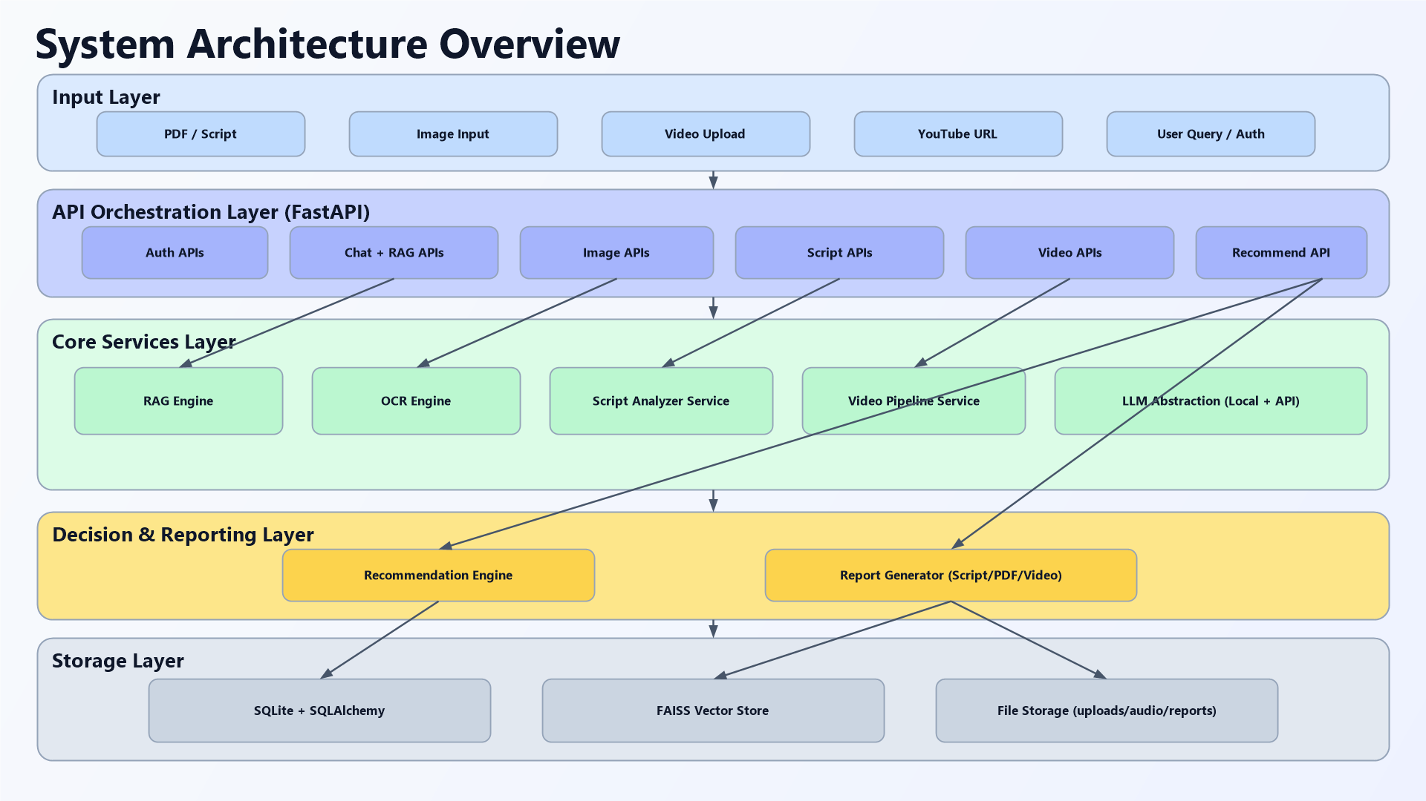
Modelling / Block Diagram / Flow of Project
Input Layer: ? Chat text, PDFs, images, script text, uploaded videos, and YouTube URLs Processing Layer: ? Chat module ? RAG document pipeline ? OCR image pipeline ? Script emotion pipeline ? Video transcription and intensity pipeline ? Recommendation engine ? Report generator Output Layer: ? AI answers, emotion summaries, emotional arcs, recommendations, and PDF reports
CogniFlow-AI | Multi-Modal AI Project

Slide 8
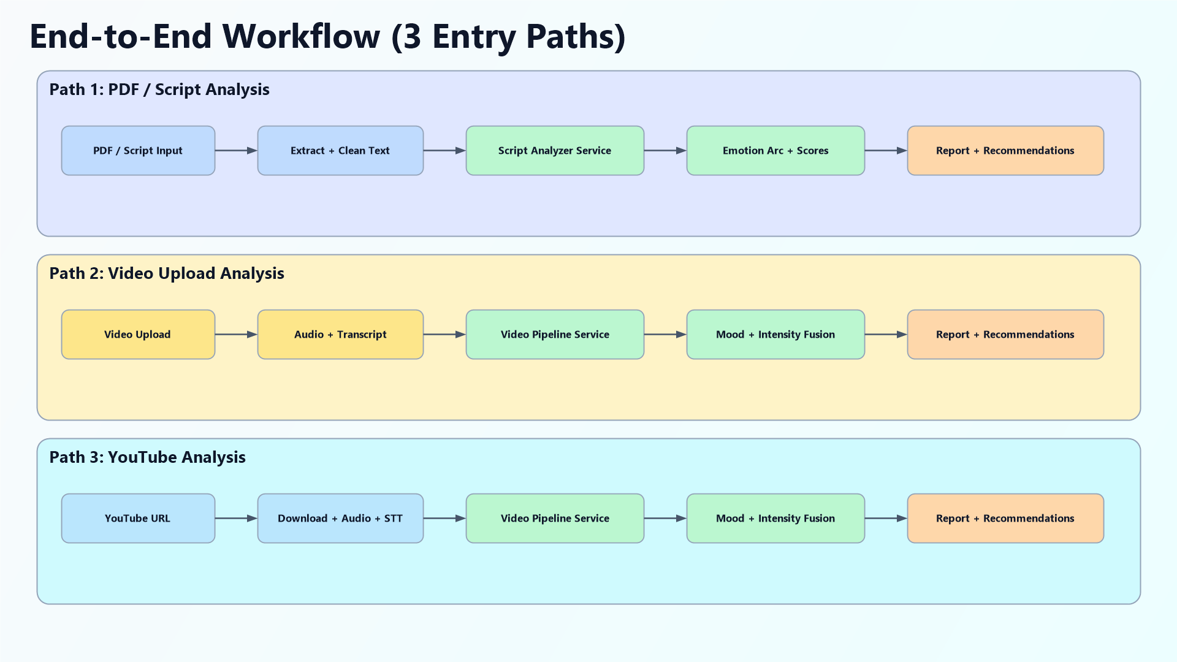
Result / Outcomes
? The application successfully integrates multiple AI services under one platform. ? PDF documents can be indexed and queried using retrieval-augmented generation. ? Images can be solved through OCR-based text extraction. ? Scripts and videos produce dominant mood, confidence, emotional arc, and recommendations. ? Downloadable PDF reports are generated from analysis pipelines. ? The frontend dashboard provides a dedicated experience for each module.
CogniFlow-AI | Multi-Modal AI Project

Slide 9
Conclusion
? CogniFlow-AI successfully combines chatbot interaction, document intelligence, OCR, script analysis, video understanding, recommendations, and reporting into one project. ? The system demonstrates modular backend architecture and practical use of modern AI libraries. ? It serves as a strong academic project and a promising prototype for future intelligent media analysis systems.
CogniFlow-AI | Multi-Modal AI Project

Slide 10
Future Perspective
? Add persistent vector database support. ? Improve authentication and session security. ? Introduce automated testing for backend and frontend modules. ? Support multilingual analysis for documents and scripts. ? Enhance recommendations with feedback-based ranking. ? Deploy the project using containerized and scalable infrastructure.
CogniFlow-AI | Multi-Modal AI Project

Slide 11
Thank You
CogniFlow-AI Project Presentation

