Slide 1
Smoothing Techniques – A Primer
Deepak Suyel
Geetanjali Rakshit
Sachin Pawar
CS 626 – Speech, NLP and the Web
02-Nov-12

Slide 2
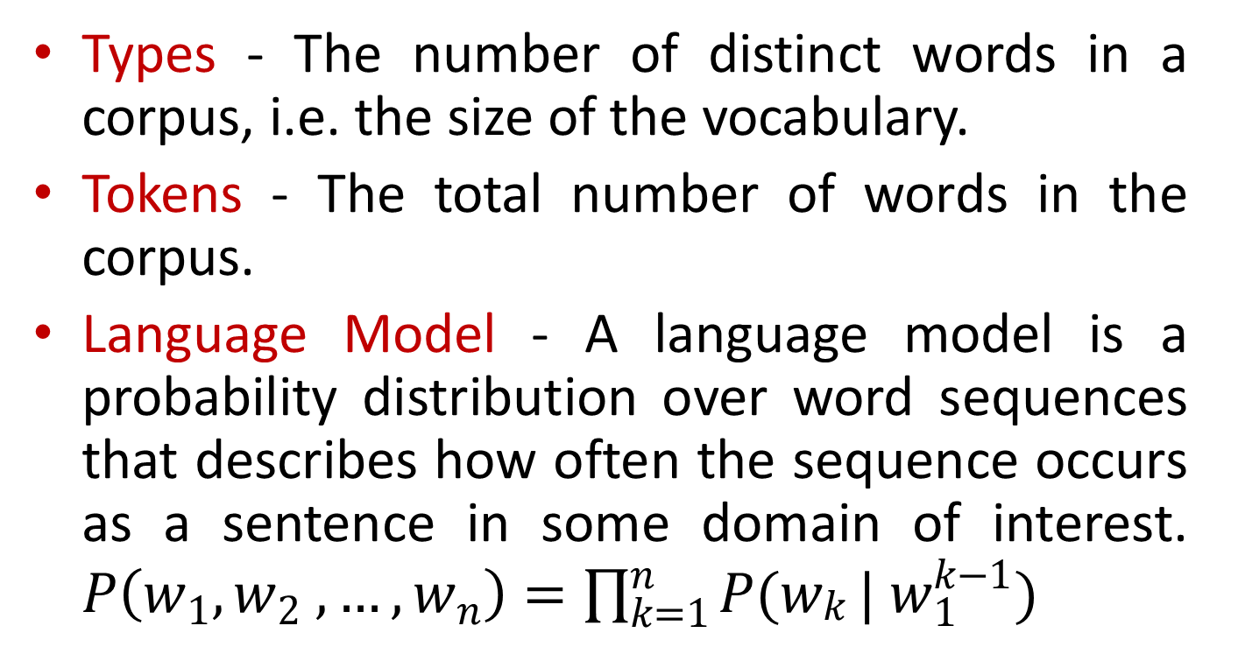
Some terminology
Types - The number of distinct words in a corpus, i.e. the size of the vocabulary.
Tokens - The total number of words in the corpus.
Language Model - A language model is a probability distribution over word sequences that describes how often the sequence occurs as a sentence in some domain of interest. $P\left(w_{1},w_{2} ,…, w_{n}\right)=\prod_{k=1}^{n}{P(w_{\begin{aligned}k \\ \end{aligned}}}| w_{1}^{k−1})$

Slide 3
Language Models
Language models are useful for NLP applications such as
Next word prediction
Machine translation
Spelling correction
Authorship Identification
Natural language generation
For intrinsic evaluation of language models, Perplexity metric is used.

Slide 4
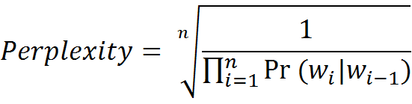
Perplexity
It is an evaluation metric for N-gram models.
It is the weighted average number of choices a random variable can make, i.e. the number of possible next words that can follow a given word.

Slide 5
Roadmap
Motivation
Types of smoothing
Back-off
Interpolation
Comparison of smoothing techniques

Slide 6
The Berkeley Restaurant Example
Corpora
Can you tell me about any good cantonese restaurants close by
Mid-priced Thai food is what I’m looking for
Can you give me a listing of the kinds of food that are available
I am looking for a good place to eat breakfast

Slide 7
Raw Bigram Counts
 | I | Want | to | eat | Chinese | food | lunch
I | 8 | 1087 | 0 | 13 | 0 | 0 | 0
Want | 3 | 0 | 786 | 0 | 6 | 8 | 6
To | 3 | 0 | 10 | 860 | 3 | 0 | 12
Eat | 0 | 0 | 2 | 0 | 19 | 2 | 52
Chinese | 2 | 0 | 0 | 0 | 0 | 120 | 1
Food | 19 | 0 | 17 | 0 | 0 | 0 | 0
lunch | 4 | 0 | 0 | 0 | 0 | 1 | 0

Slide 8
Probability Space
 | I | Want | to | eat | Chinese | food | lunch
I | .0023 | .32 | 0 | .0038 | 0 | 0 | 0
Want | .0025 | 0 | .65 | 0 | .0049 | .0066 | .0049
To | .00092 | 0 | .0031 | .26 | .00092 | 0 | .0037
Eat | 0 | 0 | .0021 | 0 | .020 | .0021 | .055
Chinese | .0094 | 0 | 0 | 0 | 0 | .56 | .0047
Food | .013 | 0 | .011 | 0 | 0 | 0 | 0
lunch | .0087 | 0 | 0 | 0 | 0 | .0022 | 0

Slide 9
Motivation for Smoothing
Even if one n-gram is unseen in the sentence, probability of the whole sentence becomes zero.
To avoid this, some probability mass has to be reserved for the unseen words.
Solution - Smoothing techniques
This zero probability problem also occurs in text categorization using Multinomial Naïve Bayes
Probability of a test document given some class can be zero even if a single word in that document is unseen

Slide 10
Smoothing
Smoothing is the task of adjusting the maximum likelihood estimate of probabilities to produce more accurate probabilities.
The name comes from the fact that these techniques tend to make distributions more uniform, by adjusting low probabilities such as zero probabilities upward, and high probabilities downward.
Smoothing not only prevents zero probabilities, attempts to improves the accuracy of the model as a whole.

Slide 11
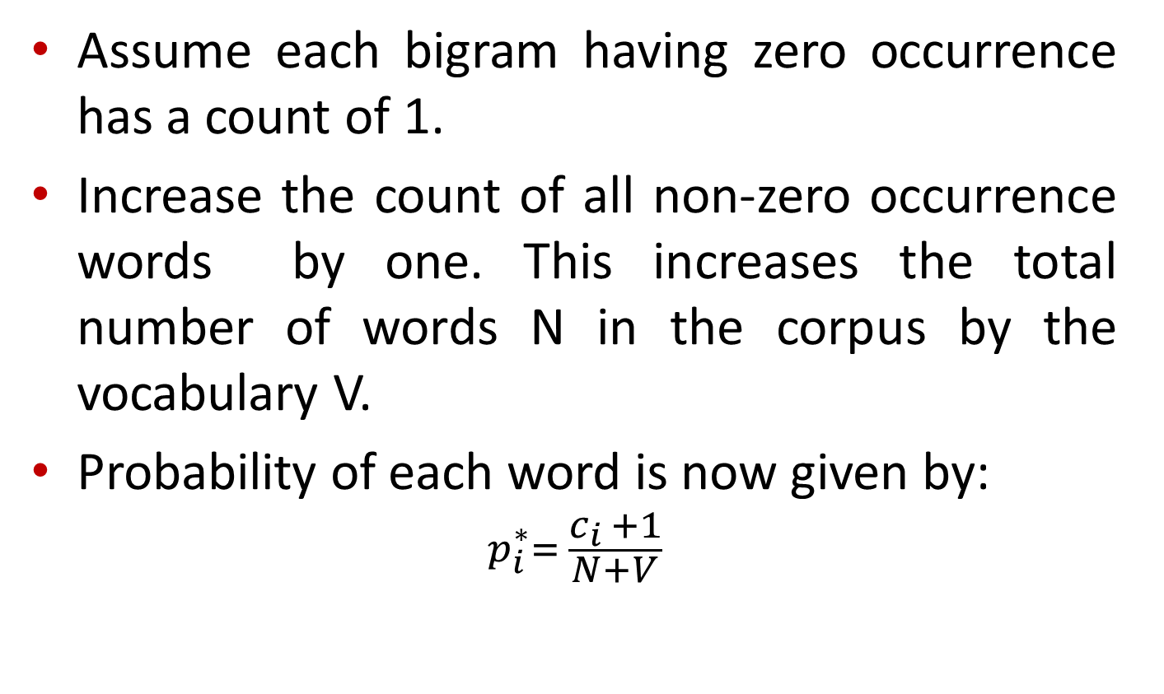
Add-one Smoothing (Laplace Correction)
Assume each bigram having zero occurrence has a count of 1.
Increase the count of all non-zero occurrence words by one. This increases the total number of words N in the corpus by the vocabulary V.
Probability of each word is now given by:
$$p_{i}^{∗}= \frac{c_{i }+1}{N+V}$$

Slide 12
Add-one Smoothing (Laplace Correction) – Bigram
 | I | Want | to | eat | Chinese | food | lunch
I | 9 | 1088 | 1 | 14 | 1 | 1 | 1
Want | 4 | 1 | 787 | 1 | 7 | 9 | 7
To | 4 | 1 | 11 | 861 | 4 | 1 | 13
Eat | 1 | 1 | 3 | 1 | 20 | 3 | 53
Chinese | 3 | 1 | 1 | 1 | 1 | 121 | 2
Food | 20 | 1 | 18 | 1 | 1 | 1 | 1
lunch | 5 | 1 | 1 | 1 | 1 | 2 | 1

Slide 13
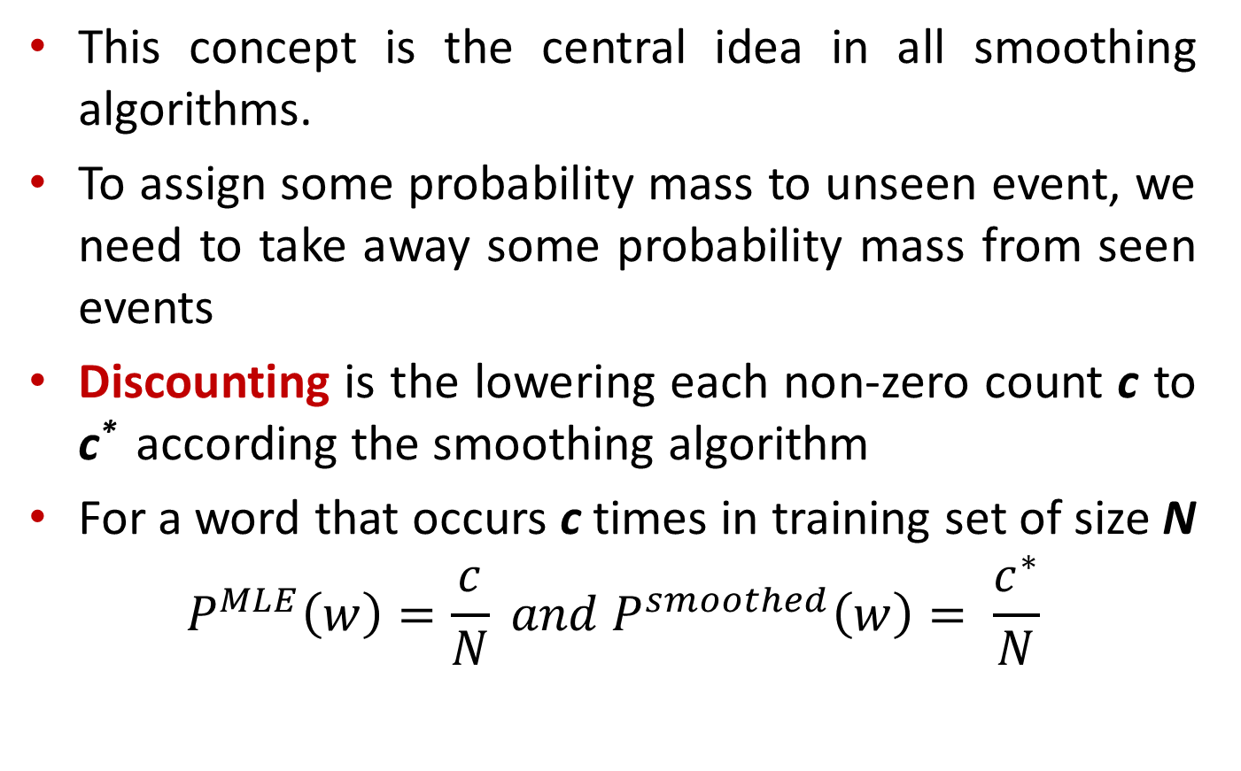
Concept of “Discounting”
This concept is the central idea in all smoothing algorithms.
To assign some probability mass to unseen event, we need to take away some probability mass from seen events
Discounting is the lowering each non-zero count c to c* according the smoothing algorithm
For a word that occurs c times in training set of size N
$$P^{MLE}\left(w\right)=\frac{c}{N} and P^{smoothed}\left(w\right)= \frac{c^{∗}}{N}$$

Slide 14

Laplace Correction - Adjusted Counts
$$c_{i}^{∗}=(c_{i}+1)\frac{N}{N+V}$$
 | I | Want | to | eat | Chinese | food | lunch
I | 6 | 740 | .68 | 10 | .68 | .68 | .68
Want | 2 | .42 | 331 | .42 | 3 | 4 | 3
To | 3 | .69 | 8 | 594 | 3 | .69 | 9
Eat | .37 | .37 | 1 | .37 | 7.4 | 1 | 20
Chinese | .36 | .12 | .12 | .12 | .12 | 15 | .24
Food | 10 | .48 | 9 | .48 | .48 | .48 | .48
lunch | 1.1 | .22 | .22 | .22 | .22 | .44 | .22

Slide 15
Laplace Correction – Observations and shortcomings
It makes a very big change to the counts. For example, C(want to) changed from 786 to 331.
The sharp change in counts and probabilities occurs because too much probability mass is moved to all the zeros. (can be avoided by adding smaller values to the counts).
Add-one is much worse at predicting the actual probability for bigrams with zero counts.

Slide 16
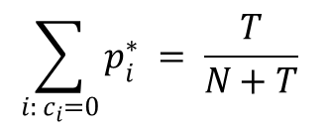
Witten-Bell Smoothing
Intuition - The probability of seeing a zero-frequency N-gram can be modeled by the probability of seeing an N-gram for the first time.
where T is the types we have already seen, and N is the number of tokens
$$\sum_{i: c_{i}=0}{p_{i }^{∗}}= \frac{T}{N+T}$$

Slide 17
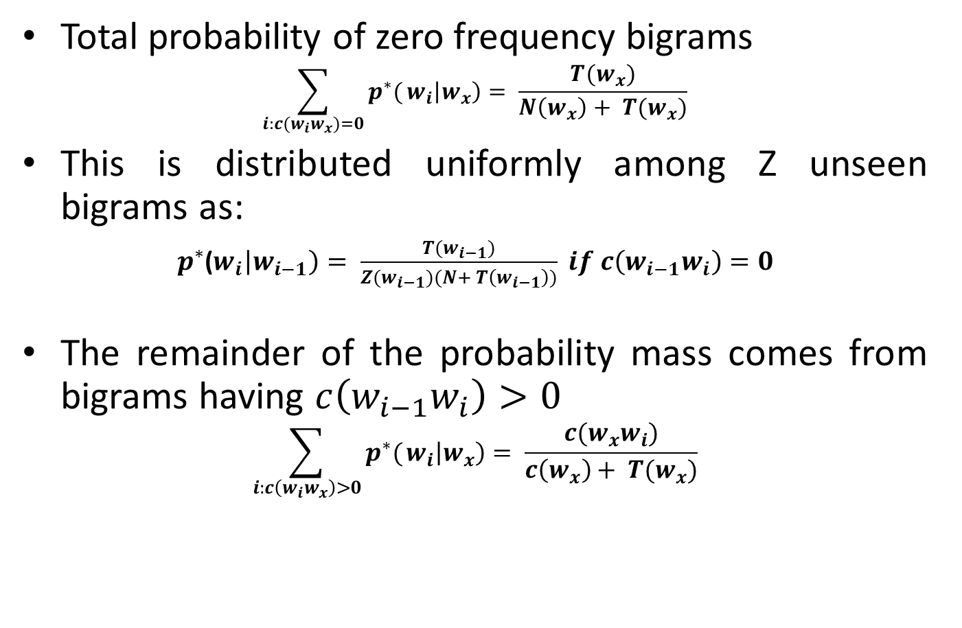
Witten Bell - for Bigram
Total probability of zero frequency bigrams
$$\sum_{i:c(w_{i}w_{x})=0}{p^{∗}(}w_{i}\left|w_{x}\right)= \frac{T(w_{x})}{N\left(w_{x}\right)+ T(w_{x})}$$
This is distributed uniformly among Z unseen bigrams as:
$p^{∗}$($w_{i}\left|w_{i−1}\right)= \frac{T(w_{i−1})}{Z(w_{i−1})(N+ T\left(w_{i−1}\right))} if c\left(w_{i−1}w_{i}\right)=0$
The remainder of the probability mass comes from bigrams having $c\left(w_{i−1}w_{i}\right)>0$
$$\sum_{i:c\left(w_{i}w_{x}\right)>0}{p^{∗}(}w_{i}\left|w_{x}\right)= \frac{c(w_{x}w_{i})}{c\left(w_{x}\right)+ T(w_{x})}$$

Slide 18

Smoothed counts
$$c_{i}^{∗}= \left\{\begin{aligned}\frac{T}{Z}\frac{N}{N+T}, if c_{i}=0 \\ c_{i}\frac{N}{N+T}, if c_{i}>0\end{aligned}\right.$$

Slide 19
Witten Bell - Example
W | T(W)
I | 95
Want | 76
To | 130
Eat | 124
Chinese | 20
Food | 82
Lunch | 45
Z(w) = V - T(w)

Slide 20
Witten Bell – Smoothed Counts
 | I | Want | to | eat | Chinese | food | lunch
I | 8 | 1060 | .062 | 13 | .062 | .062 | .062
Want | 3 | .046 | 740 | .046 | 6 | 8 | 6
To | 3 | .085 | 10 | 827 | 3 | .085 | 12
Eat | .075 | .075 | 2 | .075 | 17 | 2 | 46
Chinese | 2 | .012 | .012 | .012 | .012 | 109 | 1
Food | 18 | .059 | 16 | .059 | .059 | .059 | .059
lunch | 4 | .026 | .026 | .026 | .026 | 1 | .026

Slide 21

Good-Turing Discounting
Intuition:
Use the count of things which are seen once to help estimate the count of things never seen.
Similarly, use count of things which occur c+1 times to estimate count of things which occur c times.
Let, N_{c} be the number of things that occur c times. i.e. frequency of frequency “c”.
MLE count for N_{c} is c, but Good-Turing estimate which is function of N_{c+1} is,

Slide 22
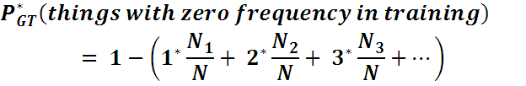



Good-Turing Discounting (contd.)
Using this estimate, probability mass set aside for things with zero frequency is,
This probability mass is divided among all unseen things.

Slide 23
Good Turing - Example
Training set – {10 times A, 3 times B, 2 times C and D, E, F once}, G, H, I, J, K are also in the vocabulary, but they never occur in training set
N = 18, N₁ = 3, N₂ = 1, N₃ = 1
P*(unseen) = N₁ /N = 3/18
P*(G) = P*(unseen)/5 = 3/90 = 1/30
P^{MLE}(G) = 0/N = 0
P*(D) = 1*/N = (2N₂/N₁)/N = (2/3)/18 = 1/27
P^{MLE}(D) = 1/N = 1/18
In practice, Good-Turing is not used by itself for n-grams; it is only used in combination with Backoff and Interpolation

Slide 24
Good Turing – Berkeley Restaurant Example
C(MLE) | N_{c} | C*(GT)
0 | 2,081, 496 | 0.002553
1 | 5315 | 0.533960
2 | 1419 | 1.357294
3 | 642 | 2.373832
4 | 381 | 4.081365
5 | 311 | 3.781350
6 | 196 | 4.500000

Slide 25
Leave-one-out Intuition (based on Jurafsky’s video lecture)
Create held-out set, by leaving one word out at a time
If training set has N words, there will be N-1 training sets for each word in the held-out set
Training set of N-1 words after leaving out w₁
w₁
Training set of N-1 words after leaving out w₂
w₂
Training set of N-1 words after leaving out w_{N}
w_{N}

Slide 26
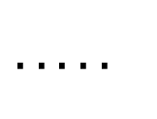
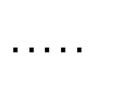
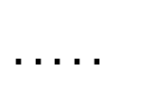
Leave-one-out Intuition (contd.)
Original Training set :
Held-out set :
N₁
N₂
N₃
N_{k+1}
$$. . . . .$$
$$. . . . .$$
N₀
N₁
N₂
N_{k}
$$. . . . .$$
$$. . . . .$$

Slide 27
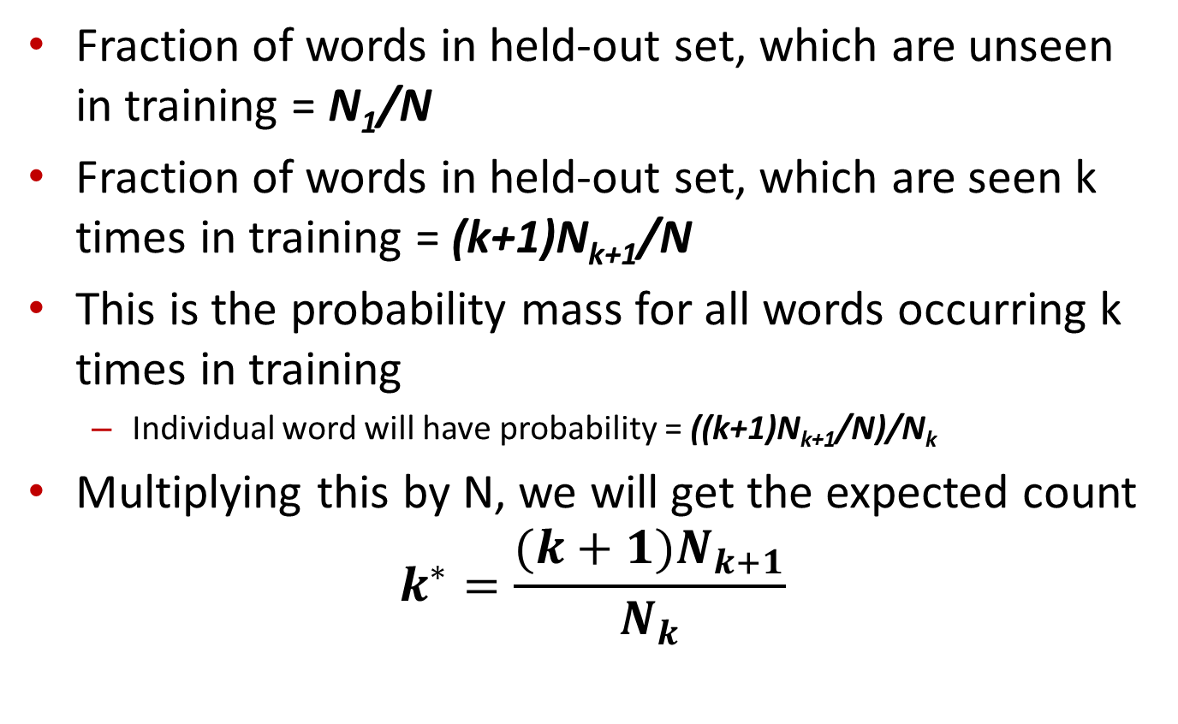
Leave-one-out Intuition (contd.)
Fraction of words in held-out set, which are unseen in training = N₁/N
Fraction of words in held-out set, which are seen k times in training = (k+1)N_{k+1}/N
This is the probability mass for all words occurring k times in training
Individual word will have probability = ((k+1)N_{k+1}/N)/N_{k}
Multiplying this by N, we will get the expected count
$$k^{∗}=\frac{(k+1)N_{k+1}}{N_{k}}$$

Slide 28
Interpolation and Backoff
Sometimes it is helpful to use less context
Condition on less context if much is not learned about larger context.
Interpolation
Mix unigram, bigram, trigram.
Backoff
Use trigram if good evidence is available.
Otherwise use bigram, otherwise unigram.
Interpolation works better in general.

Slide 29
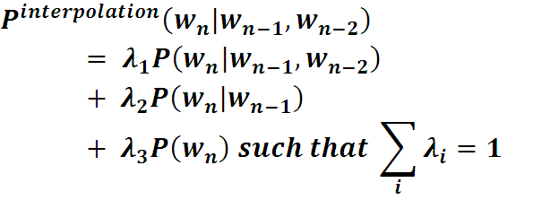
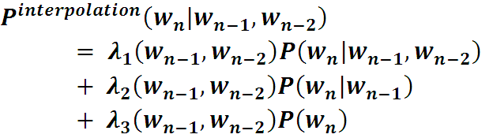

Interpolation

Slide 30
Interpolation – Calculation of λ
Held-out corpus is used to learn λ values
Trigram, bigram, unigram probabilities are learned using only training corpus.
λ values are chosen in such a way that the likelihood of the held-out corpus is maximized
EM Algorithm is used for this task.
_{Training Corpus}
Held-out Corpus
Test Corpus

Slide 31
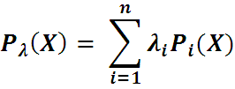


EM Algorithm for learning linear interpolation weights
Given :
Overall model P_{λ}(X) in terms of linear interpolation of n sub-models P_{i}(X)
Held-out data,
Output :
λ values that maximize likelihood of D

Slide 32
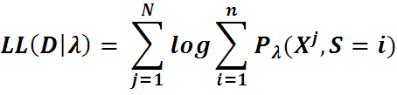
Problem Formulation
Imagine the interpolated model P_{λ} to be in any of the n states
λ_{i} : Prior probability of being in state i
P_{λ}(S=i,X) = P(S=i)P(X|S=i) = λ_{i}P_{i}(X) : Probability of being in state i and producing output X
P_{λ}(X) = Σ_{i}P_{λ}(S=i,X)
Therefore, log-likelihood becomes:

Slide 33
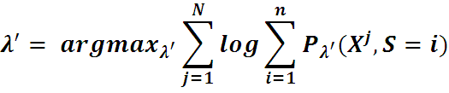
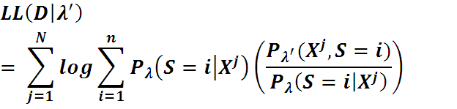
EM Algorithm
Assume some initial values for λ (current hypothesis)
Goal is to find next hypothesis λ’ such that:

Slide 34
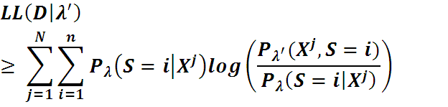
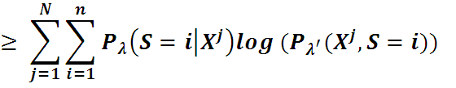
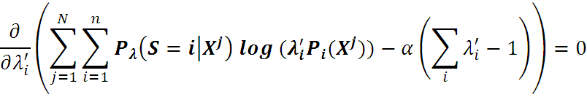
EM Algorithm (contd.)
Applying Jensen’s inequality,
Maximize above function, under the constraint that λ_{i}’ values sum to 1

Slide 35
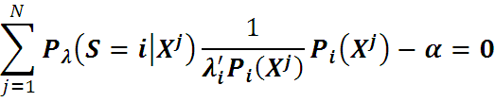
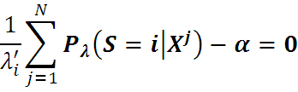
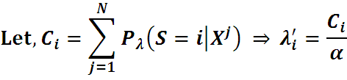


EM Algorithm (contd.)

Slide 36
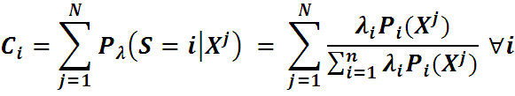

EM Algorithm (contd.)
Expectation Step :
Compute C₁, C₂,….., C_{n} using current hypothesis, i.e. current values of λ
Maximization Step :
Compute new values of λ using the following expression,

Slide 37

Backoff
Principle - If we have no examples of a particular trigram w_{n-2},w_{n-1}, w_{n}, to compute P(w_{n} | w_{n-1},w_{n-2}), we can estimate its probability by using the bigram probability P( w_{n} | w_{n-1}).
Where, P* is discounted probability (not MLE) to save some probability mass for lower order n-grams
α(w_{n-1},w_{n-2}) is to ensure that probability mass from all bigrams sums up exactly to the amount saved by discounting in trigrams

Slide 38
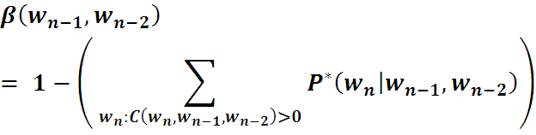
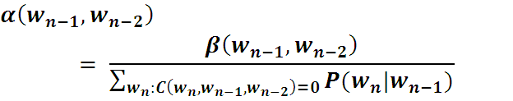
Backoff – calculation of α
Leftover probability mass for bigram w_{n-1},w_{n-2}
Each individual bigram will get fraction of this.
Normalized by total probability of all bigrams that begin some trigram that has zero count.

Slide 39
Stupid Backoff (contd.)
Authors named this method stupid, because their initial thought was that such a simple scheme can’t be possibly good.
But this method turned out to be as good as the state of the art “Kneser Ney”. (discussed later)
Important conclusions:
Inexpensive calculations, but quite accurate if training set is large.
Lack of normalization doesn’t affect, because functioning of LM in their setting depends on relative rather than absolute scores.

Slide 40



Stupid Backoff (Brants et.al.)
No discounting, instead only relative frequencies are used.
Inexpensive to calculate for web-scale n-grams
S is used instead of P, because these are not probabilities but scores.

Slide 41


Absolute Discounting
Revisit the Good Turing estimates
Intuition : c* seems to be c – 0.25 for higher c.
Above intuition is formalized in Absolute Discounting by subtracting a fixed D from each c
D is chosen to such that 0 < D < 1.
c(MLE) | 0 | 1 | 2 | 3 | 4 | 5 | 6 | 7 | 8 | 9
c*(GT) | 0.000027 | 0.446 | 1.26 | 2.24 | 3.24 | 4.22 | 5.19 | 6.21 | 7.24 | 8.25

Slide 42
Kneser Ney Smoothing
Augments Absolute Discounting by a more intuitive way to handle backoff distribution.
Shannon Game : Predict the next word….
I can’t see without my reading .
E.g. suppose the required bigram “reading glasses” is absent in the training corpus.
Backing off to unigram model, it is observed that “Fransisco” is more common than “glasses”.
But, information that “Fransisco” always follows “San” is not at all used, as backed off model is simple unigram model P(w).

Slide 43

Kneser Ney Smoothing (contd.)
Kneser and Ney, 1995 proposed-
Instead of P(w) i.e. “how likely is w”.
Use P_{continuation}(w) i.e. “how likely w can occur as a novel continuation”.
This continuation probability is proportional to number of distinct bigrams (*,w) that w completes

Slide 44

Kneser Ney Smoothing (contd.)
Final expression:

Slide 45
Short Summary
Applications like Text Categorization
Add one smoothing can be used.
State of the art technique
Kneser Ney Smoothing - both interpolation and backoff versions can be used.
Very large training set like web data
like Stupid Backoff are more efficient.

Slide 46
Performance of Smoothing techniques
The relative performance of smoothing techniques can vary over training set size, n-gram order, and training corpus.
Back-off Vs Interpolation – For low counts, lower order distributions provide valuable information about the correct amount to discount, and thus interpolation is superior for these situations.

Slide 47
Comparison of Performance
Algorithms that perform well on low counts perform well overall when low counts form a larger fraction of the total entropy i.e. small datasets. – why kesner ney performs best
Backoff is superior on large datasets because it is superior on high counts while interpolation is superior on low counts.
Since bigram models contain more high counts than trigram models on the same size data, backoff performs better on bigram models than on trigram models.

Slide 48
Summary
Need for Smoothing
Types of smoothing
Laplace Correction
Witten Bell
Good Turing
Kesner Ney
Backoff
Back off
Interpolation
Comparison

Slide 49
References
SF Chen, J Goodman , An empirical study of smoothing techniques for language modeling- Computer Speech & Language, 1999
Jurafsky, Daniel, and James H. Martin. 2009. Speech and Language Processing: An Introduction to Natural Language Processing, Speech Recognition, and Computational Linguistics. 2nd edition. Prentice-Hall.
H Ney, U Essen, R Kneser, On the estimation of `small' probabilities by leaving-one-out, Pattern Analysis and Machine Intelligence, 1995
T Brants, AC Popat, P Xu, FJ Och, J Dean, Large language models in machine translation, EMNLP 2007
Adam Berger, Convexity, Maximum Likelihood and All That, Tutorial at http://www.cs.cmu.edu/~aberger/maxent.html
Jurafsky’s video lecture on Language Modelling : http://www.youtube.com/watch?v=XdjCCkFUBKU

