Slide 1
AGRO-TECH
TEMPERATURE AND HUMIDITY DETECTOR

Slide 2
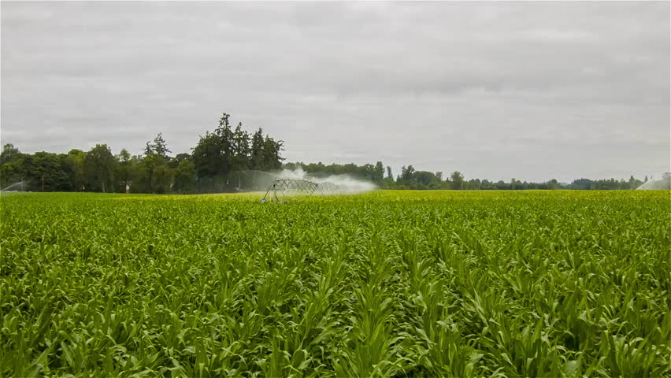

VISION:
We want to make agriculture merge with the current technology and implement new methods of agriculture techniques so that everyone gets interested to love farming.

Slide 3
DOMAIN:
Agriculture technology refers to the use and improvement of productivity, yield, and quality in agriculture.
It is the modern farming practices allowing the agriculture sector to evolve in the industry.
Throughout the years, the agrotech investment has increased as the applied technology for the industry has improved.

Slide 4
PROBLEM 1:
The assistance required for the farmers about accurate weather cast information with the help of the data from the meteorological department.
PROBLEM 2:
Develop a solution to promote sustainable farming practices and educate farmers on modern techniques.

Slide 5
WHY THIS PROBLEM:
Most of the farmers in our country aren’t aware of the information about weather conditions in the coming days.
This sudden change in weather leads to damage to the crops which will be a huge loss for them.
The change in technology has brought many new gadgets and techniques to farming.
This issue can be resolved by providing them with proper guidance about the weather report.

Slide 6
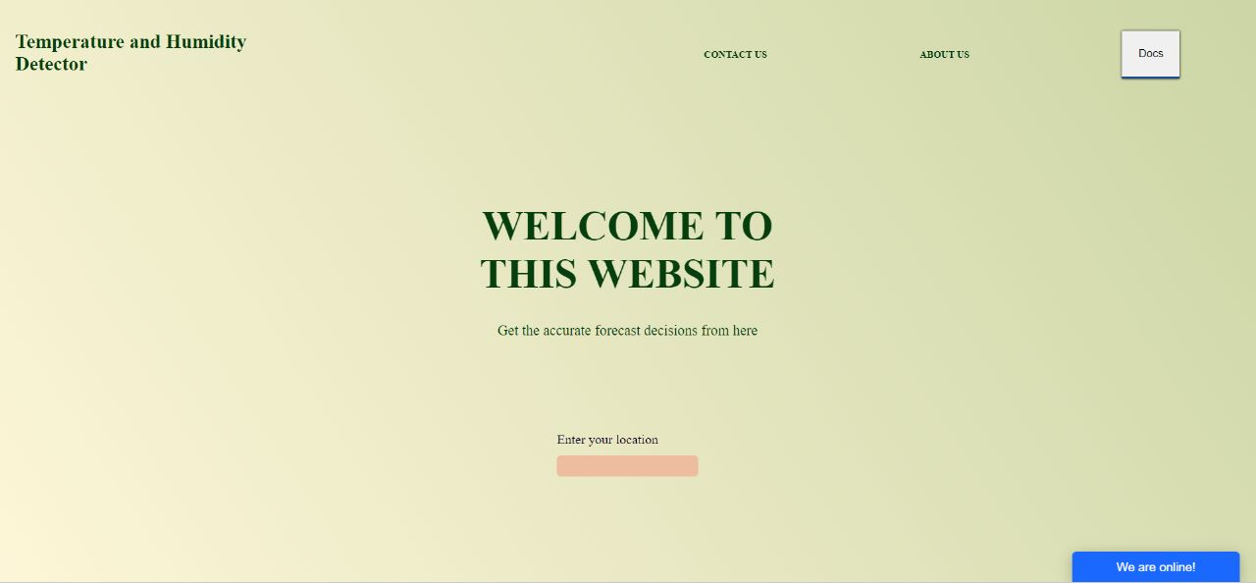
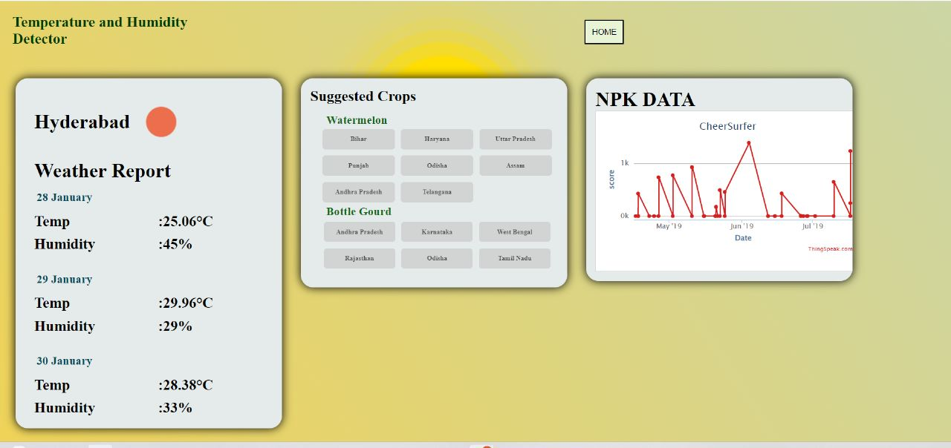
ABOUT WEBSITE:
This website is user-friendly and can get information very easily.
Our website generates the API server from the chrome services and provides the humidity and temperature.

Slide 7
CLICK HERE FOR THE DOCUMENTATION
ENTER THE LOCATION
Enter the location

Slide 8
SUGGESTED CROPS TO CULTIVATE
Weather report for the next three days

Slide 9
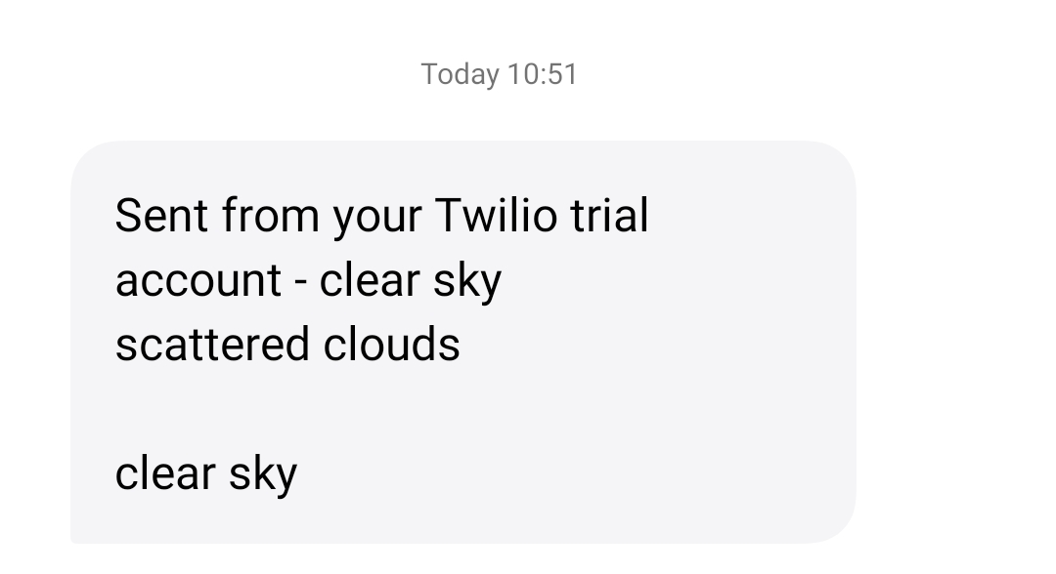
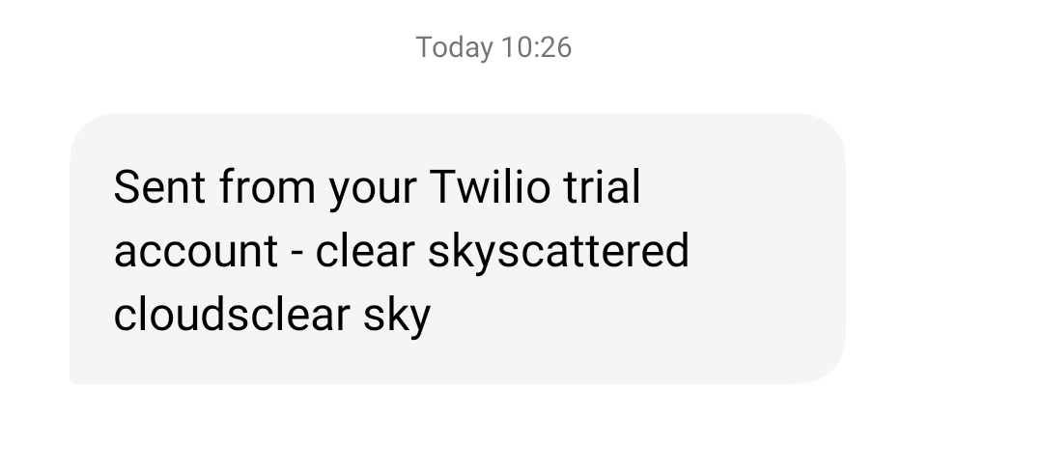
Daily weather forecast is sent through sms.

Slide 10
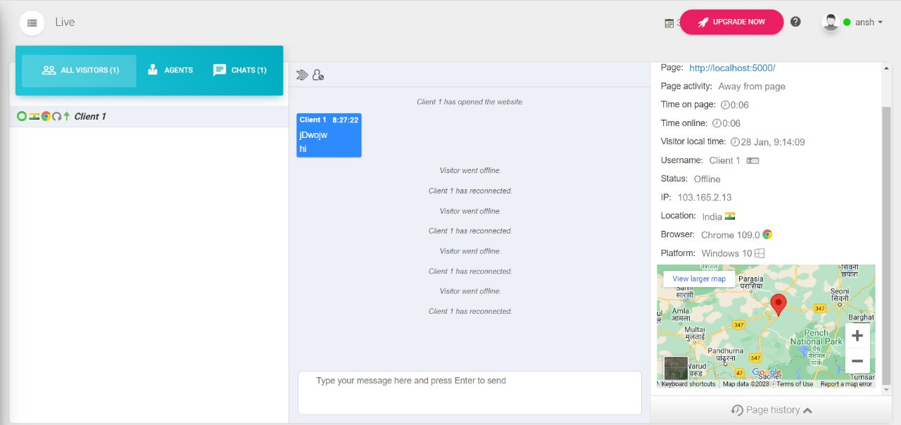
CHAT HERE

Slide 11
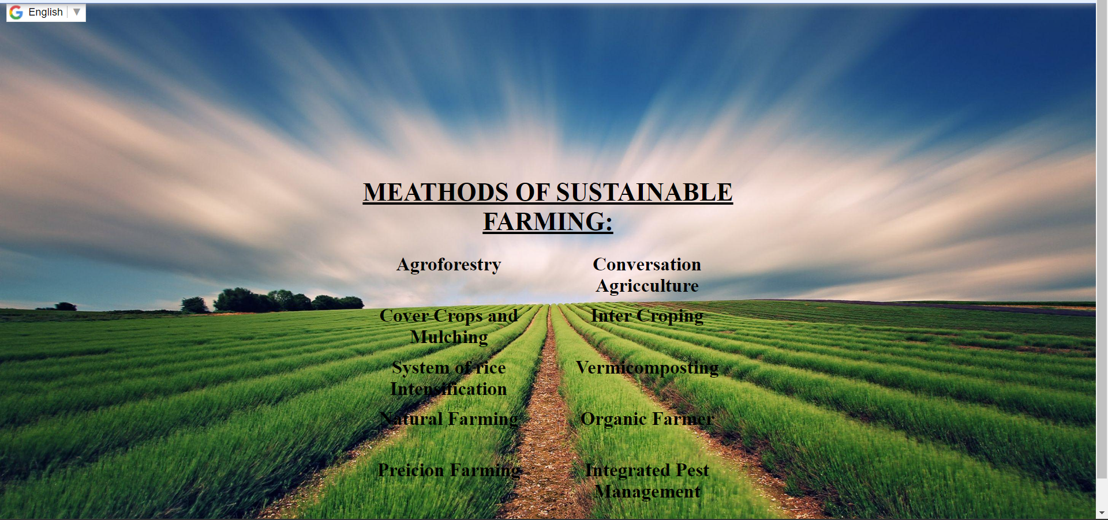

Slide 12
Our website provides accurate information and need not require any prerequisites to understand farmers.
How to work this website: It is quite easy.
we want to make agriculture merge with the current technology and implement new methods of agricultural techniques so that everyone gets interested to love farming.
The information is gathered from various sources

Slide 13
TEAM MEMBERS:
We are a team of phantoms and we come from the KESHAV MEMORIAL INSTITUTE OF TECHNOLOGY.
Ansh Kumar(Team Leader).
Shiva Prabhath.
D.L.Sathwik.
Hemanth Srinivas.

Slide 14
THANK YOU

