Slide 1
PROJECT: PERSONAL PORTFOLIO WEBSITE
Presented By:
Ansh Madanpuriya
Shri Vaishnav Vidyapeeth Vishwavidyalaya, Indore
Department of Computer Science Engineering

Slide 2
Outline
Project Goal (Problem Statement)
Design & Technology (System Approach)
Features & Implementation (Algorithm)
Final Result (Screenshots)
Conclusion
Future Enhancements
References

Slide 3
Project Goal
Problem Statement:
As a developer, I needed a professional online presence to showcase my skills, projects, and experience to potential employers.
A standard resume doesn't effectively demonstrate technical projects and design capabilities.
The Solution:
To build a personal portfolio website that is modern, visually engaging, easy to navigate, and effectively communicates my technical abilities.

Slide 4
Design & Technology
System Approach:
Frontend Technologies Used:
• HTML5: For the core structure and content of all sections.
• CSS3: For all styling, including layout, color scheme, typography, and responsiveness.
• JavaScript: To implement dynamic features like typing animation and smooth scrolling.
Design Philosophy:
• Clean, modern, and minimalist aesthetic.
• User-friendly and intuitive navigation.
• Fully responsive for desktops, tablets, and mobile phones.

Slide 5
Features & Implementation
Algorithm & Deployment:
• Hero Section: Full-screen intro with typing animation.
• Key Sections: 'About Me', 'Skills', 'Projects'.
• Project Gallery: Interactive cards with links.
• Contact Form: Simple and user-friendly.
• Testing: Cross-browser compatibility.
• Deployment: Hosted using Netlify for fast delivery.

Slide 6
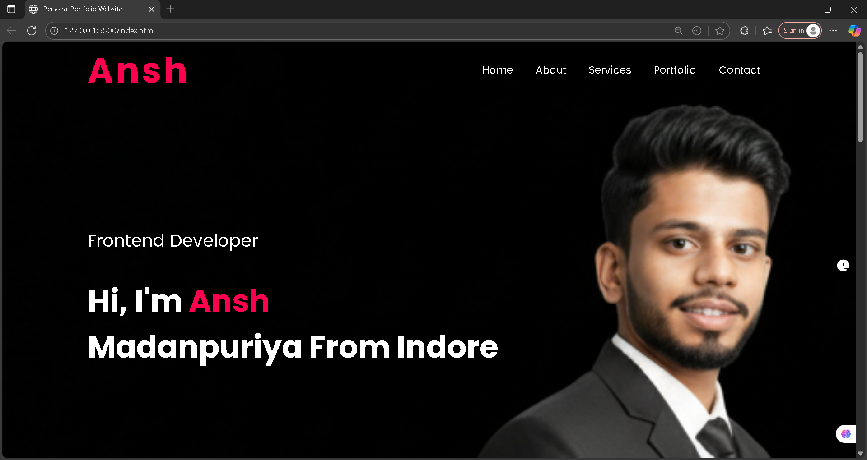
Result
• Homepage Screenshot

Slide 7
GitHub and Deployment Link
GitHub Repository:
https://github.com/AnshMadanpuriya/Portfolio_Project
Live Deployment Link:
https://magenta-torrone-a250cd.netlify.app

Slide 8
Conclusion
• Successfully created a professional digital resume that effectively showcases my skills and projects.
• Demonstrated proficiency in core frontend technologies.
• Portfolio serves as a strong tool for networking and job applications.

Slide 9
Future Scope
Achievements & Certifications Section – Highlight hackathons, internships, and certifications for stronger professional impact.
Blog/Articles Section – Share technical write-ups, learning experiences, and coding tutorials to build personal branding.
Theme Customization – Add dark/light mode toggle and customizable color schemes for better user experience.
Project Showcase Enhancements – Add live demos, detailed case studies, and downloadable project reports.
Interactive Resume Download – Provide a one-click downloadable CV/Resume in PDF format.
Animations & Micro-interactions – Use modern animation libraries to make scrolling, transitions, and hover effects more engaging.

Slide 10
References
• MDN Web Docs, W3Schools
• Awwards, Dribble (Design Inspiration)
• Stack Overflow (Community Support)

Slide 11
Thank you

