Slide 1

Presentation on
Apna Banaras
Session: 2024-25
Department of Computer Science & Engineering
BBS College Of Engineering & Technology
Pryagraj - 211013

Slide 2
Online Notes Sharing System
Under the Guidance Presented by
Ms. Shreya Agrawal
Ansh Maurya
Sachin Yadav
Pravin Pal

Slide 3
Introduction of project
The main objectives of Online Notes Sharing System
Listed Below
“Online Notes Sharing System Project” is a web based technology .
That manages user and notes database and provides rights to update their details and notes.
In this web application user must be registered.

Slide 4
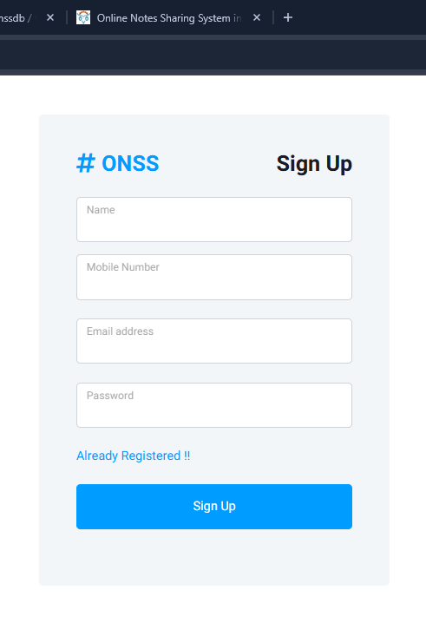
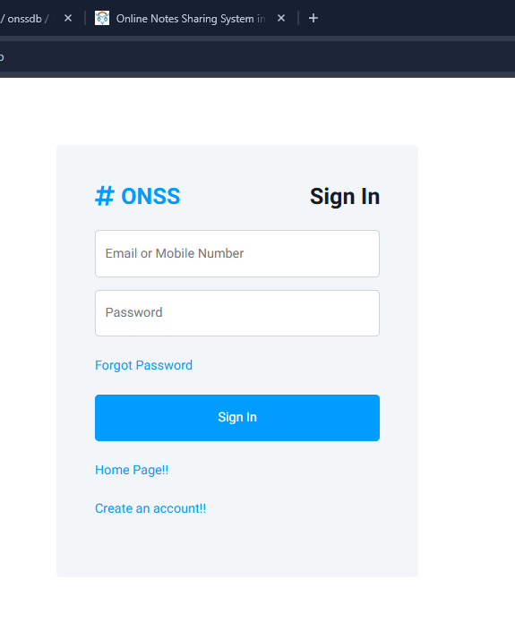

Slide 5
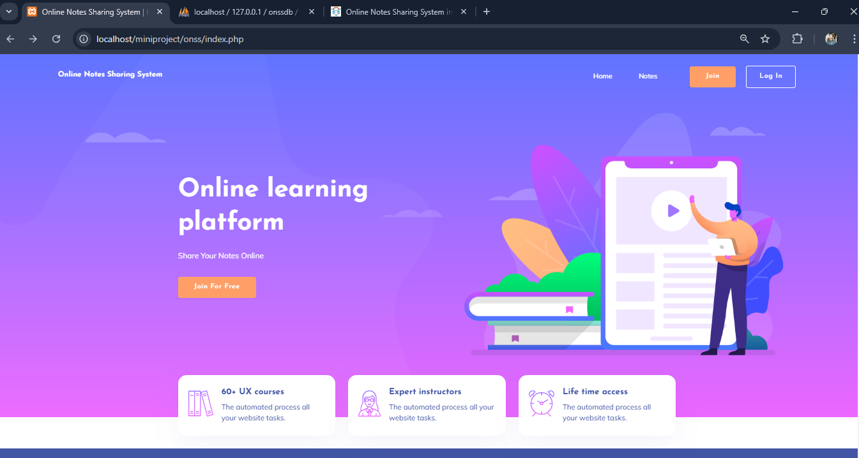
HOME

Slide 6
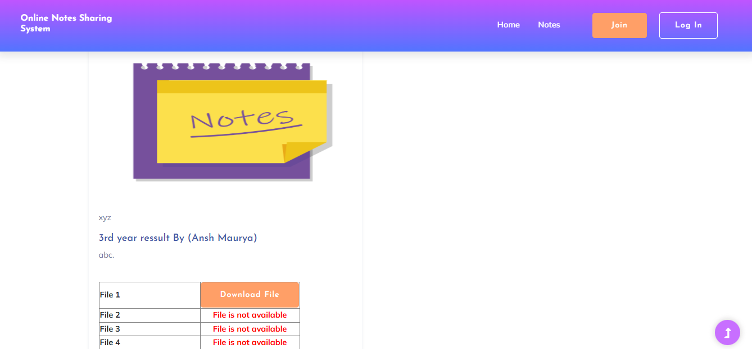

Slide 7
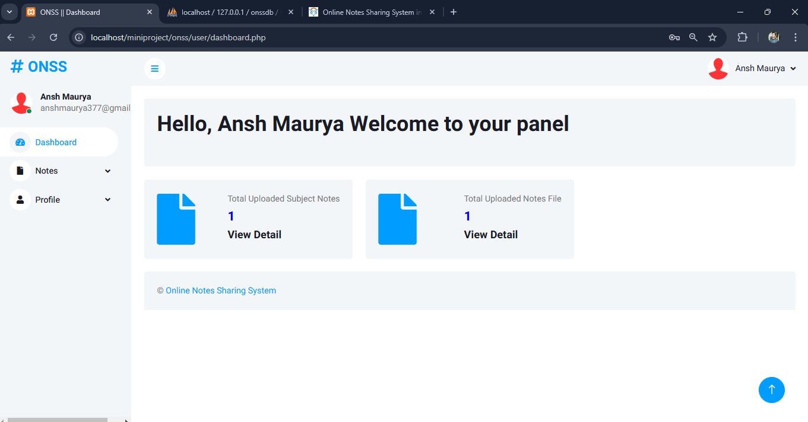
Dashboard

Slide 8
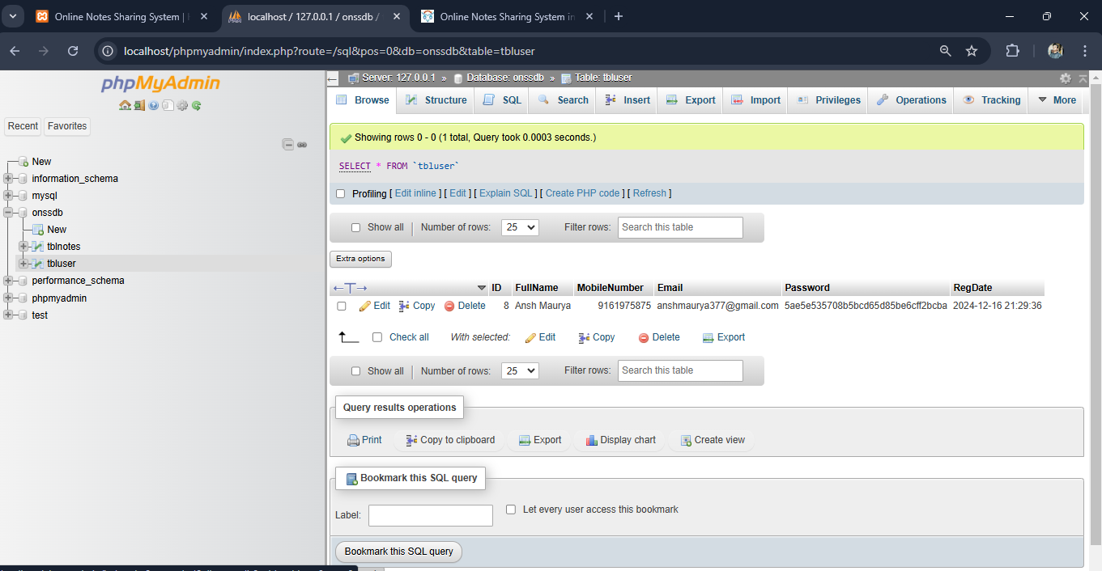

Slide 9
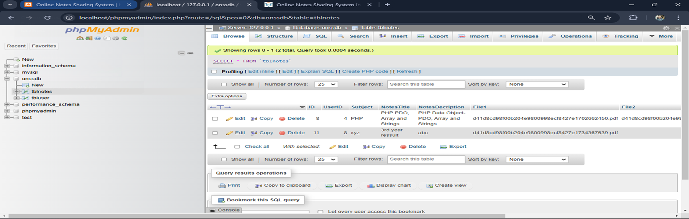

Slide 10
Features of the Project
User-Friendly Interface
User Login
Customization Option
Updation
Multi-platform Accessibility
Scalability
Security
Transparency

Slide 11
Technology Used In This Project
Front-end :
Back-end :
HTML
CSS
JavaScript
Ajax
PHP
MySQL
Libraries :
Database :
BOOTSTRAP
jQuery
MySQL
IDE:
Vs Code
Notepad ++

Slide 12
Modules Of Project
Registration System.
Login Management System.
User Authentication
User Dashboard
User Profile
Change Password

Slide 13
Future Scope of the Project
Desktop Application
Online Resource sharing plateform at large level

Slide 14
ANY QUERY ?

Slide 15

1

