Slide 1
Generative Adversarial Networks for Cosmology Mass Maps
(Simulation Emulation)
Mustafa Mustafa
Evan Racah, Rami Alrfou
MANTISSA, Berkeley Lab.
01/17/2017

Slide 2
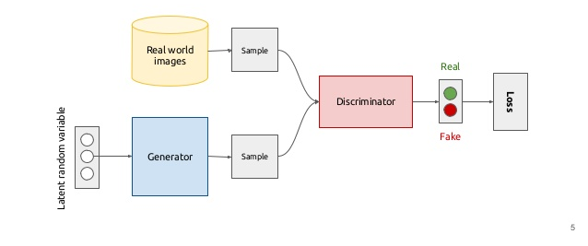
Generative Adversarial Networks
Kevin McGuinness

Slide 3
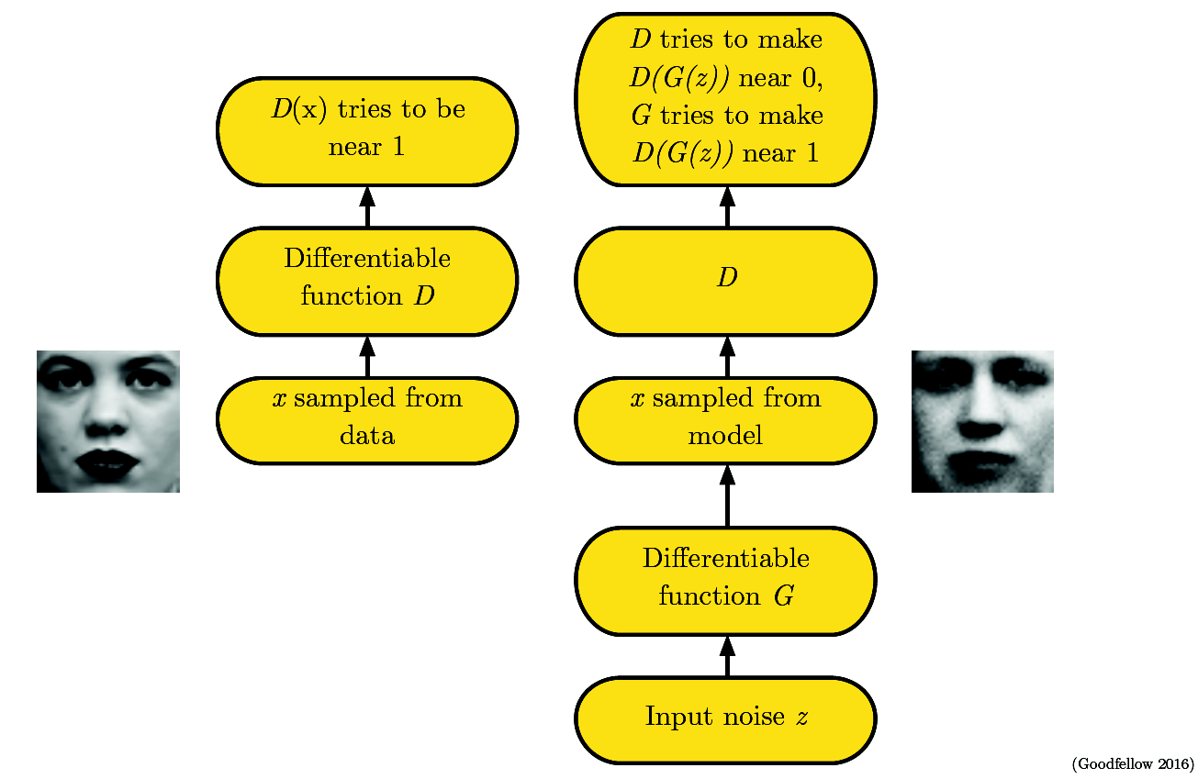
Generative Adversarial Networks

Slide 4
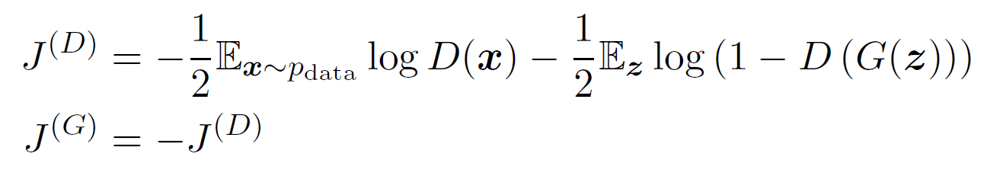
Generative Adversarial Networks – Loss Functions
Saturating game (Minimax):
Ian Goodfellow arXiv:1701.00160

Slide 5
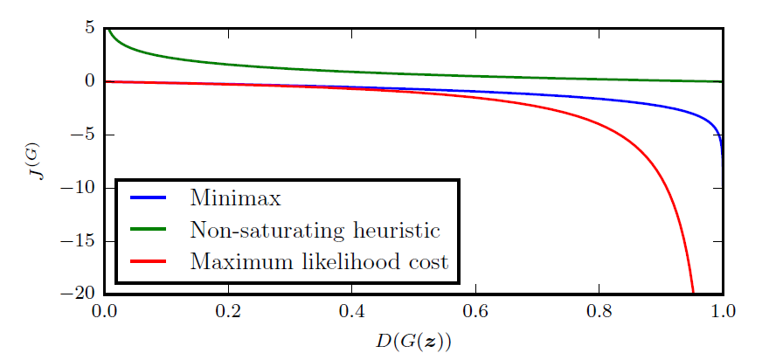
Generative Adversarial Networks – Loss Functions
Saturating game (Minimax):
Ian Goodfellow arXiv:1701.00160

Slide 6
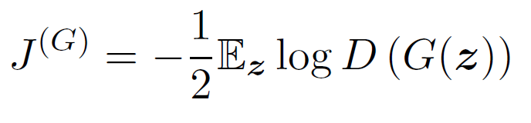
Generative Adversarial Networks – Loss Functions
Saturating game (Minimax):
Non-saturating game (heuristic):
Ian Goodfellow arXiv:1701.00160

Slide 7
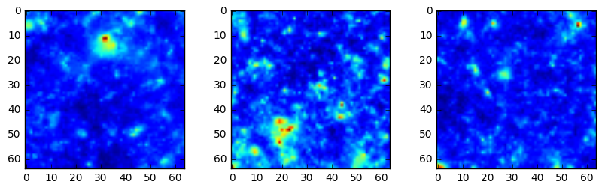
Cosmology Mass Maps Simulator Emulator
Basic idea:
Cosmologist need to run computationally expensive simulations of the mass density maps of the universe with different parameters σ = (σ1, σ2, …). The evolution of the universe is not deterministic, i.e. you can get “different” mass maps for the same set of parameters σ*.
We want to explore if we can use GANs to help in reducing the computational time. A reliable GAN duet might also be used to extract features or summary statistics.
The fidelity of the generated images can be checked using a cosmologist metric (“summary statistics”).

Slide 8
Cosmology Mass Maps Simulator Emulator
Dataset:
1000 1024x1024 mass maps generated at one σ* point. It is possible to generate more if needed.
Ultimate goal: a conditional/parametric generator G(σ, z), where σ is the cosmologists vector of parameters and z is a vector of random noise
Current goal: G(z) which will generate images at the fixed point σ* of our test sample

Slide 9
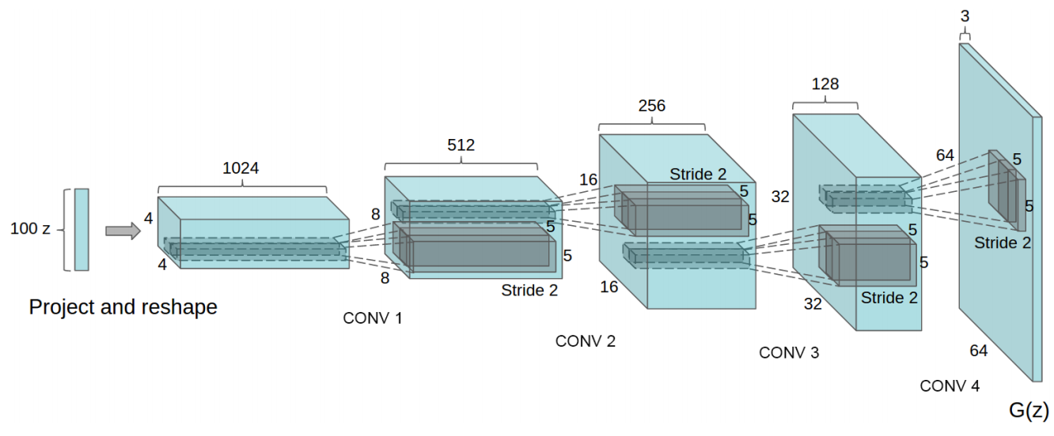
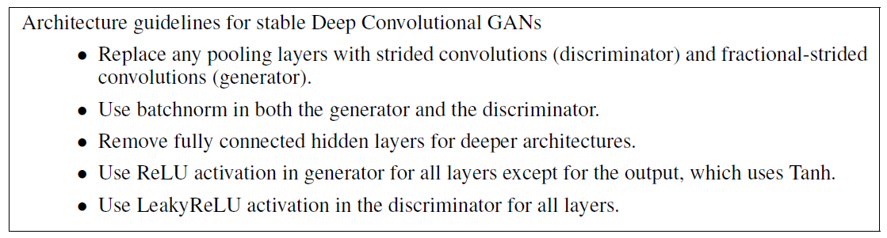
Deep Convolutional GAN (DCGAN)
Alec Radford, Luke Metz, Soumith Chintala arXiv:1511.06434
Heuristically found stable architecture

Slide 10
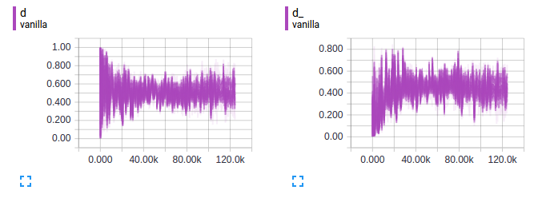
Cosmo DCGAN 64x64
epoch4
D(x)
D(G(z))
Trained on 1M 64x64 images (float32)
Total of 8 epochs with evaluations at 4 and 8

Slide 11
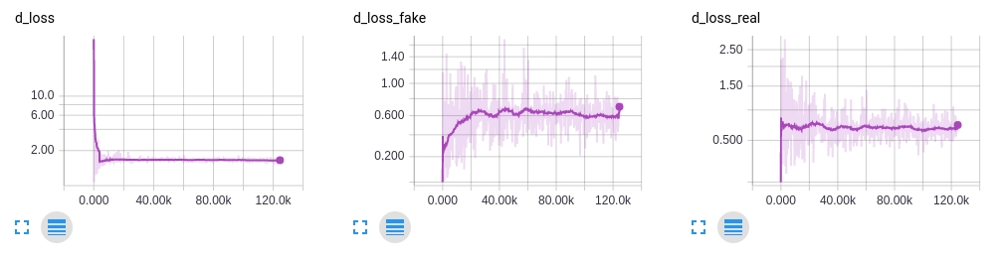
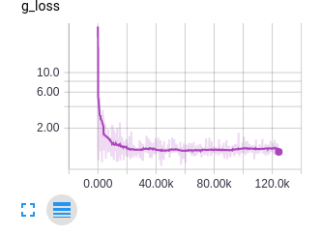
Cosmo DCGAN 64x64
epoch4
D(x)
D(G(z))
Trained on 1M 64x64 images (float32)
Total of 8 epochs with evaluations at 4 and 8

Slide 12
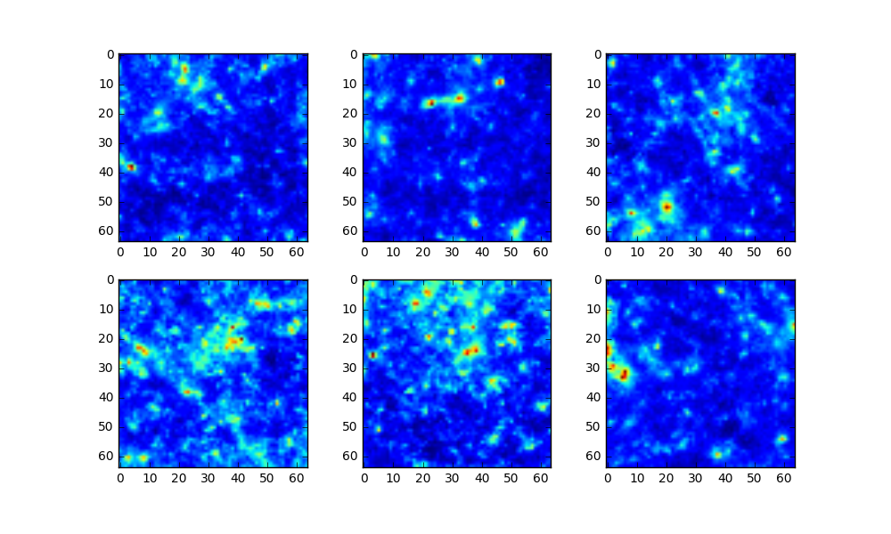
Cosmo DCGAN 64x64
Epoch4: Generated Images

Slide 13
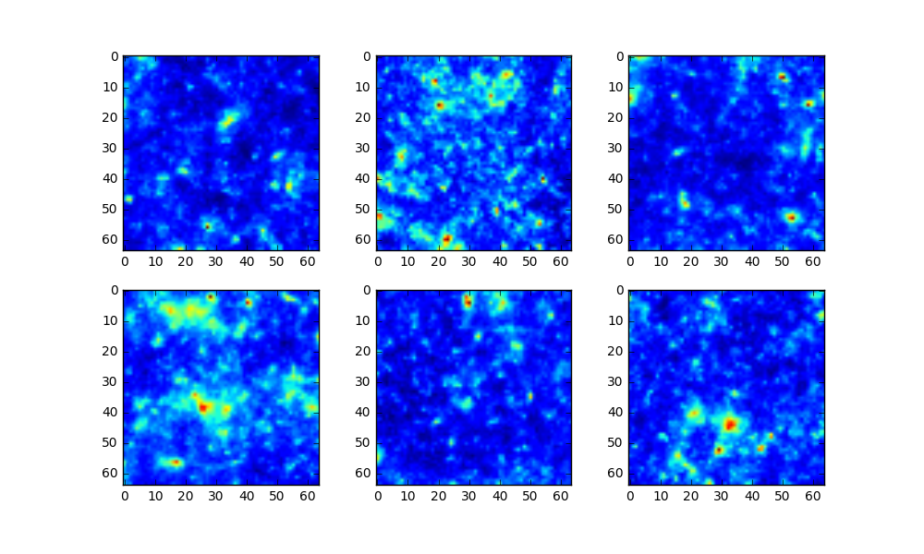
Cosmo DCGAN 64x64
Epoch4

Slide 14
Cosmo DCGAN 64x64
Generated
Real
Epoch4

Slide 15
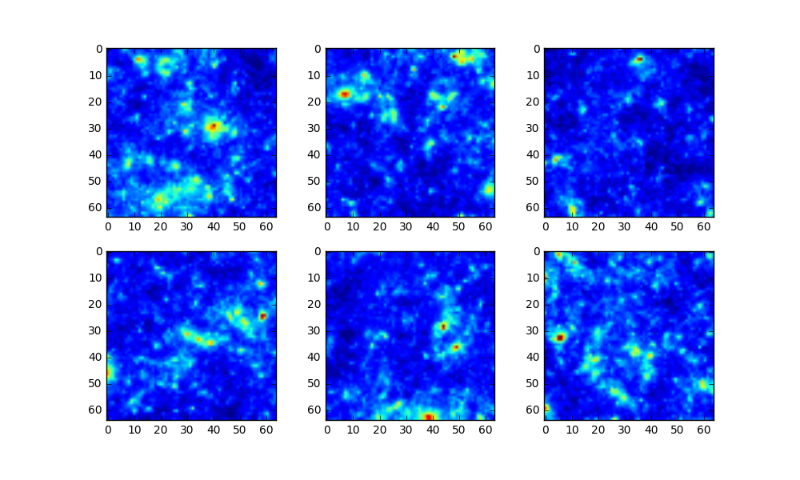
Cosmo DCGAN 64x64
Epoch8: Generated Images

Slide 16
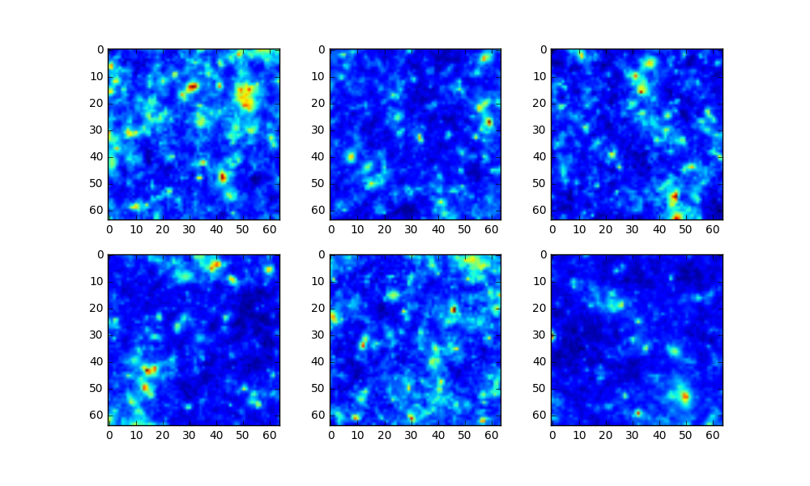
Cosmo DCGAN 64x64
Epoch8

Slide 17
Cosmo DCGAN 64x64
Generated
Real
Epoch8

Slide 18
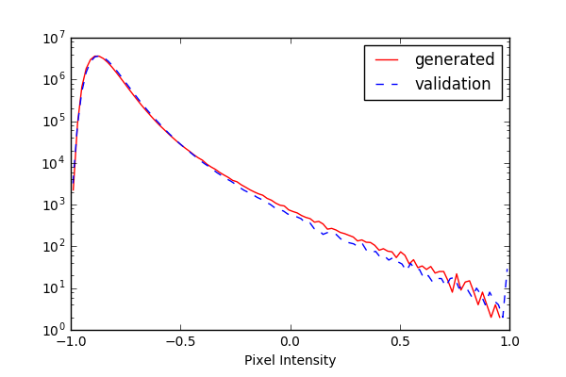
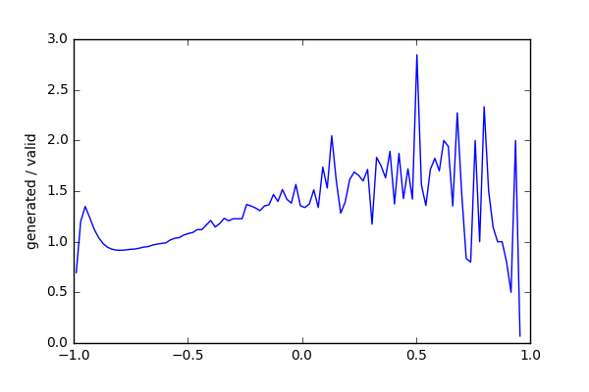
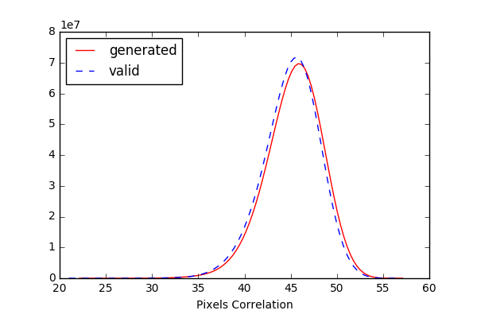
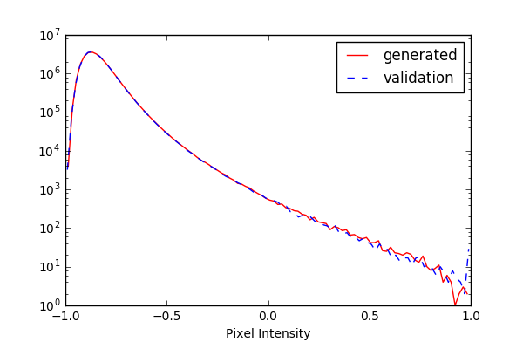
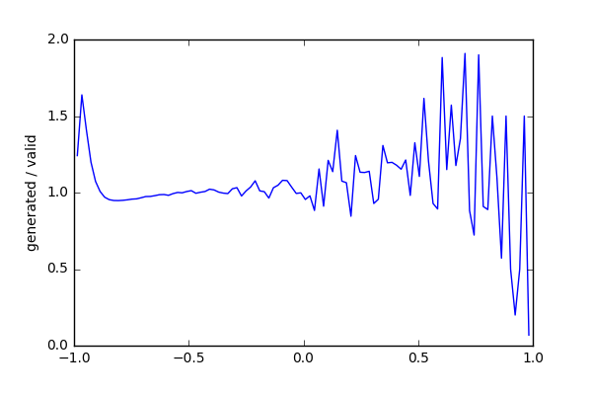
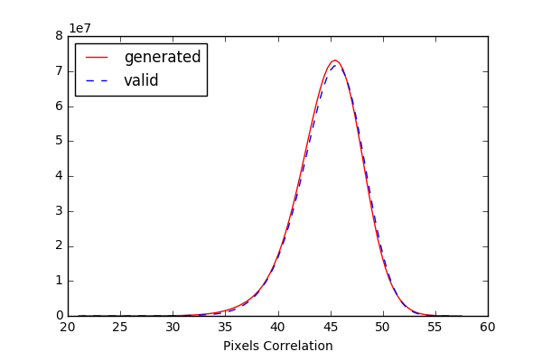
Cosmo DCGAN 64x64
Epoch 4
Epoch 4
Epoch 4
Epoch 8
Epoch 8
Epoch 8
First-order (MickyMouse) tests for the reproducibility of correlations in real mass maps

Slide 19
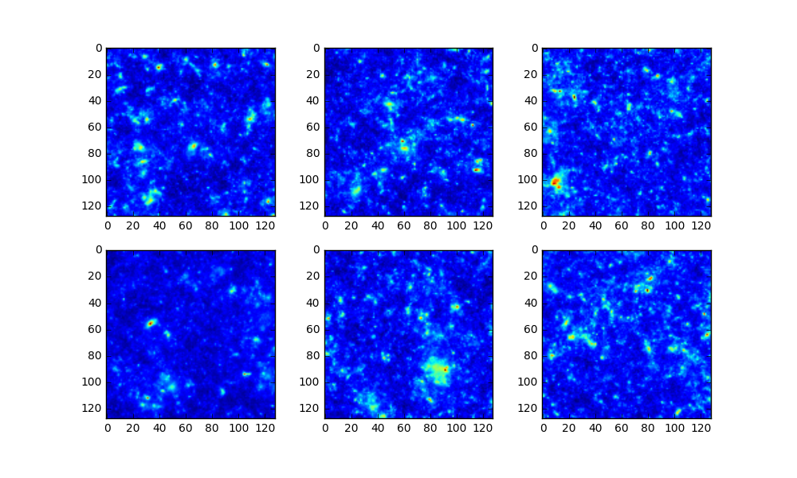
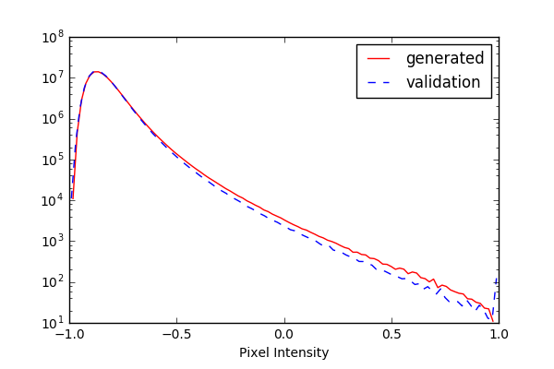
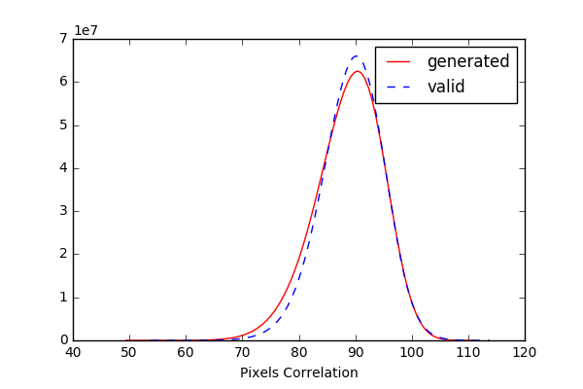
Cosmo DCGAN 128x128
10 epochs on 200k images

Slide 20
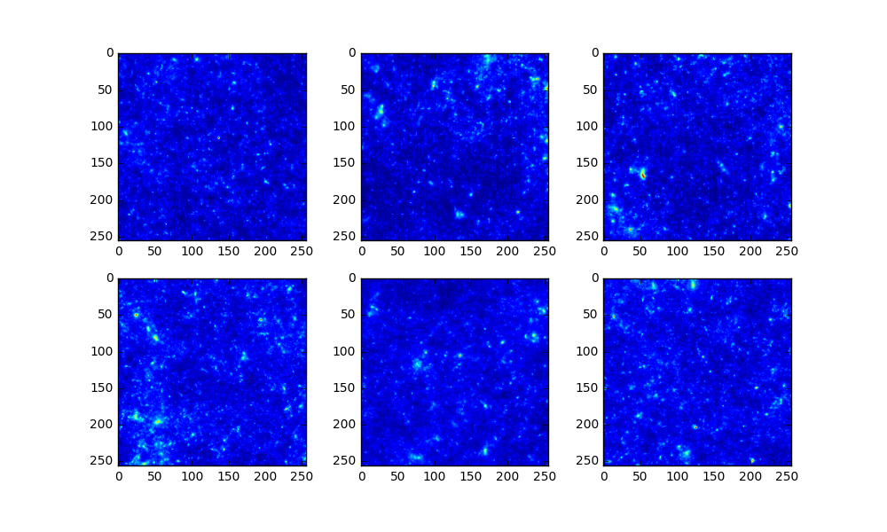
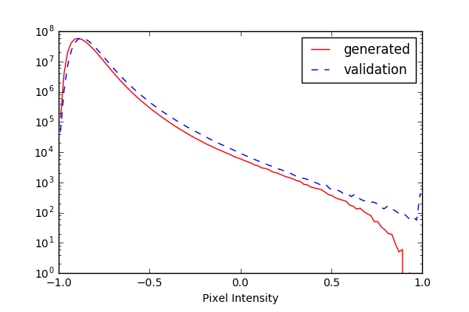
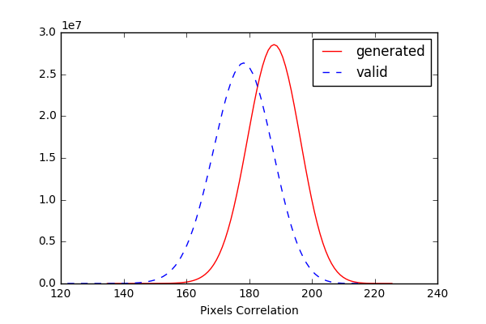
Cosmo DCGAN 256x256
3 epochs on 200k images

