Slide 1
Generative Adversarial Networks for Cosmology Mass Maps
(Simulation Emulation)
Mustafa Mustafa, Deborah Bard, Wahid Bhimji
Berkeley Lab.
04/19/2017

Slide 2
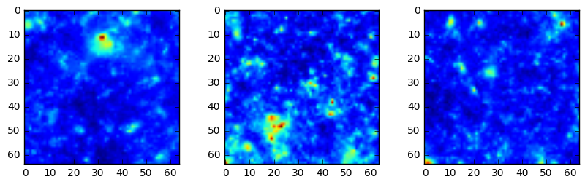
Cosmology Mass Maps Simulator Emulator
Basic idea:
Cosmologist need to run computationally expensive simulations of the mass density maps of the universe with different parameters σ = (σ1, σ2, …). The evolution of the universe is not deterministic, i.e. you can get “different” mass maps for the same set of parameters σ*.
We are exploring GANs to help in reducing the computational time. A reliable GAN dual might also be used to extract features or summary statistics.
The fidelity of the generated images can be checked using a cosmologist metric (“summary statistics”).

Slide 3
Cosmology Mass Maps Simulator Emulator
Dataset:
1000 1024x1024 mass maps generated at one σ* point. It is possible to generate more if needed.
Ultimate goal: a conditional/parametric generator G(σ, z), where σ is the cosmologists vector of parameters and z is a vector of random noise
Current goal: G(z) which will generate images at the fixed point σ* of our test sample

Slide 4
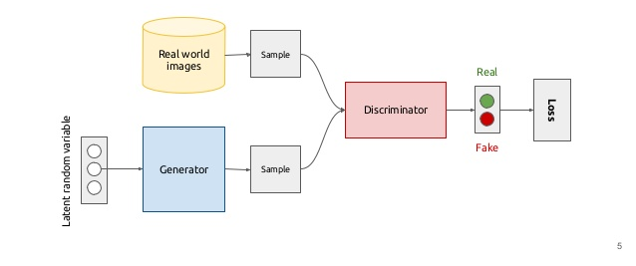
Generative Adversarial Networks
Kevin McGuinness

Slide 5
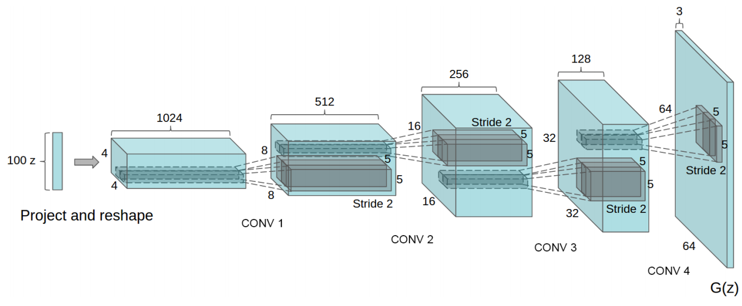
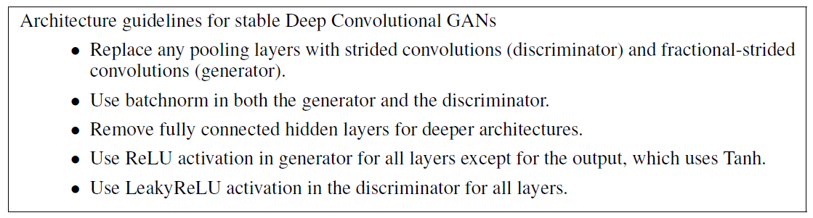
Deep Convolutional GAN (DCGAN)
Alec Radford, Luke Metz, Soumith Chintala arXiv:1511.06434
Heuristically found stable architecture

Slide 6
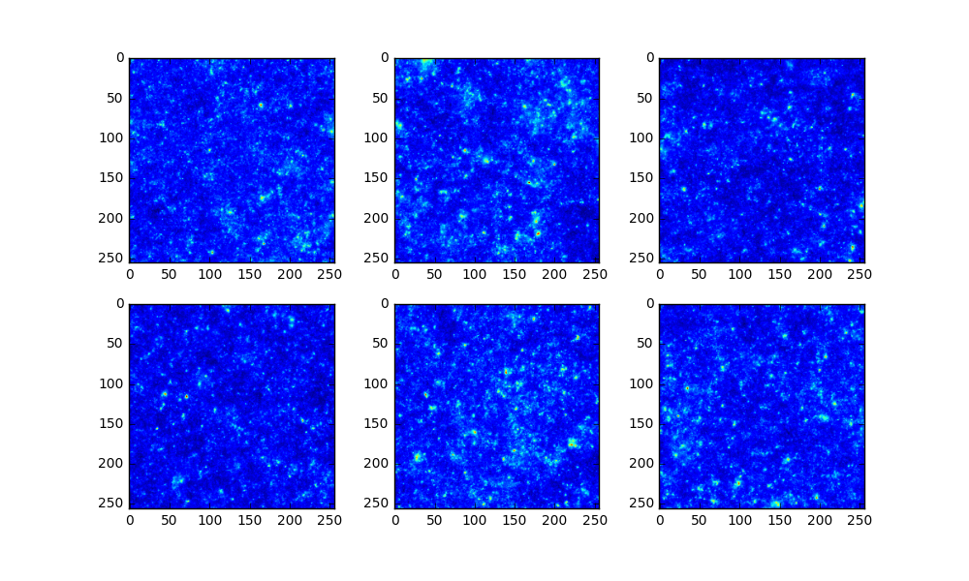
Cosmo DCGAN 256x256

Slide 7
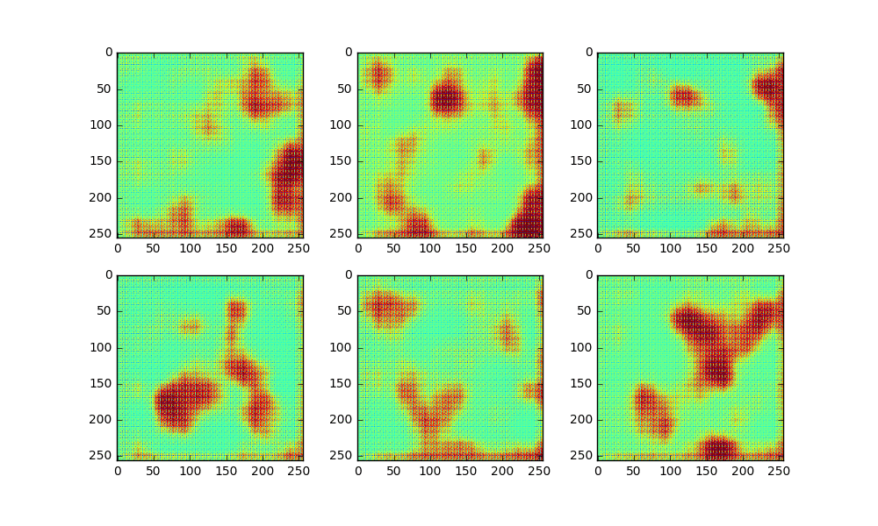
Cosmo DCGAN 256x256

Slide 8
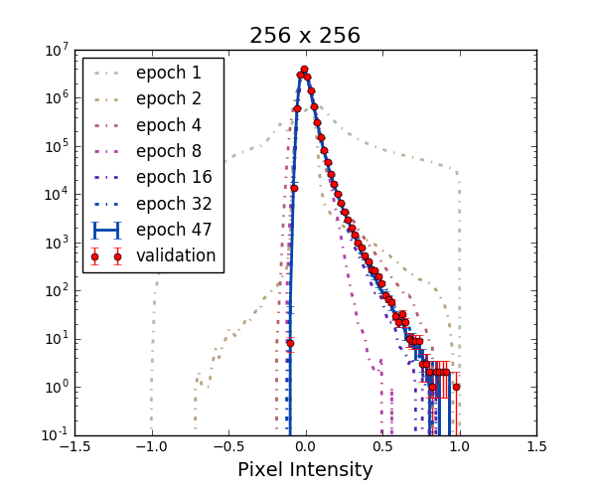
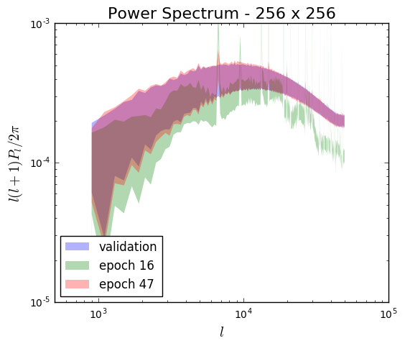
Cosmo DCGAN 256x256
First order statistics (left) and 2-pt correlations (right) are reproduced with high fidelity in generated images.

Slide 9
Outlook
Train on 512x512 and 1000x1000 maps with larger networks
Explore architectures for parametric generators

