Slide 1
Dynamic Hand gesture Recognition using Neural Network
Submitted in the partial fulfillment for the award of the degree of
BACHELOR OF ENGINEERING
IN
AIT CSE AIML
Submitted by:
Ansh Pandey 20BCS6741
Tanshi Verma 20BCS6795
Pranjal Mohana 20BCS6756
Aahish Aahan 20BCS6731
Under the Supervision of:
SUPERVISORS NAME
Department of AIT-CSE
DISCOVER . LEARN . EMPOWER

Slide 2
Outline
Introduction to Project
Problem Formulation
Objectives of the work
Methodology used
Results and Outputs
Conclusion
Future Scope
References

Slide 3
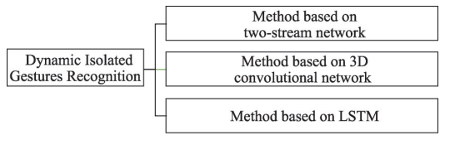
Introduction
Hand Gesture Recognition is one of the most interesting field of human-computer interface. Hand Gesture Recognition System recognizes the actions performed by the user and then send some information or perform some action as described or stated in its database.
Human actions can be sensed using either camera or sensors. There can be two types of hand gestures, one is Static and second one is Dynamic. In static hand gesture, there we need to put the hand stable and its all about the shape of the hand. While in Dynamic hand gestures, there is a continuous movement of hand.

Slide 4
Problem Formulation
sometimes we have faced issues related to keyboard that some keyboard buttons are missing or some buttons don’t work.
We are developing a system that will recognize the dynamic movements of hand and will then perform some tasks like typing, opening an app, drawing, etc. In Virtual Keyboard, we can type anything anywhere. Virtual Keyboard is necessary in a computer/laptop.This system has two parts:
Virtual Keyboard
Virtual Mouse
Using both these features we can access the apps, open them and perform different task as performed by the mouse and with the help of keyboard we can type virtually.
The camera will detect the movements of hand and detect its actions and will response accordingly. Both Virtual Keyboard and Virtual Mouse features will help in better human – computer interaction and will improve user Experience.

Slide 5
Objectives of the Work
The Dynamic hand gesture recognition is to make an application that controls some specific functionalities of computer using hand gesture via integrated webcam.
. As dynamic gesture data is generally presented in video form, it is difficult for 2D convolutional neural networks (CNNs) to extract sufficient feature information, which has prompted researchers to explore new directions.
Virtual Keyboard: It is an in-air tapping keyboard for AR/VR HMDs that supports ten figure typing experience. In designing virtual keyboard, we utilized the conventional US keyboard as our default layout.
Virtual mouse: The main objective of the proposed AI virtual mouse system is to develop an alternative to the regular and traditional mouse system to perform and control the mouse functions.

Slide 6
Methodology used
Since the movement of the hand conveys important information about the message users try to communicate, in addition to the spatial information, temporal features which represent the motion of the hand are necessary for recognizing dynamic hand gestures.
Pre-processing
The main aim of pre-processing is to eliminate noise present in the captured images. Noise creates problems in hand segmentation and tracking phase, and hence reduces the performance of the overall system.
Segmentation
In order to realize high-precision hand gesture recognition, it is necessary that the hand region is extracted correctly from the background. The main goal of this step is to segment the moving hand from the back ground.
Feature Extraction
Feature extraction is a crucial module in any Computer vision (CV) system. The implementation of this module has a considerable effect on the robustness of the system. For recognizing global hand motions, in addition to the spatial information of the hand, temporal features are also necessary.

Slide 7
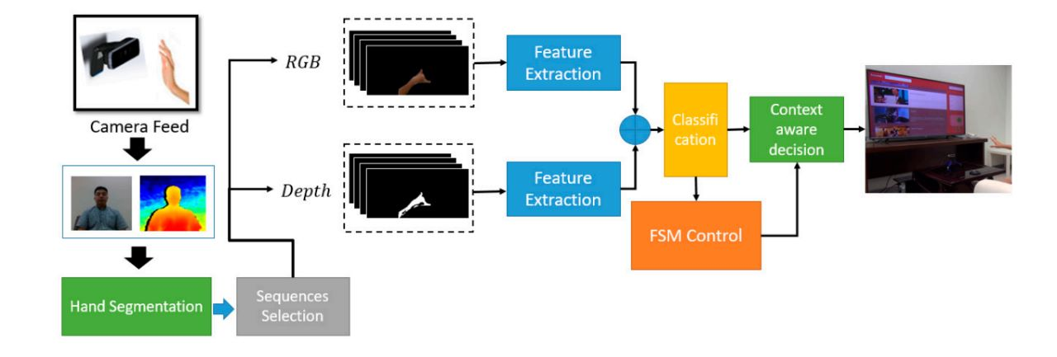
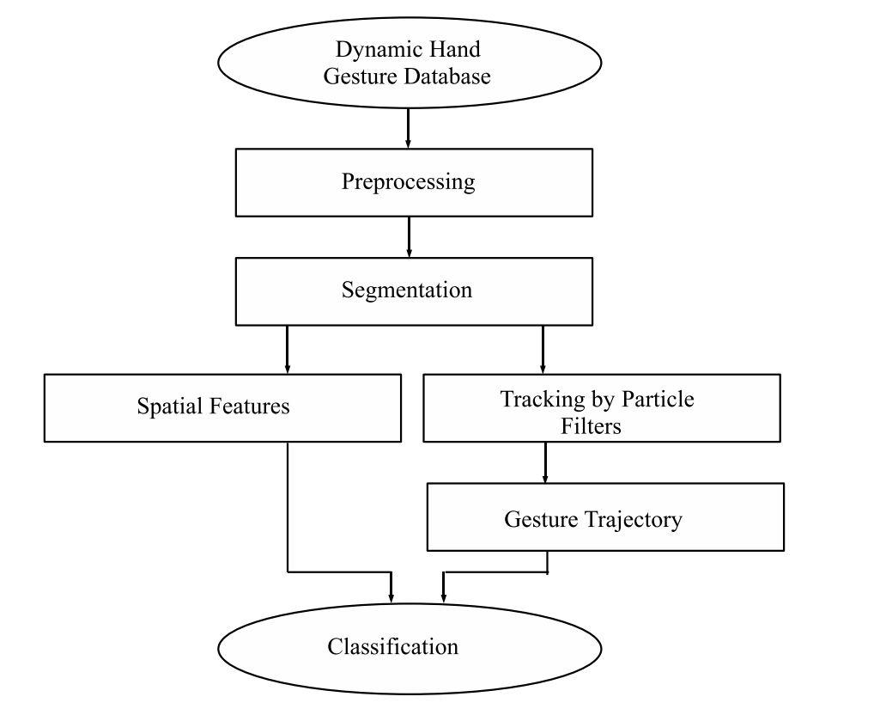
Flowchart of Methodology

Slide 8
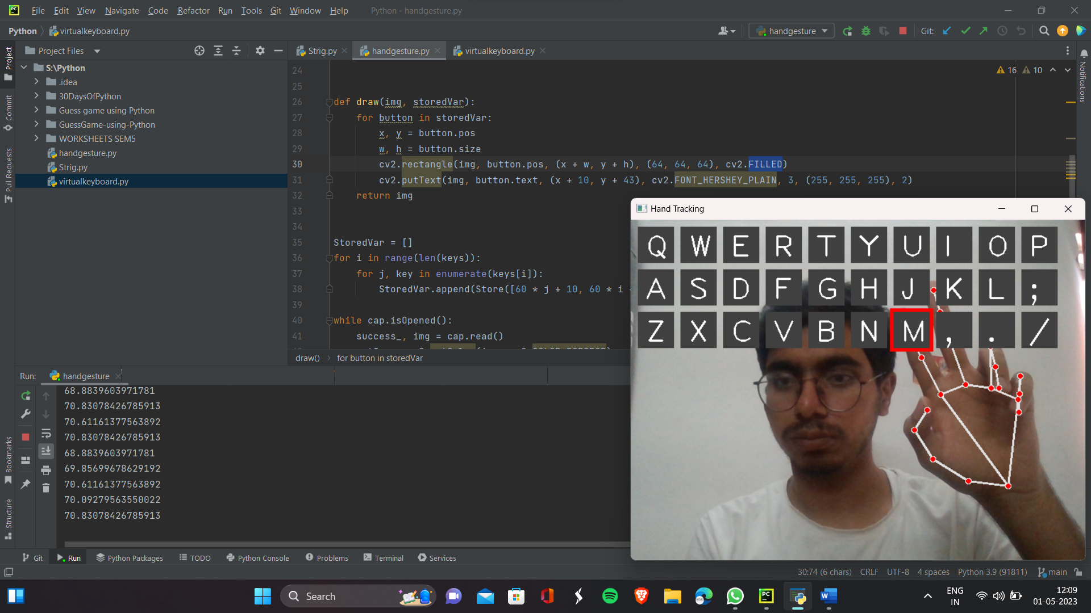
Results and Outputs
AI Virtual KEYBOARD

Slide 9
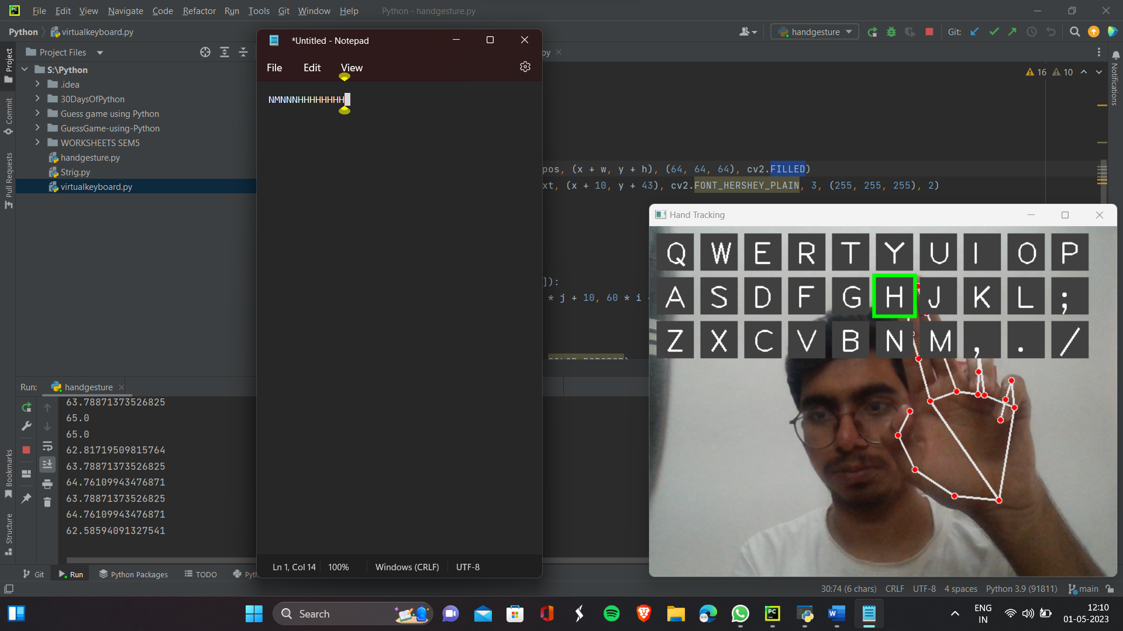
Using Notepad:

Slide 10
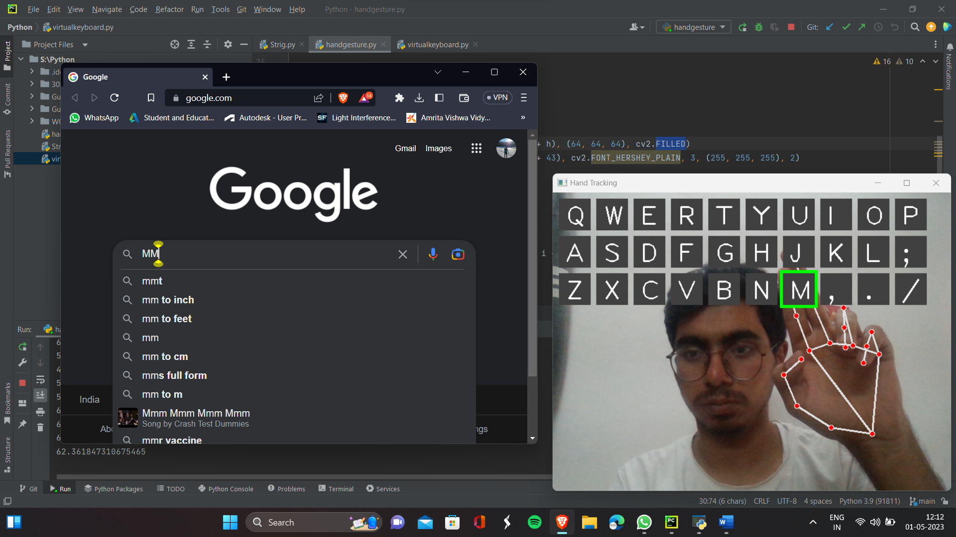
Using Google and other websites:

Slide 11
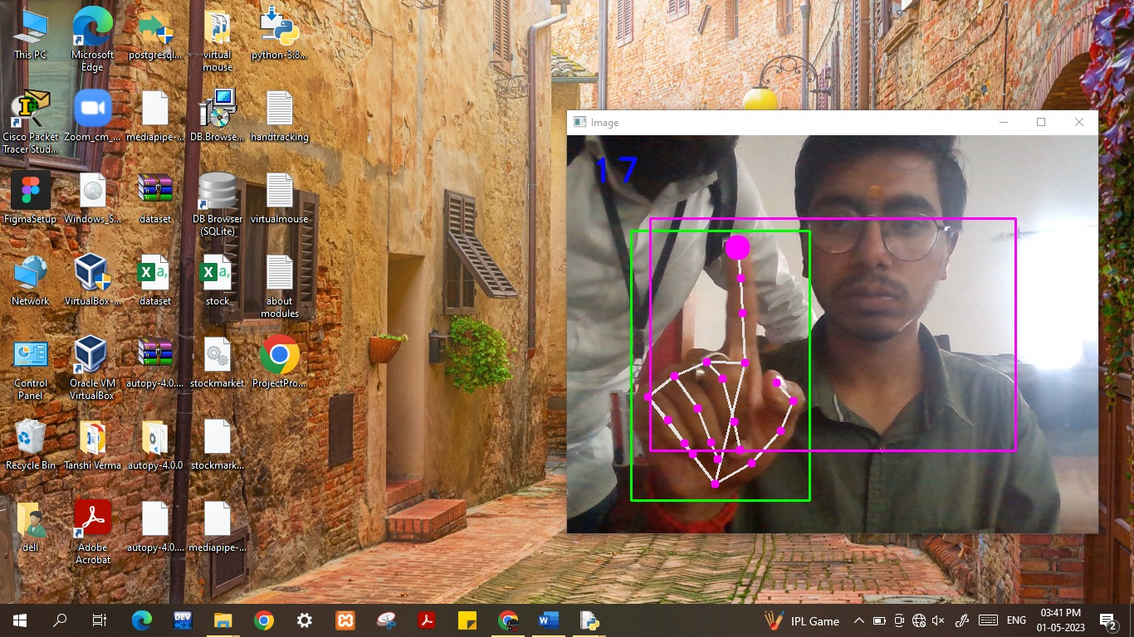
AI Virtual Mouse using Hand Gesture:

Slide 12
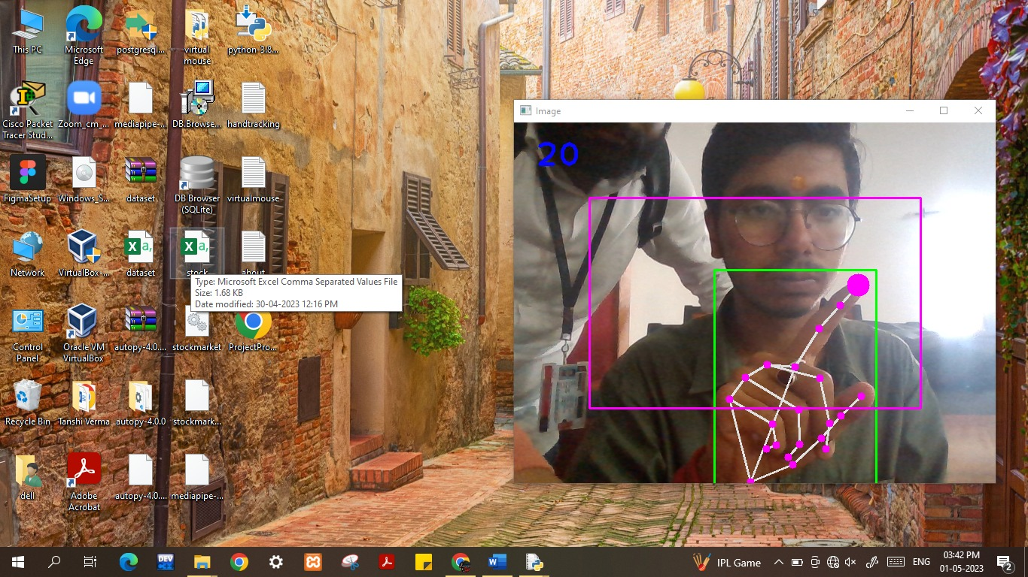
To open Excel or any app on Window Screen:

Slide 13
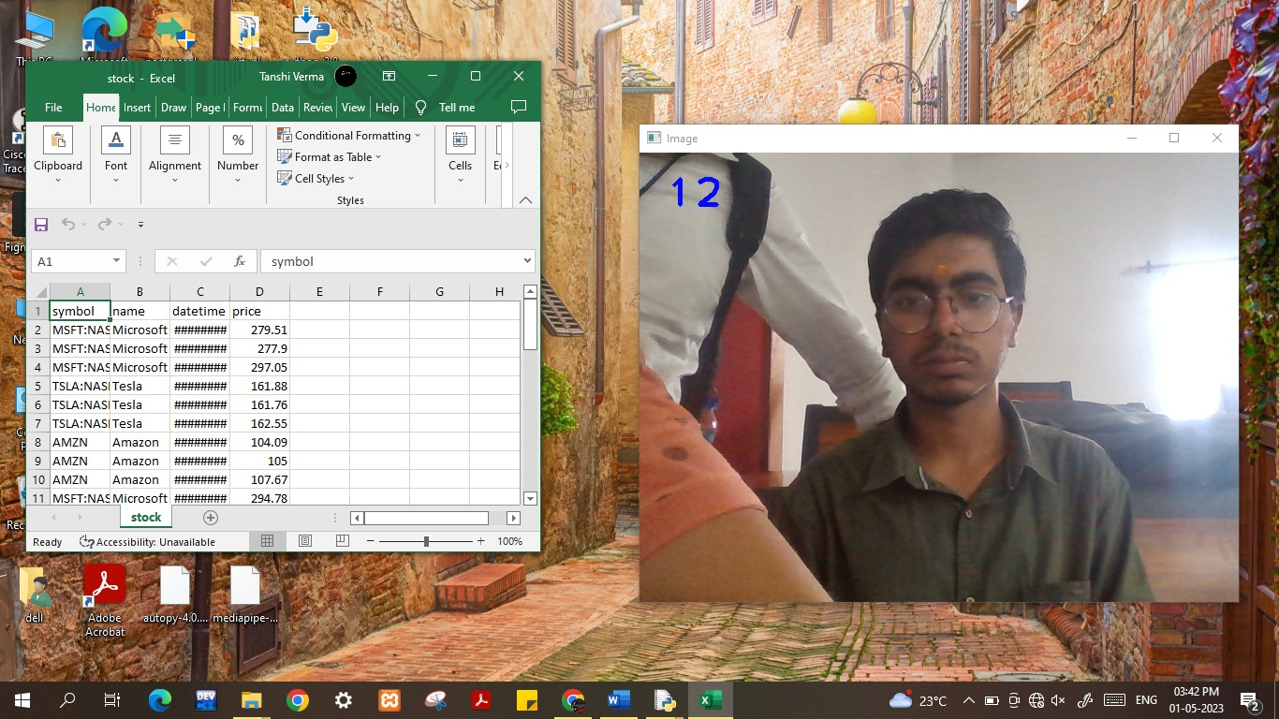
Excel opened and Windows access:

Slide 14
Conclusion
The Dynamic Hand Gesture Keyboard and Mouse using neural network is a promising technology that has the potential to revolutionize the way we interact with computers. The system uses a neural network to recognize hand gestures and translate them into computer commands, allowing users to control their computers in a more intuitive and natural way.
The use of machine learning algorithms and neural networks in this technology allows for a high level of accuracy in recognizing hand gestures, making it a reliable and efficient system. The dynamic nature of the system also makes it adaptable to different users with varying hand sizes and shapes.
Overall, the Dynamic Hand Gesture Keyboard and Mouse using neural network is a promising technology that has the potential to transform the way we interact with computers, and further research and development in this area could lead to even more advanced and innovative applications.

Slide 15
Future Scope
Dynamic hand gesture recognition using neural networks has a wide range of potential applications, including:
Human-Computer Interaction: Dynamic hand gesture recognition can be used as a natural and intuitive way for humans to interact with computers and other devices. For example, users can control their devices without touching them, making them more convenient and accessible.
Sign Language Recognition: Dynamic hand gesture recognition can be used to recognize sign language gestures and convert them into spoken language, providing a means of communication for the hearing impaired.
Gaming: Dynamic hand gesture recognition can be used in gaming to provide a more immersive and interactive experience. For example, players can control their characters using hand gestures, making the game more engaging and intuitive.
Virtual and Augmented Reality: Dynamic hand gesture recognition can be used in virtual and augmented reality applications to allow users to interact with virtual objects in a natural and intuitive way.
Medical Applications: Dynamic hand gesture recognition can be used to help patients with physical disabilities to control prosthetic devices, allowing them to perform everyday tasks more easily.

Slide 16
References
https://www.nature.com/articles/s41598-022-08133-z
https://www.semanticscholar.org/paper/Human-computer-interface-using-hand-gesture-based-Jalab-Omer/1c7e28fc4855f1948026354f12d5623918d37dda
https://www.youtube.com/watch?v=NJmk1DUyyB8
https://www.youtube.com/watch?v=L6Dbtqi7SQM
https://www.youtube.com/watch?v=9zqgvsfbz8M
https://becominghuman.ai/deep-learning-hand-gesture-recognition-b265f4e6cf02
https://becominghuman.ai/deep-learning-hand-gesture-recognition-b265f4e6cf02
https://dl.acm.org/doi/10.1145/3293353.3293421
https://www.nature.com/articles/s41598-022-08133-z
https://www.mdpi.com/1424-8220/19/24/5429

