Slide 1

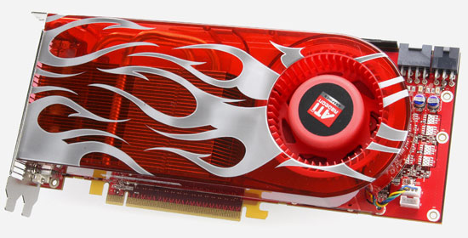
Course Evaluations
http://www.siggraph.org/courses_evaluation
4 Random Individuals will win an ATI Radeon^{tm} HD2900XT

Slide 2
A Gentle Introduction to Bilateral Filtering and its Applications
From Gaussian blur to bilateral filter – S. Paris
Applications – F. Durand
Link with other filtering techniques – P. Kornprobst
Implementation – S. Paris
Variants – J. Tumblin
Advanced applications – J. Tumblin
Limitations and solutions – P. Kornprobst
BREAK

Slide 3
A Gentle Introduction to Bilateral Filtering and its Applications
Recap
Sylvain Paris – MIT CSAIL

Slide 4
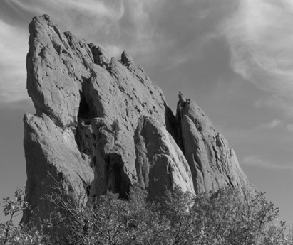
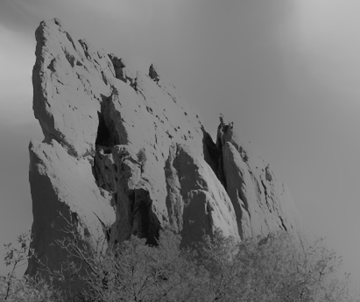
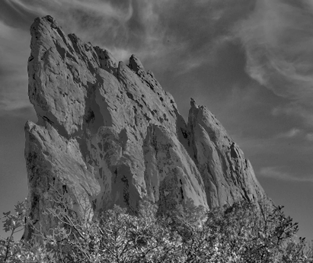
Decomposition into
Large-scale and Small-scale Layers
smoothed
(structure, large scale)
residual
(texture, small scale)
input
edge-preserving: Bilateral Filter

Slide 5
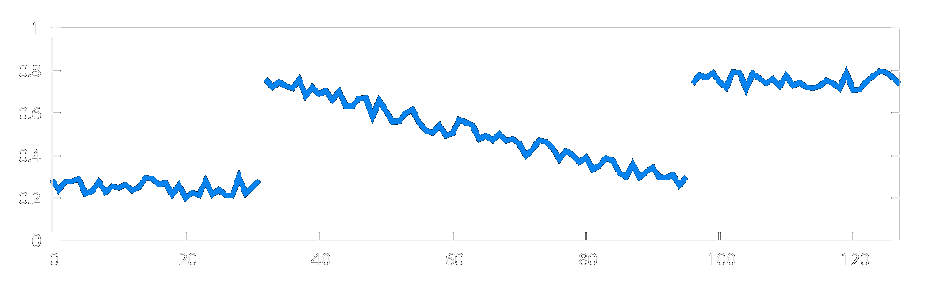
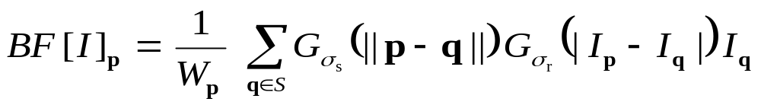
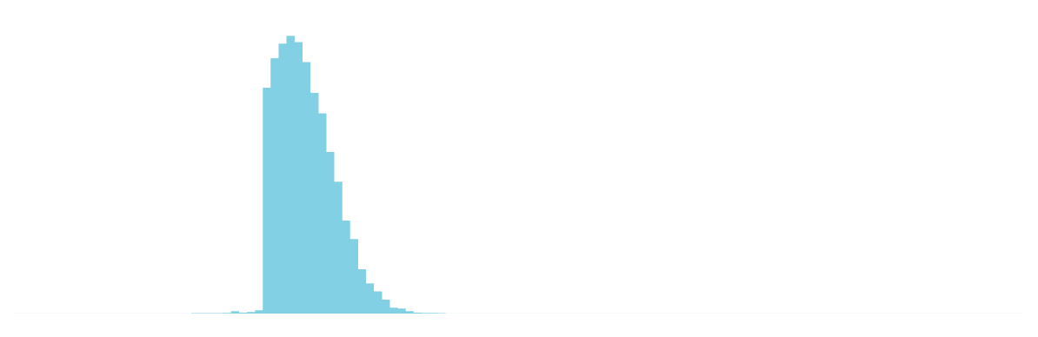
Weighted Average of Pixels
Depends on spatial distance
and intensity difference
  Pixels across edges have almost influence
p
range
q
space
range
normalization
space

Slide 6
A Gentle Introduction to Bilateral Filtering and its Applications
Efficient Implementations
of the Bilateral Filter
Sylvain Paris – MIT CSAIL

Slide 7
Outline
Brute-force Implementation
Separable Kernel [Pham and Van Vliet 05]
Box Kernel [Weiss 06]
3D Kernel [Paris and Durand 06]

Slide 8
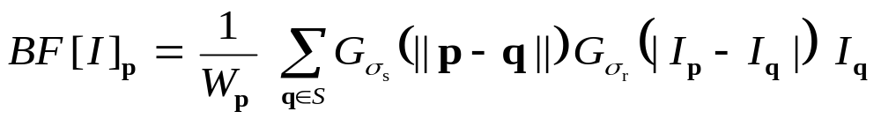

Brute-force Implementation
For each pixel p
  For each pixel q
    Compute
8 megapixel photo: 64,000,000,000,000 iterations!
V E R Y S L O W !
More than 10 minutes per image

Slide 9
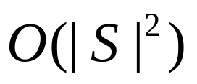
Complexity
Complexity = “how many operations are needed, how this number varies”
S = space domain = set of pixel positions
| S | = cardinality of S = number of pixels
  In the order of 1 to 10 millions
Brute-force implementation:

Slide 10

Better Brute-force Implementation
Idea: Far away pixels are negligible
For each pixel p
  For each pixel q such that || p – q || < cte × σ_{s}
looking at all pixels
looking at neighbors only

Slide 11
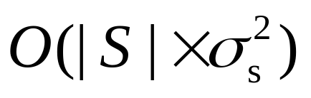
Discussion
Complexity:
Fast for small kernels: σ_{s} ~ 1 or 2 pixels
BUT: slow for larger kernels
neighborhood area

Slide 12
Outline
Brute-force Implementation
Separable Kernel [Pham and Van Vliet 05]
Box Kernel [Weiss 06]
3D Kernel [Paris and Durand 06]

Slide 13
Separable Kernel
[Pham and Van Vliet 05]
Strategy: filter the rows then the columns
Two “cheap” 1D filters
instead of an “expensive” 2D filter

Slide 14
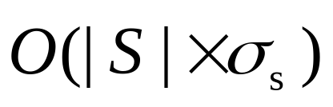
Discussion
Complexity:
  Fast for small kernels (<10 pixels)
Approximation: BF kernel not separable
  Satisfying at strong edges and uniform areas
  Can introduce visible streaks on textured regions

Slide 15
input

Slide 16

brute-force
implementation

Slide 17

separable kernel
mostly OK,
some visible artifacts
(streaks)

Slide 18
Outline
Brute-force Implementation
Separable Kernel [Pham and Van Vliet 05]
Box Kernel [Weiss 06]
3D Kernel [Paris and Durand 06]

Slide 19
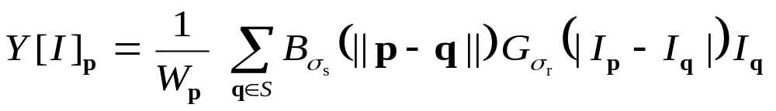
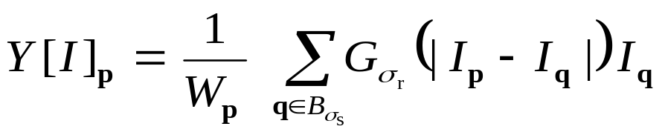
Box Kernel
[Weiss 06]
Bilateral filter with a square box window
The bilateral filter can be computed only from
the list of pixels in a square neighborhood.
[Yarovlasky 85]
box window
restrict the sum
independent of position q

Slide 20
Box Kernel
[Weiss 06]
Idea: fast histograms of square windows
Tracking one window
input:
full histogram is known
update:
add one line, remove one line

Slide 21
Box Kernel
[Weiss 06]
Idea: fast histograms of square windows
Tracking two windows at the same time
input:
full histograms are known
update:
add one line, remove one line,
add two pixels, remove two pixels

Slide 22
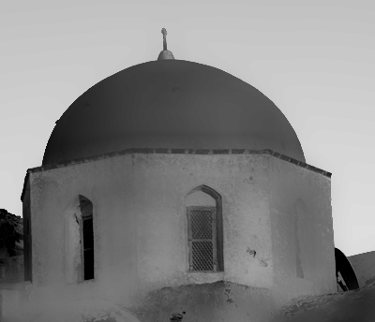
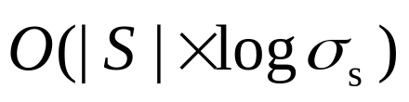

Discussion
1 iteration
Complexity:
  always fast
Only single-channel images
Exploit vector instructions of CPU
Visually satisfying results (no artifacts)
  3 passes to remove artifacts due to
  box windows (Mach bands)
3 iterations

Slide 23
input

Slide 24
brute-force
implementation

Slide 25

box kernel
visually different,
yet no artifacts

Slide 26
Outline
Brute-force Implementation
Separable Kernel [Pham and Van Vliet 05]
Box Kernel [Weiss 06]
3D Kernel [Paris and Durand 06]

Slide 27
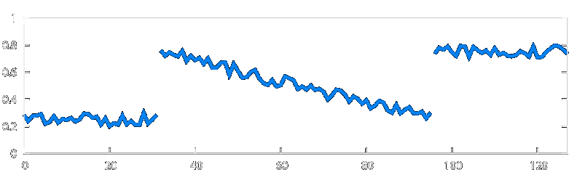
3D Kernel
[Paris and Durand 06]
Idea: represent image data such that the weights depend only on the distance between points
close in space
1D image
Plot
I = f ( x )
pixel
intensity
far in range
pixel position

Slide 28
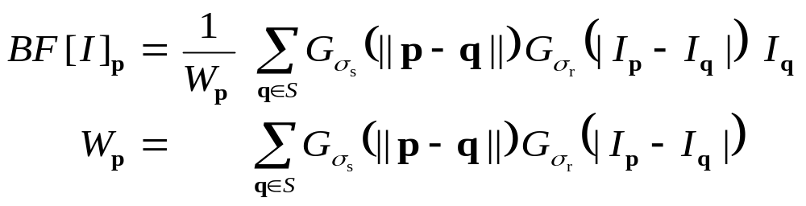
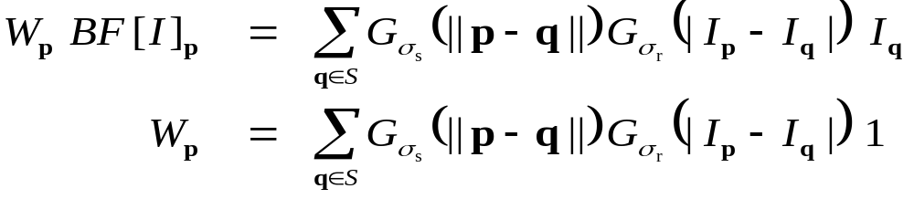
1st Step: Re-arranging Symbols
Multiply first equation by W_{p}

Slide 29
1st Step: Summary
Similar equations
No normalization factor anymore
Don’t forget to divide at the end

Slide 30
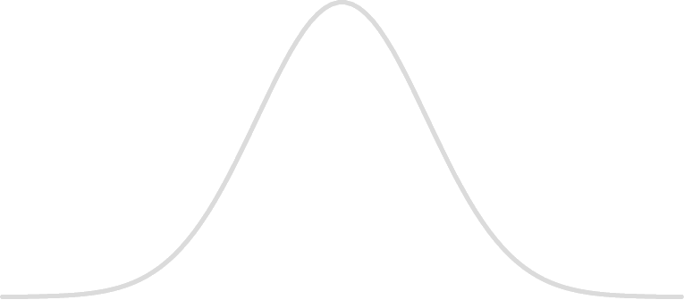

2nd Step: Higher-dimensional Space
“Product of two Gaussians” = higher dim. Gaussian
space
range
p

Slide 31
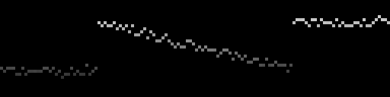
2nd Step: Higher-dimensional Space
0 almost everywhere, I at “plot location”
space
range
p

Slide 32

2nd Step: Higher-dimensional Space
0 almost everywhere, I at “plot location”
Weighted average at each point = Gaussian blur
p

Slide 33
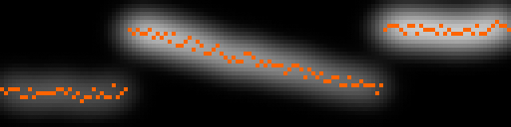
2nd Step: Higher-dimensional Space
0 almost everywhere, I at “plot location”
Weighted average at each point = Gaussian blur
Result is at “plot location”
p

Slide 34
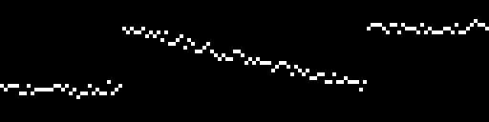


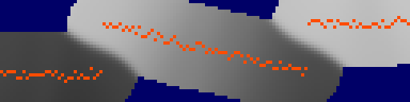
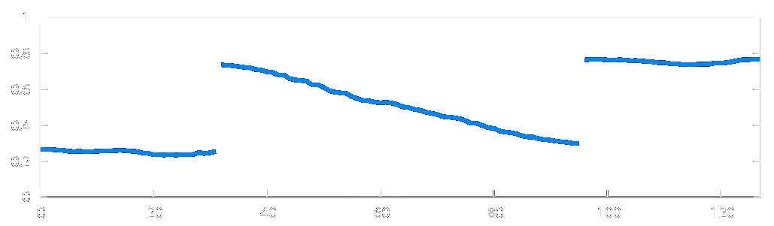
New num. scheme:
simple operations
complex space
higher dimensional functions
Gaussian blur
Higher
dimensional
Homogeneous
intensity
division
slicing

Slide 35
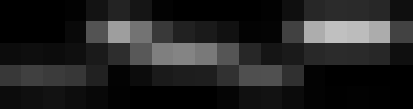

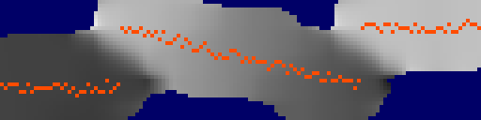
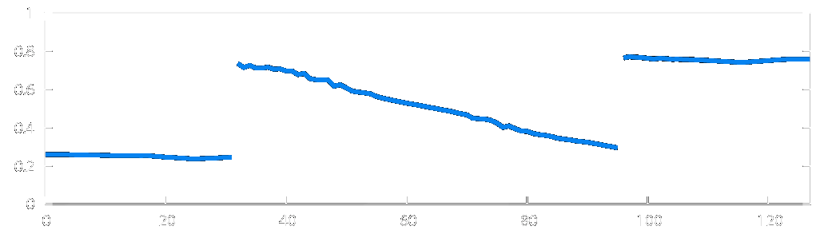
Strategy:
downsampled
convolution
higher dimensional functions
D O W N S A M P L E
Gaussian convolution
Heavily
downsampled
U P S A M P L E
division
slicing
Conceptual view,
not exactly
the actual algorithm

Slide 36
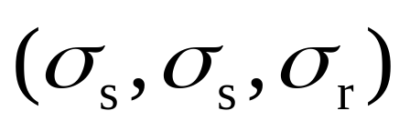
Actual Algorithm
Never compute full resolution
  On-the-fly downsampling
  On-the-fly upsampling
3D sampling rate =

Slide 37
Pseudo-code: Start
Input
  image I
  Gaussian parameters σ_{s} and σ_{r}
Output: BF [ I ]
Data structure: 3D arrays wi and w (init. to 0)

Slide 38

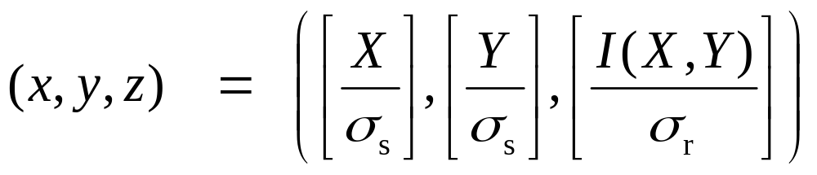
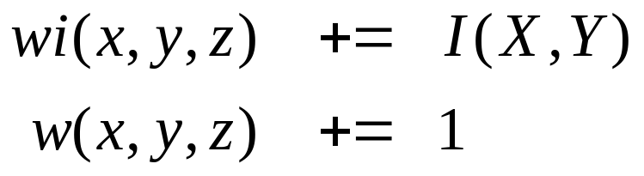
Pseudo-code:
On-the-fly Downsampling
D O W N S A M P L E
U P S A M P L E
For each pixel
  Downsample:
  Update:
[ ] = closest int.

Slide 39



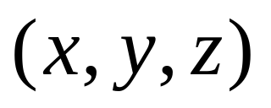
Pseudo-code:
Convolving
D O W N S A M P L E
U P S A M P L E
For each axis , , and
  For each 3D point
    Apply a Gaussian mask ( 1 , 4 , 6 , 4 , 1 ) to wi and w
    e.g., for the x axis:
  wi’(x) = wi(x-2) + 4.wi(x-1) + 6.wi(x) + 4.wi(x+1) + wi(x+2)

Slide 40
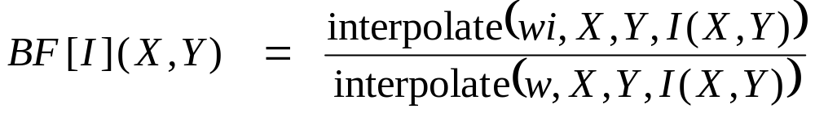
Pseudo-code:
On-the-fly Upsampling
D O W N S A M P L E
U P S A M P L E
For each pixel
  Linearly interpolate the values in the 3D arrays

Slide 41
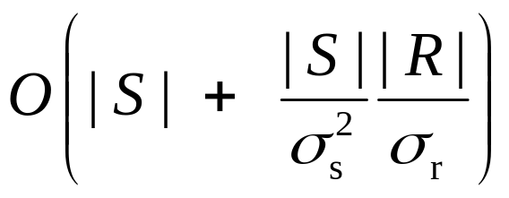
Discussion
number
of pixels
number
of 3D cells
| R | : number of
gray levels
Complexity:
Fast for medium and large kernels
  Can be ported on GPU [Chen 07]: always very fast
Can be extended to color images but slower
Visually similar to brute-force computation

Slide 42
input

Slide 43
brute-force
implementation

Slide 44

3D kernel
visually similar

Slide 45
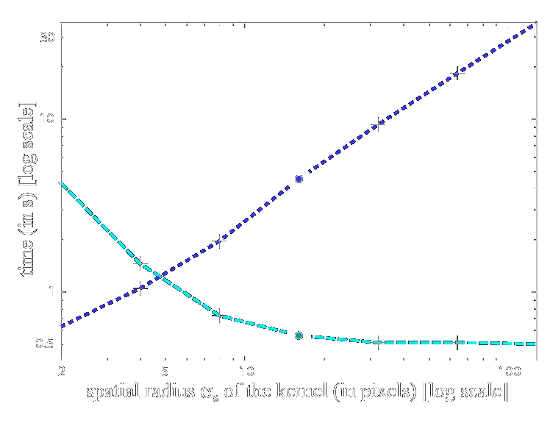
Running Times
separable kernel
brute force
3D kernel
box kernel

Slide 46
How to Choose an Implementation?
Depends a lot on the application. A few guidelines:
Brute-force: tiny kernels or if accuracy is paramount
Box Kernel: for short running times on CPU with any kernel size, e.g. editing package
3D kernel:
  if GPU available
  if only CPU available: large kernels, color images, cross BF
  (e.g., good for computational photography)

Slide 47
Questions ?

